Slide 1
Orthogonal Sequence based Reference Signal for LTF Reduction
Date: 2019-09-16
Authors:
Name | Affiliation | Address | Phone | Email
Junghoon Suh | Huawei |  |  | junghoon.suh@huawei.com
Osama Aboul-Magd |  |  |  | osama.aboulmagd@huawei.com
Edward Au |  |  |  | edward.ks.au@huawei.com

Slide 2
Background
Number of Spatial Streams will be extended to 16 streams in the EHT
  16 LTFs necessary to support the 16 stream channel estimation according to the current
  802.11 LTF schemes
  Maximum airtime for 16 LTFs can be as big as 256 usec with 4X LTF
We need to come up with a new Reference Signal design to accommodate 16 streams
  We propose an Orthogonal Sequence based Reference Signal (OSRS) for the multi stream channel estimation
    In MIMO SC-FDMA, multiple access scheme for the UL transmission of cellular network, code-division multiplexed (CDM) pilots such as cyclic-shifted Zadoff-Chu sequences have been used for channel estimation.
    We want to apply the similar principle to the WLAN MIMO DL frame.

Slide 3
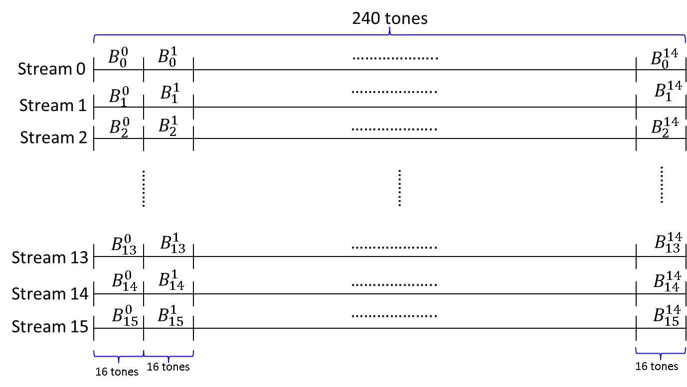

OSRS
An Orthogonal Sequence is assigned to each stream ($B_{i}$: i represents each stream)
  $B_{i}⊥B_{j}$
  Received signal ($Y$: $Y=\sum_{i=0}^{N−1}{h_{i}}B_{i}$+$n$), for N streams, the i^{th} stream channel parameter $h_{i}$, and AWGN n
  The $h_{i}$ is obtained with the following inner product, $h_{i}$=${\left(B_{i}\right)}^{H}Y/N$
Application to 802.11
  For MU-PPDU, the number of tones where channel estimation is needed is 234 tones (26 tones (2 pilots included) * 9RU), excluding the DC and Nulls (22 tones) per 20 MHz
    Length of orthogonal sequences had better be 2’s power, and 4, 8 or 16 is the good sequence length
    240 is divisible by 4, 8 or 16, and we can estimate the channel up to 240 using 4, 8 or 16 tone long Sequences
      E.g.) Each OFDM symbol may have 15 Segment based Orthogonal Sequences with length 16
Hadamard (16) can be used for the orthogonal Sequence
There will be one estimated channel parameter per
each 16 sub-carrier segment
Hence, there will be 15 channel parameters available
per 20 MHz OFDM
Channel smoothing such as Linear Interpolation is
required to obtain channel parameter per every subcarrier

Slide 4
20 MHz Tone Plan for the OSRS Symbol:
This tone plan can be applied to both MU and SU PPDU.
Guard
Tones
Guard
Tones
DC
…..
…..
Tone Index →
-128 ~ -123
-2 -1 0 1 2
123 ~ 127
Hence, the tone index from -122 to -3 and from 3 to 122 will be used for OSRS.
For example, 16 long sequence can be indexed as follows.
Segment 0: -122 ~ -107
Segment 1: -106 ~ -91
Segment 2: -90 ~ -75
Segment 3: -74 ~ -59
Segment 4: -58 ~ -43
Segment 5: -42 ~ -27
Segment 6: -26 ~ -11
Segment 7: -10 ~ -3 & 3 ~ 10
Segment 8: 11 ~ 26
Segment 9: 27 ~ 42
Segment 10: 43 ~ 58
Segment 11: 59 ~ 74
Segment 12: 75 ~ 90
Segment 13: 91 ~ 106
Segment 14: 107 ~ 122

Slide 5
Simulation verification for OL SU-MIMO
4X4 Open-loop SU-MIMO
  4 SS, 4 TX, 4 RX, QPSK and MMSE detection with BCC for FEC
  Packet size, 800 byte
Scenario for Channel Estimation Reference Signal
  11ac LTF based (64 point OFDM symbol)
    11ac based PPDU for data
  11ax LTF based (256 point OFDM symbol; 4X LTF is used)
    11ax based SU-PPDU for data
  OSRS with each segment length, 4 tones w/o interpolation
    There are 60 segments in an OFDM symbol
    Estimated Channel parameter per each segment are the same, that is, the same over every 4 tone
  OSRS with each segment length, 4 tones with interpolation
    There are 60 segments in an OFDM symbol
    Linear Interpolation is performed for those 60 estimated channel parameters to come up with 240 channel parameters for each 240 tones

Slide 6
Linear Interpolation for Length 4 OSRS
With No Interpolation
Channel Parameters,
`i’ represents segment index
h_{i}
h_{i}
h_{i}
h_{i}
h_{i+1}
h_{i+1}
h_{i+1}
h_{i+1}
h_{i+2}
h_{i+2}
h_{i+2}
h_{i+2}
…….
…….
t_{n}
t_{n+1}
t_{n+2}
t_{n+3}
t_{n+4}
t_{n+5}
t_{n+6}
t_{n+7}
t_{n+8}
t_{n+9}
t_{n+10}
t_{n+11}
Tone index
With a Mid-tone Interpolation
Chan. parameters
obtained by Interpolation
between h_{i} and h_{i+1}
Chan. parameters
obtained by Interpolation
between h_{i+1} and h_{i+2}
…….
h_{i}
h_{i+1}
h_{i+2}
…….
t_{n}
t_{n+1}
t_{n+2}
t_{n+3}
t_{n+4}
t_{n+5}
t_{n+6}
t_{n+7}
t_{n+8}
t_{n+9}
t_{n+10}
t_{n+11}
Tone index
We need to place the channel parameter obtained by the inner product (or correlation) with the corresponding orthogonal sequence onto a middle tone of the segment
  There are two middle tones in a segment because the segment length (orthogonal sequence length) is 2’s power
    It is ok to place the channel parameter obtained by the inner product onto either of these middle two tones before we run the interpolation, but needs to be consistent in each segment
The same principle can be applied to any length of the sequence like length 8 or 16.

Slide 7
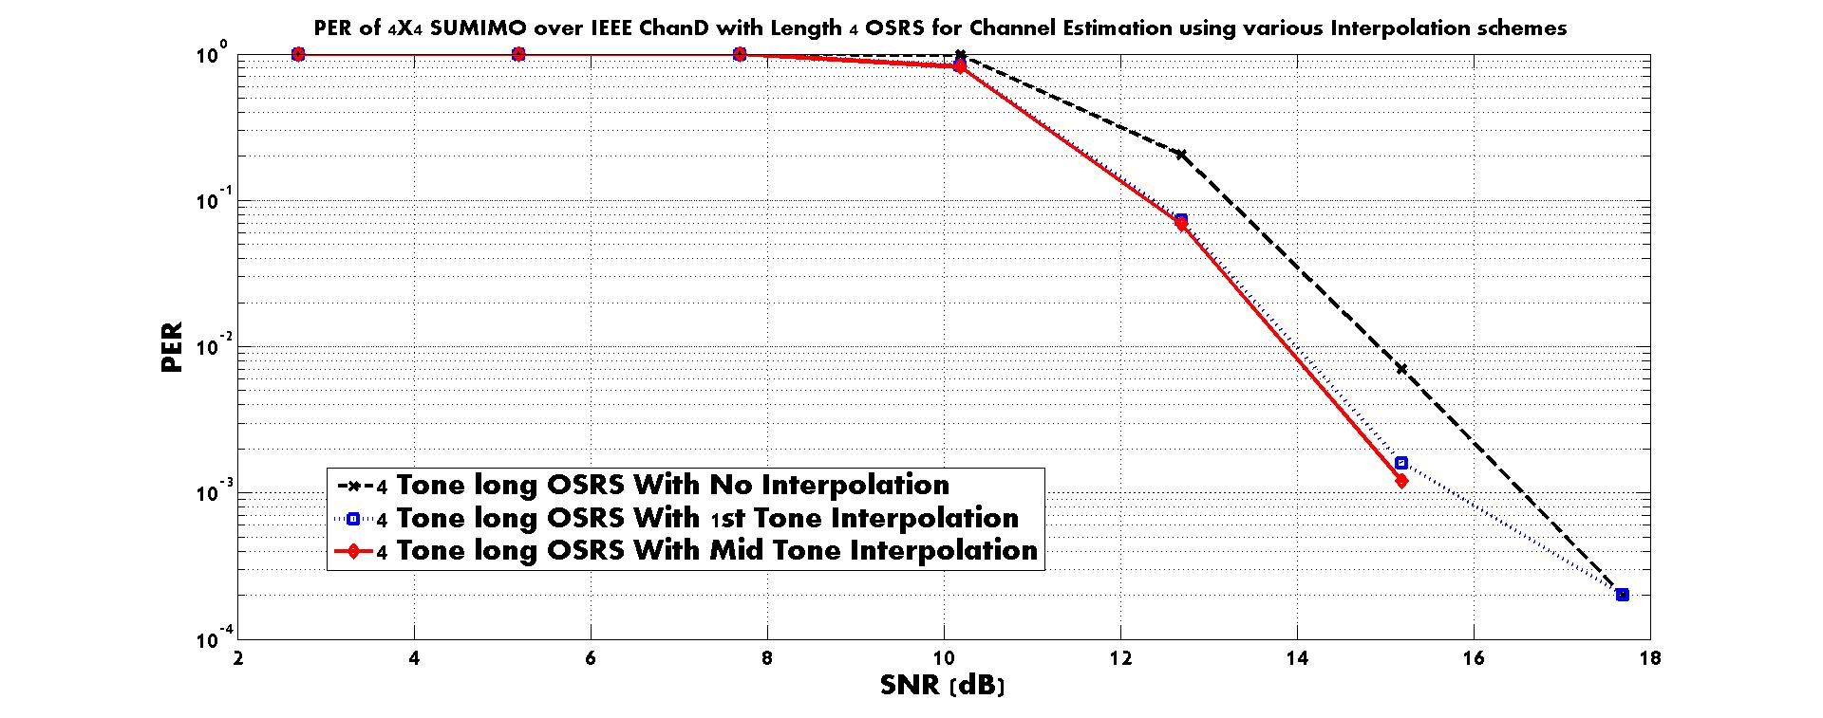
Effect of Interpolation for OSRS:
4X4 OL SU-MIMO with Length 4 OSRS

Slide 8
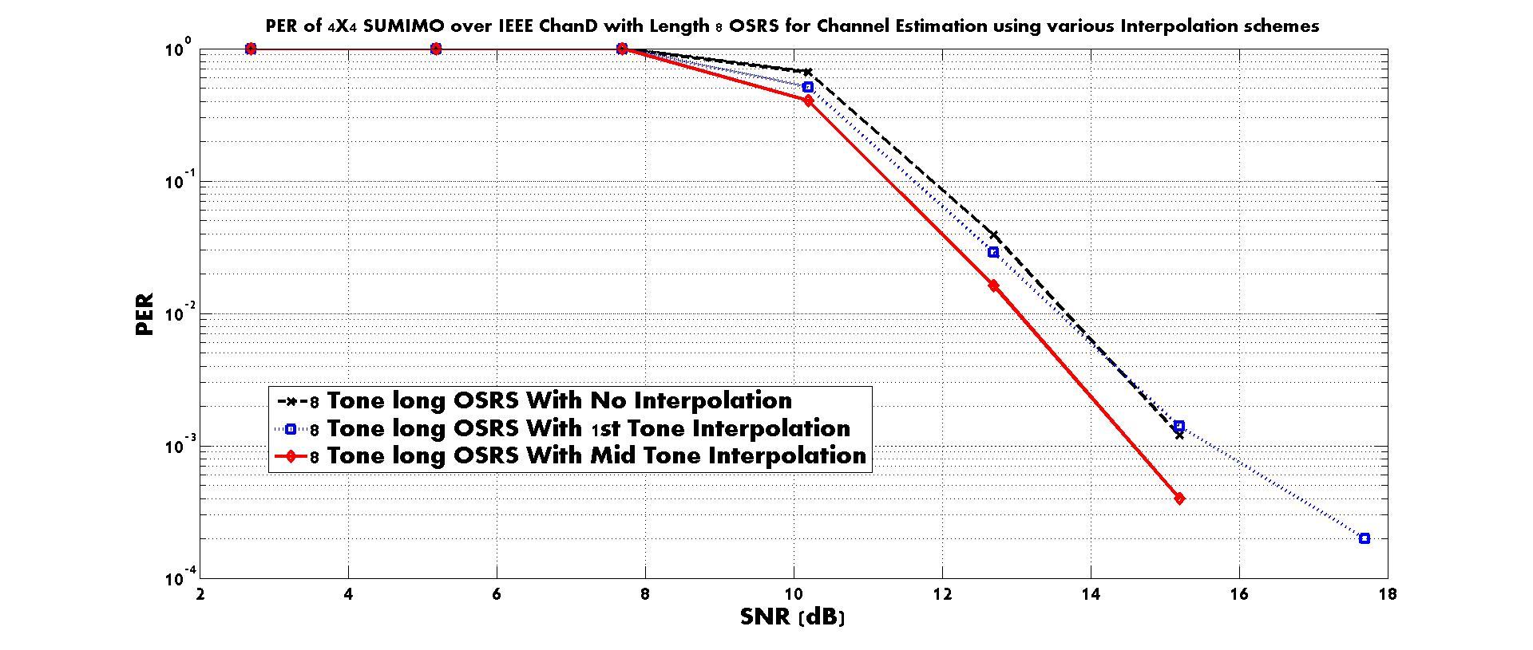
Effect of Interpolation for OSRS:
4X4 OL SU-MIMO with Length 8 OSRS

Slide 9
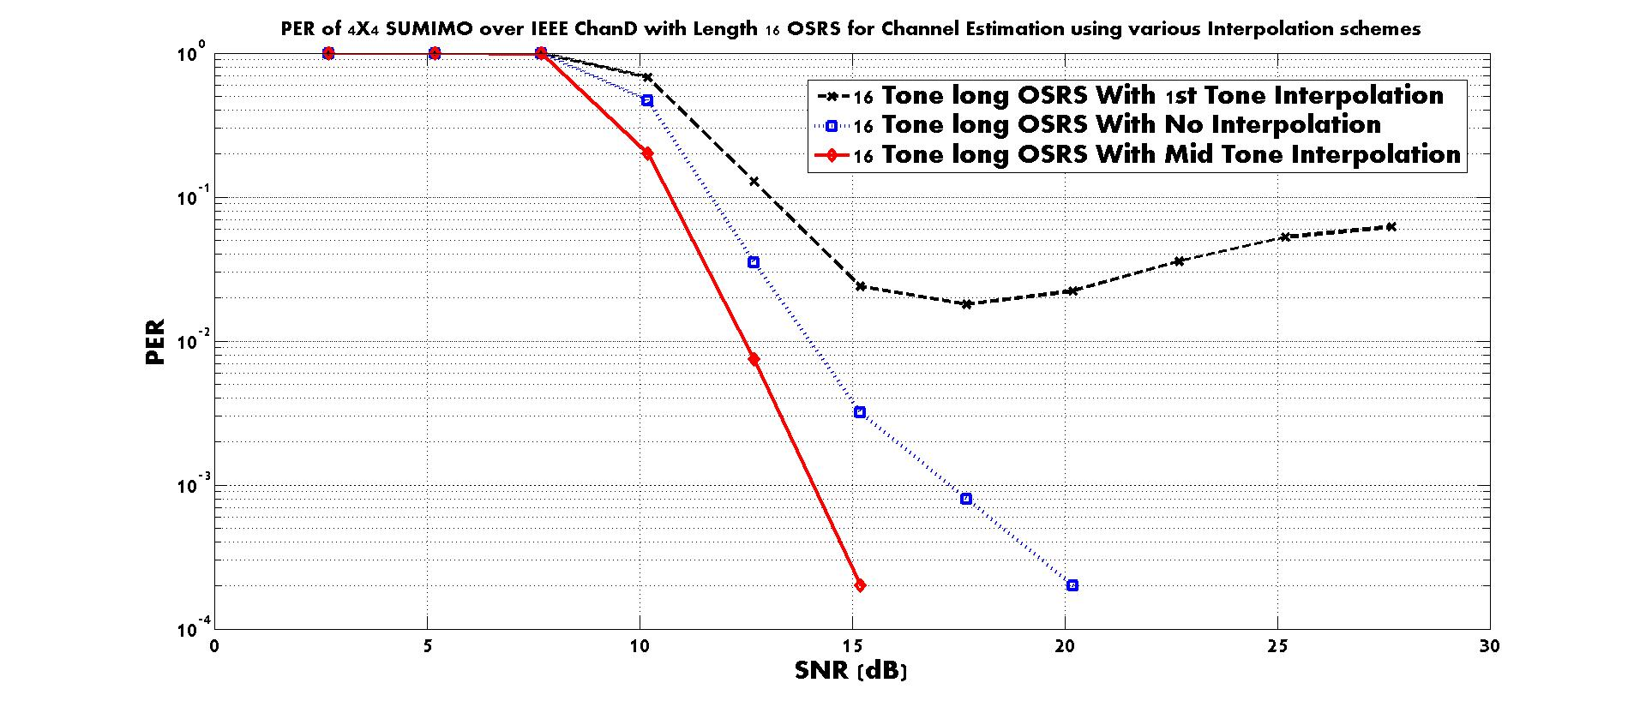
Effect of Interpolation for OSRS:
4X4 OL SU-MIMO with Length 16 OSRS
Mid Tone Interpolation is necessary when the Length of the OSRS is big.

Slide 10
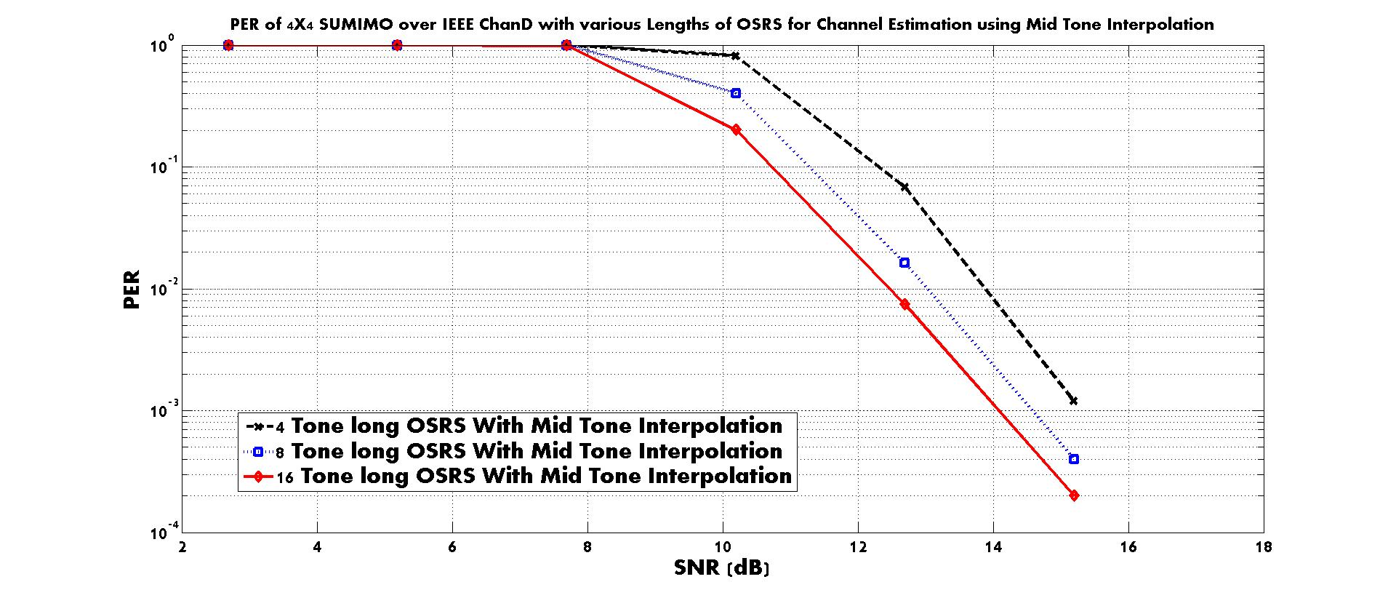
11ax based SU-PPDU used
The longer the sequence, the better the performance, when there is no Beam-forming
  The length of the sequence can be regarded as a smoothing window size → the larger the better

Slide 11
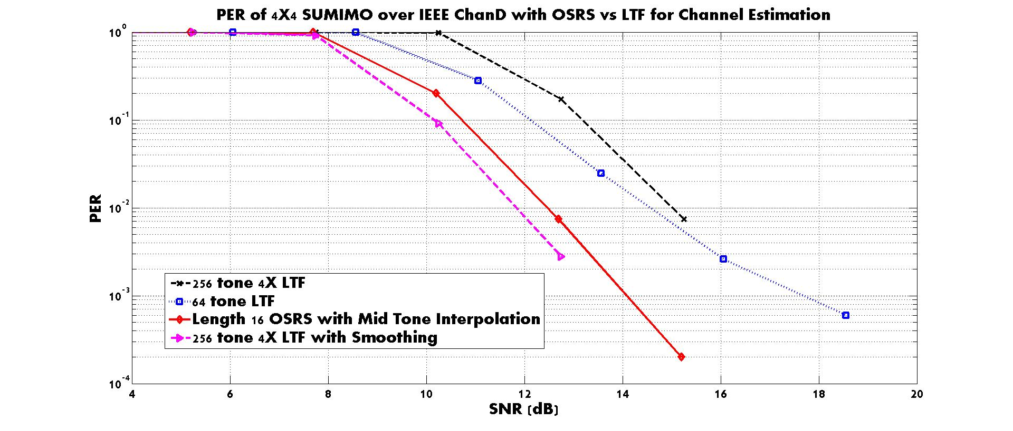
For 256 tone LTF based RS with Smoothing, a moving average based smoothing (Window size 16 tone) is applied on top of a Least Square method of channel estimation
The performance of using the OSRS is showing no degradation compared to the 802.11 LTF based RS design
The gain is in the overhead Reduction: There are 4 LTFs but there is only one symbol for OSRS

Slide 12

Simulations for the Beam-formed frame
16 TX MU-MIMO with 4 STA MU-MIMO scheduling (2 streams each STA; 8 total streams)
  8 LTF symbol based Channel Estimation for 8 total streams (4 STA MU-MIMO case)
  1 OSRS symbol for the Channel Estimation of 8 total streams (4 STA MU-MIMO case)
  Perfect sounding (No CSI Quantization error, No CSI feedback error, but real channel estimation using the 4X LTF based NDP)
  User Selection algorithm [1] to select from 8 total STAs for MU-MIMO scheduling
  Zero-forcing BF in the TX, and MMSE detection or Interference Whitening based MLD in each STA
  BCC for FEC
  MCS 1, 3, 5, and 7
  Packet size for PER: 400 bytes for MCS 1, 3, 5, and 500 bytes for MCS 7
  P-matrix for 16 Stream Channel Estimation in case of 16 LTF symbol based case
$P_{16X16}$=$\left[\begin{matrix}P_{8X8} & P_{8X8} \\ P_{8X8} & {−P}_{8X8}\end{matrix}\right]$

Slide 13
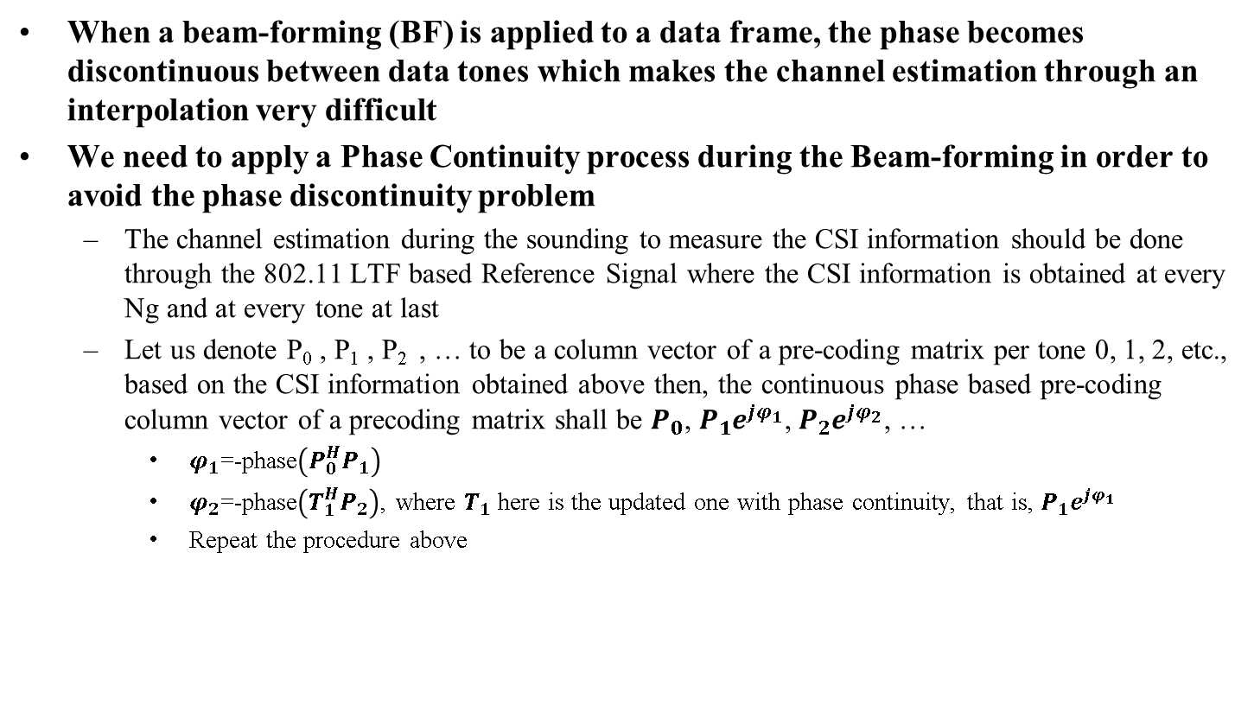
Phase Continuity
When a beam-forming (BF) is applied to a data frame, the phase becomes discontinuous between data tones which makes the channel estimation through an interpolation very difficult
We need to apply a Phase Continuity process during the Beam-forming in order to avoid the phase discontinuity problem
  The channel estimation during the sounding to measure the CSI information should be done through the 802.11 LTF based Reference Signal where the CSI information is obtained at every Ng and at every tone at last
  Let us denote P₀ , P₁ , P₂ , … to be a column vector of a pre-coding matrix per tone 0, 1, 2, etc., based on the CSI information obtained above then, the continuous phase based pre-coding column vector of a precoding matrix shall be $P_{0}$, $P_{1}e^{jφ_{1}}$, $P_{2}e^{jφ_{2}}$, …
    $φ_{1}$=-phase$\left(P_{0}^{H}P_{1}\right)$
    $φ_{2}$=-phase$\left(T_{1}^{H}P_{2}\right)$, where $T_{1}$ here is the updated one with phase continuity, that is, $P_{1}e^{jφ_{1}}$
    Repeat the procedure above

Slide 14
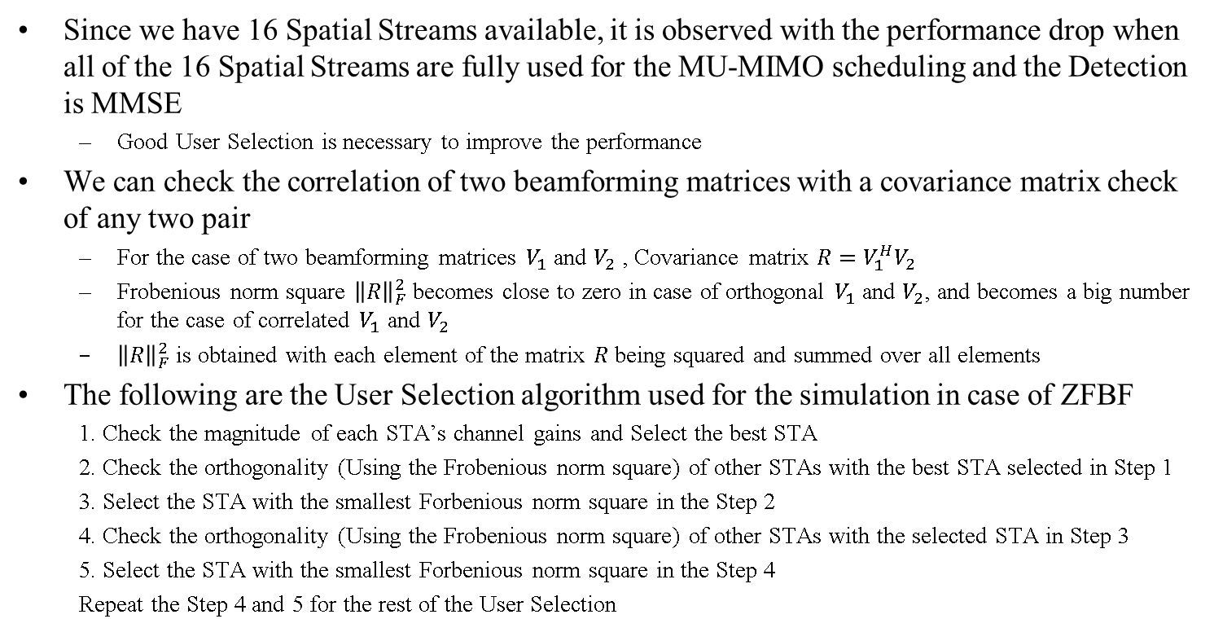
User Selection for MU-MIMO [1]
Since we have 16 Spatial Streams available, it is observed with the performance drop when all of the 16 Spatial Streams are fully used for the MU-MIMO scheduling and the Detection is MMSE
  Good User Selection is necessary to improve the performance
We can check the correlation of two beamforming matrices with a covariance matrix check of any two pair
  For the case of two beamforming matrices $V_{1}$ and $V_{2}$ , Covariance matrix $R=V_{1}^{H}V_{2}$
  Frobenious norm square ${\left\|R\right\|}_{F}^{2}$ becomes close to zero in case of orthogonal $V_{1}$ and $V_{2}$, and becomes a big number for the case of correlated $V_{1}$ and $V_{2}$
  ${\left\|R\right\|}_{F}^{2}$ is obtained with each element of the matrix $R$ being squared and summed over all elements
The following are the User Selection algorithm used for the simulation in case of ZFBF
  1. Check the magnitude of each STA’s channel gains and Select the best STA
  2. Check the orthogonality (Using the Frobenious norm square) of other STAs with the best STA selected in Step 1
  3. Select the STA with the smallest Forbenious norm square in the Step 2
  4. Check the orthogonality (Using the Frobenious norm square) of other STAs with the selected STA in Step 3
  5. Select the STA with the smallest Forbenious norm square in the Step 4
  Repeat the Step 4 and 5 for the rest of the User Selection

Slide 15
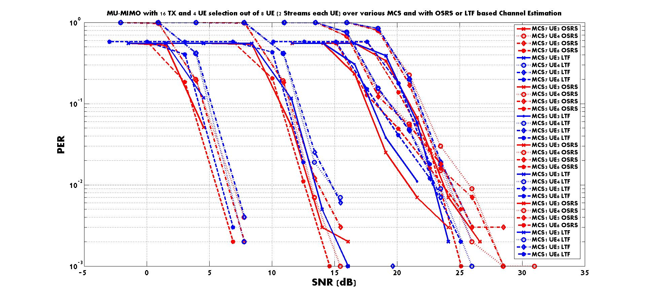
MCS 7
MCS 5
MCS 3
MCS 1
  1 OSRS symbol for the Channel Estimation of 8 total streams (Red curve)
  vs. 8 LTF (4x LTF) symbol based channel estimation of 8 total streams (Blue curve)
  MMSE Detection

Slide 16
Summary
We proposed an OSRS for the channel estimation of DL MIMO streams
  Proposed for data packet only, not for the NDP sounding
The larger the OSRS size is, the better performance is achieved, in case of Open Loop SU-MIMO, however, when BF is applied like MU-MIMO, we observed the shorter OSRS size performs better
  For 4X4 OL SU-MIMO, the Length 16 OSRS can be the most optimum choice for the sequence size
  For BF case such as MU-MIMO, the length 4 OSRS is better than the length 8 OSRS, and the length 8 OSRS is better than the length 16 OSRS
OSRS is a good choice when the Inter-stream Interferences are very small such as 8 Stream MU-MIMO out of 16 available TX
  Very useful for the MU-MIMO when the degree of freedom in the available TX is large
    (e.g. 7 or 8 total stream MU-MIMO from 16 available TX)

Slide 17
Reference
[1] T. Yoo and A. Goldsmith, “On the optimality of multiantenna broadcast scheduling using zero-forcing beamforming”, IEEE Journal on Selected Areas in Communications, Vol. 24, March 2006

