Slide 1
Multi-Link BSS Operations
Date: 2019-09-06
Authors:

Slide 2
Abstract
This submission discusses some of the major MLME functions for the Multi-Link model:
Pre-association operations
Authentication and Association
Post-association power management

Slide 3
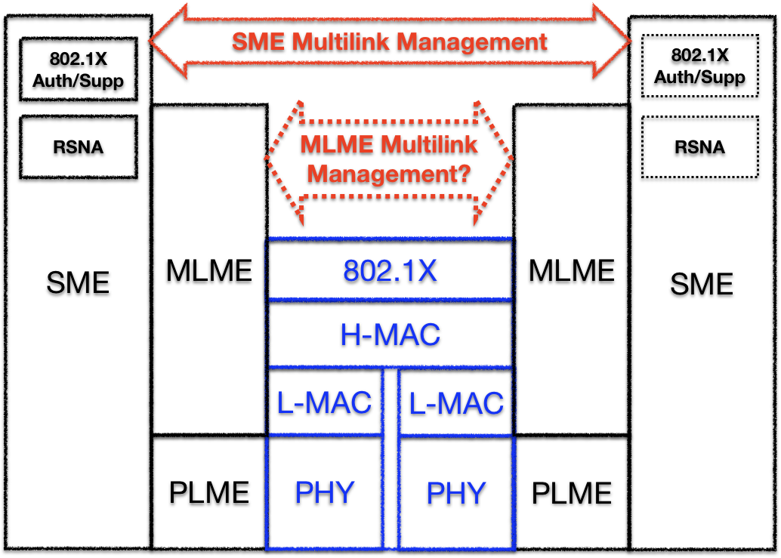
An Example of Overall Architecture

Slide 4
Phases in Multi-Link Setup
Multi-Link AP
Multi-Link STA
Authentication exchange
AP discovery
Discover EHT APs and their links
Authentication exchange
Pre-association
Pre-association
Authenticate and create master keys
Association exchange
Associate to an EHT AP and signal/negotiate capabilities
4-way handshake
Post association
Post association
Setup the pairwise and group transient key
Data channel in 5G
Data channels
Data exchange
Link1
2.4G
Link2
5G
Link3
6G
Link1
2.4G
Link2
5G
Link3
6G

Slide 5
Multi-Link Setup (1/2)
A Multi-Link AP is discoverable on all channels in which it operates, i.e. beacons and probe responses are transmitted on all links
  EHT STAs may discover the Multi-Link AP with multiple links in different channels
  Legacy STAs may discover multiple BSSs with the same SSID in different channels
A single authentication, association and 4-way handshake enable a Multi-Link STA to securely join a Multi-Link BSS
  Authentication and Association may be done in any link

Slide 6
Multi-Link Setup (2/2)
The multi-link capabilities and operations are signaled / negotiated / confirmed during the association
  e.g. A Multi-Link STA can select its own operating link(s), based on a Multi-Link AP’s capabilities and operating links, and indicate its selection in the Associate Request frame
After association, a Multi-Link STA may use the Power Management and/or A-Control fields in MAC header to dynamically signal / change the availabilities of its operating links
  Examples are shown at the end of the submission

Slide 7
Example:

Slide 8
Power Management / Link Availability Examples
Indicate doze for the whole Multi-Link STA
Indicate awake for the whole Multi-Link STA
Indicate unavailability of a different link

Slide 9
Power Management / Link Availability Approaches

Slide 10
Summary
This submission discussed on major MLME functions of the Multi-Link BSS
The main principles of Multi-Link power save and link availability mechanisms are described

Slide 11
Straw poll 1
Do you agree that a Multi-Link STA may signal on one link the availability of all links and/or other link(s)?
Yes:
No:
Abstain:

