Slide 1
Adapting the 802.11be Channel Model to
Modern (Doppler) Use-Cases
Date: 2020-01-06
Authors:

Slide 2
Introduction
The TGn indoor channel models A-E defined a temporal Doppler component corresponding to an environmental speed
The motivation for using the ‘environmental speed’ is given by the following passage from Section 4.7.1 of the TGn channel model [1]:
  In indoor wireless systems transmitter and receiver are stationary and people are moving in between, while in outdoor mobile systems the user terminal is often moving through an environment.
In the TGac model [2] the environmental speed was reduced to 0.089km/h
An additional Doppler component due to fluorescent lights was also incorporated (removed in 11-09-0308-04-00ac and re-introduced in 11-09-0308-05-00ac)
In this contribution, we will discuss the applicability of these Doppler models to prevalent scenarios today; we will also present lab measurement results showing the Doppler PSD with movements
This revision (r2) addresses questions raised during the PHY conf-call

Slide 3
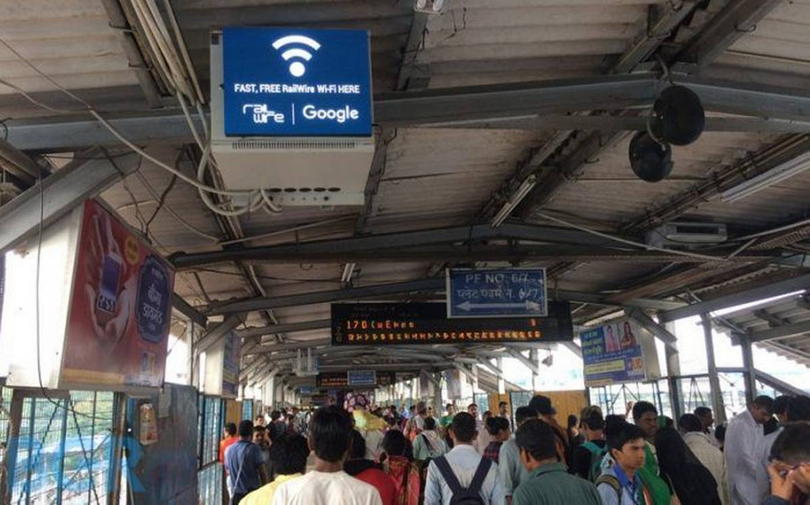
Modern Use-Cases
Back in 2004, when the TGn channel model was developed, the vast majority of transmitters and receivers were indeed stationary
This was probably the case for the TGac channel model as well, as smartphones were in their early days
Today, with the proliferation of smartphones, there are numerous use-cases where the STA would be moving while communicating with its AP; for example, consider:
  Convention centers (e.g. IEEE F2F venues)
  Airports/Train Stations
  Schools & Universities
  Stadium
We need to understand how this affects the channel model, so that we can more realistically evaluate the performance of various schemes

Slide 4
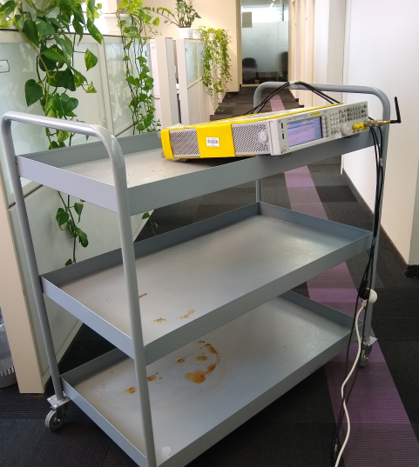
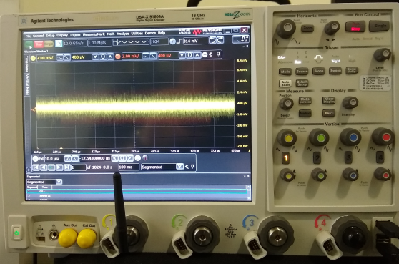
Test Setup
In order to measure the Doppler PSD associated with moving transmitters, we used the following setup:
Frequency locked
Keysight Scope recording the transmission over-the-air;
analysis done via MATLAB
Keysight MXG transmitting an 80MHz 11ax signal repeatedly @2.5GHz

Slide 5
Test Setup
We transmitted an 11ax
signal every 500usec, and
recorded over 0.5sec for a
total of 1024 packets
Omni antennas were used
at both Tx & Rx
  Instead of using directional antennas, which
  suppress the multipath and hence the impact of ‘environmental’ movements
The measurements were carried out for several scenarios:
  Static transmitter/receiver with no movement
  Static transmitter/receiver with person moving between them
  Transmitter moves away/towards the receiver

Slide 6
Analysis
For every packet (of the 1024) we perform channel estimation
We compute the channel taps in the delay domain, and for each tap we compute the PSD
Finally, we average the PSD for all taps to obtain a single PSD for the measurement
We expect the Doppler spread to be very narrow for static measurements, and wider with movements; we further expect to see the impact of a moving transmitter in the form of a peak around the maximal Doppler shift

Slide 7
Analysis
For movement towards the receiver at ~2km/h (~=0.5m/sec), the corresponding maximum Doppler shift is
Similarly for movement away from the receiver the shift is -4.6Hz
We hence expect to see the measured Doppler PSD around these (approximate) values for the measurements with a moving transmitter
  We performed several measurements for each movement direction in order to see that results are consistent and adhere to theory

Slide 8
PSD Results
In case of stationary measurements, the PSD is very narrow (similar to the TGn-D 0.089km/h PSD)
For the moving person case, the PSD is wider and similar to the TGn-D 1.2km/h PSD

Slide 9
PSD Results
The results for the moving transmitter cases, compared with
TGn-D NLOS (using both 0.089km/h & 1.2km/h environmental speeds) are shown below
Moving towards Rx,
PSD around ~+3Hz
Moving away from Rx,
PSD around ~-5Hz

Slide 10
Why is it important?
Multi-user MIMO transmission is the only way to linearly increase the number of spatial streams
Focusing on the downlink, such schemes rely on creating spatial nulls making them very sensitive to channel variations (uplink MU-MIMO is less sensitive); hence we will need to evaluate the impact of practical Doppler on these schemes
On the other hand, some schemes – such as HARQ – will benefit from changes in the channel, as these variations create more diversity
Using the existing TGn/TGac channel model, without any practical Doppler components, will yield misleading (optimistic) results which will not reflect real-life

Slide 11
Analysing the Correlation Coefficient
Based on the measurements, we compute the correlation between the magnitude of the frequency domain channel estimates over time
  We average the different types of measurements (to get better statistics)
We compare between three cases in the figure below:
  Stationary measurement, where we expect
  the channel to be highly correlated
  Moving measurement, where we expect
  the correlation to drop over time
  Reference TGn-D NLOS channel model
  with 2km/h speed
We can see that after 40-50msec
the correlation drops to ~0.5, whereas
after 100msec, there is practically
no correlation

Slide 12
Impact of Varying Channel on MU-MIMO
From field measurements, we know that DL MU-MIMO is very sensitive to channel variations
Let us look at the impact of a varying channel on MU-MIMO using the TGn channel model where we assume a 2km/h speed and a varying time gap between the (NDP-based) feedback computation and the DL transmission
We assume the following:
  An AP with 8 Tx antennas
  Transmission to 2 STAs, each with 2 Rx
  antennas, each using MMSE
  MCS 7, 2 streams per STA, 1500B data
  Practical CHEST (smoothing)
We can see how even very small time
gaps severely degrade the performance
If the impact was negligible, we could
neglect it; but since there is a huge impact, we cannot simply ignore it

Slide 13
Conclusions
Unlike a decade ago, smartphone usage today means Wi-Fi STAs are – in many cases – moving at pedestrian speeds in various indoor cases; such movement creates a Doppler PSD which should be accounted for in the 802.11be channel model
We presented the PSD corresponding to various measurements in an office scenario, with and without movements
We’ve shown that the existing TGn/TGac channel model Doppler PSD does not reflect the true PSD generated by STA movement; we further analyzed the correlation between channel samples and the impact on DL MU-MIMO (via simulations)
The 11be group should work on accommodating real-life Doppler such that simulations capture the real-life impact of indoor movements
Potential future work:
  Measurements at the 5GHz band
  Measurements with multiple antennas
  Evaluate how to accommodate practical/real-life Doppler within the 11be channel model

Slide 14
References
11-03-0940-04-000n-tgn-channel-models
11-09-0308-12-00ac-tgac-channel-model-addendum-document

