Slide 1
Secure-LTF: Unintentional Beamforming Problem and A Solution Proposal
Date: 2019-09-1317-12-14
Authors:
Name | Affiliations | Address | Phone | email
Mengchang Doong | Broadcom | 250 Innovation Drive, San Jose, CA 95134 | +1 408-922-1037 | mengchang.doong@broadcom.com
Manas Deb |  |  | +1 408-922-5984 | manas.deb@broadcom.com
Marcellus Forbes |  |  |  | marcellus.forbes@broadcom.com
Rethna Pulikkoonattu |  | 16340 West Bernardo Dr, San Diego, CA, 92127 | +1 858-521-4840 | rethnakaran.pulikkoonattu@broadcom.com
Vinko Erceg |  |  | +1-858-521-5885 | vinko.erceg@broadcom.com

Slide 2
Abstract
This document highlights a potential problem with the existing design of secure LTF sequence. In its present form, while in multi stream scenario, unintentional Beamforming (constructive and destructive addition of signals) could take place during the secure LTF transmission portion, which leads to dynamic range complications at the receiver. We propose a possible solution to mitigate the problem.

Slide 3
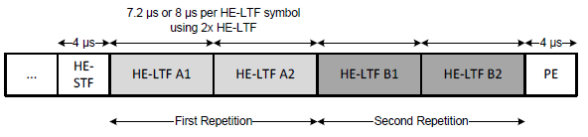
Secure-LTF Generation (from .11az/D1.0)
P bits
τ_{CS}
P_{HE_LTF} Matrix Mapping
CSD Value Generator
IDFT
Zero-GI and Windowing
Frame Format Construction
3P+3
bits
8PSK Sequence Generator
Subcarrier Mapper
CSD
IDFT
Zero-GI and Windowing
…
2^{P} 8PSK symbols
Randomized LTF Sequence
IDFT
Zero-GI and Windowing
Additional notes from .11az/D1.0
  No single stream pilot subcarriers in the secure HE-LTFs, all subcarriers are mapped using the full P-HE-LTF matrix.
  No CSD is applied to the space-time streams.
  No spatial mapping, the Q matrix is a block identity matrix.
  P ={7, 8, 9, 10} for {20, 40, 80,160/80+80} MHz PHY BW.

Slide 4
Secure-LTF (Present Design): N_STS=2 and LTF_REP = 2
TX Stream 1
…
HE-STF
Seq1
- Seq2
Seq3
- Seq4
TX Stream 2
…
HE-STF
Seq1
Seq2
Seq3
Seq4
The waveforms on TX stream 1 and stream 2 are perfectly aligned (in time domain, either in-phase or 180 degrees out of phase), causing unintentional beamforming, by way of constructive/destructive addition of signal.
Seq1, Seq2, Seq3 and Seq4 are generated from 4 different sets of 4P+3 bits.

Slide 5
Secure-LTF (Existing Design): N_STS=2 and LTF_REP = 2
TX Stream 1
…
HE-STF
Seq1
- Seq2
Seq3
- Seq4
TX Stream 2
…
HE-STF
Seq1
Seq2
Seq3
Seq4
3dB average power increase.
9.6us
RX RSSI
3dB
Constructive
interference
Destructive
interference
Zero GI
In case of in-phase LOS or some flat-fading cases
(small indoor environment)
RX signal energy stays low for 9.6us, which may cause RX packet abortion.

Slide 6
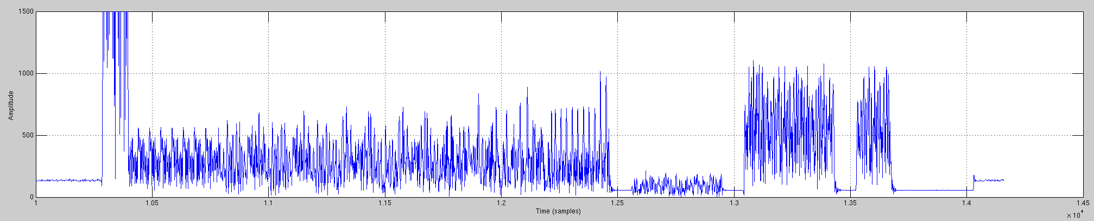
Existing LTF: RX Waveform (Simulation)
chan_indx = 2
Simulation with TGnB Channel model
If no per-STS CSD is applied, unintentional beamforming can take place, resulting in a higher signal amplitude fluctuation in the time domain. This behavior will eat up the dynamic range of receiver circuitry
L-STF
L-LTF
L-SIG
RL-SIG
HE-SIG
HE-STF
HE-LTF1
HE-LTF2
PE
AGC in work
Smaller-than-usual signal amplitude caused by un-intentional beamforming (destructive interference).
Larger-than-usual signal amplitude caused by un-intentional beamforming (constructive interference).

Slide 7
Potential Problems
Circuit dynamic range
  The secure-LTF signal power at the receiver may end up boosted by up to 10*log10(N_STS) dB. Similarly, part of the LTF signal could be completely nulled out due to the destructive addition.
  N_STS=2, can result in 3dB boost or a nulling. Can happen ~10% of time.
  RX power can increase by up to 9 dB (for 8 TX stream case) when coherent interference happens. Extra circuit dynamic range will be required to accommodate such excessive power swing.
Regulatory concerns
  Abrupt increase in power is a concern in some regulator domain
SNR loss due to Channel Estimation
  Up to 1.2494 dB (=3-1.761 dB) (Theoretical max loss)

Slide 8
Secure LTF design Proposal:
Illustration for N_STS=2 and LTF_REP = 2
TX Stream 1
A1
- A2
B1
- B2
TX Stream 2
A3
A4
B3
B4
A1, A2, A3 and A4 are different secure-LTF sequences, which can be generated by the procedure described in .11az. With the following rule, the complexity increment for channel estimation is kept minimum compared to existing design in .11az. Matrix inversion is not necessary!!
  Only need extra phase rotations on H12 and H22 after the typical channel estimation procedure.
The (time-domain) waveforms on TX stream 1 and TX stream 2, will look totally different.
  Improve randomness and thus the overall security
  The unintentional beamforming gets resolved
Rule:
  Sequence A1, A2 are generated from 2 different (and independent) sets of 4P+3 bits. They are polyphase Golay codes.
  The 8PSK sequence of A3 are generated from another independent set of 3P+3 bits. The az_csd of A3 is the same as A1.
  The 8PSK sequence of A4 is generated from 3P+3 bits which are a simple function of the previous 3 sets of 3P+3 bits. The az_csd of A4 is the same as A2.
  The function to generate 3P+3 bits for A4 is described in the subsequent pages.

Slide 9
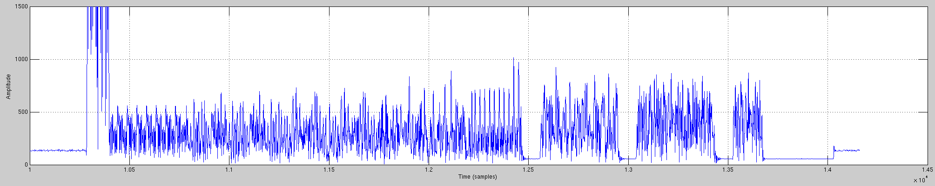
Proposed Design: RX Waveform (Simulation)
With this proposal, the unintentional beamforming behavior is minimized.
RX signal power stays even.
L-STF
L-LTF
L-SIG
RL-SIG
HE-SIG
HE-STF
HE-LTF1
HE-LTF2
PE
AGC in work

Slide 10
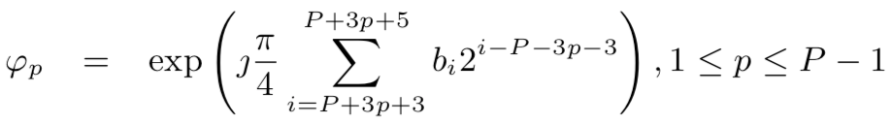
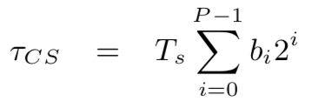
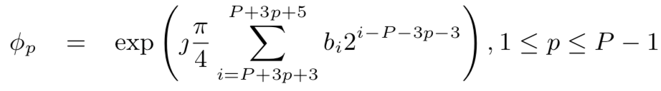


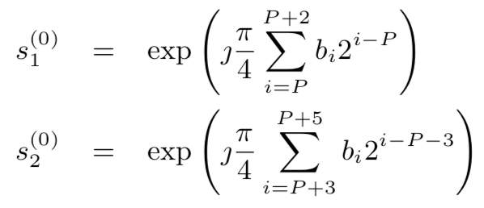
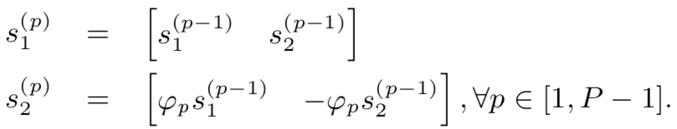
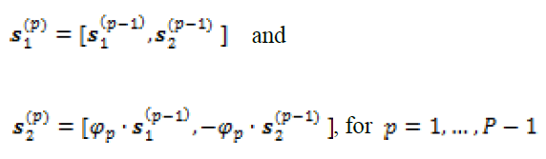
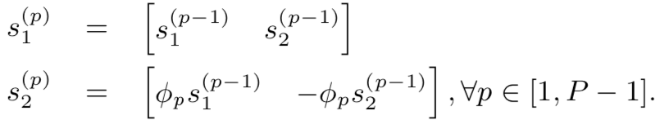
LTF generation : Recap of the 4P+3 bits and the iterative process
The 4P+3 bits can be divided into groups as shown below:
These P bits are used to generate the az_csd.
These 3P+3 = 3(P+1) bits are used to generate the 8PSK secured sequence.
b₀, b₁, … b_{P-1},
b_{P}, b_{P+1}, b_{P+2},
b_{P+3}, b_{P+4}, b_{P+5},
b_{P+6}, b_{P+7}, b_{P+8},
b_{P+9}, b_{P+10}, b_{P+11},
…
b_{4P}, b_{4P+1}, b_{4P+2}
s₁⁽⁰⁾ = exp(jθ₁)
s₂⁽⁰⁾ = exp(jθ₂)
ϕ₁= exp(jφ₁)
ϕ₂= exp(jφ₂)
…
ϕ_{P-1}= exp(jφ_{P-1})
secure az_csd
Initial values
The iterative process
A sequence of 2^{P} 8PSK symbols are generated by P-1 iterations.

Slide 11
“The Rule” and notations
b₀, b₁, … b_{P-1},
b_{P}, b_{P+1}, b_{P+2},
b_{P+3}, b_{P+4}, b_{P+5},
b_{P+6}, b_{P+7}, b_{P+8},
b_{P+9}, b_{P+10}, b_{P+11},
…
b_{4P}, b_{4P+1}, b_{4P+2}
secured az_csd
τ_{CS}
s₁⁽⁰⁾ = exp(jθ₁)
s₂⁽⁰⁾ = exp(jθ₂)
ϕ₁= exp(jφ₁)
ϕ₂= exp(jφ₂)
…
ϕ_{P-1}= exp(jφ_{P-1})
For A1
τ_{CS_A1}
θ_{1_A1}
θ_{2_A1}
φ_{1_A1}
φ_{2_A1}
…
φ_{P-1_A1}
For A2
τ_{CS_A2}
θ_{1_A2}
θ_{2_A2}
φ_{1_A2}
φ_{2_A2}
…
φ_{P-1_A2}
For A3
τ_{CS_A3}=τ_{CS_A1}
θ_{1_A3}
θ_{2_A3}
φ_{1_A3}
φ_{2_A3}
…
φ_{P-1_A3}
For A4
τ_{CS_A4}=τ_{CS_A2}
θ_{1_A4}
= −θ_{1_A1} + θ_{1_A2} + θ_{1_A3}
θ_{2_A4}
= −θ_{2_A1} + θ_{2_A2} + θ_{2_A3}
φ_{1_A4}
= −φ_{1_A1} + φ_{1_A2} + φ_{1_A3}
φ_{2_A4}
= −φ_{2_A1} + φ_{2_A2} + φ_{2_A3}
…
φ_{P-1_A4}
= −φ_{P-1_A1} + φ_{P-1_A2} + φ_{P-1_A3}
We will explain why we choose this “-++” rule in the following pages.

Slide 12
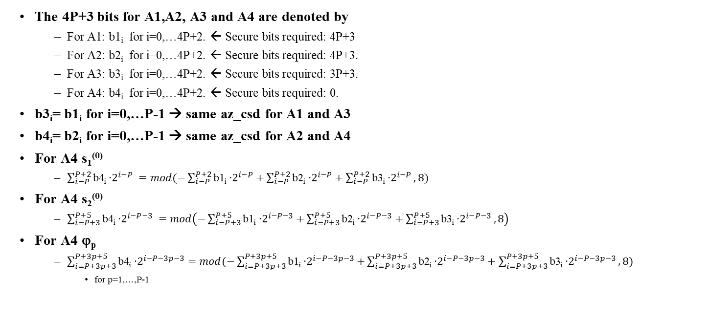
Notations and Equations to represent the function
The 4P+3 bits for A1,A2, A3 and A4 are denoted by
  For A1: b1_{i} for i=0,…4P+2. ← Secure bits required: 4P+3
  For A2: b2_{i} for i=0,…4P+2. ← Secure bits required: 4P+3.
  For A3: b3_{i} for i=0,…4P+2. ← Secure bits required: 3P+3.
  For A4: b4_{i} for i=0,…4P+2. ← Secure bits required: 0.
b3_{i}= b1_{i} for i=0,…P-1 → same az_csd for A1 and A3
b4_{i}= b2_{i} for i=0,…P-1 → same az_csd for A2 and A4
For A4 s₁⁽⁰⁾
  $\sum_{i=P}^{P+2}{\text{b}\text{4}\text{i}{\text{∙}2}^{i−P}} =mod(−\sum_{i=P}^{P+2}{\text{b}\text{1}\text{i}{\text{∙}2}^{i−P}+\sum_{i=P}^{P+2}{\text{b}\text{2}\text{i}{\text{∙}2}^{i−P}}+\sum_{i=P}^{P+2}{\text{b}\text{3}\text{i}{\text{∙}2}^{i−P}}},8)$
For A4 s₂⁽⁰⁾
  $\sum_{i=P+3}^{P+5}{\text{b}\text{4}\text{i}{\text{∙}2}^{i−P−3}} =mod\left(−\sum_{i=P+3}^{P+5}{\text{b}\text{1}\text{i}{\text{∙}2}^{i−P−3}+\sum_{i=P+3}^{P+5}{\text{b}\text{2}\text{i}{\text{∙}2}^{i−P−3}}+\sum_{i=P+3}^{P+5}{\text{b}\text{3}\text{i}{\text{∙}2}^{i−P−3}}},8\right)$
For A4 ϕ_{p}
  $\sum_{i=P+3p+3}^{P+3p+5}{\text{b}\text{4}\text{i}{\text{∙}2}^{i−P−3p−3}}=mod(−\sum_{i=P+3p+3}^{P+3p+5}{\text{b}\text{1}\text{i}{\text{∙}2}^{i−P−3p−3}+\sum_{i=P+3p+3}^{P+3p+5}{\text{b}\text{2}\text{i}{\text{∙}2}^{i−P−3p−3}}+\sum_{i=P+3p+3}^{P+3p+5}{\text{b}\text{3}\text{i}{\text{∙}2}^{i−P−3p−3}}},8)$
    for p=1,…,P-1

Slide 13
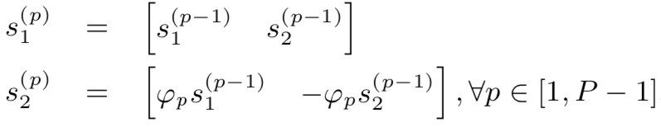
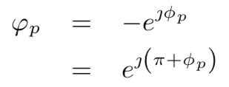
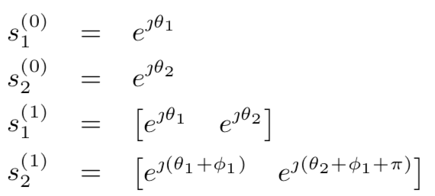
The iterative process
Note: −ϕ_{p}= - exp(jφ_{p}) = exp( j(φ_{p}+π) )
s₁⁽⁰⁾ = exp(jθ₁)
s₂⁽⁰⁾ = exp(jθ₂)
s₁⁽¹⁾ = [ exp( jθ₁ ) , exp( jθ₂ ) ]
s₂⁽¹⁾ = [ exp( j(θ₁+φ₁) ) , exp( j(θ₂+φ₁+π) ) ]
initialization
Phase of s₁⁽⁰⁾ | θ₁
Phase of s₂⁽⁰⁾ | θ₂
Phase of s₁⁽¹⁾ | θ₁ | θ₂
Phase of s₂⁽¹⁾ | θ₁+φ₁ | θ₂+φ₁+π
Phase of s₁⁽²⁾ | θ₁ | θ₂ | θ₁+φ₁ | θ₂+φ₁+π
Phase of s₂⁽²⁾ | θ₁+φ₂ | θ₂+φ₂ | θ₁+φ₁+φ₂+π | θ₂+φ₁+φ₂
Phase of s₁⁽³⁾ | θ₁ | θ₂ | θ₁+φ₁ | θ₂+φ₁+π | θ₁+φ₂ | θ₂+φ₂ | θ₁+φ₁+φ₂+π | θ₂+φ₁+φ₂
Phase of s₂⁽³⁾ | θ₁+φ₃ | θ₂+φ₃ | θ₁+φ₁+φ₃ | θ₂+φ₁+φ₃+π | θ₁+φ₂+φ₃+π | θ₂+φ₂+φ₃+π | θ₁+φ₁+φ₂+φ₃ | θ₂+φ₁+φ₂+φ₃+π
Iteration 1
Iteration 2
…
Iteration 3
…

Slide 14
For A4 (using iteration 2 as an illustration)
initialization
Phase of s₁⁽⁰⁾ | θ_{1_A4}
Phase of s₂⁽⁰⁾ | θ_{2_A4}
Phase of s₁⁽¹⁾ | θ_{1_A4} | θ_{2_A4}
Phase of s₂⁽¹⁾ | θ_{1_A4}+φ_{1_A4} | θ_{2_A4}+φ_{1_A4}+π
Phase of s₁⁽²⁾ | θ_{1_A4} | θ_{2_A4} | θ_{1_A4}+φ_{1_A4} | θ_{2_A4}+φ_{1_A4}+π
Phase of s₂⁽²⁾ | θ_{1_A4}+φ_{2_A4} | θ_{2_A4}+φ_{2_A4} | θ_{1_A4}+φ_{1_A4}+ φ_{2_A4}+π | θ_{2_A4}+φ_{1_A4}+ φ_{2_A4}
Iteration 1
Iteration 2
Re-notation
Phase of s₁⁽²⁾ | ω_{11_A4} | ω_{12_A4} | ω_{13_A4} | ω_{14_A4}
Phase of s₂⁽²⁾ | ω_{21_A4} | ω_{22_A4} | ω_{23_A4} | ω_{24_A4}
Apply similar notation for A1, A2 and A3
Using the rule mentioned earlier, it can be rewritten as
Phase of s₁⁽²⁾ | −ω_{11_A1} +ω_{11_A2} +ω_{11_A3} | −ω_{12_A1} +ω_{12_A2} +ω_{12_A3} | −ω_{13_A1} +ω_{13_A2} +ω_{13_A3} | −ω_{14_A1} +ω_{14_A2} +ω_{14_A3}
Phase of s₂⁽²⁾ | −ω_{21_A1} +ω_{21_A2} +ω_{21_A3} | −ω_{22_A1} +ω_{22_A2} +ω_{22_A3} | −ω_{23_A1} +ω_{23_A2} +ω_{23_A3} | −ω_{24_A1} +ω_{24_A2} +ω_{24_A3}
Phase addition is equivalent to value multiplication.
Phase subtraction is equivalent to value division.
“.*” and “./” denote point-wise multiplication and division for each element in the array. In our case, it means frequency domain point-wise operation.
This relationship holds for all iterations. → The final sequence A4 = A2 .* A3 ./ A1
We have just proven that the A4=A2.*A3./A1 is constructed with the same structure as A1, A2 and A3, and is therefore a Polyphase Golay sequence with the same PAPR as others.

Slide 15
Illustration for Channel Estimation
TX Stream 1
A1
- A2
B1
- B2
TX Stream 2
A3=
A1.*(A3./A1)
A4=
A2.*(A3./A1)
B3= B1.*(B3./B1)
B4= B2.*(B3./B1)
Since this term is a fixed value within one repetition period, it can be viewed as part of the channel response.
Since (A3./A1) is known, we can compensate for it after “typical” channel estimation block.
TX
RX
[A1, A2 ]
TX stream 1
[A1, -A2 ]
h₁₁
“Typical”
Channel Estimation
Est{ h₁₁ }
h₁₂
.*(A1./A3)
Est{ h₁₂ }
h₂₁
Est{ h₂₁ }
[A1, A2 ]
.*(A3./A1)
[A3, A4 ]
TX stream 2
h₂₂
.*(A1./A3)
Est{ h₂₂ }
Since A1 and A3 are 8PSK sequences, “.*(A3./A1)” and “.*(A1./A3)” are just phase rotations.

Slide 16
Extension to larger spatial streams (e.g., N_STS=4 )
Easily scalable to arbitrary number of spatial streams
Needs ( 2 * N_{HE_LTF} - 1 ) additional secured sequences required
TX Stream 1
A1
- A2
A3
A4
TX Stream 2
A5
A2.*A5./A1
-A3.*A5./A1
A4.*A5./A1
TX Stream 3
A6
A2.*A6./A1
A3.*A6./A1
-A4.*A6./A1
TX Stream 4
-A7
A2.*A7./A1
A3.*A7./A1
A4.*A7./A1

Slide 17
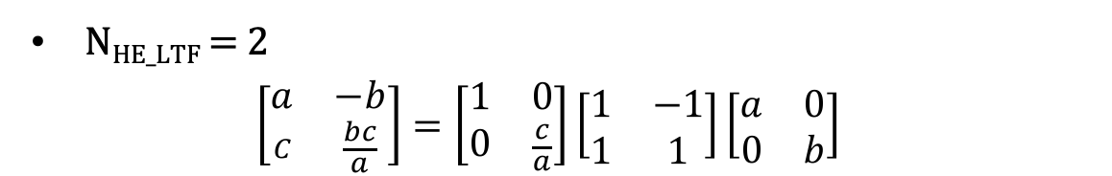
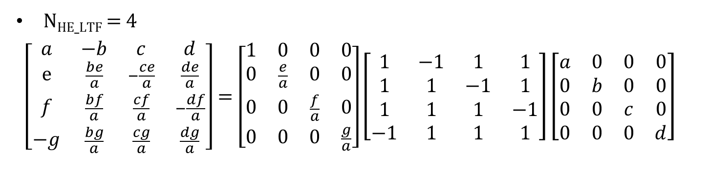
Matrix constructed in this manner is always invertible
It is a Hadamard matrix scaled by diagonal matrices.
Sequence properties (e.g., orthogonality, PAPR etc., ) are retained
N_{HE_LTF} = 2
$$\left[\begin{matrix}a & −b \\ C & \frac{bc}{a}\end{matrix}\right]=\left[\begin{matrix}1 & 0 \\ 0 & \frac{c}{a}\end{matrix}\right]\left[\begin{matrix}1 & −1 \\ 1 & 1\end{matrix}\right]\left[\begin{matrix}a & 0 \\ 0 & b\end{matrix}\right]$$
N_{HE_LTF} = 4
$$\left[\begin{matrix}a & −b & c & d \\ ⅇ & \frac{be}{a} & −\frac{ce}{a} & \frac{de}{a} \\ f & \frac{bf}{a} & \frac{cf}{a} & −\frac{df}{a} \\ −g & \frac{bg}{a} & \frac{cg}{a} & \frac{dg}{a}\end{matrix}\right]=\left[\begin{matrix}1 & 0 & 0 & 0 \\ 0 & \frac{e}{a} & 0 & 0 \\ 0 & 0 & \frac{f}{a} & 0 \\ 0 & 0 & 0 & \frac{g}{a}\end{matrix}\right]\left[\begin{matrix}1 & −1 & 1 & 1 \\ 1 & 1 & −1 & 1 \\ 1 & 1 & 1 & −1 \\ −1 & 1 & 1 & 1\end{matrix}\right]\left[\begin{matrix}a & 0 & 0 & 0 \\ 0 & b & 0 & 0 \\ 0 & 0 & c & 0 \\ 0 & 0 & 0 & d\end{matrix}\right]$$

Slide 18
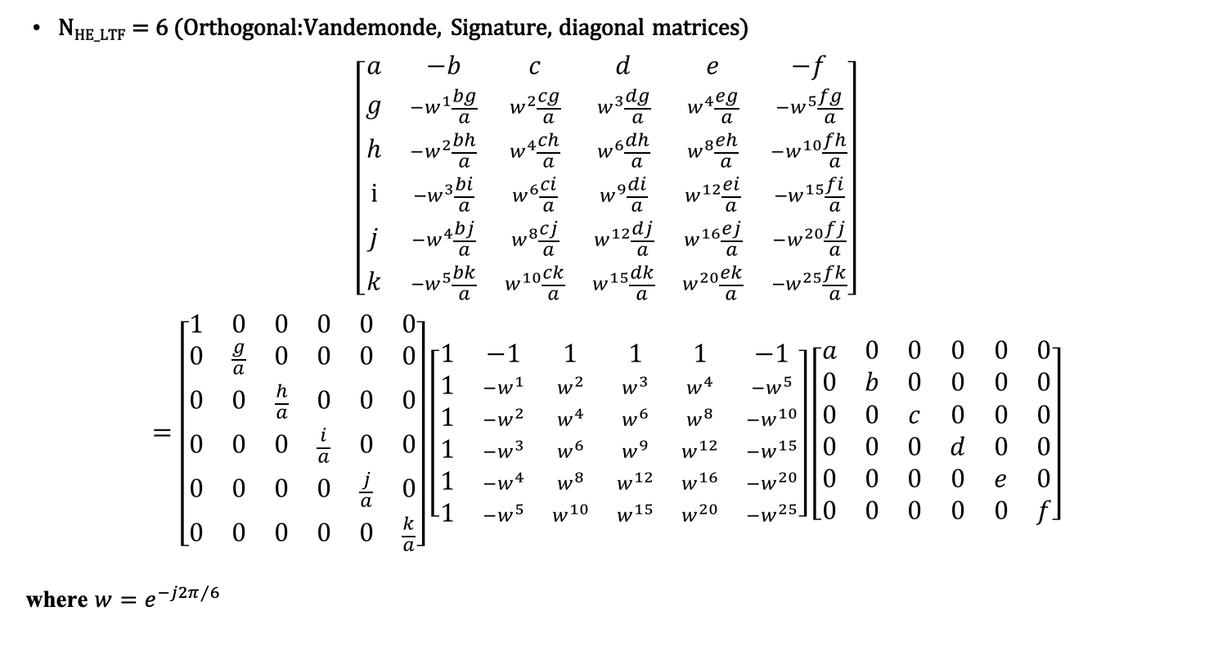
Matrix constructed in this manner is always invertible
N_{HE_LTF} = 6 (Orthogonal:Vandemonde, Signature, diagonal matrices)
$$\left[\begin{matrix}a & −b & c & d & e & −f \\ g & −w^{1}\frac{bg}{a} & w^{2}\frac{cg}{a} & w^{3}\frac{dg}{a} & w^{4}\frac{eg}{a} & {−w}^{5}\frac{fg}{a} \\ h & {−w}^{2}\frac{bh}{a} & w^{4}\frac{ch}{a} & w^{6}\frac{dh}{a} & w^{8}\frac{eh}{a} & {−w}^{10}\frac{fh}{a} \\ i & {−w}^{3}\frac{bi}{a} & w^{6}\frac{ci}{a} & w^{9}\frac{di}{a} & w^{12}\frac{ei}{a} & {−w}^{15}\frac{fi}{a} \\ j & {−w}^{4}\frac{bj}{a} & w^{8}\frac{cj}{a} & w^{12}\frac{dj}{a} & w^{16}\frac{ej}{a} & {−w}^{20}\frac{fj}{a} \\ k & {−w}^{5}\frac{bk}{a} & w^{10}\frac{ck}{a} & w^{15}\frac{dk}{a} & w^{20}\frac{ek}{a} & {−w}^{25}\frac{fk}{a}\end{matrix}\right]$$
$$=\left[\begin{matrix}1 & 0 & 0 & 0 & 0 & 0 \\ 0 & \frac{g}{a} & 0 & 0 & 0 & 0 \\ 0 & 0 & \frac{h}{a} & 0 & 0 & 0 \\ 0 & 0 & 0 & \frac{i}{a} & 0 & 0 \\ 0 & 0 & 0 & 0 & \frac{j}{a} & 0 \\ 0 & 0 & 0 & 0 & 0 & \frac{k}{a}\end{matrix}\right]\left[\begin{matrix}1 & −1 & 1 & 1 & 1 & −1 \\ 1 & −w^{1} & w^{2} & w^{3} & w^{4} & {−w}^{5} \\ 1 & {−w}^{2} & w^{4} & w^{6} & w^{8} & {−w}^{10} \\ 1 & {−w}^{3} & w^{6} & w^{9} & w^{12} & {−w}^{15} \\ 1 & {−w}^{4} & w^{8} & w^{12} & w^{16} & {−w}^{20} \\ 1 & {−w}^{5} & w^{10} & w^{15} & w^{20} & {−w}^{25}\end{matrix}\right]\left[\begin{matrix}a & 0 & 0 & 0 & 0 & 0 \\ 0 & b & 0 & 0 & 0 & 0 \\ 0 & 0 & c & 0 & 0 & 0 \\ 0 & 0 & 0 & d & 0 & 0 \\ 0 & 0 & 0 & 0 & e & 0 \\ 0 & 0 & 0 & 0 & 0 & f\end{matrix}\right]$$
where $w=e^{−j2π/6}$

Slide 19
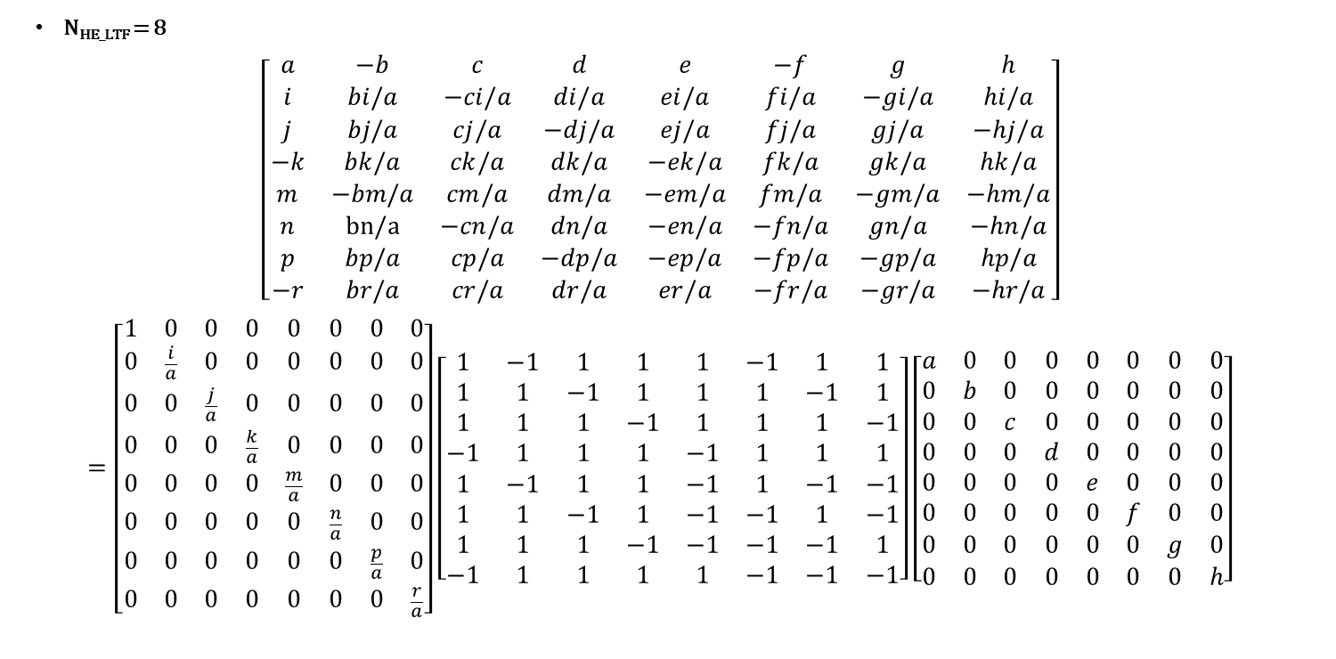
Matrix constructed in this manner is always invertible
N_{HE_LTF} = 8
$$\left[\begin{matrix}a & −b & c & d & e & −f & g & h \\ i & bi/a & −ci/a & di/a & ei/a & fi/a & −gi/a & hi/a \\ j & bj/a & cj/a & −dj/a & ej/a & fj/a & gj/a & −hj/a \\ −k & bk/a & ck/a & dk/a & −ek/a & fk/a & gk/a & hk/a \\ m & −bm/a & cm/a & dm/a & −em/a & fm/a & −gm/a & −hm/a \\ n & bn/a & −cn/a & dn/a & −en/a & −fn/a & gn/a & −hn/a \\ p & bp/a & cp/a & −dp/a & −ep/a & −fp/a & −gp/a & hp/a \\ −r & br/a & cr/a & dr/a & er/a & −fr/a & −gr/a & −hr/a\end{matrix}\right]$$
$$=\left[\begin{matrix}1 & 0 & 0 & 0 & 0 & 0 & 0 & 0 \\ 0 & \frac{i}{a} & 0 & 0 & 0 & 0 & 0 & 0 \\ 0 & 0 & \frac{j}{a} & 0 & 0 & 0 & 0 & 0 \\ 0 & 0 & 0 & \frac{k}{a} & 0 & 0 & 0 & 0 \\ 0 & 0 & 0 & 0 & \frac{m}{a} & 0 & 0 & 0 \\ 0 & 0 & 0 & 0 & 0 & \frac{n}{a} & 0 & 0 \\ 0 & 0 & 0 & 0 & 0 & 0 & \frac{p}{a} & 0 \\ 0 & 0 & 0 & 0 & 0 & 0 & 0 & \frac{r}{a}\end{matrix}\right]\left[\begin{matrix}1 & −1 & 1 & 1 & 1 & −1 & 1 & 1 \\ 1 & 1 & −1 & 1 & 1 & 1 & −1 & 1 \\ 1 & 1 & 1 & −1 & 1 & 1 & 1 & −1 \\ −1 & 1 & 1 & 1 & −1 & 1 & 1 & 1 \\ 1 & −1 & 1 & 1 & −1 & 1 & −1 & −1 \\ 1 & 1 & −1 & 1 & −1 & −1 & 1 & −1 \\ 1 & 1 & 1 & −1 & −1 & −1 & −1 & 1 \\ −1 & 1 & 1 & 1 & 1 & −1 & −1 & −1\end{matrix}\right]\left[\begin{matrix}a & 0 & 0 & 0 & 0 & 0 & 0 & 0 \\ 0 & b & 0 & 0 & 0 & 0 & 0 & 0 \\ 0 & 0 & c & 0 & 0 & 0 & 0 & 0 \\ 0 & 0 & 0 & d & 0 & 0 & 0 & 0 \\ 0 & 0 & 0 & 0 & e & 0 & 0 & 0 \\ 0 & 0 & 0 & 0 & 0 & f & 0 & 0 \\ 0 & 0 & 0 & 0 & 0 & 0 & g & 0 \\ 0 & 0 & 0 & 0 & 0 & 0 & 0 & h\end{matrix}\right]$$

Slide 20
Conclusion
MIMO mode needs modification in Secure LTF design
Simple, scalable scheme exist to address the problem. One scheme is presented here.
Very minimal change in the receiver (channel estimation)
A byproduct of this design is that, it also helps to make the system more secure.

Slide 21
Appendix

Slide 22
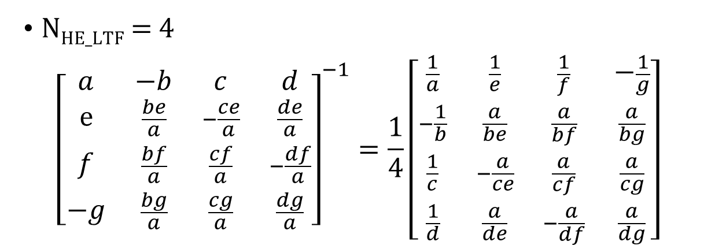
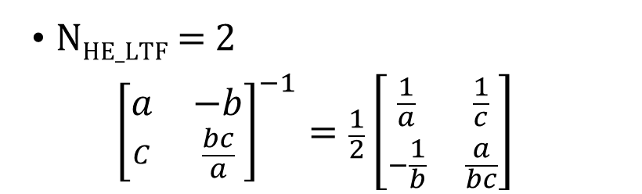
Matrix constructed in this manner is always invertible
N_{HE_LTF} = 2
$${\left[\begin{matrix}a & −b \\ C & \frac{bc}{a}\end{matrix}\right]}^{−1}=\frac{1}{2}\left[\begin{matrix}\frac{1}{a} & \frac{1}{c} \\ −\frac{1}{b} & \frac{a}{bc}\end{matrix}\right]$$
N_{HE_LTF} = 4
$${\left[\begin{matrix}a & −b & c & d \\ ⅇ & \frac{be}{a} & −\frac{ce}{a} & \frac{de}{a} \\ f & \frac{bf}{a} & \frac{cf}{a} & −\frac{df}{a} \\ −g & \frac{bg}{a} & \frac{cg}{a} & \frac{dg}{a}\end{matrix}\right]}^{−1}=\frac{1}{4}\left[\begin{matrix}\frac{1}{a} & \frac{1}{e} & \frac{1}{f} & −\frac{1}{g} \\ −\frac{1}{b} & \frac{a}{be} & \frac{a}{bf} & \frac{a}{bg} \\ \frac{1}{c} & −\frac{a}{ce} & \frac{a}{cf} & \frac{a}{cg} \\ \frac{1}{d} & \frac{a}{de} & −\frac{a}{df} & \frac{a}{dg}\end{matrix}\right]$$

Slide 23
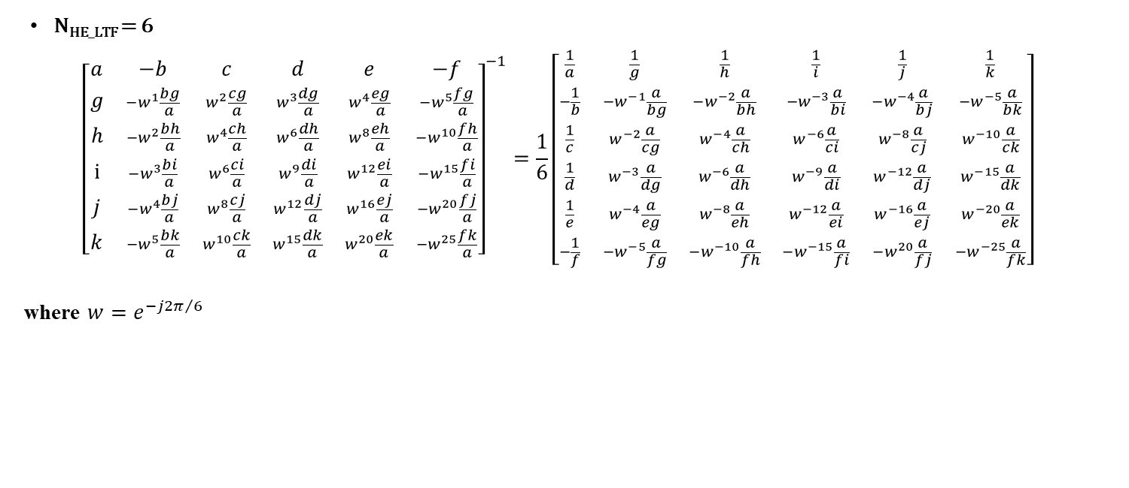
Matrix constructed in this manner is always invertible
N_{HE_LTF} = 6
$${\left[\begin{matrix}a & −b & c & d & e & −f \\ g & −w^{1}\frac{bg}{a} & w^{2}\frac{cg}{a} & w^{3}\frac{dg}{a} & w^{4}\frac{eg}{a} & {−w}^{5}\frac{fg}{a} \\ h & {−w}^{2}\frac{bh}{a} & w^{4}\frac{ch}{a} & w^{6}\frac{dh}{a} & w^{8}\frac{eh}{a} & {−w}^{10}\frac{fh}{a} \\ i & {−w}^{3}\frac{bi}{a} & w^{6}\frac{ci}{a} & w^{9}\frac{di}{a} & w^{12}\frac{ei}{a} & {−w}^{15}\frac{fi}{a} \\ j & {−w}^{4}\frac{bj}{a} & w^{8}\frac{cj}{a} & w^{12}\frac{dj}{a} & w^{16}\frac{ej}{a} & {−w}^{20}\frac{fj}{a} \\ k & {−w}^{5}\frac{bk}{a} & w^{10}\frac{ck}{a} & w^{15}\frac{dk}{a} & w^{20}\frac{ek}{a} & {−w}^{25}\frac{fk}{a}\end{matrix}\right]}^{−1}=\frac{1}{6}\left[\begin{matrix}\frac{1}{a} & \frac{1}{g} & \frac{1}{h} & \frac{1}{i} & \frac{1}{j} & \frac{1}{k} \\ −\frac{1}{b} & −w^{−1}\frac{a}{bg} & {−w}^{−2}\frac{a}{bh} & {−w}^{−3}\frac{a}{bi} & {−w}^{−4}\frac{a}{bj} & {−w}^{−5}\frac{a}{bk} \\ \frac{1}{c} & w^{−2}\frac{a}{cg} & w^{−4}\frac{a}{ch} & w^{−6}\frac{a}{ci} & w^{−8}\frac{a}{cj} & w^{−10}\frac{a}{ck} \\ \frac{1}{d} & w^{−3}\frac{a}{dg} & w^{−6}\frac{a}{dh} & w^{−9}\frac{a}{di} & w^{−12}\frac{a}{dj} & w^{−15}\frac{a}{dk} \\ \frac{1}{e} & w^{−4}\frac{a}{eg} & w^{−8}\frac{a}{eh} & w^{−12}\frac{a}{ei} & w^{−16}\frac{a}{ej} & w^{−20}\frac{a}{ek} \\ −\frac{1}{f} & {−w}^{−5}\frac{a}{fg} & {−w}^{−10}\frac{a}{fh} & {−w}^{−15}\frac{a}{fi} & {−w}^{20}\frac{a}{fj} & {−w}^{−25}\frac{a}{fk}\end{matrix}\right]$$
where $w=e^{−j2π/6}$

Slide 24
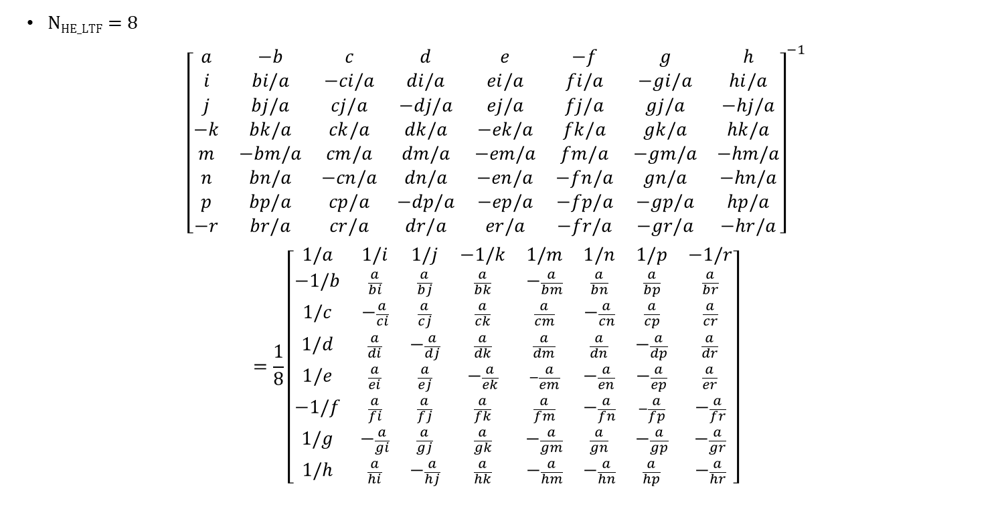
Matrix constructed in this manner is always invertible
N_{HE_LTF} = 8
$${\left[\begin{matrix}a & −b & c & d & e & −f & g & h \\ i & bi/a & −ci/a & di/a & ei/a & fi/a & −gi/a & hi/a \\ j & bj/a & cj/a & −dj/a & ej/a & fj/a & gj/a & −hj/a \\ −k & bk/a & ck/a & dk/a & −ek/a & fk/a & gk/a & hk/a \\ m & −bm/a & cm/a & dm/a & −em/a & fm/a & −gm/a & −hm/a \\ n & bn/a & −cn/a & dn/a & −en/a & −fn/a & gn/a & −hn/a \\ p & bp/a & cp/a & −dp/a & −ep/a & −fp/a & −gp/a & hp/a \\ −r & br/a & cr/a & dr/a & er/a & −fr/a & −gr/a & −hr/a\end{matrix}\right]}^{−1}$$
$$=\frac{1}{8}\left[\begin{matrix}1/a & 1/i & 1/j & −1/k & 1/m & 1/n & 1/p & −1/r \\ −1/b & \frac{a}{bi} & \frac{a}{bj} & \frac{a}{bk} & −\frac{a}{bm} & \frac{a}{bn} & \frac{a}{bp} & \frac{a}{br} \\ 1/c & −\frac{a}{ci} & \frac{a}{cj} & \frac{a}{ck} & \frac{a}{cm} & −\frac{a}{cn} & \frac{a}{cp} & \frac{a}{cr} \\ 1/d & \frac{a}{di} & −\frac{a}{dj} & \frac{a}{dk} & \frac{a}{dm} & \frac{a}{dn} & −\frac{a}{dp} & \frac{a}{dr} \\ 1/e & \frac{a}{ei} & \frac{a}{ej} & −\frac{a}{ek} & −\frac{a}{em} & −\frac{a}{en} & −\frac{a}{ep} & \frac{a}{er} \\ −1/f & \frac{a}{fi} & \frac{a}{fj} & \frac{a}{fk} & \frac{a}{fm} & −\frac{a}{fn} & −\frac{a}{fp} & −\frac{a}{fr} \\ 1/g & −\frac{a}{gi} & \frac{a}{gj} & \frac{a}{gk} & −\frac{a}{gm} & \frac{a}{gn} & −\frac{a}{gp} & −\frac{a}{gr} \\ 1/h & \frac{a}{hi} & −\frac{a}{hj} & \frac{a}{hk} & −\frac{a}{hm} & −\frac{a}{hn} & \frac{a}{hp} & −\frac{a}{hr}\end{matrix}\right]$$

Slide 25
Math for Channel Estimation (using 2x2 as an example)
Assume the frequency domain value of the k^{th} tone for sequence A1, A2 and A3 are A1_{k}, A2_{k} and A3_{k} respectively. Since A1_{k} and A3_{k} are 8PSK symbols, A1_{k} and A3_{k} can be written as exp( j * θ_{A1k}) and exp( j * θ_{A3k}) respectively. The k_th tone being send out through the two antennas:
  Symbol: n n+1 n+2 n+3
  TX Ant 0: A1_{k} -A2_{k} B1_{k} -B2_{k}
  TX Ant 1: A3_{k} A2_{k}*exp( j*θ_{A3k})*exp( -j*θ_{A1k}) B3_{k} B2_{k}*exp( j*θ_{B3k})*exp( -j*θ_{B1k})
We can rewrite them as (only show symbol n and n+1)
  Symbol: n n+1
  TX Ant 0: A1_{k} -A2_{k}
  TX Ant 1: A1_{k}*exp( j*θ_{A3k})*exp( -j*θ_{A1k}) A2_{k}*exp( j*θ_{A3k})*exp( -j*θ_{A1k})

Slide 26
Math for Channel Estimation (using 2x2 as an example)
If the channel matrix for k^{th} tone is H_{k}=[ h_{11_k} h_{12_k} ; h_{21_k} h_{22_k} ], then at the receiver for symbol n and n+1, we get (ignoring noise):
  RX Ant 0:
    y1[n] = h_{11_k}* A1_{k} + h_{12_k}* A1_{k}*exp( j*θ_{A3k})*exp( -j*θ_{A1k})
    y1[n+1] = h_{11_k}* (-A2_{k} )+ h_{12_k}* A2_{k}*exp( j*θ_{A3k})*exp( -j*θ_{A1k})
  RX Ant 1:
    y2[n] = h_{21_k}* A1_{k} + h_{22_k}* A1_{k}*exp( j*θ_{A3k})*exp( -j*θ_{A1k})
    y2[n+1] = h_{21_k}* (-A2_{k} )+ h_{22_k}* A2_{k}*exp( j*θ_{A3k})*exp( -j*θ_{A1k})
We can write
  H_{12_k}’ = h_{12_k}*exp( j*θ_{A3k})*exp( -j*θ_{A1k})
  H_{22_k}’ = h_{22_k}*exp( j*θ_{A3k})*exp( -j*θ_{A1k})
Substituting these into the equations, we get
  RX Ant 0:
    y1[n] = h_{11_k}* A1_{k} + h_{12_k}’ * A1_{k}
    y1[n+1] = h_{11_k}* (-A2_{k} )+ h_{12_k}’ * A2_{k}
  RX Ant 1:
    y2[n] = h_{21_k}* A1_{k} + h_{22_k}’ * A1_{k}
    y2[n+1] = h_{21_k}* (-A2_{k} )+ h_{22_k}’ * A2_{k}

Slide 27
Math for Channel Estimation (using 2x2 as an example)
Now we can solve h₁₁ , h₁₂’ , h₂₁ and h₂₂’ from previous equations
  RX Ant 0:
    y1[n] / A1_{k} = h_{11_k} + h_{12_k}’
    y1[n+1] / A2_{k} = h_{11_k} + h_{12_k}’
  RX Ant 1:
    y2[n] / A1_{k} = h_{21_k} + h_{22_k}’
    y2[n+1] / A2_{k} = h_{21_k} + h_{22_k}’
By adding and subtracting the equations
  RX Ant 0
    h_{11_k} = ( y1[n] / A1_{k} - y1[n+1] / A2_{k} ) /2
    h_{12_k}’ = ( y1[n] / A1_{k} + y1[n+1] / A2_{k} ) /2
  RX Ant 1
    h_{21_k} = ( y2[n] / A2_{k} - y2[n+1] / A2_{k} ) /2
    h_{22_k}’ = ( y2[n] / A2_{k} + y2[n+1] / A2_{k} ) /2
After we solve h_{12_k}’ and h_{22_k}’ , we can then compensate for the phase shift and get h_{12_k} and h_{22_k}
  h_{12_k} = h_{12_k}’ * exp( -j * θ_{A3k}) * exp( j * θ_{A1k})
  h_{22_k} = h_{22_k}’ * exp( -j * θ_{A3k}) * exp( j * θ_{A1k})

