Slide 1
Simulation results with bit-loading for the LC-optimized PHY
Date: 2019-09-15
Authors:

Slide 2
Abstract
This presentation contains simulation results for the evaluation of bit-loading in the LC PHY.

Slide 3
Overview
Adaptive bit-loading is the central feature in the proposed LC PHY based on G.9991
“Flat” bit-loading using fixed MCS over all subcarriers is compared to adaptive bit-loading (according to [1])
Target: PER < 10⁻³
Approach:
  Fixed bit rate
  Find power threshold (SNR) for flat bit-loading
  Find power threshold for adaptive bit-loading algorithm
[1] Fischer, R. F., & Huber, J. B. (1996, November). A new loading algorithm for discrete multitone transmission. In Proceedings of GLOBECOM'96. 1996 IEEE Global Telecommunications Conference (Vol. 1, pp. 724-728). IEEE.

Slide 4
PHY configuration
Base configuration: G.hn PHY, subcarrier spacing 195.3125 kHz, sample rate 1 GHz, FFT size 5120, CP length 320, DC offset 4.59 MHz
Bandwidth settings:
942 active subcarriers (bandwidth 183.98 MHz)
410 active subcarriers (bandwidth 80.32 MHz)
205 active subcarriers (bandwidth 40.39 MHz)
Bits/active SC: 4, 6
FEC: LDPC, rate: 5/6, block length: 4320 (960) bits

Slide 5
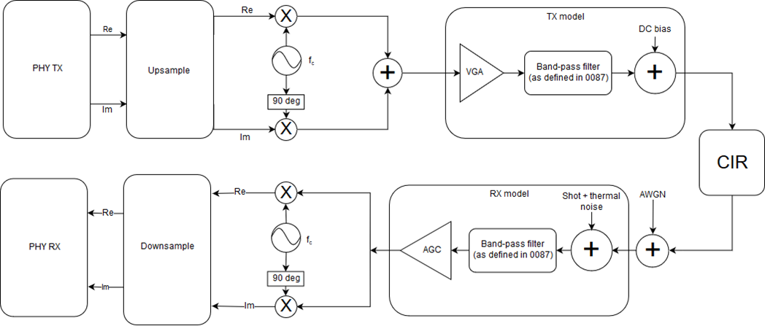
Simulation setup
+ LED model
(low pass filter)
Frontend models (band-pass filter):
See doc. 11-19/187r4
Additional narrow-band LED
model for some simulations
Signal power is measured at red circle. The SNR is set by adjusting noise power in the following AWGN block accordingly. The impact of the Rx model on SNR is assumed to be neglibible, as the used bandpass cutoff frequencies exceed the signal bandwidth.

Slide 6
Channel Models – Frequency Domain
Enterprise Conference Room S3-D1
  Low pass <45 MHz
  Flat >45 MHz
Industrial Wireless D7 (overall)
  Low pass <30 MHz
  Deep fades >30 MHz

Slide 7
Channel Models – Time Domain
Enterprise Conference Room S3-D1
  Pronounced LOS peak
  Some multi-path components
Industrial Wireless D7 (overall)
  No pronounced peak
  Energy spread over 3 main components

Slide 8
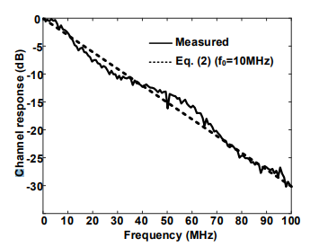
LED model
Measurement (solid) and approximation (dashed) as presented in doc. 19-1208r0
Approximation from left figure (dashed red) and digital filter fit (solid blue)
Second order IIR filter
Matlab code (SOS form):
g_led = 0.003078294298992;
sos_led = [1,2,1,1,-1.83703636178762,0.849349538983590];

Slide 9
Enterprise Conference room channel, 184 MHz, 4 bits/SC
Bit error rate
Block error rate
Simulation length: 10,000 FEC blocks

Slide 10
Industrial Wireless channel, 184 MHz, 4 bits/SC
Bit error rate
Block error rate
Simulation length: 10,000 FEC blocks

Slide 11
Enterprise Conference room channel, 184 MHz, 4 bits/SC, FEC block length 960 bits
Bit error rate
Block error rate
Simulation length: 10,000 FEC blocks

Slide 12
Industrial Wireless channel, 184 MHz, 4 bits/SC, FEC block length 960 bits
Bit error rate
Block error rate
Simulation length: 10,000 FEC blocks

Slide 13
Enterprise Conference room channel, 184 MHz, 6 bits/SC
Bit error rate
Block error rate
Simulation length: 10,000 FEC blocks

Slide 14
Industrial Wireless channel, 184 MHz, 6 bits/SC
Bit error rate
Block error rate
Simulation length: 10,000 FEC blocks

Slide 15
Enterprise Conference room channel, 80 MHz, 4 bits/SC
Bit error rate
Block error rate
Simulation length: 5,000 FEC blocks

Slide 16
Enterprise Conference room channel, 80 MHz, 4 bits/SC
+ LED model
Bit error rate
Block error rate
Simulation length: 5,000 FEC blocks

Slide 17
Enterprise Conference room channel, 40 MHz, 4 bits/SC
Bit error rate
Block error rate
Simulation length: 2,000 FEC blocks

Slide 18
Enterprise Conference room channel, 40 MHz, 4 bits/SC
+ LED model
Bit error rate
Block error rate
Simulation length: 2,000 FEC blocks

