Slide 1
VHT LO Leakage Requirement
Date: 2019-09-11
Authors:
Name | Affiliations | Address | Phone | Email
Matthew Fischer | Broadcom | 250 Innovation Dr, San Jose, CA 95134 |  | Matthew.fischer@broadcom.com
Jun Zheng
Jason Tseng
Ron Porat
Vinko Erceg

Slide 2
Abstract
VHT LO Leakage limits are unrealistic when accounting for reduced TX power situations
Other proposed amendments account for reduced total TX power in a manner that is realistic
This document proposes a relaxation of the VHT LO Leakage limits under certain conditions

Slide 3
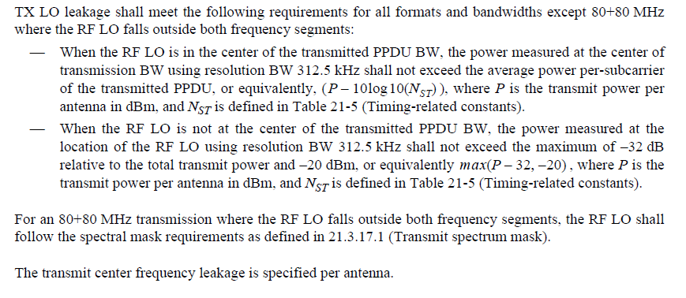
VHT LO Leakage Specification
REVmd_D2.4 -- 21.3.17.4.2 Transmit center frequency leakage

Slide 4
VHT dBr Calculation
BW | 20 | 40 | 80 | 160
N_{ST} | 56 | 114 | 242 | 484
-10log10(N_{ST}) | -17.48 | -20.57 | -23.84 | -26.85
VHT dBr
  When RF LO is at the center of the PPDU BW
Constant dBr requirement across all TX power
  When RF LO is at the center of the PPDU BW

Slide 5
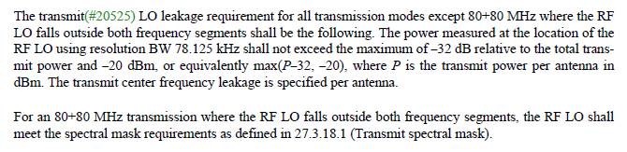
TGax Draft 2.4 LO Leakage Specification
27.3.18.4.2 Transmit center frequency leakage

Slide 6
TGax Effective dBr Requirement
Leakage power = max(P – 32, -20)
- dBr = P – max(P – 32, -20)
  P > 12, - dBr = P – P +32 = 32
  P < 12, - dBr = P + 20

Slide 7
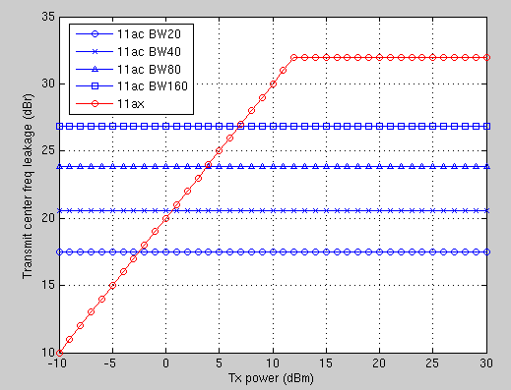
Comparison of -dBr Requirements
TGax is relaxed at low TX power

Slide 8
Proposed Changes
REVmd_D2.4 -- 21.3.17.4.2 Transmit center frequency leakage
TX LO leakage shall meet the following requirements for all formats and bandwidths except 80+80 MHz where the RF LO falls outside both frequency segments:
— When the RF LO is in the center of the transmitted PPDU BW, the power measured at the center of transmission BW using resolution BW 312.5 kHz shall not exceed the average power per-subcarrier of the transmitted PPDU, or equivalently, (P-10log10(N_{ST}) ), where P is the transmit power per antenna in dBm, and N_{ST} is defined in Table 21-5 (Timing-related constants).
— When the RF LO is not at the center of the transmitted PPDU BW, tThe power measured at the location of the RF LO using resolution BW 312.5 kHz shall not exceed the maximum of –3210log10(N_{ST}) dB relative to the total transmit power and –20 dBm, or equivalently max(P-10log10(N_{ST})32, -20) , where P is the transmit power per antenna in dBm, and N_{ST} is defined in Table 21-5 (Timing-related constants).
For an 80+80 MHz transmission where the RF LO falls outside both frequency segments, the RF LO shall follow the spectral mask requirements as defined in 21.3.17.1 (Transmit spectrum mask).
The transmit center frequency leakage is specified per antenna.

Slide 9
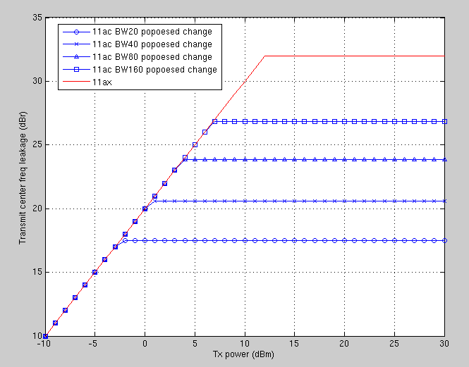
Comparison of -dBr Requirements After the Proposed Change
TGax is relaxed at low TX power

Slide 10
Straw poll #1
Do you support the proposed change to Draft P802.11REVmd_D2.4 21.3.17.4.2 Transmit center frequency leakage as described in 11-19-1561-00-000m-VHT-LO-Leakage-Requirement?
  YES
  NO
  ABS

Slide 11
References
[1] Draft P802.11REVmd_D2.4
[2] Draft P802.11ax_D4.3

