Slide 1
Remarks on P matrices for EHT
Date: 2019-09-13
Authors:

Slide 2
Abstract
This contribution discusses requirements for the P matrices, gives an overview possible matrix designs and presents examples of P matrices

Slide 3

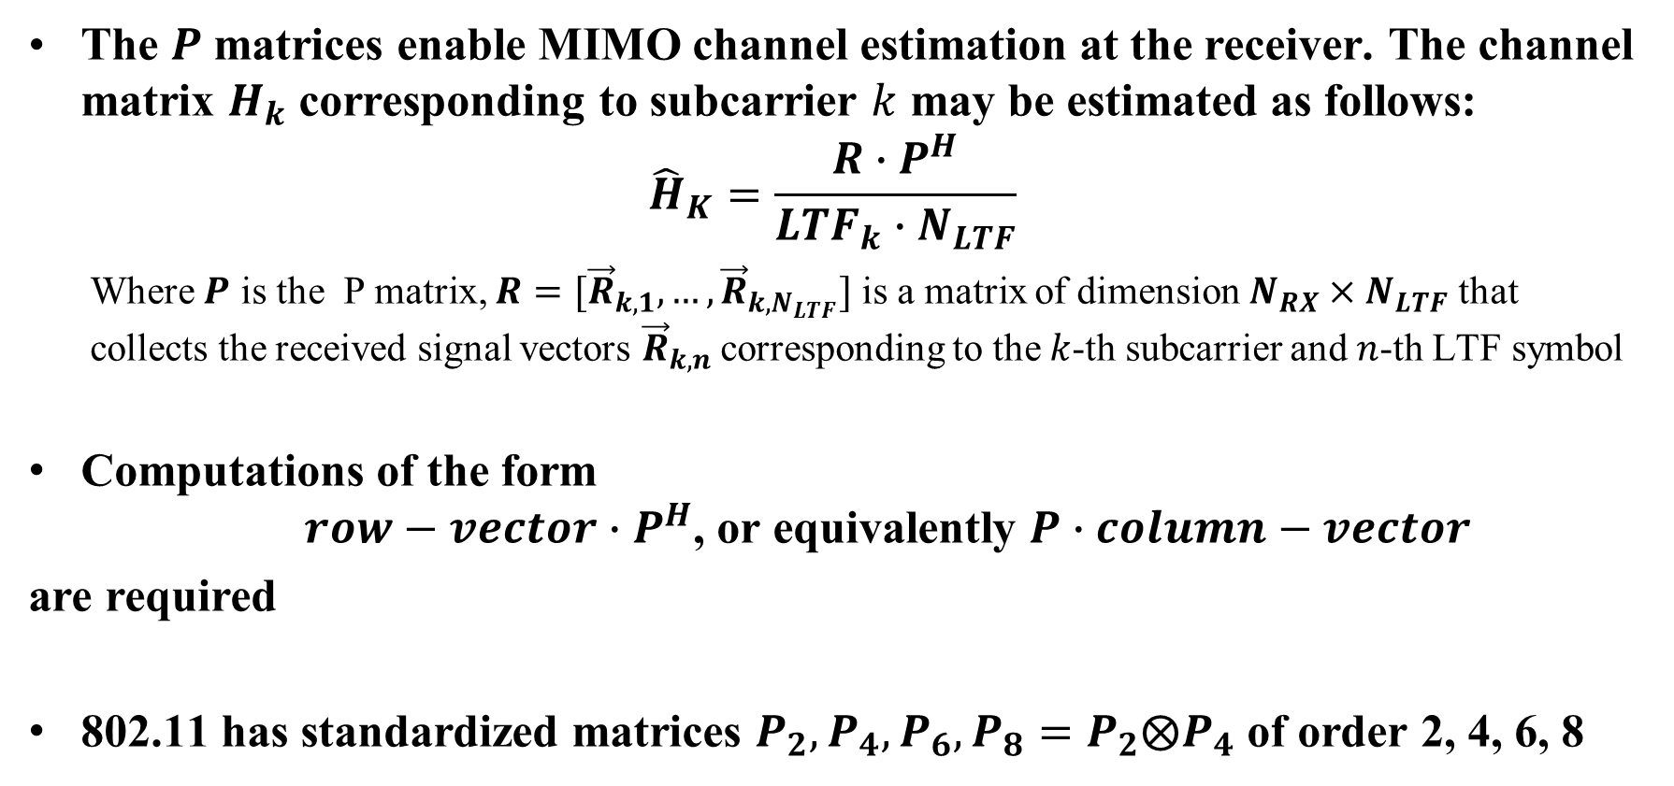
$P$matrices (recap)
The $P$ matrices enable MIMO channel estimation at the receiver. The channel matrix $H_{k}$ corresponding to subcarrier $k$ may be estimated as follows:
$${\hat{H}}_{K}=\frac{R∙P^{H}}{{{LTF}_{k}∙N}_{LTF}}$$
  Where $P$ is the P matrix, ${R=[\vec{R}}_{k,1},…,{\vec{R}}_{{k,N}_{LTF}}]$ is a matrix of dimension $N_{RX}×N_{LTF}$ that collects the received signal vectors ${\vec{R}}_{k,n}$corresponding to the $k$-th subcarrier and $n$-th LTF symbol
Computations of the form
$row−vector∙$ $P^{H}$, or equivalently $P$ $∙column−vector$
are required
802.11 has standardized matrices $P_{2},P_{4},P_{6},P_{8}=P_{2}⨂P_{4}$ of order 2, 4, 6, 8

Slide 4

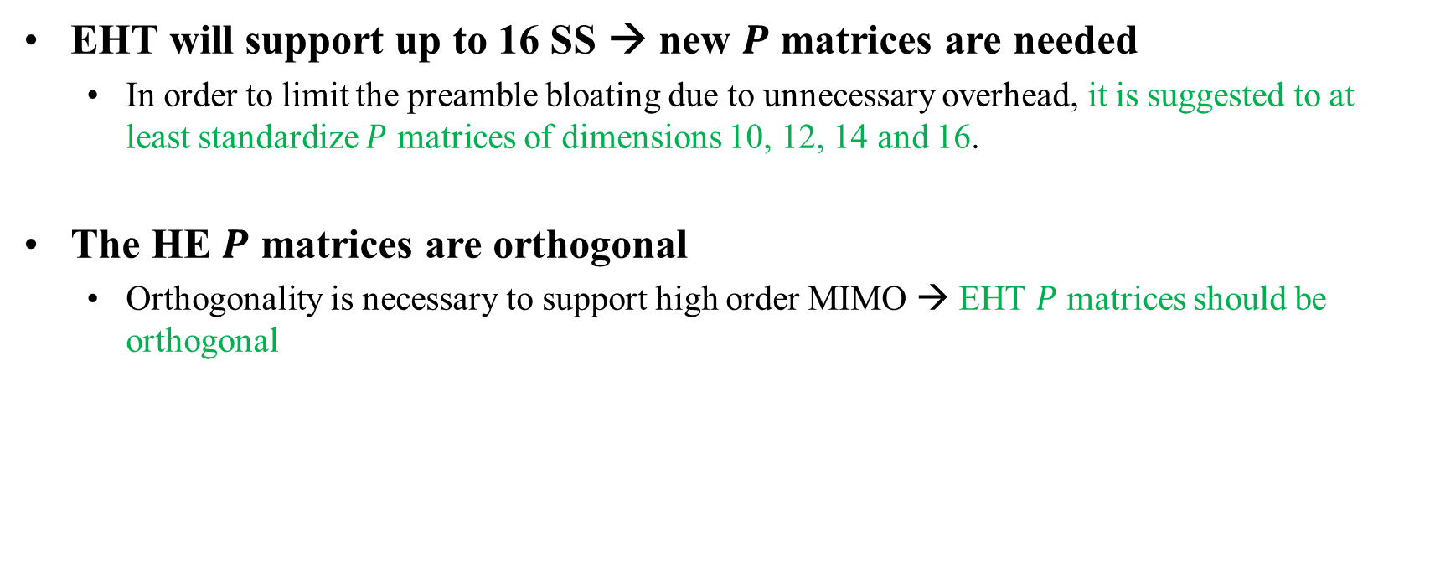
$P$ matrices in EHT (1)
EHT will support up to 16 SS → new $P$ matrices are needed
  In order to limit the preamble bloating due to unnecessary overhead, it is suggested to at least standardize $P$ matrices of dimensions 10, 12, 14 and 16.
The HE $P$ matrices are orthogonal
  Orthogonality is necessary to support high order MIMO → EHT $P$ matrices should be orthogonal

Slide 5

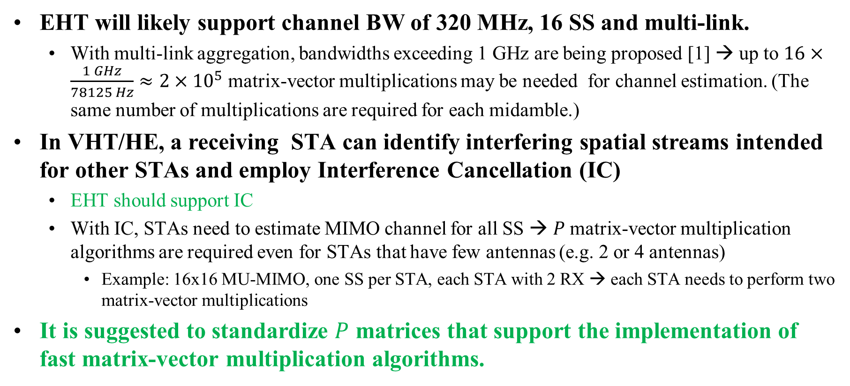
$P$matrices in EHT (2)
EHT will likely support channel BW of 320 MHz, 16 SS and multi-link.
  With multi-link aggregation, bandwidths exceeding 1 GHz are being proposed [1] → up to $16×\frac{1 GHz}{78125 Hz}≈2{×10}^{5}$ matrix-vector multiplications may be needed for channel estimation. (The same number of multiplications are required for each midamble.)
In VHT/HE, a receiving STA can identify interfering spatial streams intended for other STAs and employ Interference Cancellation (IC)
  EHT should support IC
  With IC, STAs need to estimate MIMO channel for all SS → $P$matrix-vector multiplication algorithms are required even for STAs that have few antennas (e.g. 2 or 4 antennas)
    Example: 16x16 MU-MIMO, one SS per STA, each STA with 2 RX → each STA needs to perform two matrix-vector multiplications
It is suggested to standardize $P$ matrices that support the implementation of fast matrix-vector multiplication algorithms.

Slide 6

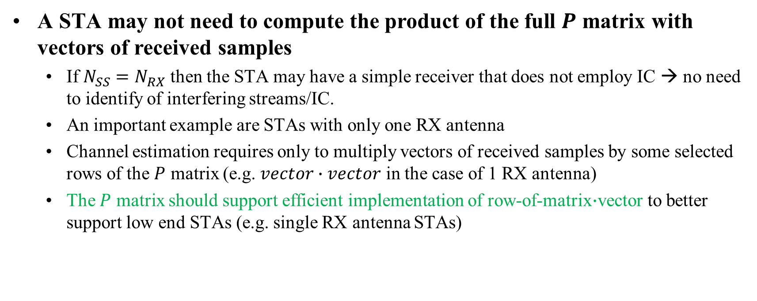
$P$matrices in EHT (3)
A STA may not need to compute the product of the full $P$ matrix with vectors of received samples
  If $N_{SS}=N_{RX}$ then the STA may have a simple receiver that does not employ IC → no need to identify of interfering streams/IC.
  An important example are STAs with only one RX antenna
  Channel estimation requires only to multiply vectors of received samples by some selected rows of the $P$ matrix (e.g. $vector∙vector$ in the case of 1 RX antenna)
  The $P$ matrix should support efficient implementation of row-of-matrix$∙$vector to better support low end STAs (e.g. single RX antenna STAs)

Slide 7
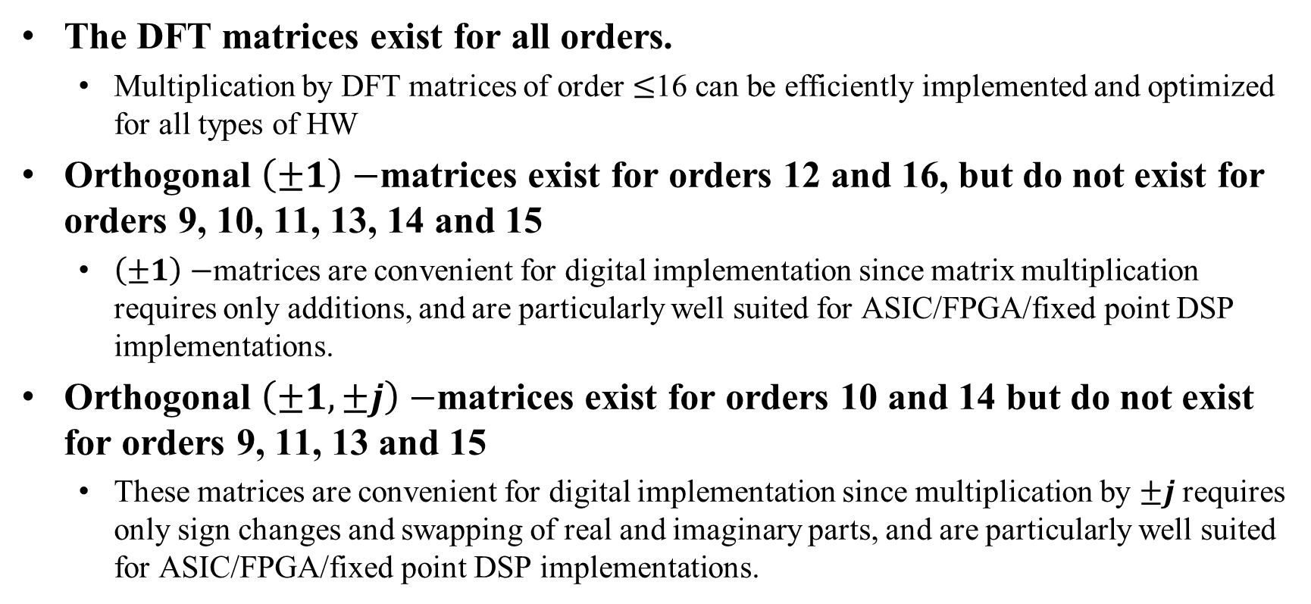
Overview of Some Orthogonal Matrices
The DFT matrices exist for all orders.
  Multiplication by DFT matrices of order $≤$16 can be efficiently implemented and optimized for all types of HW
Orthogonal $\left(±1\right)−$matrices exist for orders 12 and 16, but do not exist for orders 9, 10, 11, 13, 14 and 15
  $\left(±1\right)−$matrices are convenient for digital implementation since matrix multiplication requires only additions, and are particularly well suited for ASIC/FPGA/fixed point DSP implementations.
Orthogonal $\left(±1,±j\right)−$matrices exist for orders 10 and 14 but do not exist for orders 9, 11, 13 and 15
  These matrices are convenient for digital implementation since multiplication by $±j$ requires only sign changes and swapping of real and imaginary parts, and are particularly well suited for ASIC/FPGA/fixed point DSP implementations.

Slide 8

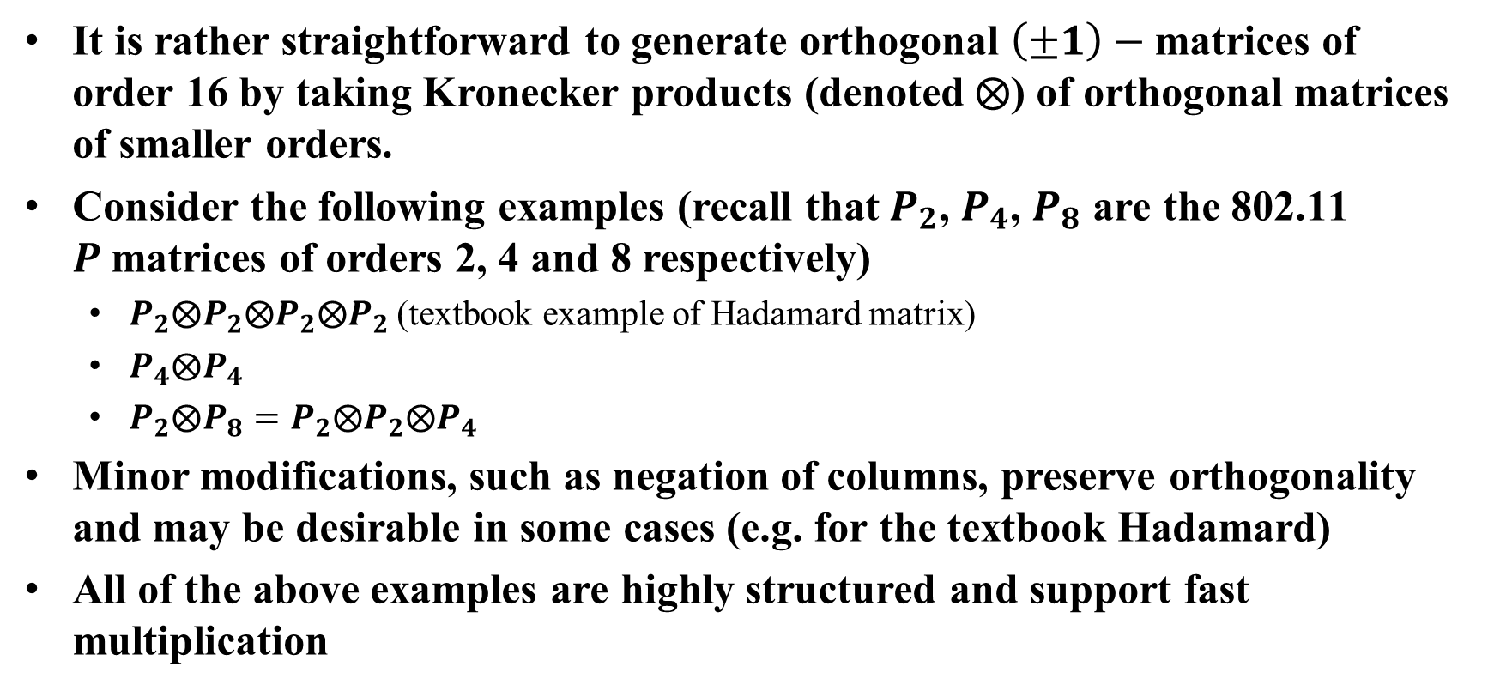
$\left(±1\right)−$Matrices of order 16
It is rather straightforward to generate orthogonal $\left(±1\right)−$matrices of order 16 by taking Kronecker products (denoted $⨂$) of orthogonal matrices of smaller orders.
Consider the following examples (recall that $P_{2}$, $P_{4}$, $P_{8}$ are the 802.11 $P$matrices of orders 2, 4 and 8 respectively)
  $P_{2}⨂P_{2}⨂P_{2}⨂P_{2}$ (textbook example of Hadamard matrix)
  $P_{4}⨂P_{4}$
  $P_{2}⨂P_{8}=P_{2}⨂P_{2}⨂P_{4}$
Minor modifications, such as negation of columns, preserve orthogonality and may be desirable in some cases (e.g. for the textbook Hadamard)
All of the above examples are highly structured and support fast multiplication

Slide 9

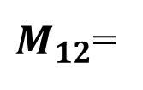

$\left(±1\right)−$Matrices of order 12
Consider the matrix
All orthogonal $\left(±1\right)−$matrices of order 12 can be derived from this matrix by swapping rows or columns, and negating rows or columns
1 -1 -1 1 -1 1 -1 -1 1 1 1 1
1 1 -1 -1 1 1 -1 1 -1 1 1 -1
1 1 1 1 1 -1 -1 -1 -1 -1 1 1
-1 1 1 -1 -1 1 -1 1 1 -1 1 1
1 1 1 -1 -1 1 1 -1 -1 1 -1 1
1 -1 1 -1 1 -1 1 1 1 1 1 1
1 1 -1 1 1 1 1 1 1 -1 -1 1
1 1 1 1 -1 -1 -1 1 1 1 -1 -1
1 -1 1 1 -1 1 1 1 -1 -1 1 -1
-1 1 1 1 1 1 1 -1 1 1 1 -1
-1 -1 1 1 1 1 -1 1 -1 1 -1 1
-1 1 -1 1 -1 -1 1 1 -1 1 1 1
$M_{12}$=

Slide 10

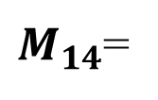

$\left(±1,±j\right)−$Matrices of order 14
Consider the matrix
$M_{14}$ is an orthogonal matrix with 14 purely imaginary elements along the diagonal, while the remaining 182 elements are $±1$’s
-j 1 1 1 1 1 -1 1 -1 1 1 -1 1 -1
1 -j -1 1 -1 -1 -1 1 -1 1 -1 1 1 1
1 -1 -j -1 1 -1 1 1 -1 1 1 1 -1 -1
1 1 -1 -j -1 1 1 -1 -1 1 1 -1 -1 1
1 -1 1 -1 -j -1 -1 -1 1 1 1 -1 1 1
1 -1 -1 1 -1 -j 1 1 1 -1 1 -1 1 -1
-1 -1 1 1 -1 1 -j 1 1 1 1 1 -1 1
1 1 1 -1 -1 1 1 -j 1 1 -1 1 1 -1
-1 -1 -1 -1 1 1 1 1 -j 1 -1 -1 1 1
1 1 1 1 1 -1 1 1 1 -j -1 -1 -1 1
1 -1 1 1 1 1 1 -1 -1 -1 -j 1 1 1
-1 1 1 -1 -1 -1 1 1 -1 -1 1 -j 1 1
1 1 -1 -1 1 1 -1 1 1 -1 1 1 -j 1
-1 1 -1 1 1 -1 1 -1 1 1 1 1 1 -j
$M_{14}$=

Slide 11

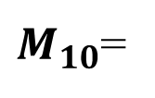

$\left(±1,±j\right)−$Matrices of order 10
Consider the matrix
$M_{10}$ is an orthogonal matrix with 10 imaginary elements along the diagonal, while the remaining 90 elements are $±1$’s
-j 1 -1 1 1 1 -1 -1 1 1
1 -j -1 1 1 1 1 1 -1 -1
-1 -1 -j 1 1 -1 1 1 1 1
1 1 1 -j 1 -1 -1 1 1 -1
1 1 1 1 -j -1 1 -1 -1 1
1 1 -1 -1 -1 -j 1 1 1 1
-1 1 1 -1 1 1 -j 1 -1 1
-1 1 1 1 -1 1 1 -j 1 -1
1 -1 1 1 -1 1 -1 1 -j 1
1 -1 1 -1 1 1 1 -1 1 -j
$M_{10}$=

Slide 12
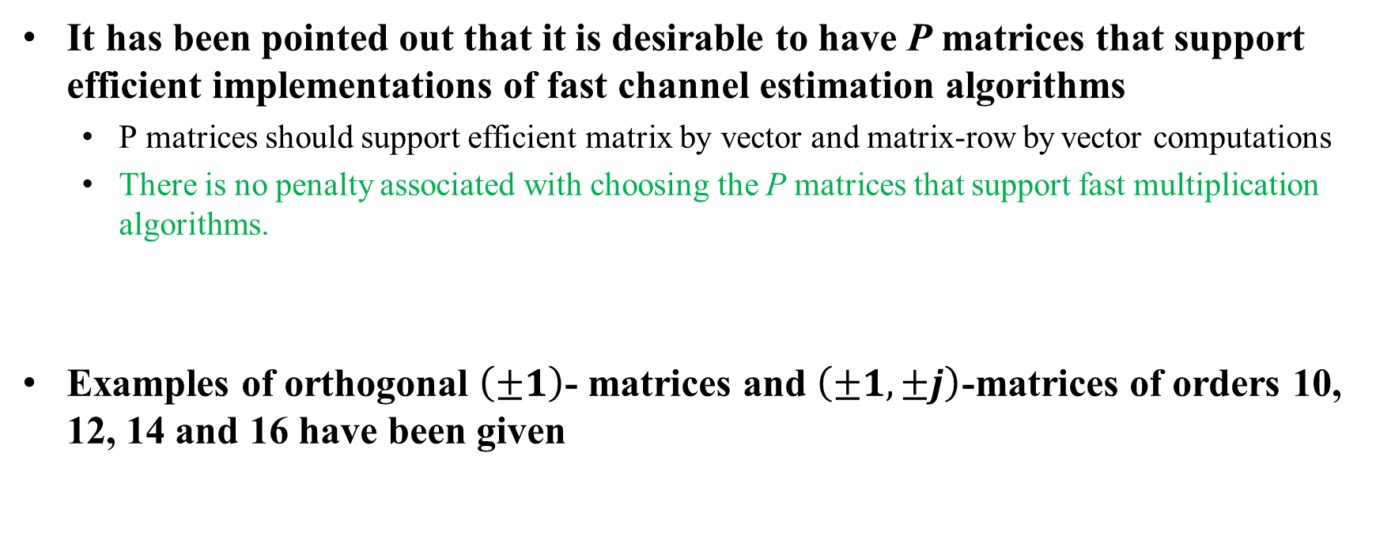
Summary
It has been pointed out that it is desirable to have P matrices that support efficient implementations of fast channel estimation algorithms
  P matrices should support efficient matrix by vector and matrix-row by vector computations
  There is no penalty associated with choosing the P matrices that support fast multiplication algorithms.
Examples of orthogonal $\left(±1\right)$- matrices and $\left(±1,±j\right)$-matrices of orders 10, 12, 14 and 16 have been given

Slide 13
Straw poll #1
Regarding the standardization of P matrices in EHT, which option do you prefer?
Opt 1) Standardize P matrices of orders 9, 10, 11, 12, 13, 14, 15 and 16
Opt 2) Standardize only P matrices of orders 10, 12, 14, and 16
Opt 3) Standardize only P matrices of orders 12 and 16
Opt 4) Standardize only one P matrix of order 16
Opt 5) None of the above
Opt1/opt2/opt3/opt4/opt5

Slide 14
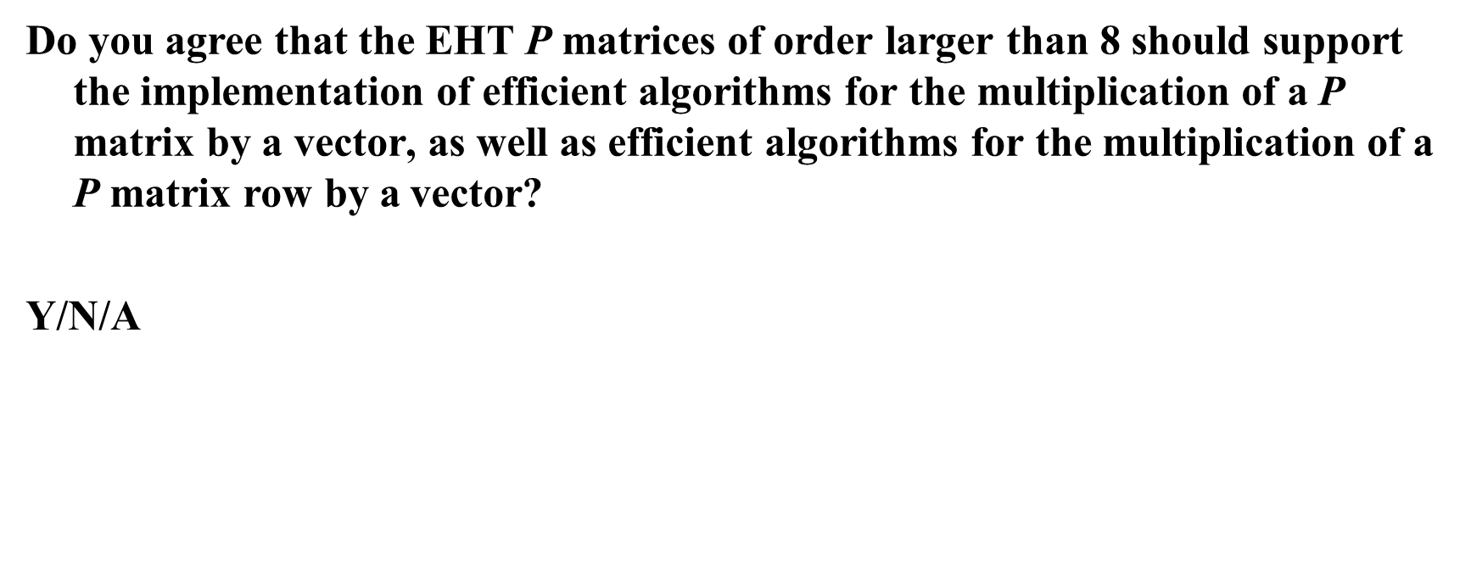
Straw poll #2
Do you agree that the EHT P matrices of order larger than 8 should support the implementation of efficient algorithms for the multiplication of a P matrix by a vector, as well as efficient algorithms for the multiplication of a P matrix row by a vector?
Y/N/A

Slide 15
References
[1] R. Jian Yu, “11be Peak Data Rate Analysis”, IEEE 802.11-19-0754-00-00be, May 2019

