Slide 1
Data Sharing for Multi-AP Coordination
Date: 2019-09-16
Authors:
Name | Affiliation | Address | Phone | Email
Sungjin Park | LG Electronics | 19, Yangjae-daero 11gil, Seocho-gu, Seoul 137-130, Korea |  | allean.park@lge.com
Ensung Park |  |  |  | esung.park@lge.com
Jeongki Kim |  |  |  | jeongki.kim@lge.com
Jinsoo Choi |  |  |  | js.choi@lge.com

Slide 2
Introduction
The Multi-AP transmission has been discussed as one of the candidate features for adoption in 11be.
Before the data is sent to STA by using one of the Multi-AP transmission schemes, the data sharing between APs should be considered.
In this contribution, we introduce data sharing method for Multi-AP transmission scheme.

Slide 3
Need of data sharing in Multi-AP schemes
Data sharing for Joint TX case:
If the data is shared through wired link, data sharing issue is out of scope.
However, if the data is shared through wireless link, data sharing should be defined.
To support data sharing through wireless link between APs, 11be needs to define how to share the data.
Data sharing for Coordinated TX case:
There is no need to define data sharing because each AP already has data to be transmitted to its own associated STA.
Therefore, this contribution focuses on data sharing in case of Joint TX with wireless link.

Slide 4
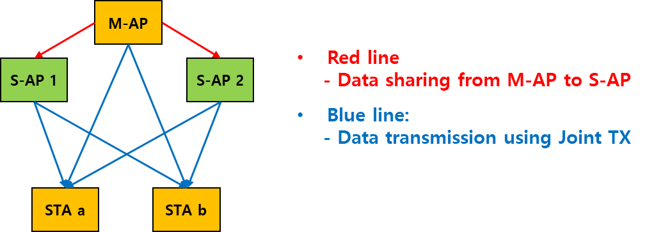
Joint transmission scenario
We consider the following Joint TX scenario in this contribution.
Master AP (M-AP) is being a role of the AP coordinator.
Slave AP (S-AP) is the AP which can participate in the Joint transmission.
STA “a” and “b” are associated with M-AP.
M-AP shares data to the S-APs and then all APs send data by using joint transmission scheme.

Slide 5
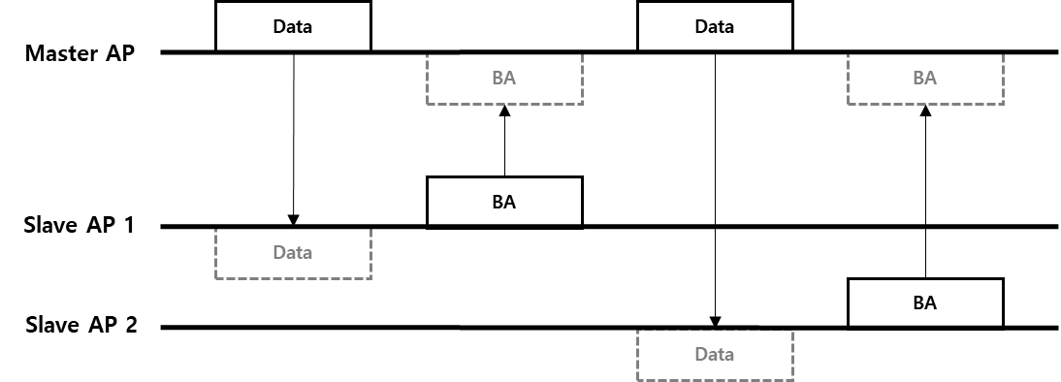
Method 1: Unicast Data Sharing
M-AP shares data to be used for Joint transmission with each S-AP sequentially.
The data sent to each S-AP is same.
However, the overhead increases as the number of S-APs increases.

Slide 6
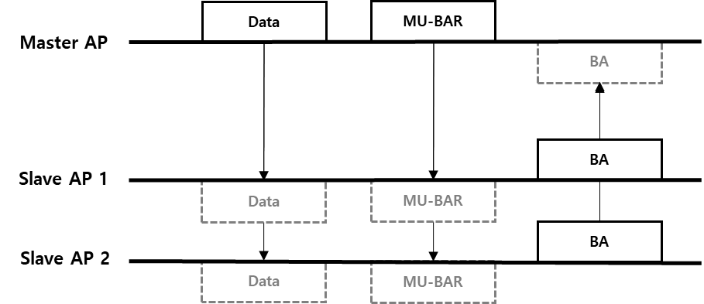
Method 2: Broadcast Data Sharing
M-AP shares data with S-APs simultaneously.
Regardless of the number of S-APs, the data can be shared at once.
The data frame sent from M-AP to each S-AP is same and is sent with broadcast address.
In this method, third party devices have to decode data frame unnecessarily.

Slide 7
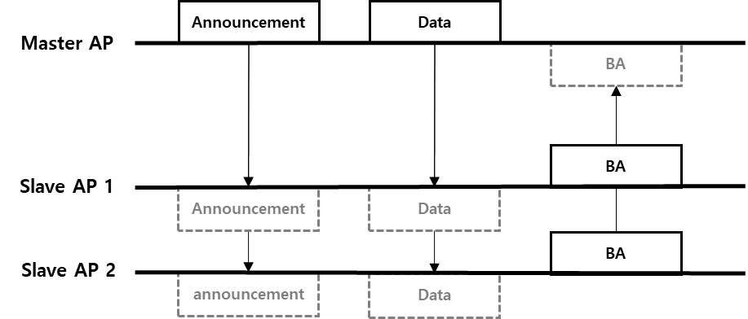
Method 3: Multicast Data Sharing
M-AP shares data with S-APs simultaneously.
Regardless of the number of S-APs, the data can be shared at once.
By using grouping indication, the data frame can be sent to only grouped S-APs.
In order to use this method, the announcement frame needs to be used for grouping of S-APs.

Slide 8
Signaling for Multicast Data Sharing
Announcement frame
M-AP notifies candidate S-APs to share the data.
TA: M-AP MAC address, RA: broadcast, Frame body: candidate S-AP’s identifier & RU allocation for BA
When candidate S-APs received Announcement frame, the identified S-APs recognize Data frame will follow.
Data frame
The data frame is sent simultaneously and all S-APs receive same data.
TA: M-AP MAC address, RA: M-AP MAC address (if this field is set to Broadcast address, third party devices should perform decoding process.)
The identified S-APs decode Data frame with RA&TA fields indicating M-AP MAC address.
BA frame
Candidate S-APs transmit BA using assigned RU indicated in Announcement frame.
TA: each candidate S-AP MAC address, RA: M-AP MAC address

Slide 9
Comparison of data sharing methods
 | Method 1: Unicast data sharing | Method 2: Broadcast data sharing | Method 3: Multicast data sharing
Pros. | Third party devices are prevented interpreting as that data sent to the third party devices. | Regardless of the number of S-APs, the data can be shared at once. | Third party devices are prevented interpreting as that data sent to the third party devices. Regardless of the number of S-APs, the data can be shared at once.
Cons. | Time overhead increases as the number of S-APs increases. | Third party devices interpret as that data sent to the third party devices. | Announcement frame for the grouping of S-APs needs to be additionally defined.
We prefer the method that M-AP shares data with S-APs simultaneously, considering time efficiency.
Especially, we prefer method 3 that has both advantages of method 1 and method 2.
Notes:
AP selection이 아니라 STA selection이라는 코멘트
→ AP와 STA 사이의 link를 이용하여 AP를 선택 (buffer를 보고)

Slide 10
Timing for data sharing
There are two options when the data sharing is performed.
Option 1: before Multi-AP sounding:
M-AP has to share the data with multiple unspecified S-APs without knowing the result of Multi-AP sounding.
It can be a burden on the S-APs in respect of memory of buffer if the Joint transmission is performed after a long time of Multi-AP sounding.
Option 2: after Multi-AP sounding:
M-AP can share the data with S-APs that will eventually participate if Multi-AP sounding that has be performed is valid.
If the result of Multi-AP sounding is outdated, the M-AP can perform Multi-AP sounding again before the data sharing.
Notes:
AP selection이 아니라 STA selection이라는 코멘트
→ AP와 STA 사이의 link를 이용하여 AP를 선택 (buffer를 보고)

Slide 11
Conclusion
To support data sharing through wireless link between APs, the method of data sharing should be considered.
In this contribution, we investigate the method and timing of data sharing between M-AP and S-APs.
We prefer the multicast data sharing, considering time efficiency and power consumption.
We prefer that the timing of data sharing is performed after sounding, considering buffer issue.

Slide 12
Straw Poll 1
Do you agree to add the following text to the SFD:
Master AP can share the data to be sent by using Joint transmission with Slave APs simultaneously.

Slide 13
Straw Poll 2
Which option do you prefer when Master AP shares the data to be sent by using Joint transmission with Slave APs?
Option 1: Master AP shares the data with Slave AP by using broadcast method.
Option 2: Master AP shares the data with Slave AP by using multicast method.

