Slide 1
Wi-Fi Sensing in 60GHz band
Usage models, Performance and What is need in 802.11 Standard
Date: September 16, 2019
Authors:

Slide 2
Abstract
This document discusses some usage models for Wi-Fi sensing.
This presentation is focused on 60GHz band.
802.11ay Draft includes an annex which presents recommendations for (Monostatic) Radar.
Some use-cases will significantly benefit from Multi-Static Radar architecture.

Slide 3
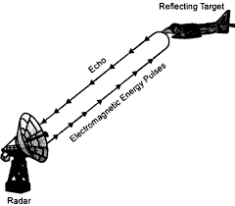
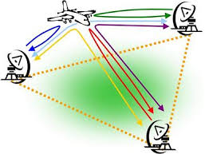
Radar introduction
Monostatic Radar
Multi-Static Radar

Slide 4
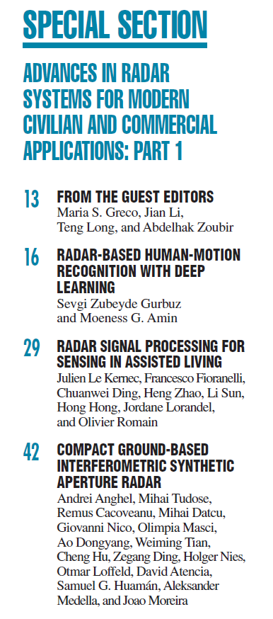
Some literature
IEEE Signal Processing Magazine:
(Volume 36 | Number 4 | July 2019)
Alecsander Eitan (Qualcomm)

Slide 5
Some literature
IEEE Spectrum - June 2019
Seeing with radio Wi-Fi-like equipment can see people through walls, measure their heart rates, and gauge emotions
Alecsander Eitan (Qualcomm)

Slide 6
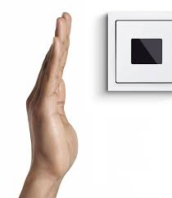
Proximity
User interacts with a device by being close to it.
The device is able to sense the proximity of the user.
(Example: hand close to the screen wakes the phone)
The proximity detection is active for relatively long time and therefore low power is essential.
The proximity is usually used to activate or deactivate something on the device.
One device and one object are involved in the interaction.
Monostatic radar is adequate.
Alecsander Eitan (Qualcomm)

Slide 7
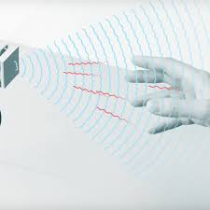
Gesture recognition
User interacts with a device by performing a gesture.
The device is able to recognize a gesture from a predefined set
(Example: wave right/left/up/down/hold/tap/…)
A gesture can be small (hand or fingers) or large (full body)
The gesture activates an application or a selection
One device and one object are involved in the interaction
Monostatic radar is adequate.
Full body gesture can benefit from multi-static radar.
Alecsander Eitan (Qualcomm)

Slide 8
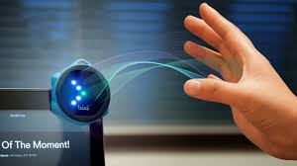
Gaming Control
User interacts with a device to control a game (variant of the gesture use-case)
The device is able to recognize a gesture from a predefined set
(Example: wave right/left/up/down/hold/tap/…, location, movement,…)
A gesture can be small (hand or fingers) or large (full body)
The control can be 1D, 2D or 3D.
One device and one object are involved in the interaction.
Monostatic radar is adequate for simple cases, multi-static can perform better.
Alecsander Eitan (Qualcomm)

Slide 9
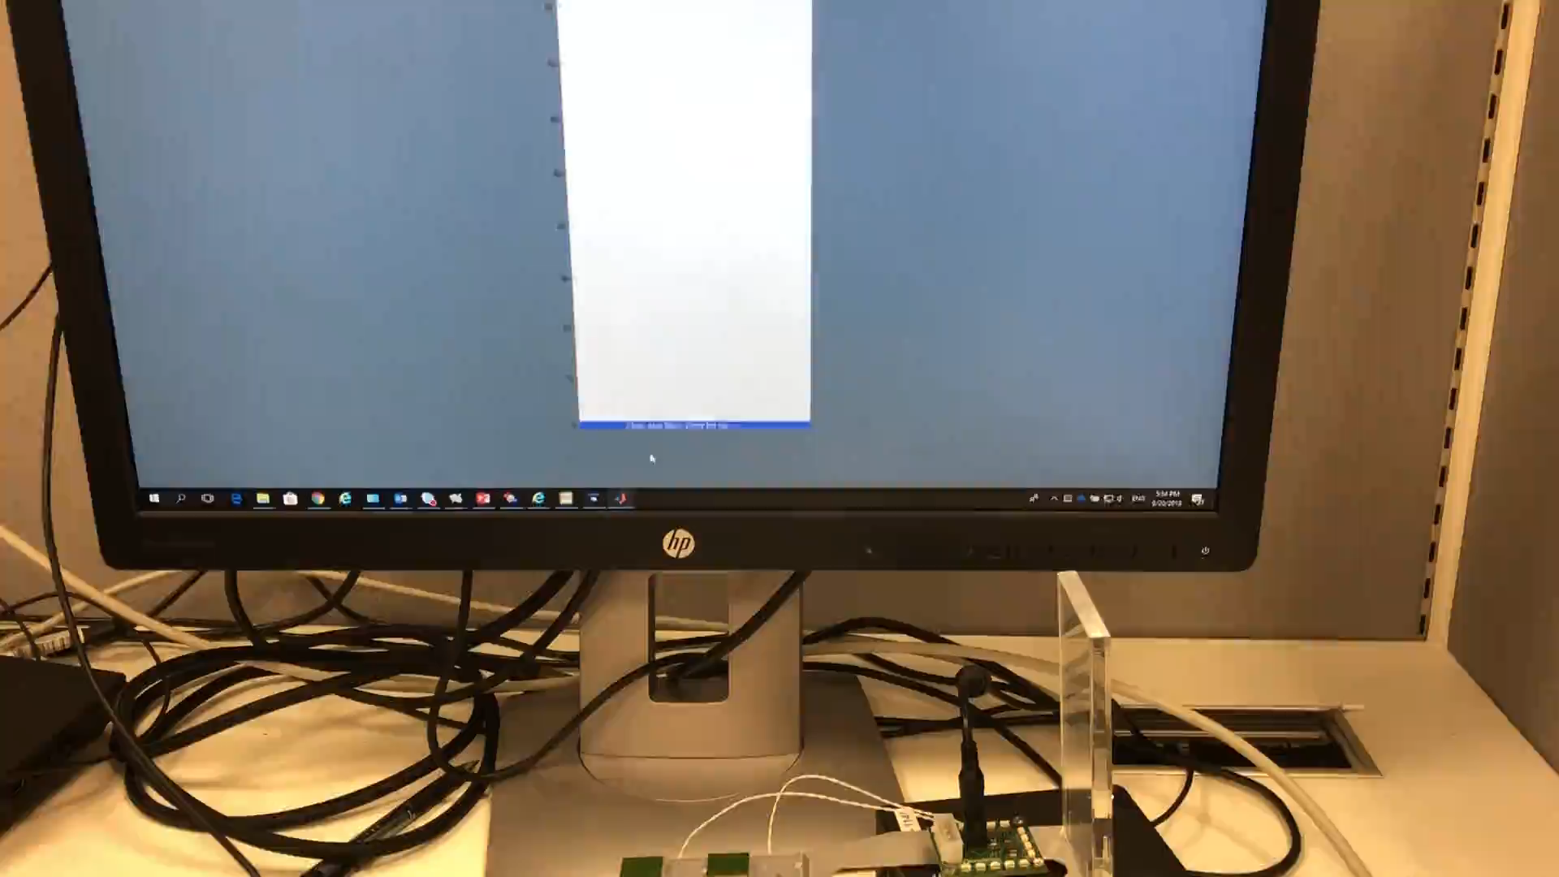
Volume control demo
Alecsander Eitan (Qualcomm)

Slide 10
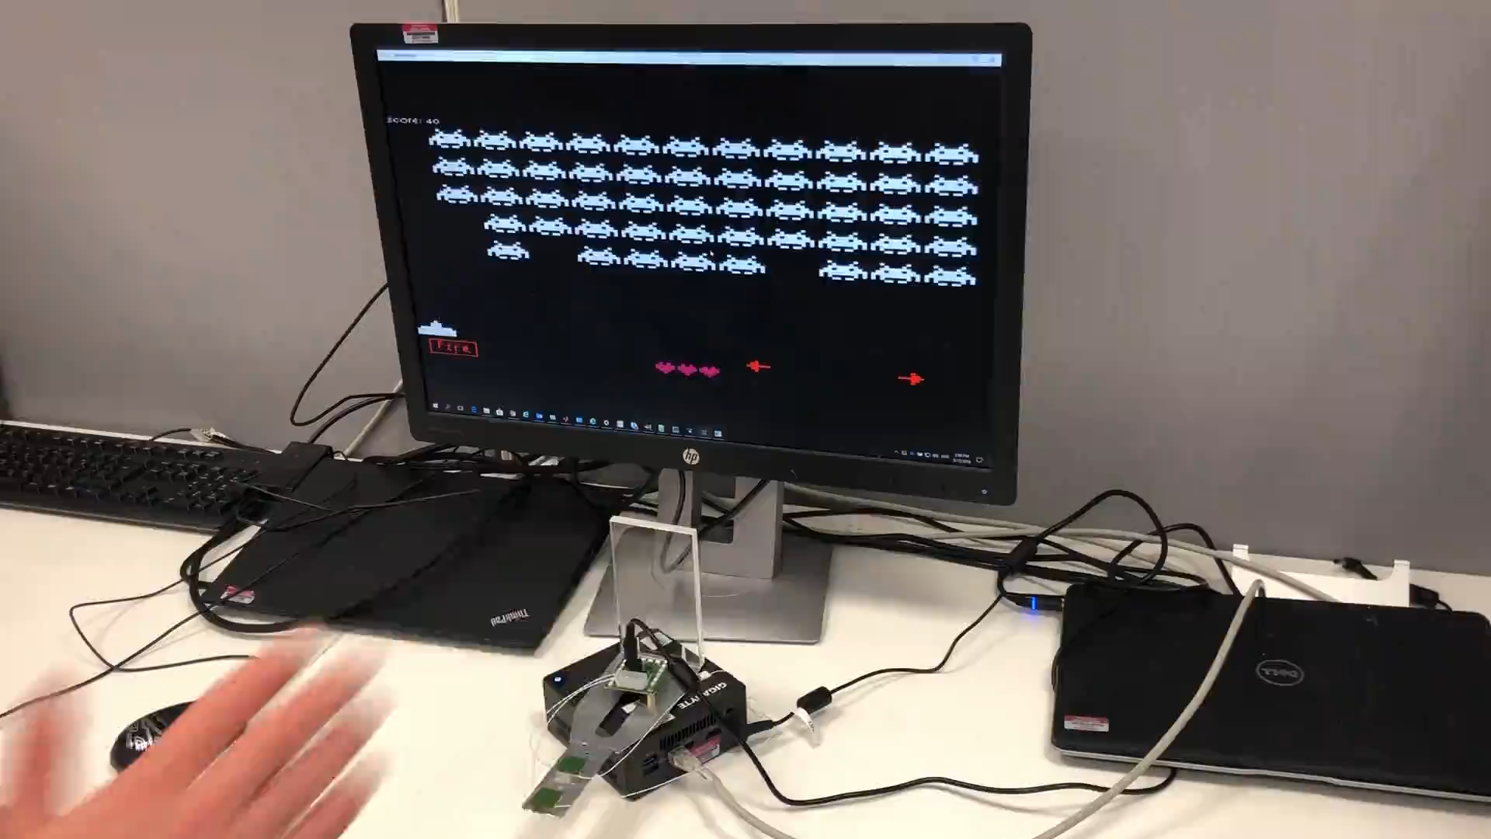
Game control demo
Alecsander Eitan (Qualcomm)

Slide 11

Liveness
The device has to detect the liveness of the face in-front of it as part of the face recognition.
The device is able to validate the liveness of the face in-front of it
(Example: face recognition to unlock the phone/tablet/computer. )
The liveness test is activated as part of the face recognition.
One device and one object are involved in the interaction
Monostatic radar is adequate.
Alecsander Eitan (Qualcomm)

Slide 12
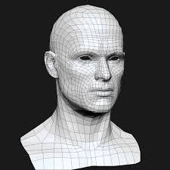
Facial/Body Recognition
The device has to validate the identity of the user.
The device is able to validate the face (or full body) of the user/person.
(Example: face recognition to unlock the phone/tablet/computer. )
The recognition needs to have high confidence and able to operate in various conditions.
One device and one object are involved in the interaction
Monostatic radar is adequate for simple cases, multi-static can perform better especially for full body scan.
Alecsander Eitan (Qualcomm)

Slide 13
Area Sensing / Presence Detection
One or more devices monitor an area, mainly to detect humans.
The device(s) perform monitoring of the area providing one or more of the following:
  Detect presence of one or more persons in the area
  Location of each person
  Count the number of persons
  Estimate the activity of each person (velocity estimation)
  Detect pets
  Detect a person fall
  Detect (human) vital signs
  Detect the presence of people in a car and where they are seated.
Example applications:
  Activate light according to people presence
  Activate and control power of air condition based on presence and number of people.
  Intrusion detection
  Fall detection of elderly people
  Car passenger's safety
Radar monitoring doesn’t violate privacy
Alecsander Eitan (Qualcomm)

Slide 14
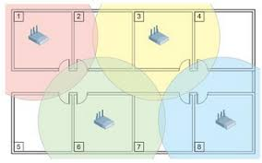
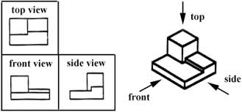
Area Sensing / Presence Detection
One or more devices monitor an area, mainly to detect humans.
Goal can be achieved with multiple mono-static radars, but multi-static radar will be much more efficient and perform better.
Area illumination from multiple points and multiple receivers improve the environment sensing.
Multiple receivers can share same illumination, improving efficiency.
Alecsander Eitan (Qualcomm)

Slide 15
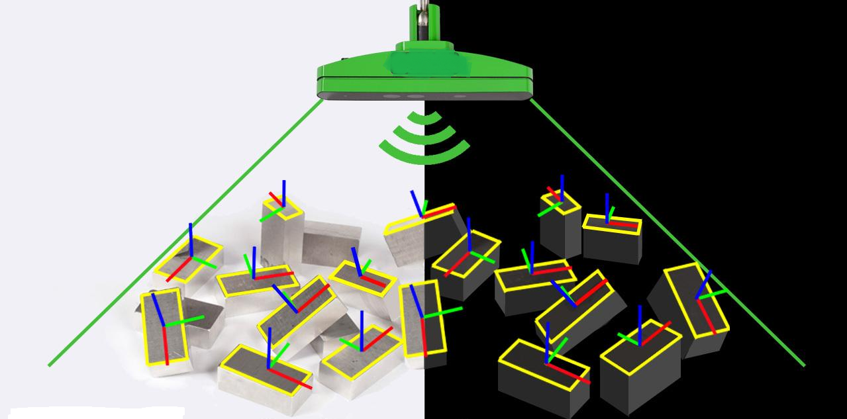
Robot 3D Vision
One or more robots use the sensing to get the 3D map of their environment.
The robot acquires 3D map of the surrounding, including doppler information to allow safe and efficient movement.
Examples:
  House robots
  Warehouse robots
One or more devices device and multiple objects are involved in the interaction
Multi-Static radar improves efficiency and environment sensing.
Alecsander Eitan (Qualcomm)

Slide 16
60GHz Radar Performance
Monostatic radar can achieve the following:
Angular resolution of 4°with 32 elements in a row/column (raw)
Range resolution of 9cm (raw @1.76Gsps)
Doppler resolution of 0.5m/sec for 5msec measurement
(depends on no of repetitions)
Micromovement differential resolution of 0.1mm (raw)
[see backup slides for numbers explanation and examples]
Alecsander Eitan (Qualcomm)

Slide 17
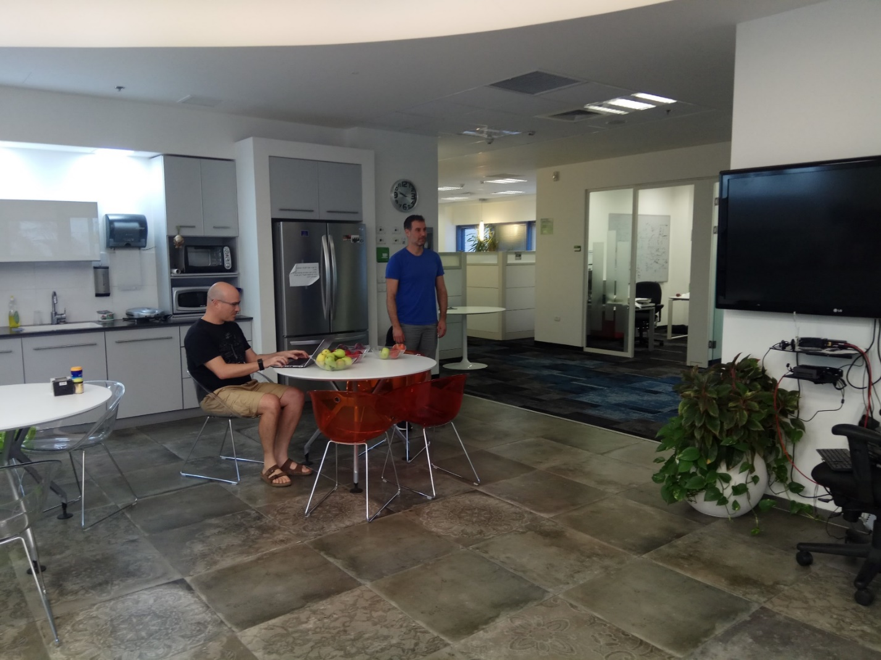
Mono-static 60GHz Radar demo
Alecsander Eitan (Qualcomm)

Slide 18
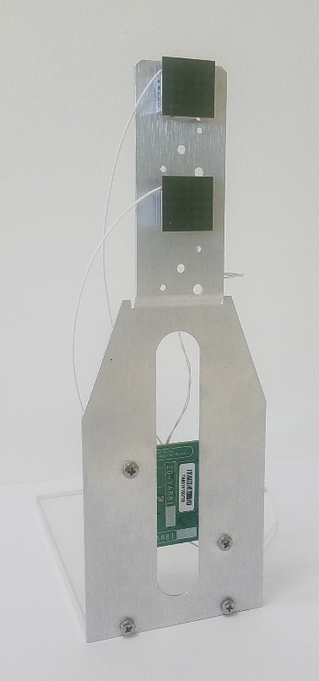
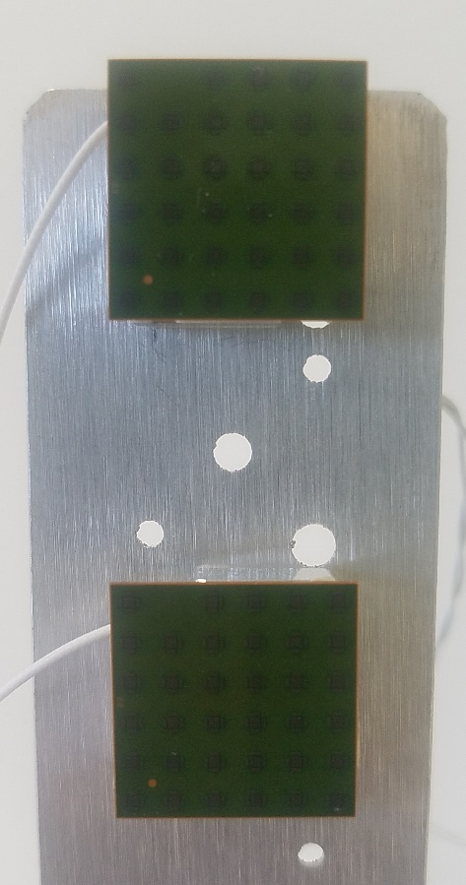
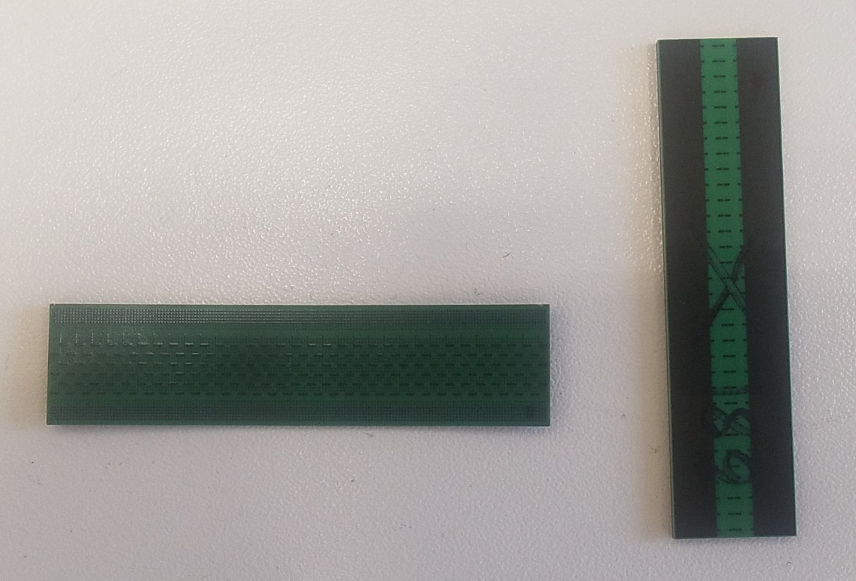
Mono-static 60GHz Radar demo
Alecsander Eitan (Qualcomm)

Slide 19
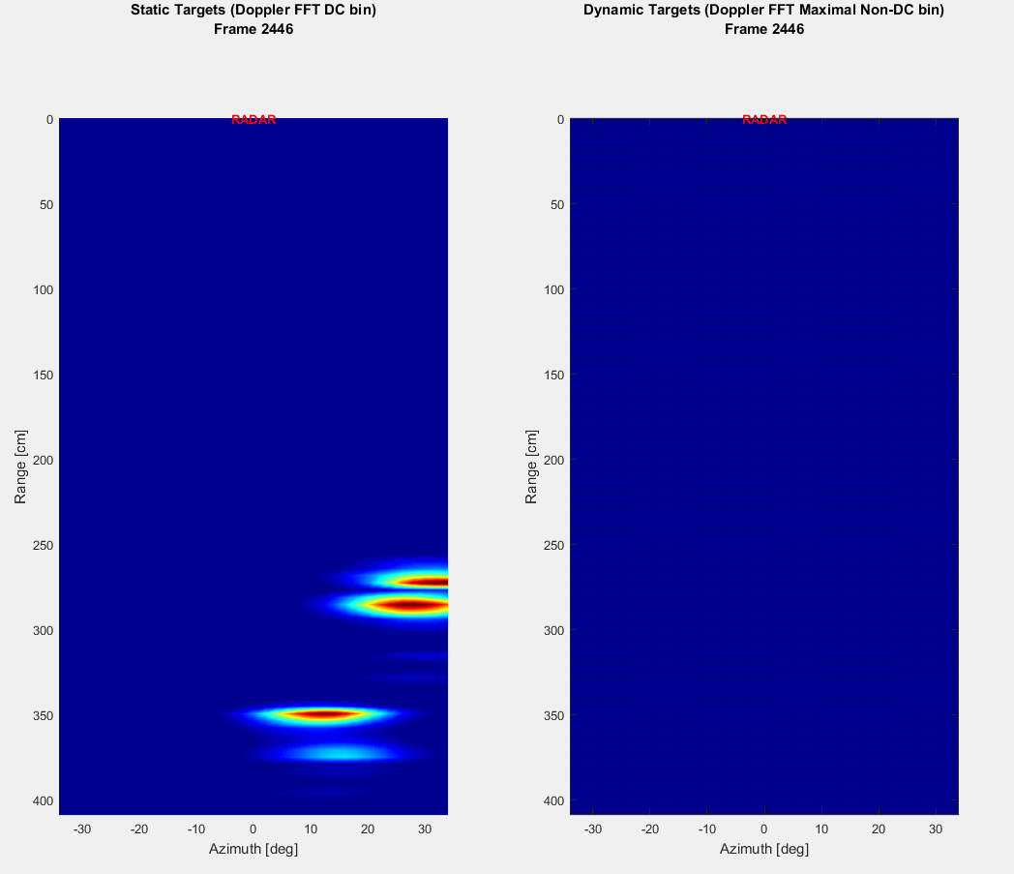
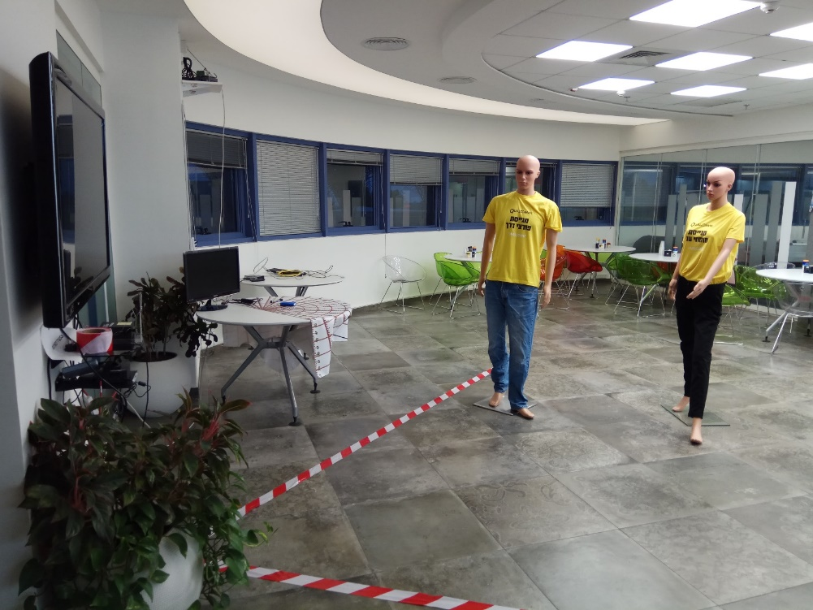
Mono-static 60GHz Radar demo
Alecsander Eitan (Qualcomm)

Slide 20
Why extend beyond Mono-Static Radar?
Topologies included:
  Bistatic with two devices – One Tx and One Rx
  Multiple Tx & Single Rx
  Single Tx and Multiple Rx
  Multiple Tx and Multiple Rx
  Multiple Mono-Static devices with information sharing
Performs better than monostatic since multiple different views of the
environment (room) are sensed. It allows:
  Better resolution
  View of occluded objects
  3D information of objects
Multiple Tx and/or Multiple Rx save air-time since multiple measurements are done concurrently.
Multiple Tx and single Rx (only), facilitates low power devices
Alecsander Eitan (Qualcomm)

Slide 21
Synchronisation
Coarse synchronization can be achieved by messaging and TSF time stamps
There are many fine synchronization methods.
One of the simplest methods is to have a LOS beam link between each
transmitter and each receiver.
Alecsander Eitan (Qualcomm)

Slide 22
Measurement Range
L-CEF and EDMG-CEF based CIR are always ~73nsec long, which
corresponds to ~10meter range.
Long Golays in TRNs allow up to ~20 meters measurements
However, since reflections will be received as well, reflections will arrive with equivalent distance much larger than the room size.
We suggest to add options for longer Golays or additional sequences.
Alecsander Eitan (Qualcomm)

Slide 23
What is missing for Radar in 60GHz band that requiers 802.11 spec changes ?
Multi-Static radar requires cooperation and sync between the stations.
Achievable by messaging and protocol
Multi-Static radar with information sharing between receivers can achieve
better performance.
Achievable by messaging and protocol
Normal mode Golay limits the range to ~10m.
Higher range requires longer Golays or additional sequences
Alecsander Eitan (Qualcomm)

Slide 24
Summary
We believe that Wi-Fi Sensing in the 60GHz band can provide new
opportunities and new applications for WLAN devices and systems.
Some use-cases can use monostatic radar, however multi-static radar can
provide much better performance.
Multi-static radar require multiple WLAN devices to communicate and share
information. 802.11 is the natural way for such communication.
WLAN based radar has the advantage of having all the WLAN coexistence
methods and reuse the WLAN hardware.
Recommend formation of a new IEEE802.11 TIG for Wi-Fi Sensing
Alecsander Eitan (Qualcomm)

Slide 25
SP
Do you support the creation of a TIG on Wi-Fi sensing?
Yes
No
Abstain
Alecsander Eitan (Qualcomm)

Slide 26

Alecsander Eitan (Qualcomm)

Slide 27
60GHz Radar Performance Numbers
Angular resolution of 4°with 32 elements in a row/column (raw)
Assuming 32 elements in a row, the theoretical beamwidth is 2/Nel [rad],
which are 2/32*180/pi = 3.6 deg.
Range resolution of 9cm (raw @1.76Gsps)
The raw resolution is the light speed divided by the sampling rate and divided by 2 since
it is forward & back travel.
The chip rate of DMG is 1.76Gsps (with basic Golay correlator). This gives 8.5cm.
Doppler resolution of 0.5m/sec for 5msec measurement (depends on no of repetitions)
Doppler resolution: achieved by multiple repetition and FFT on results. The resolution is only a function of the repetitions (aka sampling duration).
Doppler resolution = Lambda/2/ObservationTime. In our case Lambda=5mm. Hence for 5msec observation time the resolution is 0.5m/sec.
Micromovement differential resolution of 0.1mm (raw)
Resolution: is derived from the correlations phase and it can be seen as the range resolution when the sampling frequency is replaced by the RF frequency.
One wavelength is 5mm, hence 0.1mm requires to measure phase (of the Golay
correlation) with resolution of lower than 14 deg, which is not an issue.
Alecsander Eitan (Qualcomm)

