Slide 1
Multi-Link Operation and Channel Access Discussion
Date: 2019-11-12
Authors:

Slide 2
Motivation
In this proposal, we discuss the multi-link operation of the AP having an in-device coexistence (IDC) interference between multiple links (eg. 5 GHz & 6 GHz).

Slide 3
Issues
When an AP is operating on a pair of links with IDC interference, simultaneous Tx-Rx might cause severe performance degradation.
  DL data TX on one link interferes the reception of large portion or whole of UL data on the other link as shown below
Back-off
STA2 Tx PPDU2 to AP (6 GHz)
Link1
Back-off
AP Tx PPDU1 to STA1 (5 GHz)
BA
Link2

Slide 4
Multi-Link Simulation Set Up
Topology
  13 STA and 3 AP.
  5 STA associated with AP1 are on Link 1. 5 STA associated with AP2 are on Link 2. The third BSS has 3 target EHT devices for throughput measurement.
Parameters:
  Background traffic
    Symmetrical UDP traffic on both links/channels.
    Different % of loading will be tested.
    Randomized TXOP limit between 1ms and 5.4ms for each AP <-> STA.
  Each UDP packet is 1460B.
  AMPDU setting
    Legacy and background traffic STA/AP use 64. EHT AP/STA uses 128.

Slide 5
Multi-Link Simulation Set Up
AP1
Link 1
STA1
Link 1
STA2
BSS1
Link 1
STA3
Link 1
STA4
Link 1
STA5
Link 1/Link 2
EHT STA
EHT AP
BSS3
EHT STA
EHT STA
AP2
Link 2
STA6
Link 2
STA7
BSS2
Link 2
STA8
Link 2
STA9
Link 2
STA10

Slide 6

Multi-Link Simulation Set Up
EHT AP configuration : Multiple Primary Channel based link access ($\text{MPC}$)
  A STA of a MLLE performs a contention independently on each primary channel of the link 1 and the link 2.
  After obtaining a TXOP on either link, the MLLE transmits frames on the link on which the TXOP is obtained.
    NOTE- PIFS based link access is not used.
TXOP
TXOP
TX
RX
busy
TX
RX
STA 1
Link 1
3 | 2 | 1 | 0
4 | 3
2 | 1 | 0
TXOP
TXOP
TXOP
MLLE
busy
TX
RX
TX
RX
TX
RX
STA 2
Link 2
2 | 1 | 0
3 | 2 | 1 | 0
1 | 0

Slide 7
Multi-Link Simulation Set Up
Simulation cases:
  Case 0: baseline - Legacy single link operation
  Case 1: MPC with no IDC interference
    EHT AP transmits any frame on a link once it obtains a TXOP on the link
  Case 2: MPC with IDC interference constraints
    EHT AP does not transmit a frame except for a control response frame on one link while it is receiving a frame on the other link.
Link 1
UL A-MPDU
BA
UL A-MPDU
BA
UL A-MPDU
BA
Back-off
Back-off
Back-off
Link 2
UL A-MPDU
BA
UL A-MPDU
BA
UL A-MPDU
BA
Back-off
Error
Back-off
Error
Back-off
Error

Slide 8
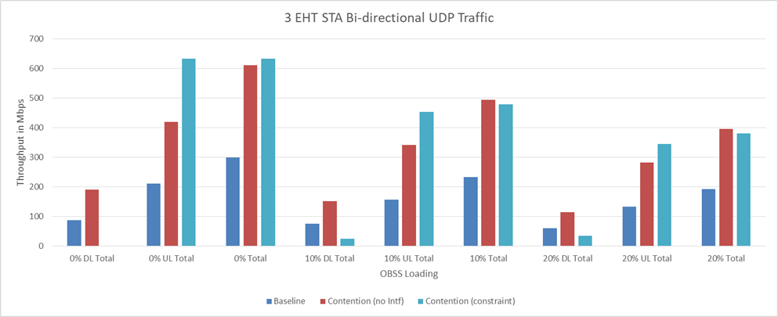
Multi-Link Simulation Results
Case 2 (light blue bar) has better total uplink throughput than that of case 1 (red bar)
Case 2 (light blue bar) has worse downlink throughput than that of case 1 (red bar)

Slide 9
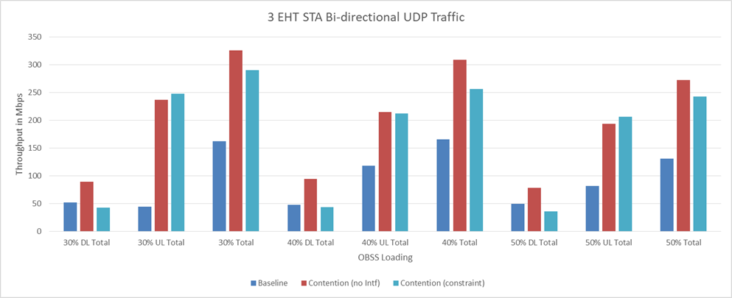
Multi-Link Simulation Results
  The uplink throughput difference between case 1 and case 2 shrinks as OBSS load increases
  Case 2’s uplink throughput decreases as OBSS load increases
  Case 2’s downlink throughput improved a little bit as OBSS load increases.

Slide 10
Multi-Link Simulation Result Observations
For case 2 “MPC with IDC interference constraints”, the AP won’t start transmission if there is an ongoing Rx on the other link, UL total throughput is dramatically increased but with DL goodput sufferring a lot due to much less chance for DL traffic.
Fairness between downlink and uplink needs to be improved.

Slide 11
Proposal
When an AP has an in-device coexistence (IDC) interference on a pair of links,
  Contention based channel access for uplink transmission on the pair of links can be considered.
  Contention based channel access on one link and trigger based only on the other link for uplink transmission can also be considered.
Link 1
UL A-MPDU
BA
UL A-MPDU
BA
UL A-MPDU
BA
Back-off
Link 2
Back-off
UL A-MPDU
BA
UL A-MPDU
BA
UL A-MPDU
BA
Link 1
UL A-MPDU
BA
UL A-MPDU
BA
UL A-MPDU
BA
Back-off
Link 2
Back-off
TF
TUL A-MPDU
TF
TUL A-MPDU
TF
TUL A-MPDU
BA

Slide 12
Multi-Link Simulation Set Up
Simulation cases:
  Case 0: MPC with no IDC interference
    EHT AP transmits any frame on a link once it obtains a TXOP on the link
  Case 1: MPC with IDC interference constraints
    EHT AP does not transmit a frame except for a control response frame on one link while it is receiving a frame on the other link.
  Case 2: Contention on one link and triggered based uplink on the other line

Slide 13
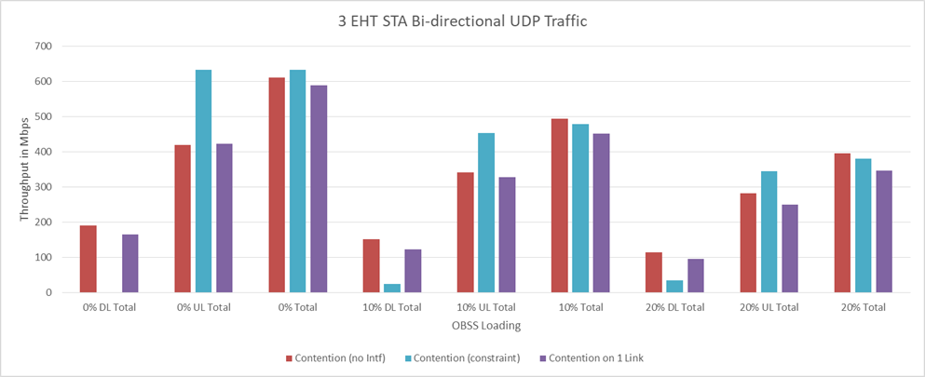
Multi-Link Simulation Results
Case 1 (light blue bar) has better uplink throughput than that of case 2 ( purple bar)
Case 2 ( purple bar) has better downlink throughput than that of case 1 (light blue bar)
Case 2 has better balanced downlink and uplink throughput than that of case1

Slide 14
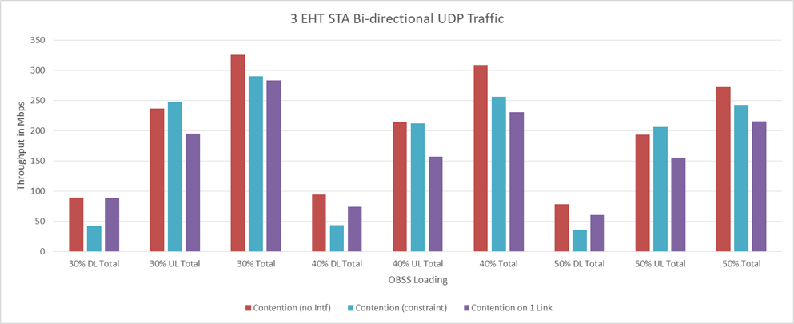
Multi-Link Simulation Results
Similar observation as OBSS load increases

Slide 15
Conclusion
  Some simulation results are shown for different channel access schemes for a pair of links with constraints have been discussed
  Proposed to consider channel access rules and control schemes to avoid Tx/Rx interference on the pair of links with IDC interference constraints

Slide 16
Straw Poll 1
Do you support that channel access mechanism for the pair of links with IDC interference constraints should be further considered?

Slide 17
Reference
[1] https://mentor.ieee.org/802.11/dcn/19/11-19-1927-00-00be-multi-link-operation-simulation-methodology.pptx

