Slide 1
Performance aspects of Multi-link operations with constraints
Date: 2019-09-10
Authors:
Name | Affiliations | Address | Phone | Email
Dmitry Akhmetov | Intel
Laurent Cariou
Notes:
September 2012

Slide 2
Recap:
In [1] we proposed classification of multi-link device operations based on channel access capabilities
SPC – single primary channel operation
MPC – multiple primary channel operation
JMPC – join multiple primary channel operation
We discussed performance aspects of a device with multi-link capabilities in comparison to a single link operation with a conclusion that MPC is a preferable mode of operation
~1.27x gain for SPC mode of operation
~2.09x gain for MPC mode of operation
~2.22x gain for JMPC mode of operation
In this presentation we will focus on modes of operation with constraints arising from physical limitations of co-located radios
EHT MLLE 1
STA
STA
Link 1
Link 2
EHT MLLE 2
STA
STA

Slide 3
Complicated life of a device with co-located radios
Multi-link device may need to impose constraints on concurrent TX/RX operations on different bands
For example, interference across links/radios - TX on band 1 can impact radio on band 2 (and vice versa).
Levels of interference/leakage across links vary depending on device capabilities and link/channel location in a frequency domain
Devices radio capabilities / implementation may not allow for concurrent operation
No TX operation is possible on band1 if band 2 is busy with RX operation and vice versa
Introducing 2 new modes of operation with restrictions
isolated (R)estricted MPC
Non-isolated (R)estricted MPC
TXOP
TXOP
MLLE STA
STA1
Tx data
Rx ack
Tx data
Rx ack
Tx data
Rx ack
band 1
3
2
1
0
5
4
3
2
1
0
TXOP
TXOP
STA 2
band 2
Tx data
Rx ack
Rx data
Tx ack
Tx
Rx
Tx data
Rx ack
Tx data
Rx ack
1
0

Slide 4
Restricted operation mode assumptions
isolated RMPC
Leakage/interference from TX on link1 is not sufficient to cross ED threshold on link2
Leakage still add interference noise
sufficient to harm data frame receptions on a high MCSes but not enough to damage RX of control frames
A better study of how exactly leakage can affect performance of a link 2 is required
non-isolated RMPC
Leakage from TX on link1 is sufficient to cross ED threshold on link2
Leaking power rise CCA Busy signal on link 2 stopping it from contention and destroying all ongoing RX events/processes
Channel access rules to accommodate restrictions:
Before initiating TXOP on a link1 MLLE STA need to verify status of a link 2
do not initiate TX operation if other link/radio is in RX state
do not initiate TXOP if a response is expected on link 2
do not initiate TXOP is STA on link 2 is going to send a response frame on link 2
if the other link/radio is in TX state, limit own TX duration to match end of the other transmission
If status of link 2 does not allow MLLE STA to initiate TXOP, restart backoff counter on link 1
AP is considered a “better” device and can operate under “isolated RMPC” while STA operates under “non-isolated RMPC” rules
AP initialize TXOP operations in a way to avoid interfering with RX activity of a STA operating under non-isolated RMPC on another link.
AP does not initiate TXOP on link 1 if it detect UL transmission from a STA operating under non-isolated RMPC on another link
Synchronization of TX/TX and RX/Rx operations, i.e. packet level/PHY level synchronization across links is desirable

Slide 5
Simulation setup. DL case
SU HE, 2x2x80, MCS11
BSS TXOP limit 5.4ms
OBSS TXOP limit: uniformly distributed for each TXOP between 1 and 5.4ms
No TXOP bursting
RTS/CTS on
A-MPDU size: 256
EHT AP
EHT STA
AP1
STA1
OBSS AP1
OBSS STA 1
OBSS AP n
OBSS STA n
Link 1
OBSS AP 2
OBSS STA2
OBSS AP 2n
OBSS STA 2n
AP2
STA2
Link 2
BSS load: UDP traffic in DL direction with load of
Case 1: 300Mbps, e.g. 25% of MCS11 rate; Case 2: 600Mbps, e.g. 50% of MCS11 rate; Case 3: 1200Mbps, e.g. 100% of MCS11 rate
For each case vary number of OBSSes from 0 to 10
Each OBSS has bidirectional UDP traffic with total load 120Mbps ( e.g.10% MCS11 rate)
All BSSes are in ED/PD range of each other
Metrics of interest
Throughput
# of synchronous/asynchronous operations ( simultaneous TXOP start)

Slide 6
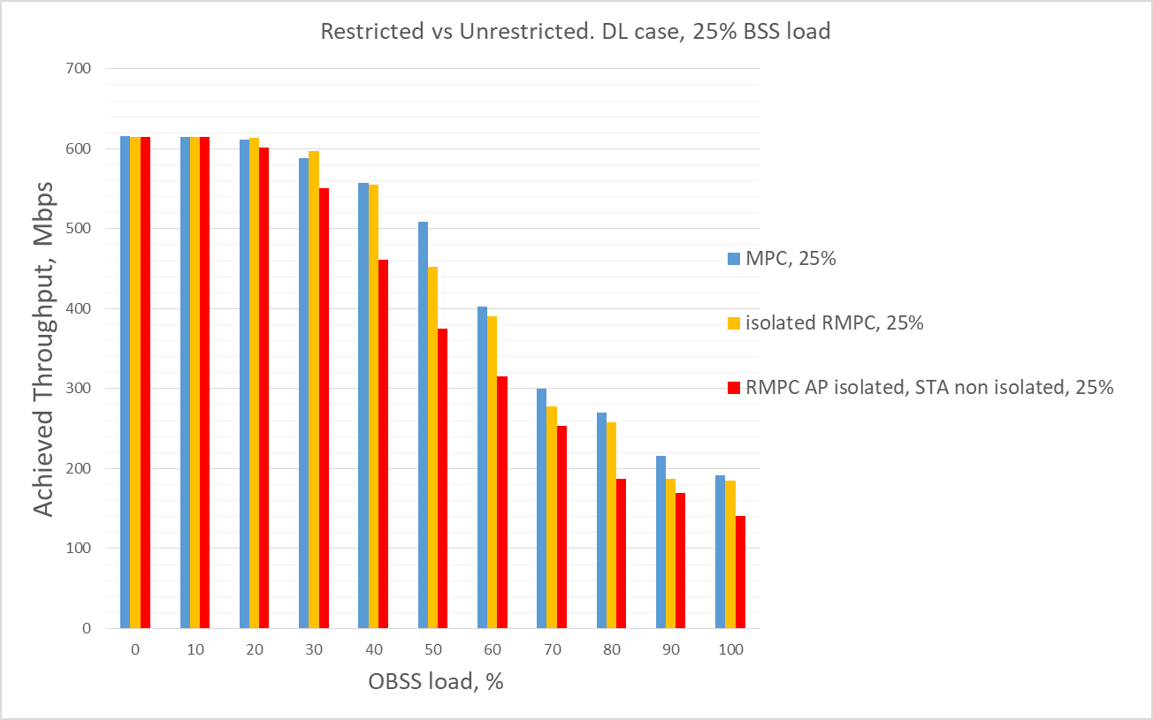
Restricted vs Unrestricted. DL case

Slide 7
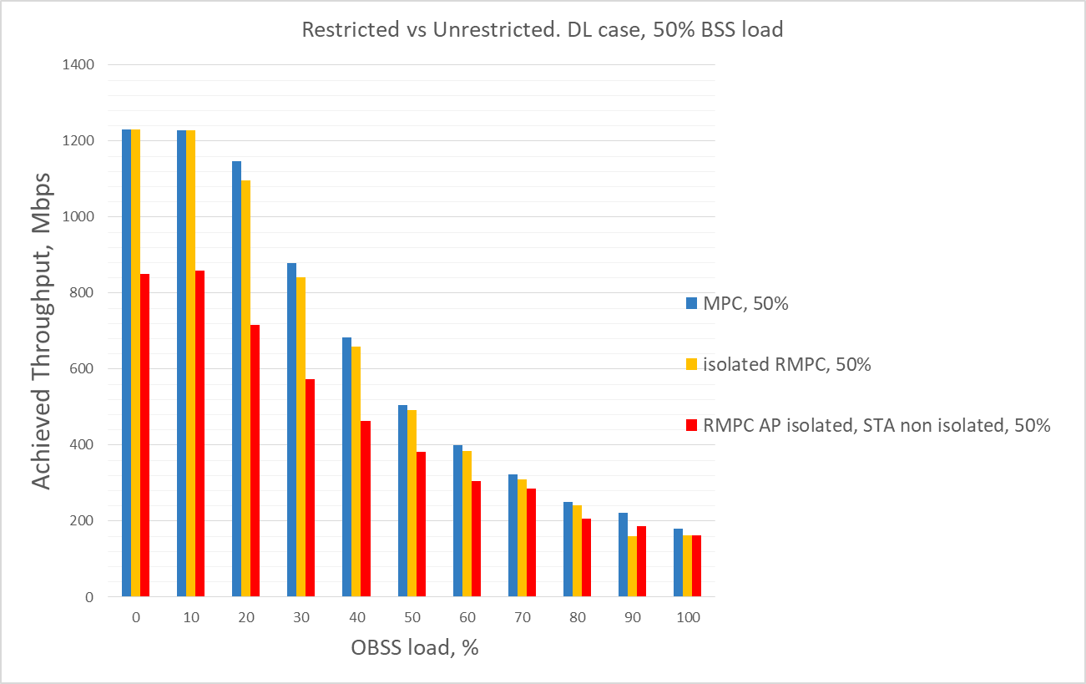
Restricted vs Unrestricted. DL case

Slide 8
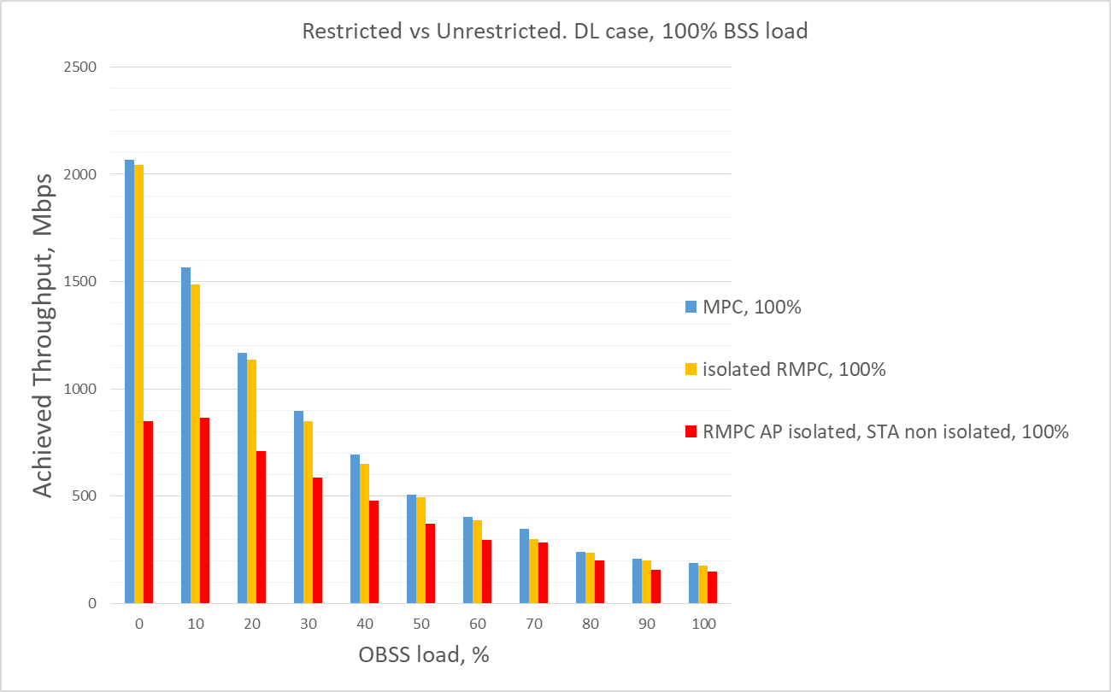
Restricted vs Unrestricted. DL case

Slide 9
Conclusion
For STAs without Tx/Rx constraints, MPC mode of operation performs very well
For STAs that have Tx/Rx constraints, both isolated and non isolated RMPC mode of operations preform much better than fully synchronized access
Operational modes with constraints, including non-isolated cases, require additional study/simulations
Average performance gain from multi-link operation over a single link operation
MPC mode of operation: DL case: 2.07x;
isolated RMPC mode of operation: DL case: 1.91x;
non-isolated RMPC: DL case: 1.6x ;
SPC mode of operation: DL case: 1.27x;

Slide 10
Appendix
[1] Performance aspects of Multi-link operations, 11-19-1291/02

Slide 11
Classification: Completely synchronous (S)ingle (P)rimary (C)hannel, SPC
TXOP
TXOP
TXOP
AP1
band 1
3
2
1
0
2
1
0
3
2
1
0
busy
busy
TXOP
busy
AP2
band 2
Perform contention on primary channel
Do energy detect for PIFS on a secondary channel
If IDLE – transmit over two channels
If BUSY – transmit on primary only

Slide 12
Classification: Completely asynchronous, (M)ultiple (P)rimary (C)hannels, MPC
TXOP
busy
TXOP
AP1
band 1
3
2
1
0
9
8
7
6
5
4
3
2
1
0
busy
TXOP
TXOP
TXOP
AP2
band 2
2
1
0
3
2
1
0
4
3
2
1
0
Perform contention independently on both links
Transmit/receive independently on both links

Slide 13
Classification: Semi-asynchronous (J)oin (M)ultiple (P)rimary (C)hannels, JMPC
band 1
TXOP
TXOP
TXOP
TXOP
AP1
3
2
1
0
9
8
7
6
5
4
3
2
1
0
band 2
busy
TXOP
TXOP
busy
AP2
2
1
0
4
3
2
1
0
7
6
Perform contention independently on each link
If one channel/link won contention - verify status of a another channel/link
If another link is in IDLE/Contention state – transmit jointly
Otherwise transmit using on available link only

