Slide 1
Use of Uplink Persistent Allocation for RTA
Date: 2019-09-17
Authors:
Name | Company | Address | Phone | Email
Xin Zuo | Tencent | Tencent Building, Kejizhongyi Avenue, Hi-tech Park, Nanshan District, Shenzhen | +86-18621746207 | xinzuo@tencent.com
Kate Meng
Glenn Hu
Lei Huang | Panasonic Corporation |  |  | lei.huang@sg.panasonic.com
Rojan Chitrakar
Yanyi Ding
Yoshio Urabe
Thomas Handte | Sony Corporation |  |  | thomas.handte@sony.com
Yusuke Tanaka
Mohamed Abouelseoud

Slide 2
Background
Uplink persistent allocation (UPA) has been proposed to be enabled for 11be UL MU transmission for overhead reduction [1]
  For an UPA, resource allocation information is unchanged for a time period.
UPA can be used to shorten some specialized Trigger frames (e.g. BSRP, BQRP, etc) since the solicited UL OFDMA responses have small fixed size [1].
  In this contribution, we propose UPA can also be used to shorten basic Trigger frames for soliciting TB PPDU transmission carrying RTA traffic.

Slide 3
RTA Challenge
RTAs are latency-sensitive.
  Several milliseconds could be desired.
Challenging to satisfy the latency requirements
  There will be even more devices, more applications/services running over Wi-Fi networks in the future.
  Unlicensed spectrum.
Even more challenging to satisfy the UL latency requirement.
  Basic trigger frame of 11ax could be helpful.

Slide 4
Feasibility of Applying UPA to RTA
The statistics are collected at Tencent servers.
RTA UL traffic pattern:
  Typical gaming:
    payload is a few hundreds of Bytes, and rarely larger than 500 Bytes.
    one service session lasting for a few minutes to ~20 minutes.
    1~3 users under the same Wi-Fi in home, and many more, up to 10~20, in café/restaurant/e-sport events.
  Therefore, the data rate required for gaming is about 10K~100K bps.
    A small fraction of spectrum resource can be assigned to RTAs as their UPA, for a relatively long period.
    HE-MCS 0 for 26-tone RU, either GI, could be sufficient for RTA UPA.
Data rate ≈ 10 Kbps
X-axis: the gap of transmitting time between two consecutive packets.
Y-axis: the payload size.
The area of the circle: the percentage.
Data rate ≈ 100 Kbps
Data rate < 100 Kbps

Slide 5
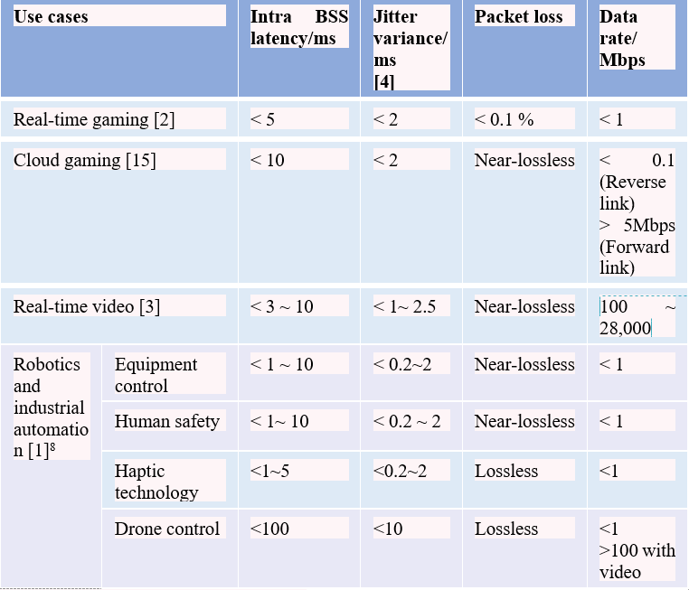
Feasibility of Applying UPA to RTA
  Industrial automation:
    Data rate requirement is < 1Mbps [2].
    Devices usually are simple, battery-enabled, etc.
    Could transmit data in the similar pattern for very long period, or the entire battery life.
    Many sensors/users under the same Wi-Fi network.
  Therefore, UPA may keep unchanged for relatively long time, to reduce the trigger overhead in UL.
    HE-MCS 0 for 26-tone RU, either GI, could be sufficient for RTA UPA.
From the RTA TIG report [2].

Slide 6
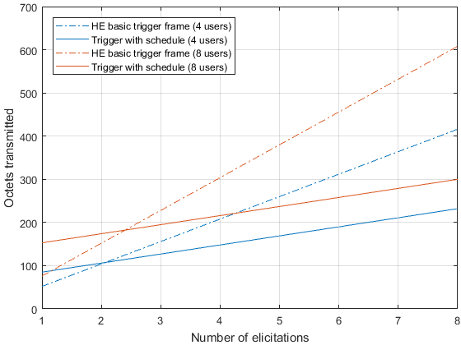
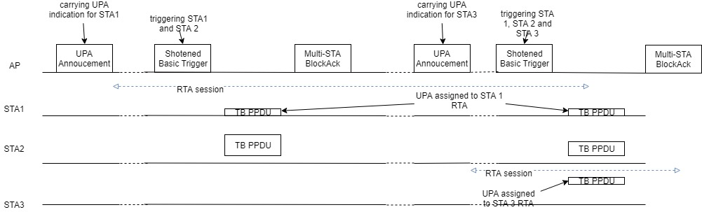
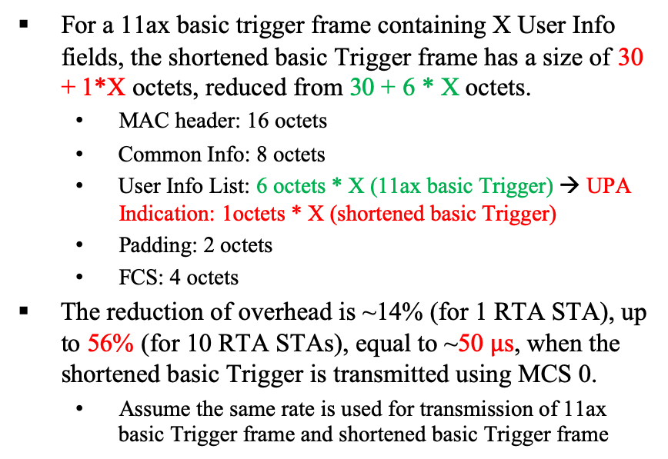
Examples of Applying UPA to RTA
  For a 11ax basic trigger frame containing X User Info fields, the shortened basic Trigger frame has a size of 30 + 1*X octets, reduced from 30 + 6 * X octets.
    MAC header: 16 octets
    Common Info: 8 octets
    User Info List: 6 octets * X (11ax basic Trigger) → UPA Indication: 1octets * X (shortened basic Trigger)
    Padding: 2 octets
    FCS: 4 octets
  The reduction of overhead is ~14% (for 1 RTA STA), up to 56% (for 10 RTA STAs), equal to ~50 $μ$s, when the shortened basic Trigger is transmitted using MCS 0.
    Assume the same rate is used for transmission of 11ax basic Trigger frame and shortened basic Trigger frame
Previous submission in 1118r1 [3] has also demonstrated the benefit of reducing overhead, based on the similar ideas.
Slide 8 in [3]

Slide 7
Summary
RTAs are usually latency-sensitive, and small in packet size. Trigger frame helps improve the uplink latency.
UPA could reduce the basic trigger overhead in UL, especially when the number of RTA STAs is large.

Slide 8
Reference
[1] 11-19-0806-02-00be-enabling-persistent-allocation-for-EHT, July 2019
[2] 11-18-2009-06-0rta-rta-report-draft.docx
[3] 11-19-1118-01-00be-enhancements-for-time-critical-data-transmission, July 2019

