Slide 1
Sounding for AP Collaboration
Date: 2019-09-16
Authors:
Name | Affiliation | Address | Phone | Email
Junghoon Suh | Huawei |  |  | junghoon.suh@huawei.com
Osama Aboul-Magd |  |  |  | osama.aboulmagd@huawei.com
Yan Xin |  |  |  | yan.xin@huawei.com

Slide 2
Background
[1] proposed several options of sounding procedures for the AP collaboration scenario, and we want to describe the NDPA/NDP transmission protocol in further detail in this contribution
Sounding packets are sequentially transmitted from each AP towards STAs, the sounding overhead increases in proportion to the number of APs in collaboration in this case, however the computation burden on the CSI is not relatively heavy
When the sounding packets are simultaneously transmitted from the APs in collaboration, the sounding protocol overhead is reduced but all the CSI computation burden is transferred to the STA side

Slide 3
Serial Sounding Packet Transmission [1][2]
Master AP can send an NDPA, followed by NDP1 and the Slave APs will send NDPs towards STAs one by one serially and/or respectively
  NDPA may need an indication of EHT NDPA type.
Master AP
NDPA
NDP1
Trigger*
Slave AP1
NDP2
Slave AP2
NDP3
STA 1
….
STA N
* This Trigger frame is to collect the BF Report from STAs

Slide 4
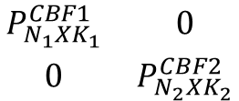

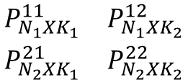

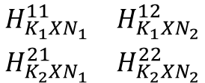


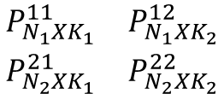
How to compute CBF and JT Pre-coders from Serial Sounding and Concurrent sounding of method (2)
TX 1
RX 1
$$H_{M_{1}XN_{1}}^{11}$$
Aggregated Channel reconstructed at APs
K₁
AP1
….
TX N₁
RX M₁
….
STA 1
$$\begin{matrix}H_{K_{1}XN_{1}}^{11} & H_{K_{1}XN_{2}}^{12} \\ H_{K_{2}XN_{1}}^{21} & H_{K_{2}XN_{2}}^{22}\end{matrix}$$
$$H_{M_{2}XN_{1}}^{21}$$
$$H_{M_{1}XN_{2}}^{12}$$
TX 1
RX 1
ZFBF
Precoding Matrix across APs in collaboration
K₂
AP2
….
TX N₂
RX M₂
STA 2
$$\begin{matrix}P_{N_{1}XK_{1}}^{11} & P_{N_{1}XK_{2}}^{12} \\ P_{N_{2}XK_{1}}^{21} & P_{N_{2}XK_{2}}^{22}\end{matrix}$$
$$H_{M_{2}XN_{2}}^{22}$$
….
CBF
JT
d₁
Top K₁Streams of outputs
are transmitted from AP1
d₁
Top K₁Streams of outputs
are transmitted from AP1
$$\begin{matrix}P_{N_{1}XK_{1}}^{CBF1} & 0 \\ 0 & P_{N_{2}XK_{2}}^{CBF2}\end{matrix}$$
…
$$\begin{matrix}P_{N_{1}XK_{1}}^{11} & P_{N_{1}XK_{2}}^{12} \\ P_{N_{2}XK_{1}}^{21} & P_{N_{2}XK_{2}}^{22}\end{matrix}$$
…
d_{K1}
d_{K1}
s₁
s₁
…
Bottom K₂Streams of outputs
are transmitted from AP2
…
BottomK₂Streams of outputs
are transmitted from AP2
s_{K2}
s_{K2}
P^{CBF1} is obtained with Pseudo-Inverse of H¹¹ and H²¹and taking the 1st K₁ columns, while P^{CBF2} can be computed with Pseudo-Inverse of H¹² and H²²and taking the last K₂ columns.

Slide 5
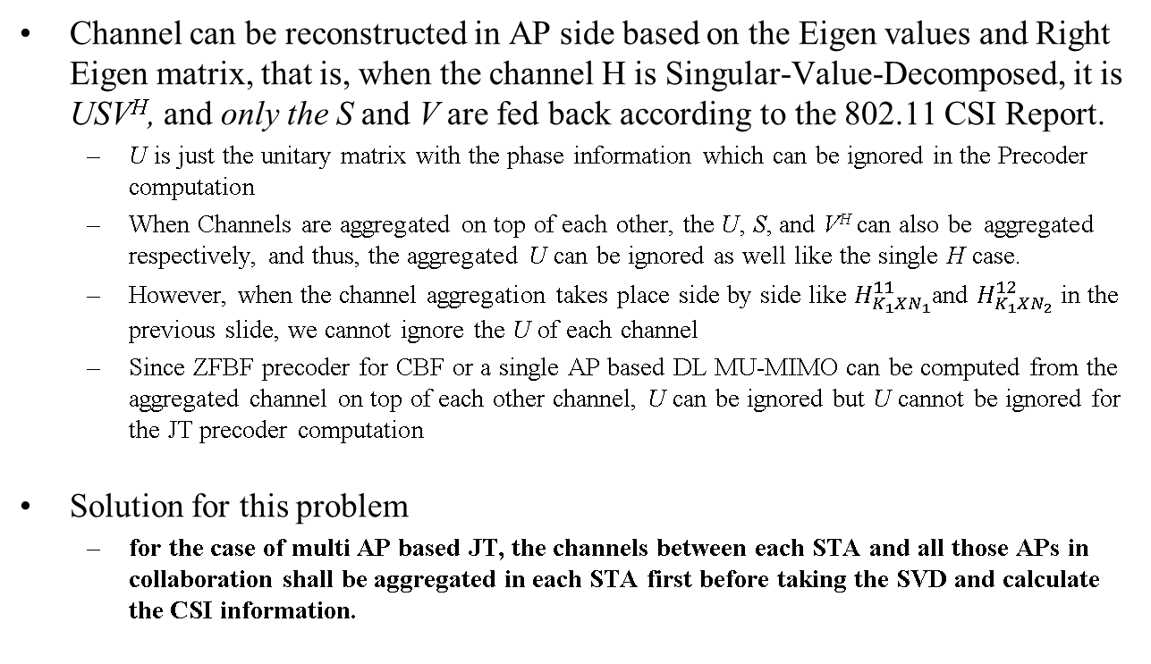
Issues and Solution for a Serial Sounding and Concurrent Sounding method (2)
Channel can be reconstructed in AP side based on the Eigen values and Right Eigen matrix, that is, when the channel H is Singular-Value-Decomposed, it is USV^{H}, and only the S and V are fed back according to the 802.11 CSI Report.
  U is just the unitary matrix with the phase information which can be ignored in the Precoder computation
  When Channels are aggregated on top of each other, the U, S, and V^{H} can also be aggregated respectively, and thus, the aggregated U can be ignored as well like the single H case.
  However, when the channel aggregation takes place side by side like $H_{K_{1}XN_{1}}^{11}$and $H_{K_{1}XN_{2}}^{12}$ in the previous slide, we cannot ignore the U of each channel
  Since ZFBF precoder for CBF or a single AP based DL MU-MIMO can be computed from the aggregated channel on top of each other channel, U can be ignored but U cannot be ignored for the JT precoder computation
Solution for this problem
  for the case of multi AP based JT, the channels between each STA and all those APs in collaboration shall be aggregated in each STA first before taking the SVD and calculate the CSI information.

Slide 6
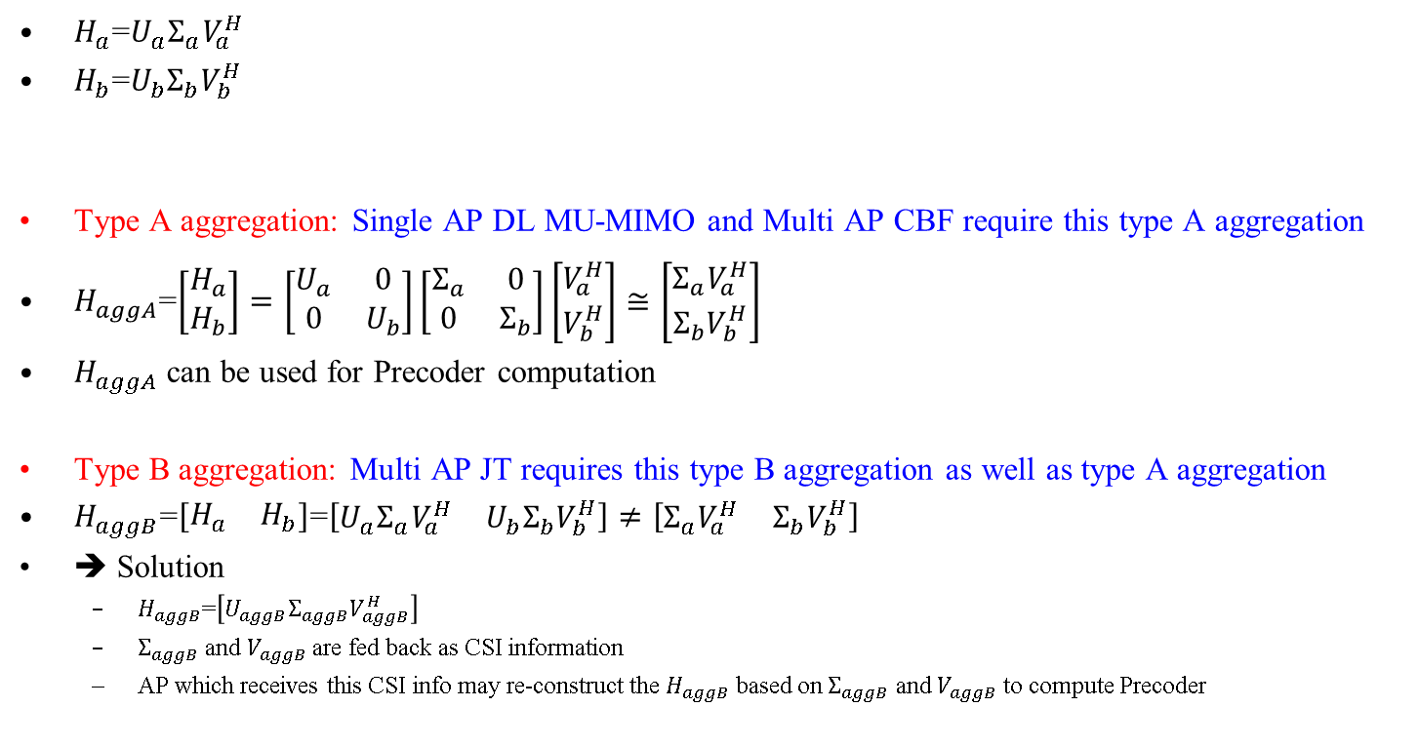
Continued for the Issues and Solution for a Serial Sounding and Concurrent Sounding method (2)
$H_{a}$=$U_{a}Σ_{a}V_{a}^{H}$
$H_{b}$=$U_{b}Σ_{b}V_{b}^{H}$
Type A aggregation: Single AP DL MU-MIMO and Multi AP CBF require this type A aggregation
$H_{aggA}$=$\left[\begin{matrix}H_{a} \\ H_{b}\end{matrix}\right]=\left[\begin{matrix}U_{a} & 0 \\ 0 & U_{b}\end{matrix}\right]\left[\begin{matrix}Σ_{a} & 0 \\ 0 & Σ_{b}\end{matrix}\right]\left[\begin{matrix}V_{a}^{H} \\ V_{b}^{H}\end{matrix}\right]≅\left[\begin{matrix}Σ_{a}V_{a}^{H} \\ Σ_{b}V_{b}^{H}\end{matrix}\right]$
$H_{aggA}$ can be used for Precoder computation
Type B aggregation: Multi AP JT requires this type B aggregation as well as type A aggregation
$H_{aggB}$=$\left[\begin{matrix}H_{a} & H_{b}\end{matrix}\right]$=$\left[\begin{matrix}U_{a}Σ_{a}V_{a}^{H} & U_{b}Σ_{b}V_{b}^{H}\end{matrix}\right]≠\left[\begin{matrix}Σ_{a}V_{a}^{H} & Σ_{b}V_{b}^{H}\end{matrix}\right]$
➔ Solution
  $H_{aggB}$=$\left[U_{aggB}Σ_{aggB}V_{aggB}^{H}\right]$
  $Σ_{aggB}$ and $V_{aggB}$are fed back as CSI information
  AP which receives this CSI info may re-construct the $H_{aggB}$ based on $Σ_{aggB}$ and $V_{aggB}$ to compute Precoder

Slide 7
Concurrent Sounding Packet Transmission [2][3]
Master AP can send an NDPA, and both Master and Slave APs will send simultaneous NDP towards STAs immediately following the NDPA (Scheme A)
Sounding Trigger may allow both Master AP and Slave AP to transmit NDPA simultaneously, followed by the concurrent NDP frames from both APs (Scheme B)
  NDPA may need an indication of EHT NDPA type
Scheme A
Scheme B
Master AP
NDPA
NDP1
Trigger*
Sounding
Trigger
NDPA
NDP1
Trigger*
Slave AP
NDP2
NDPA
NDP2
STA 1
….
STA N
* This Trigger frame is to collect the BF Report from STAs

Slide 8
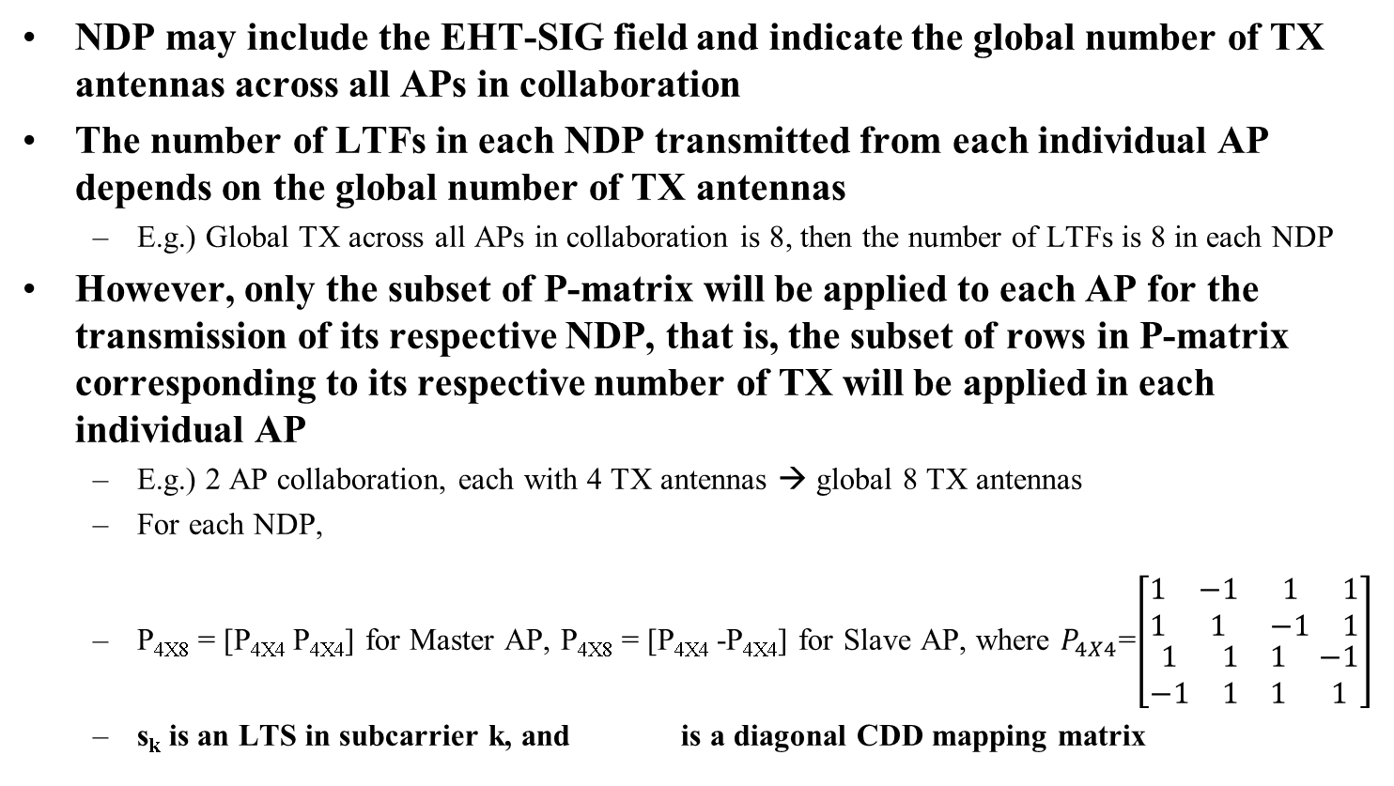
Realization of Simultaneous NDP Transmission (1)
NDP may include the EHT-SIG field and indicate the global number of TX antennas across all APs in collaboration
The number of LTFs in each NDP transmitted from each individual AP depends on the global number of TX antennas
  E.g.) Global TX across all APs in collaboration is 8, then the number of LTFs is 8 in each NDP
However, only the subset of P-matrix will be applied to each AP for the transmission of its respective NDP, that is, the subset of rows in P-matrix corresponding to its respective number of TX will be applied in each individual AP
  E.g.) 2 AP collaboration, each with 4 TX antennas → global 8 TX antennas
  For each NDP,
  P_{4X8} = [P_{4X4} P_{4X4}] for Master AP, P_{4X8} = [P_{4X4} -P_{4X4}] for Slave AP, where $P_{4X4}$=$\left[\begin{matrix}\begin{matrix}1 & −1 \\ 1 & 1\end{matrix} & \begin{matrix}1 & 1 \\ −1 & 1\end{matrix} \\ \begin{matrix}1 & 1 \\ −1 & 1\end{matrix} & \begin{matrix}1 & −1 \\ 1 & 1\end{matrix}\end{matrix}\right]$
  s_{k} is an LTS in subcarrier k, and is a diagonal CDD mapping matrix
${\left[\left(\begin{matrix}\begin{matrix}{LTF1}_{k} & {LTF2}_{k}\end{matrix} & … & \begin{matrix}{LTF7}_{k} & {LTF8}_{k}\end{matrix}\end{matrix}\right)\right]}_{4X8}$=$D_{CDD}^{(k)}P_{4X8}s_{k}$

Slide 9
Realization of Simultaneous NDP Transmission (2)
Sub-carrier interleaved LTF between APs in collaboration can also be used to realize the concurrent NDP transmission from APs in collaboration
  Sub-carriers of LTFs are alternately occupied by the LTS of each AP
  Drawback is the minimum Ng size is determined by the number of APs in collaboration
  Number of LTFs is determined by the largest number of TX in any AP of APs in collaboration
  We need to indicate the actual number of TX antennas for each AP in collaboration in the EHT-SIG field of NDP frame or in the NDPA
    NDPA or EHT-SIG field of NDP needs to indicate the number of APs in collaboration, as well
………….
Sub-carriers in one of the sub-carrier interleaved LTF symbols in case of 4 AP Collaboration
: Long Training Sequence (LTS) from Master AP
: Long Training Sequence (LTS) from Slave AP1
: Long Training Sequence (LTS) from Slave AP2
: Long Training Sequence (LTS) from Slave AP3

Slide 10



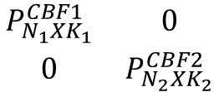

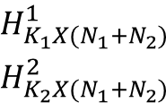
How to compute CBF and JT Pre-coders from Concurrent Sounding, Realization Method (1)
TX 1
RX 1
Aggregated Channel reconstructed at APs
K₁
AP1
….
TX N₁
$$H_{M_{1}X{(N}_{1}+N_{2})}^{1}$$
RX M₁
….
STA 1
$$\begin{matrix}H_{K_{1}X{(N}_{1}+N_{2})}^{1} \\ H_{K_{2}X{(N}_{1}+N_{2})}^{2}\end{matrix}$$
TX 1
$$H_{M_{2}X{(N}_{1}+N_{2})}^{2}$$
RX 1
ZFBF
Precoding Matrix across APs in collaboration
K₂
AP2
….
TX N₂
RX M₂
STA 2
P
….
${(N}_{1}+N_{2})$X${(K}_{1}+K_{2})$
CBF
JT
d₁
Top K₁Streams of outputs
are transmitted from AP1
d₁
Top K₁Streams of outputs
are transmitted from AP1
$$\begin{matrix}P_{N_{1}XK_{1}}^{CBF1} & 0 \\ 0 & P_{N_{2}XK_{2}}^{CBF2}\end{matrix}$$
…
P
…
d_{K1}
d_{K1}
s₁
${(N}_{1}+N_{2})$X${(K}_{1}+K_{2})$
s₁
…
Bottom K₂Streams of outputs
are transmitted from AP2
…
BottomK₂Streams of outputs
are transmitted from AP2
s_{K2}
s_{K2}
The channel between each STA and each AP is separated from the fed-back CSI info, and then newly aggregate the channels between each AP and the CB scheduled STAs. And then, the same
procedure as in slide 4 can be taken for the CBF precoder.

Slide 11
Comparisons for NDP transmission procedures
 | Pros | Cons
Serial NDP Transmission | CSI computation is limited to one AP at a time Avoid the indication in NDPA such as global TX antennas and/or Number of APs in collaboration EHT-SIG field can be used instead for any possible indication (e.g. BSS color) | Protocol overhead is proportional to the number of APs in collaboration CSI computational burden becomes high as the MIMO size increases with the global TX *Global TX can be limited to 16
Concurrent NDP Transmission (1) | Protocol overhead is reduced Minimize the indications in NDPA except for global number of TX across APs in collaboration EHT-SIG field of NDP can be used for the indication of global number of TX Incumbent 802.11 based implementation, relatively simple | CSI computational burden becomes high as the MIMO size increases with the global TX *Global TX can be limited to 16
Concurrent NDP Transmission (2) | Protocol overhead is reduced | EHT-SIG field of NDP can be used only for the common information of APs in collaboration Number of TX antennas of each AP in collaboration can be indicated only in NDPA CSI computational burden becomes high as the MIMO size increases with the global TX *Global TX can be limited to 16

Slide 12
Summary
We compared the Serial NDP Transmission and Concurrent NDP Transmission
For the JT schedule, the channels between each STA and all the APs in collaboration need to be aggregated in each STA before computing the CSI information
The global number of TX across collaborative APs is limited to 16, so the APs can choose to transmit the NDP sounding multiple times in case the global TX is more than 16.
Both Serial and Concurrent NDP transmission are recommended to be available in EHT, so APs can choose the sounding method according to the scheduling situation

Slide 13
Reference
[1] Ross Jian Yu et. al., “11-19/1097r0 Sounding Procedure in AP Collaboration”, July 2019
[2] Kosuke Aio et. al., “11-19/1134r1 Consideration of Multi AP Sounding”, Aug 2019
[3] Sudhir Srinivasa et. al., “11-19/1094r0 Joint BF Simulations”, Aug 2019
[4] Sudhir Srinivasa et. al., “11-18/1510r1 AP Coordinated Beamforming for EHT”, Sep 2018

Slide 14
SP 1
For the AP collaboration sounding, do you agree to include the Joint NDP transmission?
  Including the Serial Sounding based on slide 3 is TBD
  How and when to apply the Serial sounding and Joint Sounding, TBD
  Y/N/A

Slide 15
SP 1-b
For the multi AP system, do you agree to support the Joint sounding?
  Y/N/A

Slide 16
SP 2
For the Concurrent NDP transmission, which realization of concurrent NDP transmission do you prefer?
  Option 1: P-matrix based one such as Concurrent NDP Realization (1)
  Option 2: Sub-carrier interleaved LTF based one such as Concurrent NDP Realization (2)

Slide 17
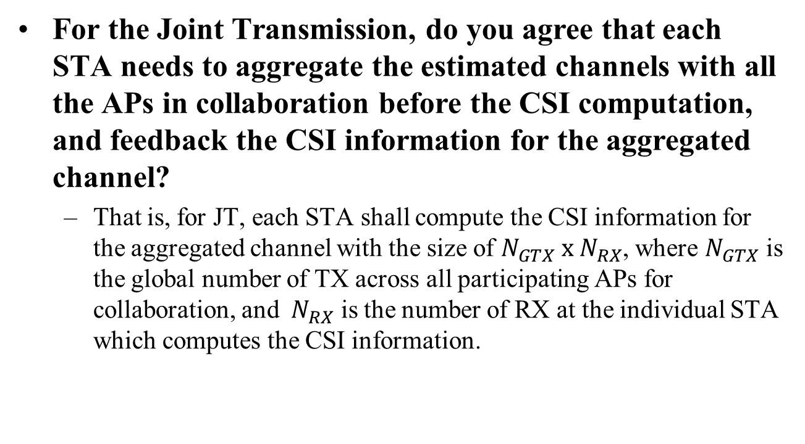
SP 3
For the Joint Transmission, do you agree that each STA needs to aggregate the estimated channels with all the APs in collaboration before the CSI computation, and feedback the CSI information for the aggregated channel?
  That is, for JT, each STA shall compute the CSI information for the aggregated channel with the size of $N_{GTX} x{ N}_{RX}$, where $N_{GTX}$ is the global number of TX across all participating APs for collaboration, and ${ N}_{RX}$ is the number of RX at the individual STA which computes the CSI information.

Slide 18
Appendix
PER of Scheduled STAs for CBF and JT
  Concurrent Sounding based on P-matrix based method (1)
PER of Scheduled STAs for CBF and JT
  Serial Sounding, Individual CSI feedback between a STA and an AP
PER of Scheduled STAs for JT
  Serial Sounding, Individual full Channel feedback between a STA and an AP
PER of Scheduled STAs for JT
  Serial Sounding, Aggregated CSI feedback between a STA and APs in Collaboration

Slide 19
Common Simulation Parameters
  Zero-forcing BF for JT and CBF in the TX as in slide 4 or slide 7
    ZFBF for all the Channels between APs and STAs in case of JT
    ZFBF for all the channels in each AP with all the STAs (including the STAs scheduled from coordinated APs) in case of CBF
  MMSE detection in each STA
  BCC for FEC, MCS 1 and 7, and Perfect Sync
  Packet size for PER: 400 bytes for MCS 1 and 500 bytes for MCS 7
  TGnD Channel

Slide 20
Coordinated BF
TX 1
RX 1
$$H_{M_{1}XN_{1}}^{11}$$
K₁
AP1
….
TX N₁
RX M₁
….
STA 1
$$H_{M_{2}XN_{1}}^{21}$$
$$H_{M_{1}XN_{2}}^{12}$$
TX 1
RX 1
K₂
AP2
….
TX N₂
RX M₂
STA 2
$$H_{M_{2}XN_{2}}^{22}$$
….
K₁= K₂=2
M₁= M₂=2
N₁= N₂=4
There are 2 APs and 2 STAs
STA1 is scheduled with AP1, and STA2 is scheduled with AP2
  These two STAs are selected among 4 STAs total, and the selected 2 STAs supposed to be scheduled with each AP, respectively.

Slide 21

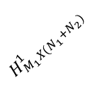


Joint Transmission
RX 1
RX M₁
….
STA 1
K₁= K₂=4
M₁= M₂=2
N₁= N₂=4
There are 2 APs and 4 STAs
STA1 and STA2 are scheduled with AP1, and STA3 and STA4 are scheduled with AP2
K₁ streams of data and K₂ streams of data shall be shared across the AP1 and AP2
TX 1
RX 1
$$H_{M_{1}X{(N}_{1}+N_{2})}^{1}$$
K₁
AP1
….
TX N₁
RX M₂
$$H_{M_{2}X{(N}_{1}+N_{2})}^{2}$$
….
STA 2
TX 1
$$H_{M_{3}X{(N}_{1}+N_{2})}^{3}$$
RX 1
K₂
AP2
….
TX N₂
$$H_{M_{4}X{(N}_{1}+N_{2})}^{4}$$
RX M₃
….
STA 3
RX 1
RX M₄
….
STA 4

Slide 22
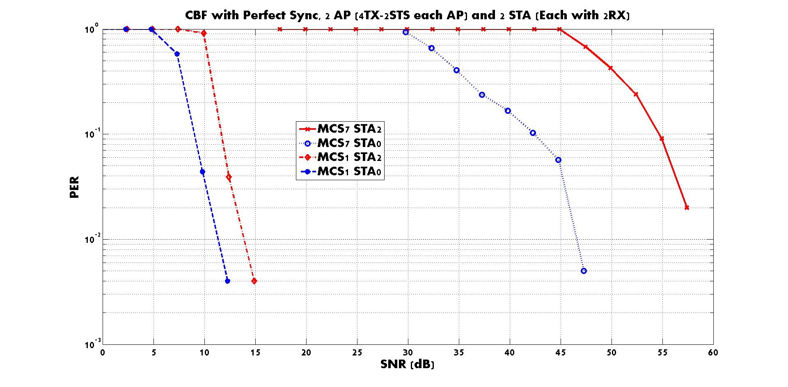
Concurrent Sounding based on Realization method (1)

Slide 23
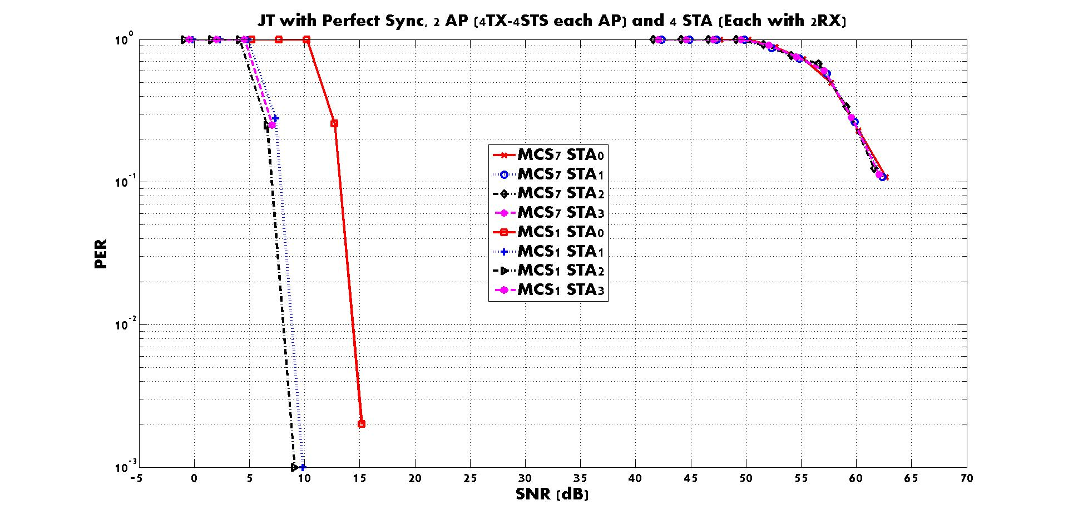
Concurrent Sounding based on Realization method (1)

Slide 24
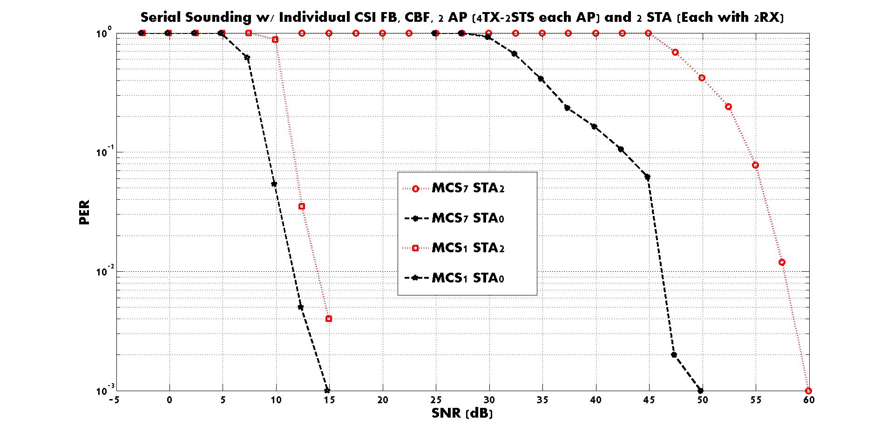
CBF, Serial Sounding: Individual CSI feedback for the channel between an AP and a STA

Slide 25
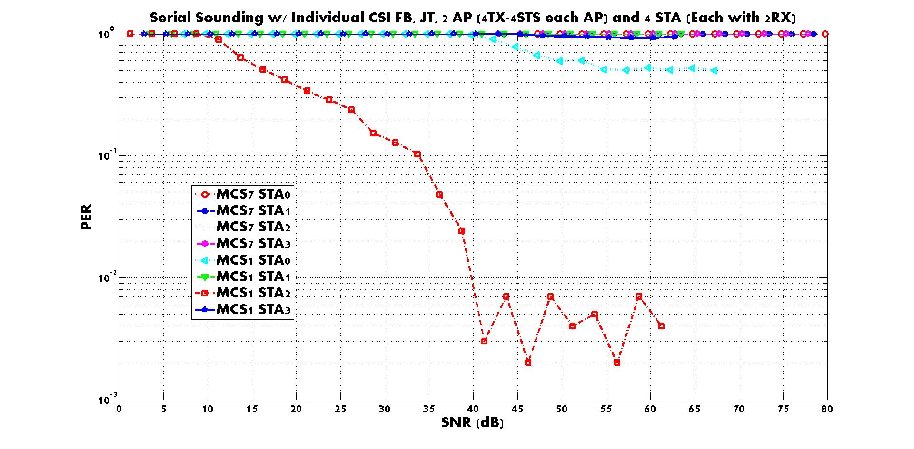
JT, Serial Sounding: Individual CSI feedback for the channel between an AP and a STA

Slide 26
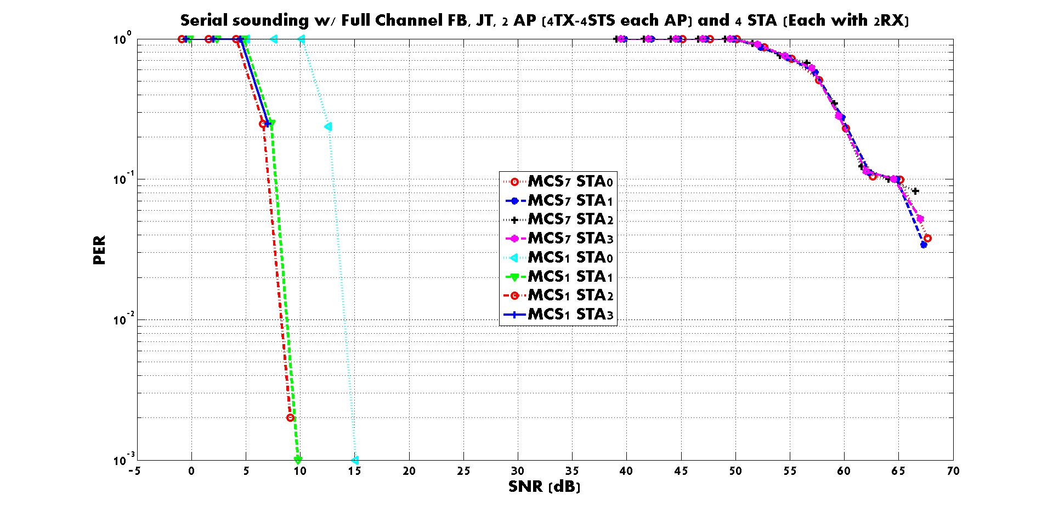
JT, Serial Sounding: Full Channel feedback for the channel between an AP and a STA

Slide 27
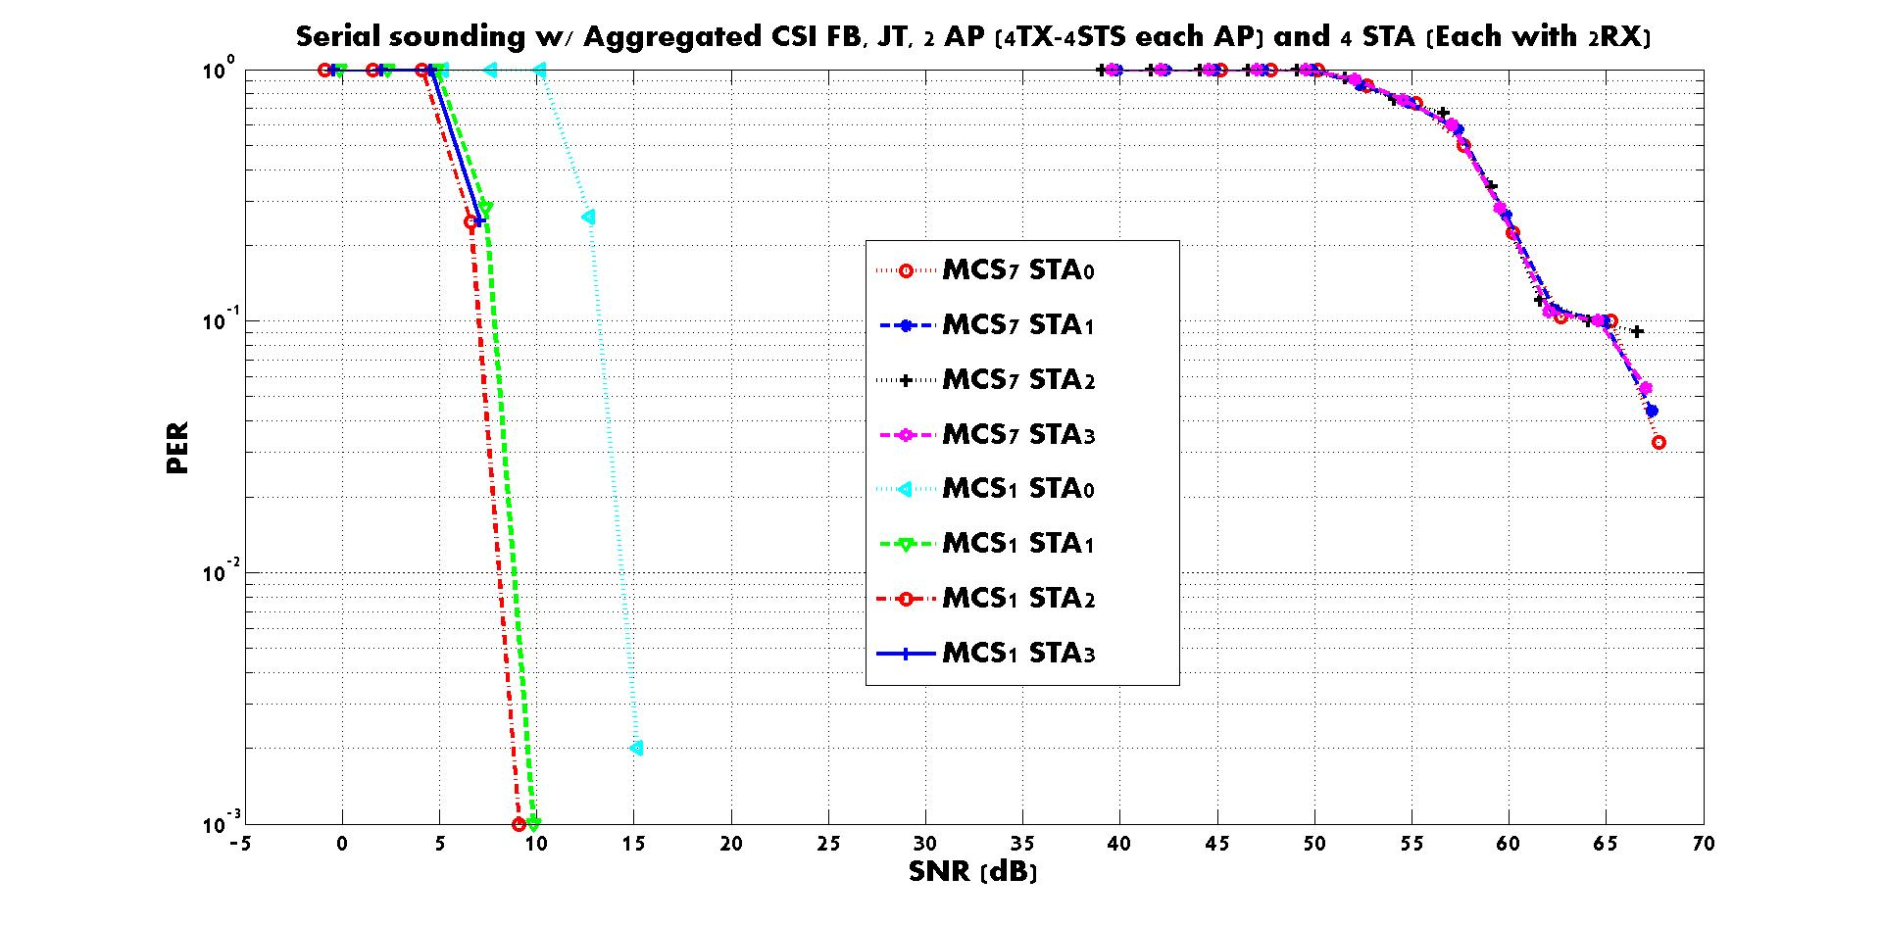
JT, Serial Sounding: Aggregated CSI feedback for the channel between a STA and all APs in collaboration

