Slide 1
Sounding for AP Collaboration
Date: 2019-09-16
Authors:
Name | Affiliation | Address | Phone | Email
Junghoon Suh | Huawei |  |  | junghoon.suh@huawei.com
Osama Aboul-Magd |  |  |  | osama.aboulmagd@huawei.com
Yan Xin |  |  |  | yan.xin@huawei.com

Slide 2
Background
[1] proposed several options of sounding procedures for the AP collaboration scenario, and we want to describe the NDPA/NDP transmission protocol in further detail in this contribution
Sounding packets are sequentially transmitted from each AP towards STAs, the sounding overhead increases in proportion to the number of APs in collaboration in this case, however the computation burden on the CSI is not relatively heavy
When the sounding packets are simultaneously transmitted from the APs in collaboration, the sounding protocol overhead is reduced but all the CSI computation burden is transferred to the STA side

Slide 3
Serial (Independent) Sounding Packet Transmission [1][2]
Master AP can send an NDPA, followed by NDP1 and the Slave APs will send NDPs towards STAs one by one serially and/or respectively
  NDPA may need an indication of EHT NDPA type.
Master AP
NDPA
NDP1
Trigger*
Slave AP1
NDP2
Slave AP2
NDP3
STA 1
….
STA N
* This Trigger frame is to collect the BF Report from STAs

Slide 4
Concurrent Sounding Packet Transmission [2][3]
Master AP can send an NDPA, and both Master and Slave APs will send simultaneous NDP towards STAs immediately following the NDPA (Scheme A)
Sounding Trigger may allow both Master AP and Slave AP to transmit NDPA simultaneously, followed by the concurrent NDP frames from both APs (Scheme B)
  NDPA may need an indication of EHT NDPA type
Scheme A
Scheme B
Master AP
NDPA
NDP1
Trigger*
Sounding
Trigger
NDPA
NDP1
Trigger*
Slave AP
NDP2
NDPA
NDP2
STA 1
….
STA N
* This Trigger frame is to collect the BF Report from STAs

Slide 5
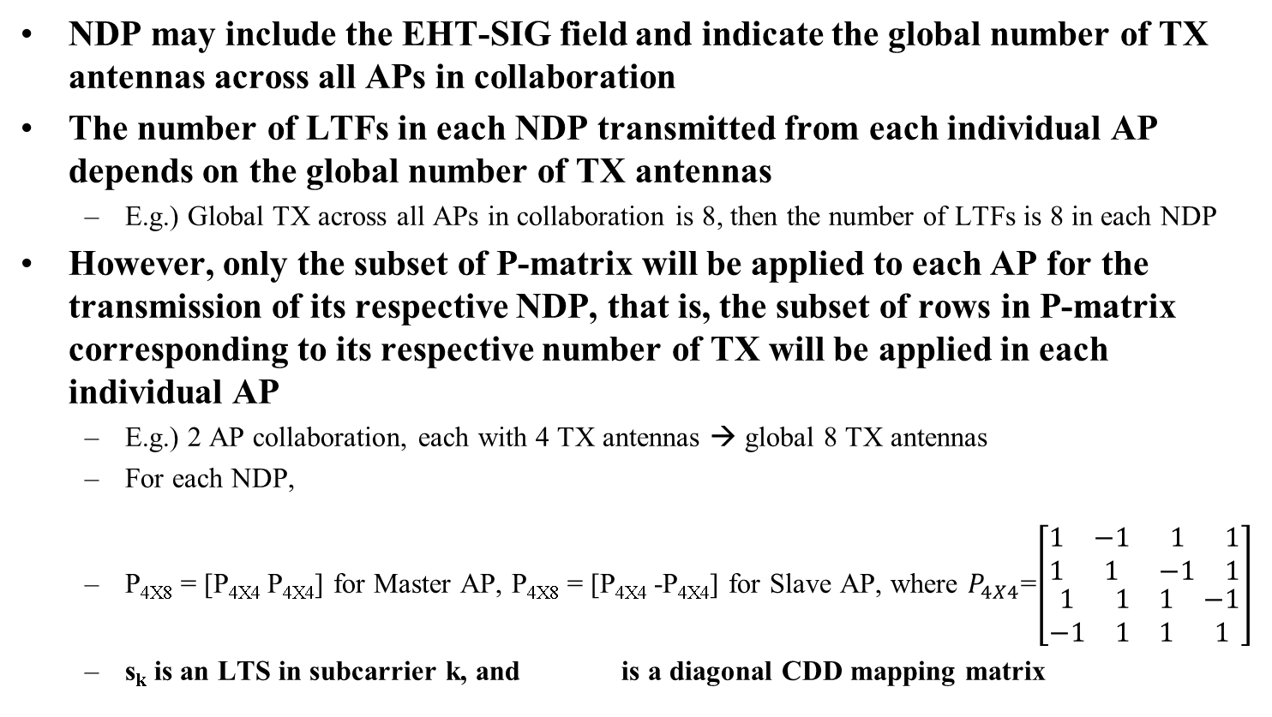
Realization of Simultaneous NDP Transmission (1)
NDP may include the EHT-SIG field and indicate the global number of TX antennas across all APs in collaboration
The number of LTFs in each NDP transmitted from each individual AP depends on the global number of TX antennas
  E.g.) Global TX across all APs in collaboration is 8, then the number of LTFs is 8 in each NDP
However, only the subset of P-matrix will be applied to each AP for the transmission of its respective NDP, that is, the subset of rows in P-matrix corresponding to its respective number of TX will be applied in each individual AP
  E.g.) 2 AP collaboration, each with 4 TX antennas → global 8 TX antennas
  For each NDP,
  P_{4X8} = [P_{4X4} P_{4X4}] for Master AP, P_{4X8} = [P_{4X4} -P_{4X4}] for Slave AP, where $P_{4X4}$=$\left[\begin{matrix}\begin{matrix}1 & −1 \\ 1 & 1\end{matrix} & \begin{matrix}1 & 1 \\ −1 & 1\end{matrix} \\ \begin{matrix}1 & 1 \\ −1 & 1\end{matrix} & \begin{matrix}1 & −1 \\ 1 & 1\end{matrix}\end{matrix}\right]$
  s_{k} is an LTS in subcarrier k, and is a diagonal CDD mapping matrix
${\left[\left(\begin{matrix}\begin{matrix}{LTF1}_{k} & {LTF2}_{k}\end{matrix} & … & \begin{matrix}{LTF7}_{k} & {LTF8}_{k}\end{matrix}\end{matrix}\right)\right]}_{4X8}$=$D_{CDD}^{(k)}P_{4X8}s_{k}$

Slide 6
Realization of Simultaneous NDP Transmission (2)
Sub-carrier interleaved LTF between APs in collaboration can also be used to realize the concurrent NDP transmission from APs in collaboration
  Sub-carriers of LTFs are alternately occupied by the LTS of each AP
  Drawback is the minimum Ng size is determined by the number of APs in collaboration
  Number of LTFs is determined by the largest number of TX in any AP of APs in collaboration
  We need to indicate the actual number of TX antennas for each AP in collaboration in the EHT-SIG field of NDP frame or in the NDPA
    NDPA or EHT-SIG field of NDP needs to indicate the number of APs in collaboration, as well
………….
Sub-carriers in one of the sub-carrier interleaved LTF symbols in case of 4 AP Collaboration
: Long Training Sequence (LTS) from Master AP
: Long Training Sequence (LTS) from Slave AP1
: Long Training Sequence (LTS) from Slave AP2
: Long Training Sequence (LTS) from Slave AP3

Slide 7
Comparisons for NDP transmission procedures
 | Pros | Cons
Serial NDP Transmission | CSI computation is limited to one AP at a time Avoid the indication in NDPA such as global TX antennas and/or Number of APs in collaboration EHT-SIG field can be used instead for any possible indication (e.g. BSS color) | Protocol overhead is proportional to the number of APs in collaboration
Concurrent NDP Transmission (1) | Protocol overhead is reduced Minimize the indications in NDPA except for global number of TX across APs in collaboration EHT-SIG field of NDP can be used for the indication of global number of TX Incumbent 802.11 based implementation, relatively simple | CSI computational burden becomes high as the MIMO size increases with the global TX *Global TX can be limited to 16 per each sounding
Concurrent NDP Transmission (2) | Protocol overhead is reduced CSI computational burden is lessened, compared to the Concurrent NDP Transmission (1) | EHT-SIG field of NDP can be used only for the common information of APs in collaboration Number of TX antennas of each AP in collaboration can be indicated only in NDPA CSI computational burden is still high compared to the Serial NDP Transmission

Slide 8
Summary
We compared the Serial (Independent) NDP Transmission and Concurrent NDP Transmission
The global number of TX across collaborative APs for the P-matrix based concurrent NDP transmission can be limited to 16 per each sounding, so the APs can choose to transmit the concurrent NDP sounding multiple times in case the global TX is more than 16.
Both Serial and Concurrent NDP transmission are recommended to be available in EHT, so APs can choose the sounding method according to the scheduling situation

Slide 9
Reference
[1] Ross Jian Yu et. al., “11-19/1097r0 Sounding Procedure in AP Collaboration”, July 2019
[2] Kosuke Aio et. al., “11-19/1134r1 Consideration of Multi AP Sounding”, Aug 2019
[3] Sudhir Srinivasa et. al., “11-19/1094r0 Joint BF Simulations”, Aug 2019
[4] Sudhir Srinivasa et. al., “11-18/1510r1 AP Coordinated Beamforming for EHT”, Sep 2018

Slide 10
SP 1
For the AP collaboration sounding, do you prefer the serial NDP transmission, Concurrent NDP transmission, or both serial and concurrent NDP transmission?
  Option 1: Serial NDP Transmission only
  Option 2: Concurrent NDP Transmission only
  Option 3: Both Serial and Concurrent NDP Transmission available so the AP can select one NDP transmission method according to the situation

Slide 11
SP 2
For the Option 2 and 3 cases in SP 1, which realization of concurrent NDP transmission do you prefer?
  Option 1: P-matrix based one such as Concurrent NDP Realization (1)
  Option 2: Sub-carrier interleaved LTF based one such as Concurrent NDP Realization (2)

