Slide 1
Coordinated Spatial Reuse Performance Analysis
Date: 2019-09-15
Authors:
Name | Company | Address | Phone | Email
Kosuke Aio | Sony Corporation |  |  | Kosuke.Aio@sony.com
Yusuke Tanaka |  |  |  | Yusuke.YT.Tanaka@sony.com
Ryuichi Hirata |  |  |  | Ryuichi.Hirata@sony.com
Kazuyuki Sakoda |  |  |  | Kazuyuki.Sakoda@sony.com
Thomas Handte |  |  |  | Thomas.Handte@sony.com
Dana Ciochina |  |  |  | Dana.Ciochina@sony.com
Mohamed Abouelseoud |  |  |  | Mohamed.Abouelseoud@sony.com

Slide 2
Introduction
Multi-AP Coordination is one of the candidate features for 11be[1]
Some types of Multi-AP coordination schemes have been discussed in TGbe as follows:
Joint Transmission (JTX) [2]
Coordinated Beamforming (CBF) [2]
Coordinated Spatial Reuse (CSR) [3]
Coordinated OFDMA [4]
CSR is a simpler coordination scheme than JTX/CBF (Sync and CSI collection are unnecessary), but so far, few simulation results show how much throughput gain CSR can potentially achieve.
This contribution provides simulation results and shows the potential performance of CSR.

Slide 3
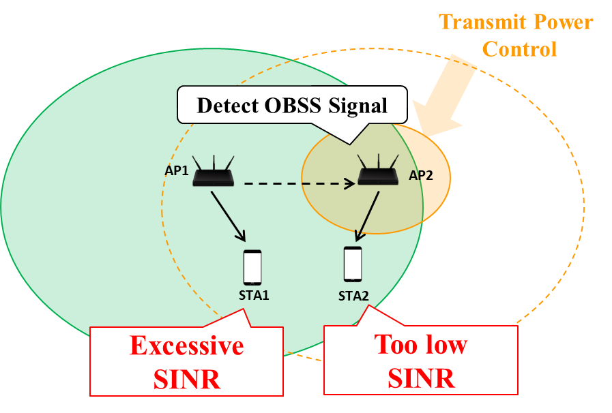
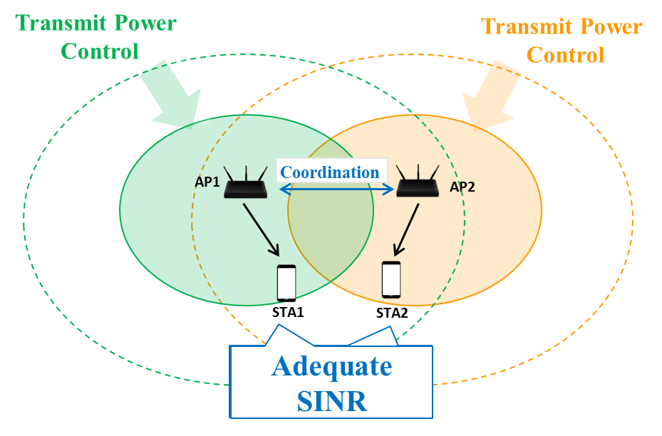
Recap of Coordinated Spatial Reuse
APs control Tx power cooperatively to improve area throughput.
CSR allows parallel transmission for multi-APs.
For adequate SINR at all STAs, APs mitigate interference by Tx power controlling.
With 11ax SR, which isn’t a coordinated way, one AP can transmit data with max Tx power and the other APs should decrease Tx Power. Hence, some STAs will get too low SINR.
We’re considering two options of coordinated ways.
The Concept of 11ax SR
The Concept of Coordinated SR

Slide 4
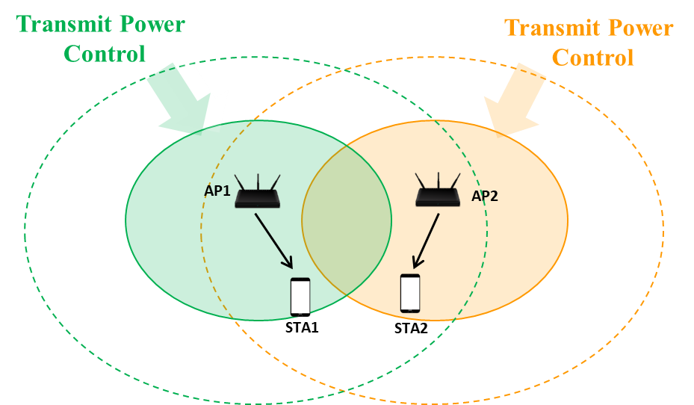
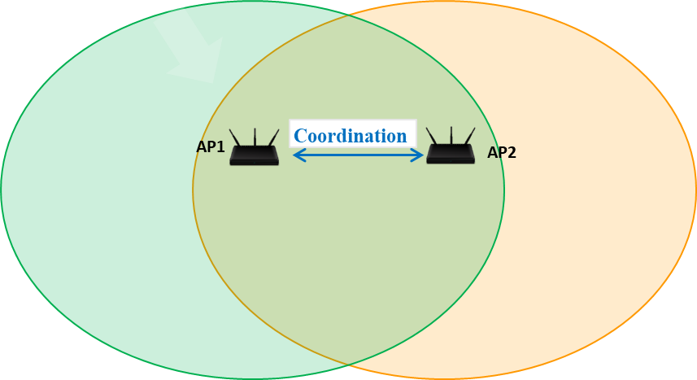
Coordinated SR : Option.1
AP manages its BSS with controlling Tx power
APs exchange some control frames and control Tx power .
AP sets Tx power, such that it is not detected at other APs.
Tx power can be changed periodically (e.g., on a beacon interval basis).
After Tx power controlling, no frame exchange (such as Trigger frame) will be necessary between multiple APs.
Example of Coordinated SR : Opt.1

Slide 5
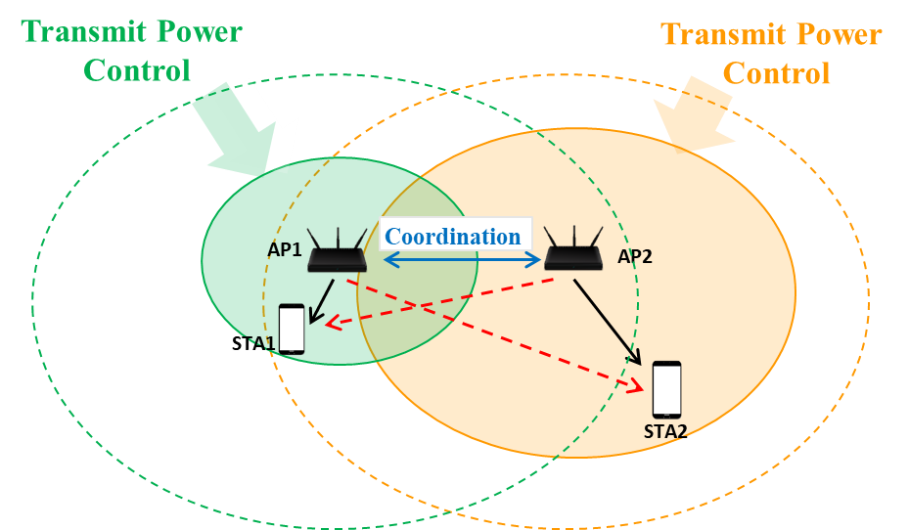
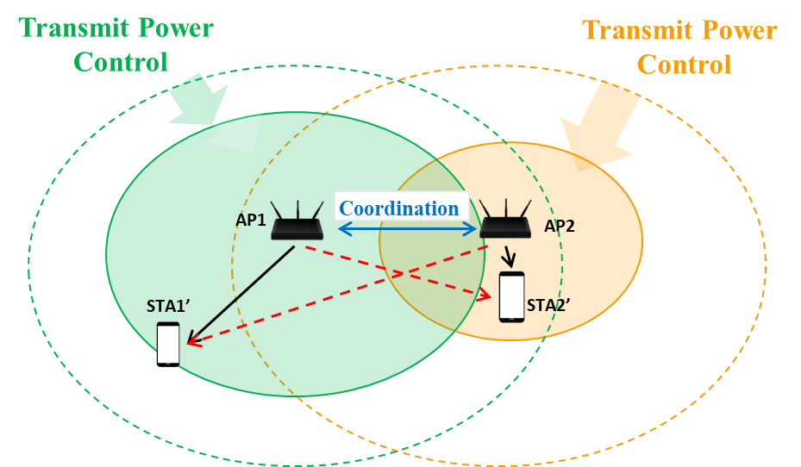
Coordinated SR : Option.2
AP controls Tx Power in every transmission
An AP, which has already gotten all link information (Pathloss/SNR etc.), calculates Tx power of all APs to maximize area throughput, then informs them to the APs.
This will be the best way to improve area throughput using Spatial Reuse.
Some frame exchanges (such as Trigger frame) will be necessary.
We need to consider the impact of the frame exchanges on system overhead.
Example of Coordinated SR : Opt.2

Slide 6
Simulation Setup
Metrics: “throughput = sum of throughput per STA”
Considering only data payload. (not including MAC and PHY preamble overhead)
Adequate MCS and theoretical PER are determined base on SINR per STA
Following four schemes are compared
TDD
One AP transmits data with max Tx power. (The AP is selected randomly)
The other APs don’t transmit data doe to the transmission described in the above.
11ax SR (OBSS_PD)
One AP transmits data with max Tx power. (The AP is selected randomly)
The other APs transmit data with Tx power calculated by OBSS_PD equation. [5]
OBSS_PD_{min} = -82dBm/20MHz, OBSS_PD_{max} = -62dBm/20MHz
Coordinated SR : Opt.1 (in Slide.4)
All APs transmit data with Tx power which allows not to detect each other.
Coordinated SR : Opt.2 (in Slide.5)
All APs transmit data with Tx power which maximizes area throughput.

Slide 7
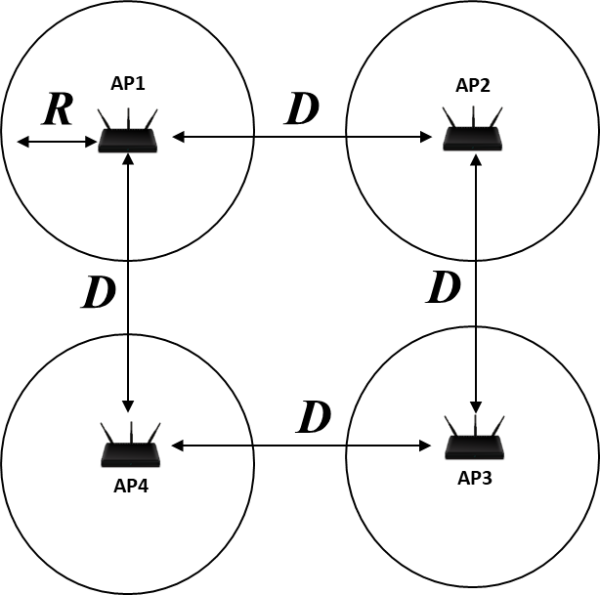
Simulation Setup
Simulation Environment
4APs are deployed as the right layout.
Assuming each AP transmits data to one STA
STAs are deployed randomly within radios of R [m] from associated-AP
Num. of Loop: 1,000
Frequency: 5180MHz
Bandwidth: 80MHz
Max Tx Power: 21dBm per AP
NF: 7dB
Pathloss : (“freq” = 5.18GHz, “Dis” = distance between Tx/Rx, “breakpoint” = 10m)
PL(d) = 40.05 + 20*log10(freq/2.4) + 20*log10(min(Dis, breakpoint)) + (Dis > breakpoint) .* (35*log10(Dis/breakpoint))
Shadowing : 5dB log-normal for all link, iid
PPDU: HE PPDU with 4x+3.2us LTF and 3.2us GI
<Layout of Nodes>

Slide 8
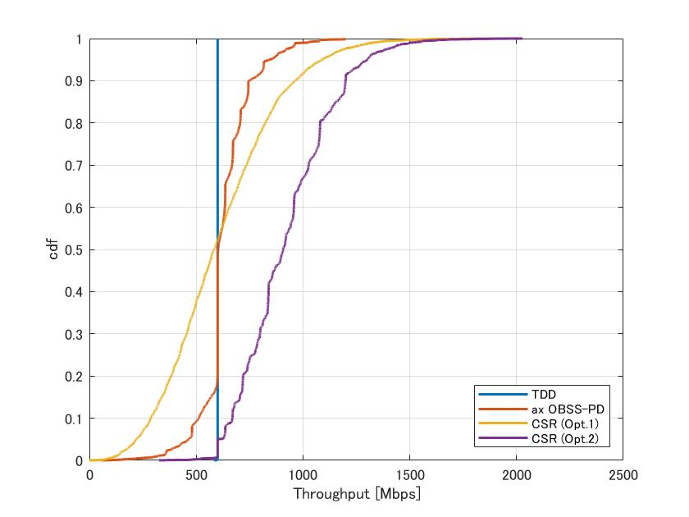
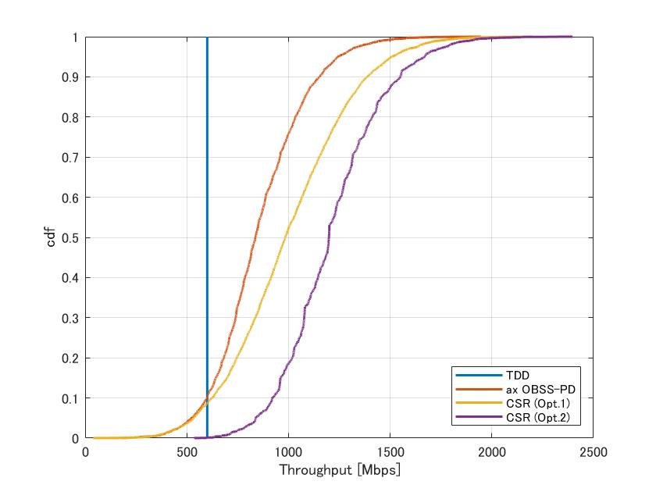
Simulation Result 1
Throughput CDF
D = 20m, R = 10m
D = 30m, R = 10m
SR Gain at cdf=0.9
- ax SR : x1.2
- CSR(Opt.1) : x1.6
- CSR(Opt.2) : x2.0
SR Gain at cdf=0.9
- ax SR : x1.9
- CSR(Opt.1) : x2.3
- CSR(Opt.2) : x2.6
Comparing with ax SR(OBSS_PD), CSR can achieve higher throughput gain.
CSR(Opt.2) can get the highest throughput gain among all schemes.

Slide 9
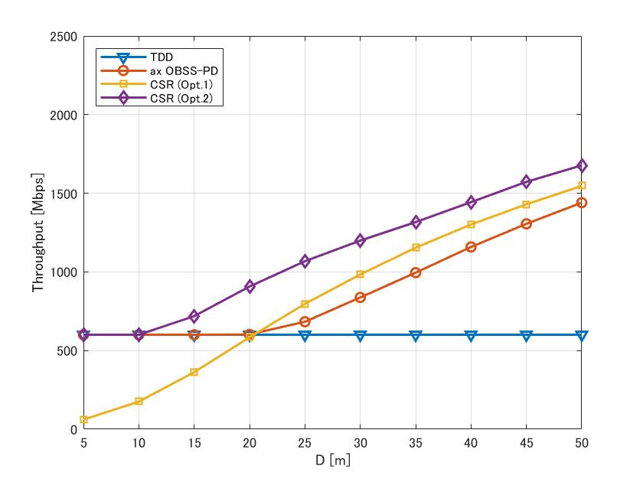
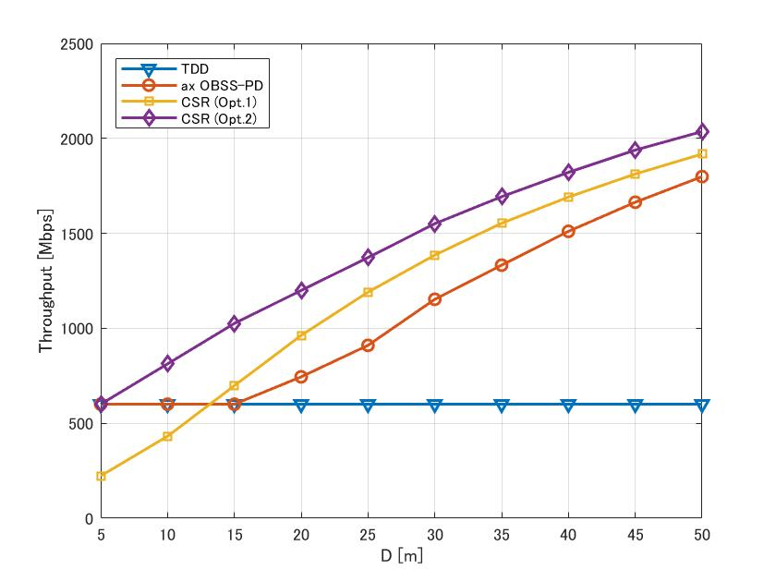
Simulation Result 2
Distance vs. Throughput (R = 10m)
CDF = 0.5
CDF = 0.9
CSR(Opt.2) can achieve the highest throughput gain in all distance conditions.
CSR(Opt.1) will be better than ax SR in the case AP-AP distance is long.

Slide 10
Summary
This contribution provided some simulation results and showed the potential performance of Coordinated SR.
The simulation results showed Coordinated SR can achieve higher throughput gain than 11ax SR (OBSS_PD).
Coordinated SR Option.2 (AP calculates Tx Power before every transmission) has the highest potential performance of thought gain.
Coordinated SR Option.1 (All APs manage BSS with controlled Tx power) will be better than 11ax SR in the non-congestive case.

Slide 11
Reference
[1] 11-18-1231-01-0eht-eht-draft-proposed-par
[2] 11-18-1926-02-0eht-terminology-for-ap-coordination
[3] 11-19-0801-00-00be-ap-coordination-in-eht
[4] 11-18-1547-00-0eht-technology-features-for-802-11-eht
[5] IEEE P802.11ax D4.0
[6] 11-14-0621-04-00ax-simulation-scenarios

Slide 12
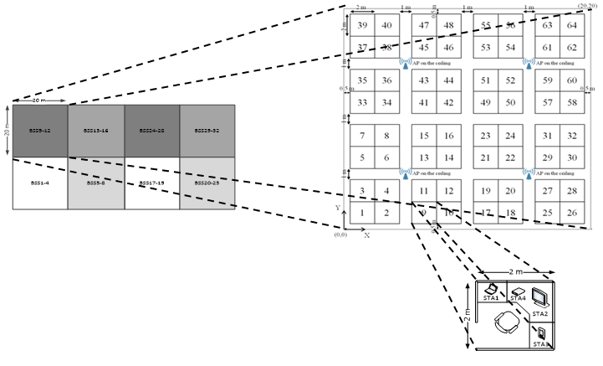
Appendix.1
Simulation Results in Office Environment
This is based on 11ax SS2 scenario [6]
But we picked up only 4 BSS which uses the same channel.
4APs are deployed as the following figure.
STAs in each BSS are deployed in 10m range.
Pathloss of wall is 7dB.
Other parameters are same as Slide.7
<Layout of Nodes>

Slide 13
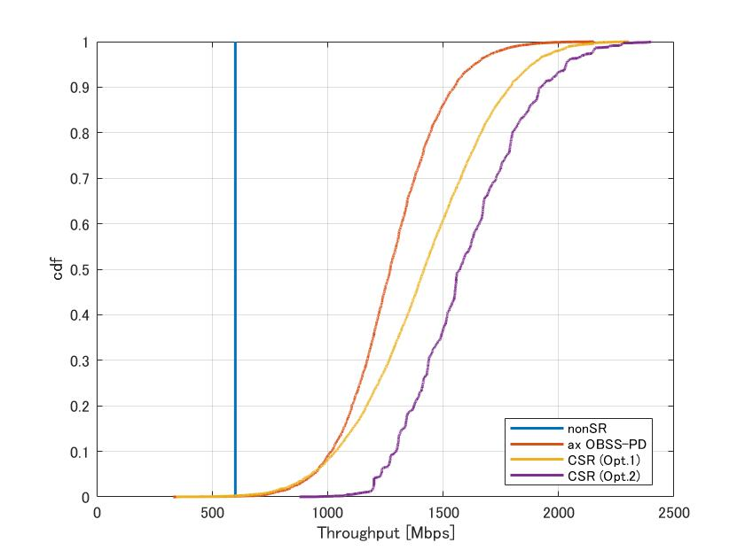
Appendix.1
Simulation Results in Office Environment
SR Gain at cdf=0.9
- ax SR : x2.6
- CSR(Opt.1) : x3.0
- CSR(Opt.2) : x3.2
SR Gain at cdf=0.5
- ax SR : x2.1 - CSR(Opt.1) : x2.4
- CSR(Opt.2) : x2.6

Slide 14
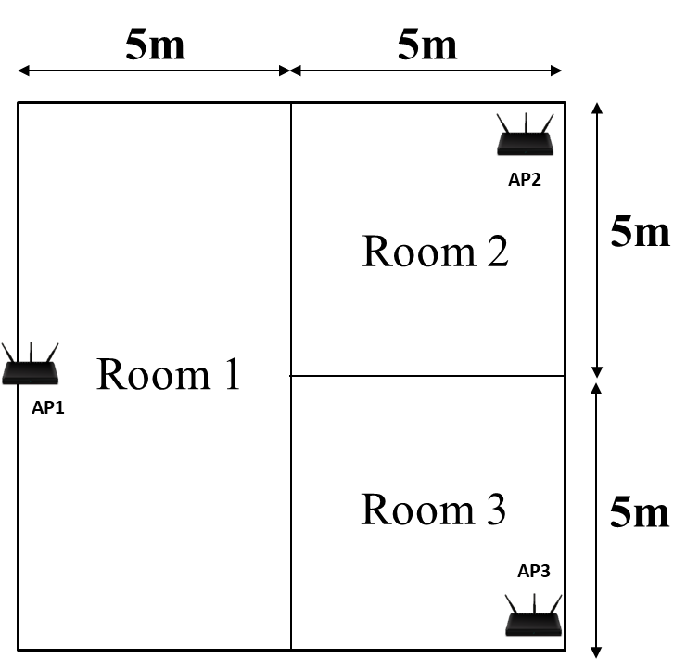
Appendix.2
Simulation Results in Home Environment
This is the original deployment scenario
3APs are deployed as the following figure.
STAs in each BSS are deployed randomly in the same room as associated-AP.
Pathloss of wall is 7dB.
Breakpoint is 5m
Other parameters are same as Slide.7
<Layout of Nodes>

Slide 15
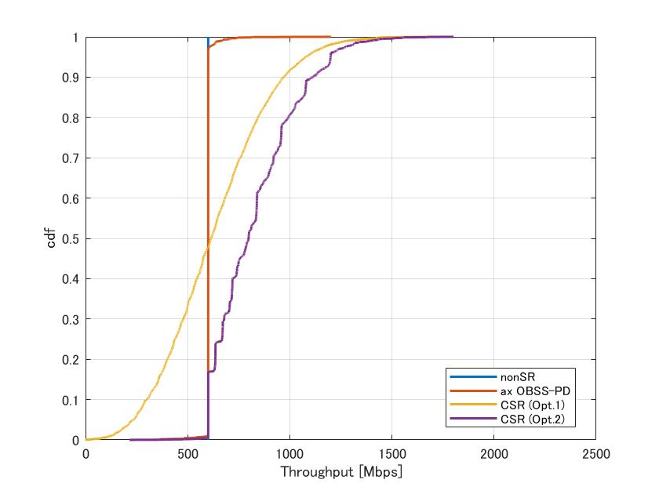
Appendix.2
Simulation Results in Home Environment
SR Gain at cdf=0.9
- ax SR : x1.0
- CSR(Opt.1) : x1.6
- CSR(Opt.2) : x1.9
SR Gain at cdf=0.5
- ax SR : x1.0
- CSR(Opt.1) : x1.0
- CSR(Opt.2) : x1.3

