Slide 1
Consideration on Multi-AP Ack Protocol
Date: 2019-09-15
Authors:
Name | Company | Address | Phone | Email
Kosuke Aio | Sony Corporation |  |  | Kosuke.Aio@sony.com
Yusuke Tanaka |  |  |  | Yusuke.YT.Tanaka@sony.com
Ryuichi Hirata |  |  |  | Ryuichi.Hirata@sony.com
Kazuyuki Sakoda |  |  |  | Kazuyuki.Sakoda@sony.com
Thomas Handte |  |  |  | Thomas.Handte@sony.com
Dana Ciochina |  |  |  | Dana.Ciochina@sony.com
Mohamed Abouelseoud |  |  |  | Mohamed.Abouelseoud@sony.com

Slide 2
Introduction
Multi-AP Coordination is one of the candidate features for 11be[1].
Some types of Multi-AP coordination schemes have been discussed in TGbe as follows:
Joint Transmission (JTX) [2]
Coordinated Beamforming (CBF) [2]
Coordinated Spatial Reuse (CSR) [3]
Coordinated OFDMA (C-OFDMA) [4]
Some Multi-AP protocols have been proposed in [5] [6], but one of the essential part of Multi-AP coordination, Ack protocol, has been not clear.
In this contribution, we discuss some issues of Ack protocol for Multi-AP coordination and show possible approaches.

Slide 3
Multi-AP Ack Protocol Based on Conventional Scheme
STA transmits Ack frame to the associated AP
SU case: In the case of data transmission from both AP1&AP2 to STA1, Ack frame is transmitted from STA1 to the AP the STA1 is associated with (e.g. AP1 in the left figure)
MU case: In the case of data transmission from AP1 to STA1 and from AP2 to STA2, Ack frames are transmitted from STA1 to AP1 and STA2 to AP2.
Based on the Ack frame, the AP decides to perform retransmission and/or flushing packets from its queue.
If packets were correctly received, they are flushed, otherwise, they are retransmitted.
Conceivable Ack Protocol (SU case)
Conceivable Ack Protocol (MU case)
AP1
AP2
MAP
Trigger
AP1
AP2
MAP
Trigger
DATA
DATA
AP1
AP2
STA1
time
time
time
AP1
AP2
STA1
STA2
time
time
time
time
Ack
Ack
Ack
STA1
Ack
STA1
STA2
Ack

Slide 4
Issues of Multi-AP Ack Protocol
There are some issues if Ack protocol for Multi-AP coordination is based on conventional scheme.
Issue.1: Ack Collision Avoidance
This issue will happen in the MU case of JTX/CBF/CSR/COFDMA.
If each STA transmits Ack frame SIFS after data reception, Ack frames transmitted from multiple STAs will collide with each other.
Issue.2: Retransmission/Queue Management for JTX
This issue will happen in both SU/MU case of JTX.
As for JTX, master and slave APs share same data packets in advance, and all APs memorize them in preparation for retransmission.
In the case, all AP can't receive all Ack frames from all STAs,
Master AP can't determine if the AP should retransmit the packets.
Slave AP can't determine if the AP can flush the shared packets from its queue.

Slide 5
Approach for Issue.1
Approach.1 : Ack Tx Time Control
AP includes information about Ack Tx time to all STAs into MAP Trigger or DATA frame.
Information can be a flag of “Immediate / Delayed” or concrete start time.
It’ll take a long time to collect all Ack frames by a number of STA.
Approach.2 : UL-MU Ack to an AP
An AP (e.g. Master AP) receives all Ack frames by UL OFDMA.
The AP needs to receive Ack frames from non-associated STAs.
Approach.1
Approach.2
MAP
Trigger
AP1
AP2
DATA
AP1
AP2
STA1
STA2
time
time
time
time
Ack
Ack
Ack
STA1
STA2

Slide 6
Approach for Issue.2
Approach.1: All AP receive all Ack frames
It is easy approach for the SU case.
Recovery for the case an AP fails to receive one of Ack frames is for further study.
It is difficult approach for the MU case.
Complicated UL Multi-Point-to-Multi-Point transmission is necessary.
Approach.2: Ack Information Exchange
After receiving Ack frames, multiple APs will exchange Ack information.
If AP1 can receive all Ack, AP1 may transmit “Rx End” or “ReTx Trigger “to AP2.
Additional frame exchanges will slightly increase system overhead.
Approach.1
Approach.2
AP1
AP2
AP1
AP2
AP1
Ack
Info.
AP2
AP1
Ack
Info.
AP2
Ack
Ack
Ack
Ack
Ack
Ack
STA1
Ack
STA1
STA1
STA2
STA1
STA2

Slide 7
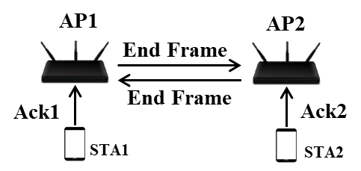
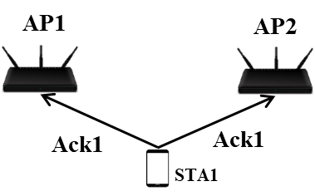
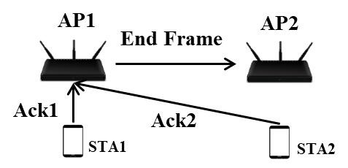
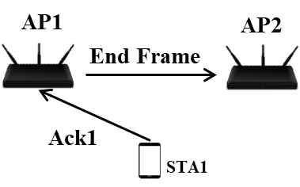
Overall of Possible Multi-AP Ack Protocol
The table below summarizes the possible Multi-AP Ack Protocols discussed in this contribution.
Considering MU case, Ack Info. Exchange among APs will be necessary.
 | MU case | SU case
All APs receive Ack
An AP receive Ack
Ack Info.
Tx Time
Control
Ack Info.
Ack Info.

Slide 8
Reference
[1] 11-18-1231-01-0eht-eht-draft-proposed-par
[2] 11-18-1926-02-0eht-terminology-for-ap-coordination
[3] 11-19-0801-00-00be-ap-coordination-in-eht
[4] 11-18-1547-00-0eht-technology-features-for-802-11-eht
[5] 11-18-1439-00-0eht-distributed-mu-mimo
[6] 11-19-0804-00-00be-multi-ap-transmission-procedure

Slide 9
Straw Poll 1
Do you agree that 11be should support a collision avoidance scheme of Ack frames for Multi-AP coordination?
Yes
No
Need more information

Slide 10
Straw Poll 2
Do you agree that 11be should support information exchange related to received Ack frames among multiple APs for Multi-AP coordination?
Yes
No
Need more information

