Slide 1
Performance evaluation of deterministic service for EHT
Date: 2019-09-16
Authors:
Name | Affiliation | Address | Phone | Email
Suhwook Kim | LG Electronics | 19, Yangjae-daero 11gil, Seocho-gu, Seoul 137-130, Korea |  | suhwook.kim@lge.com
Jinsoo Choi |  |  |  | js.choi@lge.com
Jeongki Kim |  |  |  | jeongki.kim@lge.com
Insun Jang |  |  |  | insun.jang@lge.com
Taewon Song |  |  |  | taewon.song@lge.co
Sungjin Park |  |  |  | allean.park@lge.com

Slide 2
Abstract
We addressed the simulation results for EDCA system and OFDMA system during conference call [1]
  The latency is divided into several portions and analyzed with simulation
  OFDMA shows better latency performance because it can reduce contention and collision overhead
We have enhanced the simulator from a latency perspective
  We have adopted deterministic service (and bounded latency traffic)
  Frame drop rate is added as performance metric
We will evaluate that 11ax(OFDMA) can support deterministic service

Slide 3
Deterministic Service [2]
We have implemented deterministic service
  STA can transmit UL frame within bounded latency after receiving trigger frame
  AP transmit DL frame within bounded latency after contention
  If the frame cannot be transmitted within bounded latency, it is dropped

Slide 4
Simulation Topology
Revised Residential scenario (from 11ax SS document [3])
  1 Floor, 10 Apartments
  AP is located at center of each apartment
  Blue: Acting with time-sensitive traffic
    We are focusing on this apartment
  Yellow: Acting as interference (Non time-sensitive traffic)
    They are hearable from Blue apartment
  White: Empty apartment (or acting in different channel)

Slide 5
Simulation Topology
Blue Apartment
  Traffic: Real time streaming or Cloud gaming
  Number of STA
    1 STA (Real time streaming simulation)
    2 or 4 STAs (Cloud gaming simulation)
  Location: Fixed (1 meter from AP)
Yellow Apartment
  Traffic: Constant Bit Rate
  Number of STA: 2 STAs
  Location: Random

Slide 6
Traffic details
Traffic model: Real time streaming [4][5]
  Data rate: 150 Mbps
  Latency bound: 10 msec
  Video frame rate: 120 Hz (8.33 msec)
  UDP, DL only, Near-lossless
Traffic model: Cloud Gaming [4][5]
  Data rate: 20 Mbps (DL), 100 kbps (UL)
  Latency bound: 10 msec
  Frame rate: 60 Hz (16.7 msec, DL), 15 Hz (66.7 msec, UL)
  UDP, Near-lossless
  Trigger frame duration: 4 msec or 8 msec

Slide 7
Others
Interference: Constant Bit Rate
  DL and UL mixed: 2, 4, 8 Mbps per link
    Aggregated BSS rate = 8, 16, 32 Mbps (2 STA * 2 Way * Data rate per link)
    Sum Interference rate = 24, 48, 96 Mbps (3 BSSs)
  Trigger frame duration: 8 msec
Other parameters for all apartment
  MCS is fixed (MCS 7)
  OFDMA only (No EDCA, No UORA)
  RU sizes
    996 tones(* 1), 484 tones(* 2), 242 tones(* 4) RU are used

Slide 8
Simulation Scenario
SS1: Real time streaming
  1 STA
  Interference level: 0 Mbps, 4 Mbps, 8 Mbps
SS2: Cloud gaming
  2 STAs
  Interference level: 0 Mbps, 2 Mbps, 4 Mbps
  Trigger frame duration: 4 msec, 8 msec
SS3: Cloud gaming
  4 STAs
  Interference level: 0 Mbps, 2 Mbps, 4 Mbps
  Trigger frame duration: 4 msec, 8 msec

Slide 9
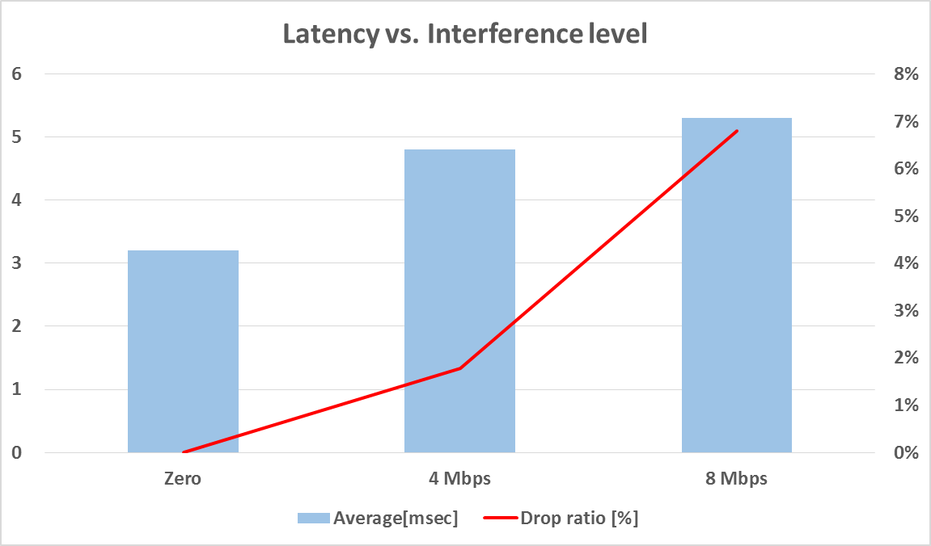
Simulation Result for SS1
Real Time Streaming

Slide 10
Observation
Even though transmission rate is above 340 Mbps (MCS 7 at 996 tones RU), it can be challengeable in OBSS environment that supporting real time streaming traffic which has bounded latency (10msec) with 150 Mbps rate at application layer

Slide 11
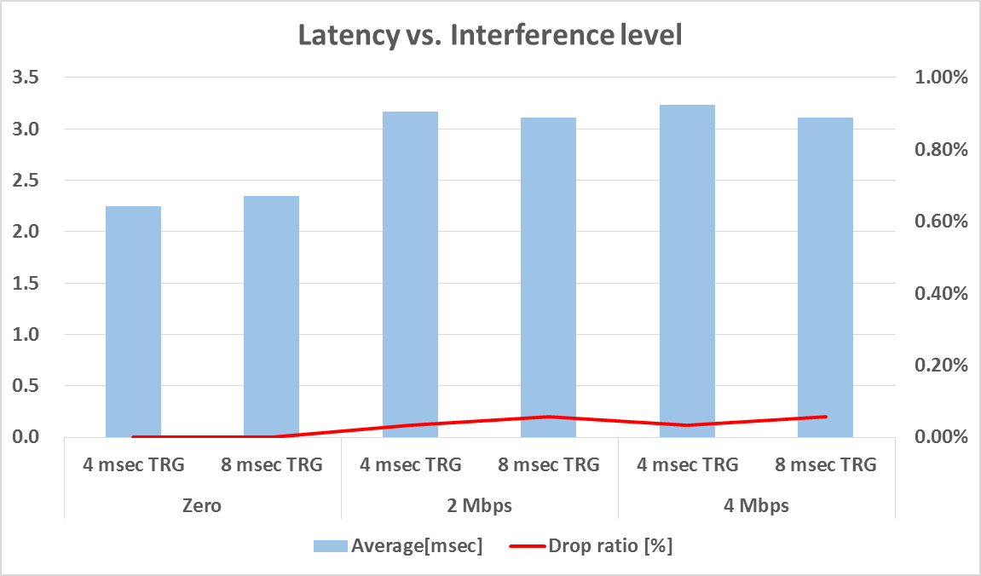
Simulation Result for SS2
Cloud Gaming (2 STAs): Downlink performance

Slide 12
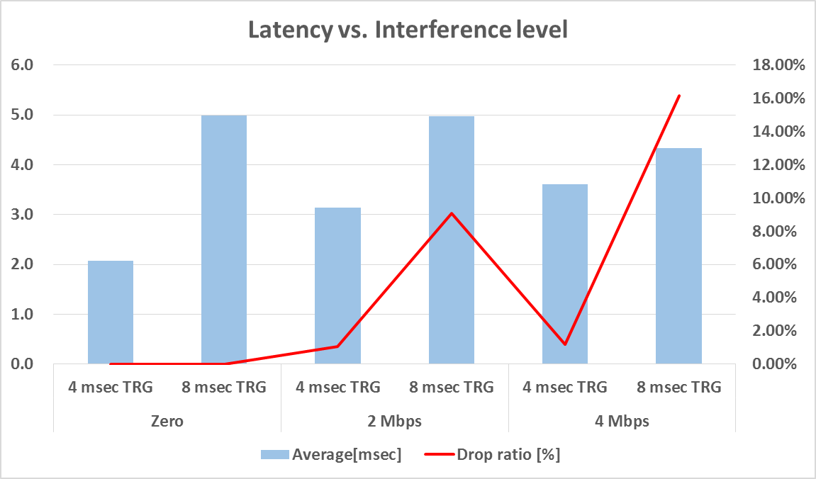
Simulation Result for SS2
Cloud Gaming (2 STAs): Uplink performance

Slide 13
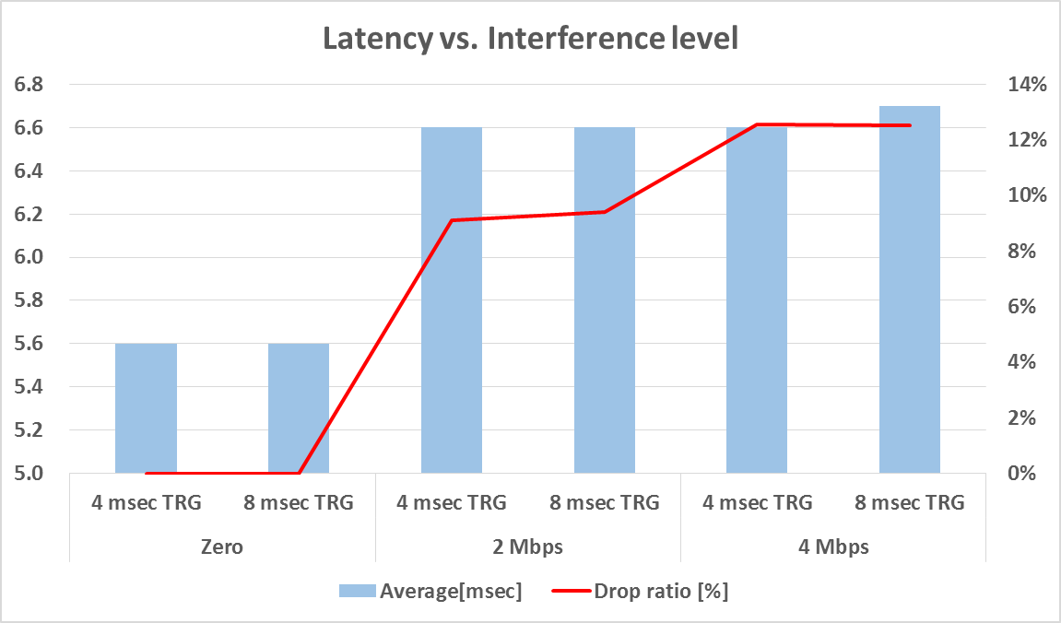
Simulation Result for SS3
Cloud Gaming (4 STAs): Downlink performance

Slide 14
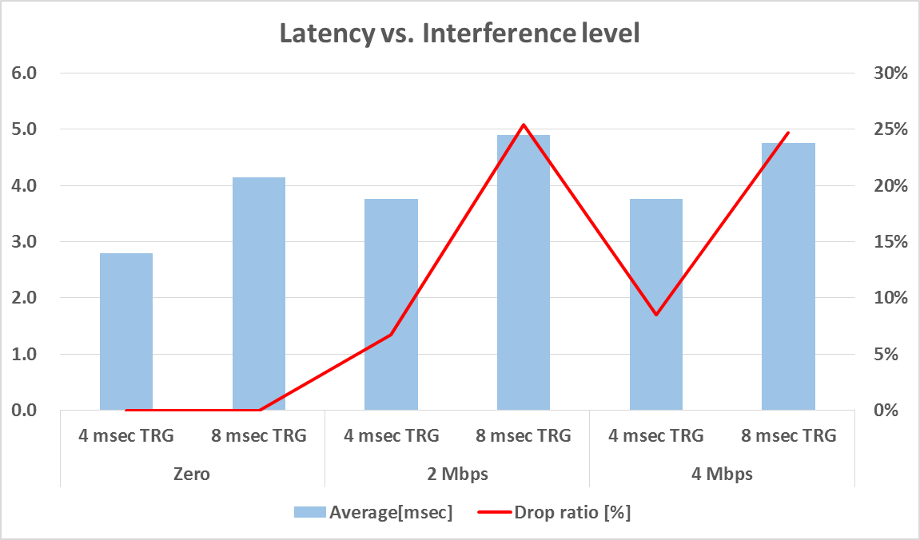
Simulation Result for SS3
Cloud Gaming (4 STAs): Uplink performance

Slide 15
Observations
If there are both DL and UL in the traffic stream, it is much vulnerable to the OBSS environment than DL only case
  Regardless of the data rate, it is difficult to guarantee latency performance in UL than DL
  Supporting 4 STAs is only possible when there is no OBSS interference
A shorter trigger frame duration can improve UL latency, but it is not effective in an dense environment
  No matter how short the duration is, it looks very hard to guarantee UL latency performance unless it is delivered to the specific STAs at the right time
DL latency performance is not significantly affected by the duration of trigger frame until certain level

Slide 16
Summary
We have evaluated that 11ax(OFDMA) can support deterministic service
  We have implemented real time streaming and cloud gaming traffic in OBSS environment
  Supporting deterministic service can be challengeable in OBSS environment regardless of data rate

Slide 17
References
[1] 11-19-0762-01-00be-latency-analysis-for-eht.pptx
[2] 11-19-1298-01-00be-ieee-802-1-tsn-an-introduction.pdf
[3] 11-14-0980-14-00ax-simulation-scenarios.docx
[4] 11-18-2009-06-0rta-rta-report-draft.docx
[5] 11-18-1973-03-0rta-old-and-new-latency-requirements.pptx

Slide 18
Appendix

Slide 19
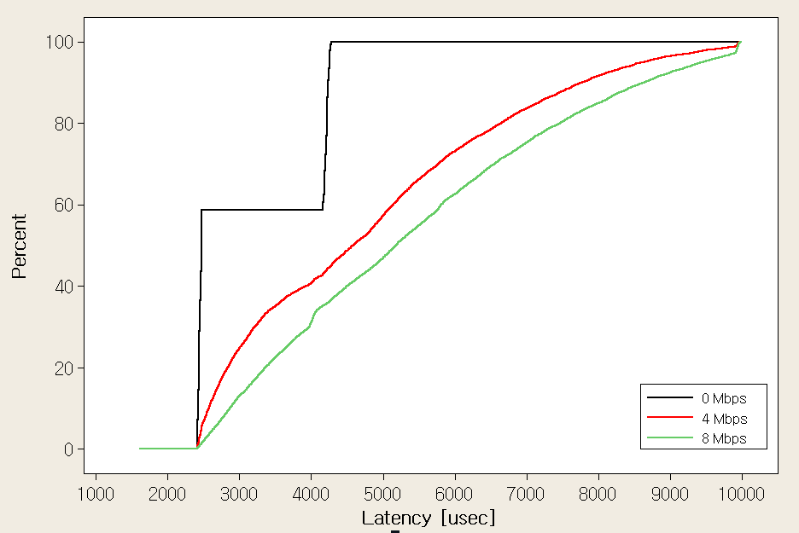
CDF for SS1

Slide 20
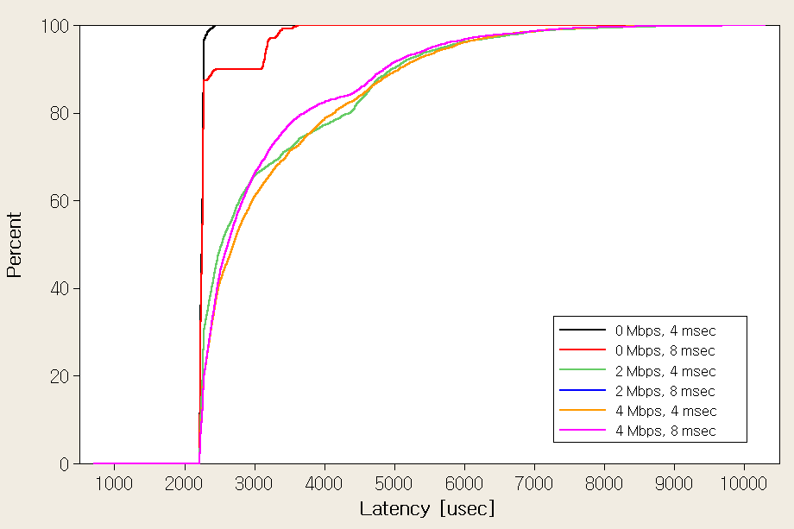
CDF for SS2: DL

Slide 21
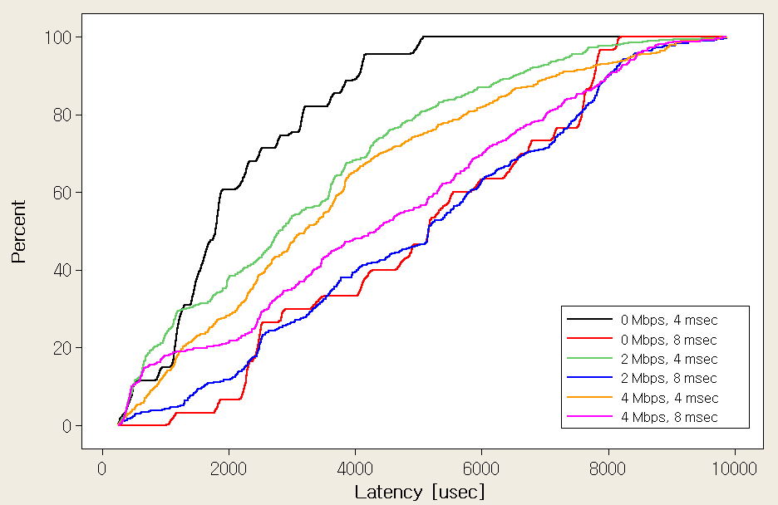
CDF for SS2: UL

Slide 22
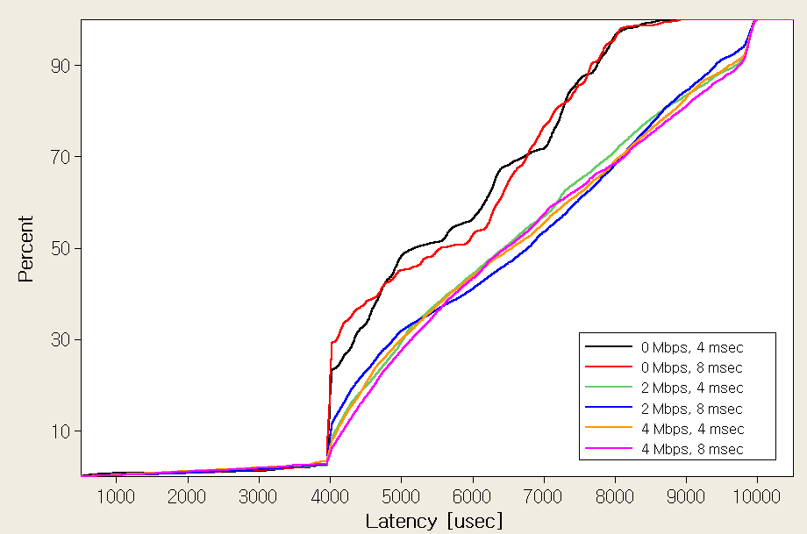
CDF for SS3: DL

Slide 23
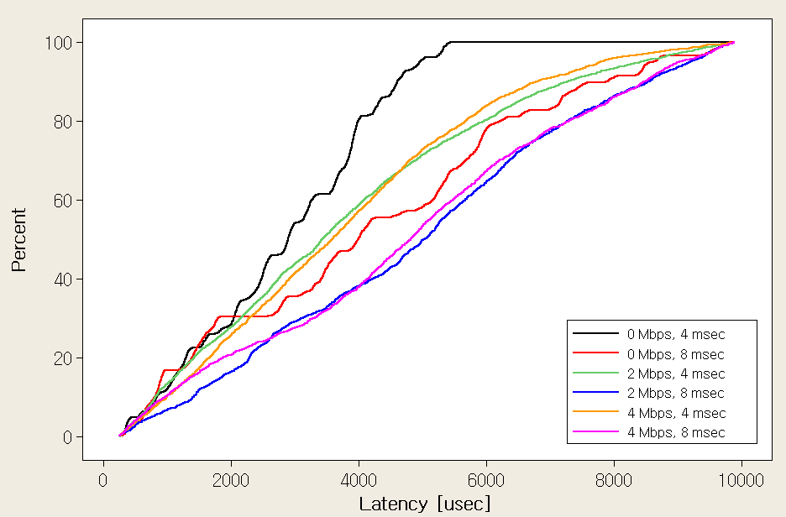
CDF for SS3: UL

