Slide 1
DMG STA Directional Transmit
Activity Report Frame
Date: 2019-09-17
Name | Affiliation | Address | Phone | Email
Payam Torab | Facebook |  |  | torab@ieee.org
Djordje Tujkovic |  |  |  | djordjet@fb.com
Krishna Gomadam |  |  |  | kgomadam@fb.com

Slide 2
Background
It is commonly agreed that high power DMG SP/TDD-SP devices should send some channel occupancy information in the direction of transmission to make alien STAs aware of the operation
  Alien STA in this context: Any STA outside the BS
    EDMG/non-EDMG, TDD/non-TDD, low/high power
  Transmitted frame can be used for different purposes
    Channel switch decisions, interference nulling …
As of Draft 4.1, DMG Beacon frame is used for this purpose
  Activity information: TDD Slot Structure and TDD Slot Schedule elements
There are issues with choice of the frame (DMG Beacon) and contents
We propose a public Action frame – called “DMG STA Directional Transmit Activity Report” for this purpose

Slide 3
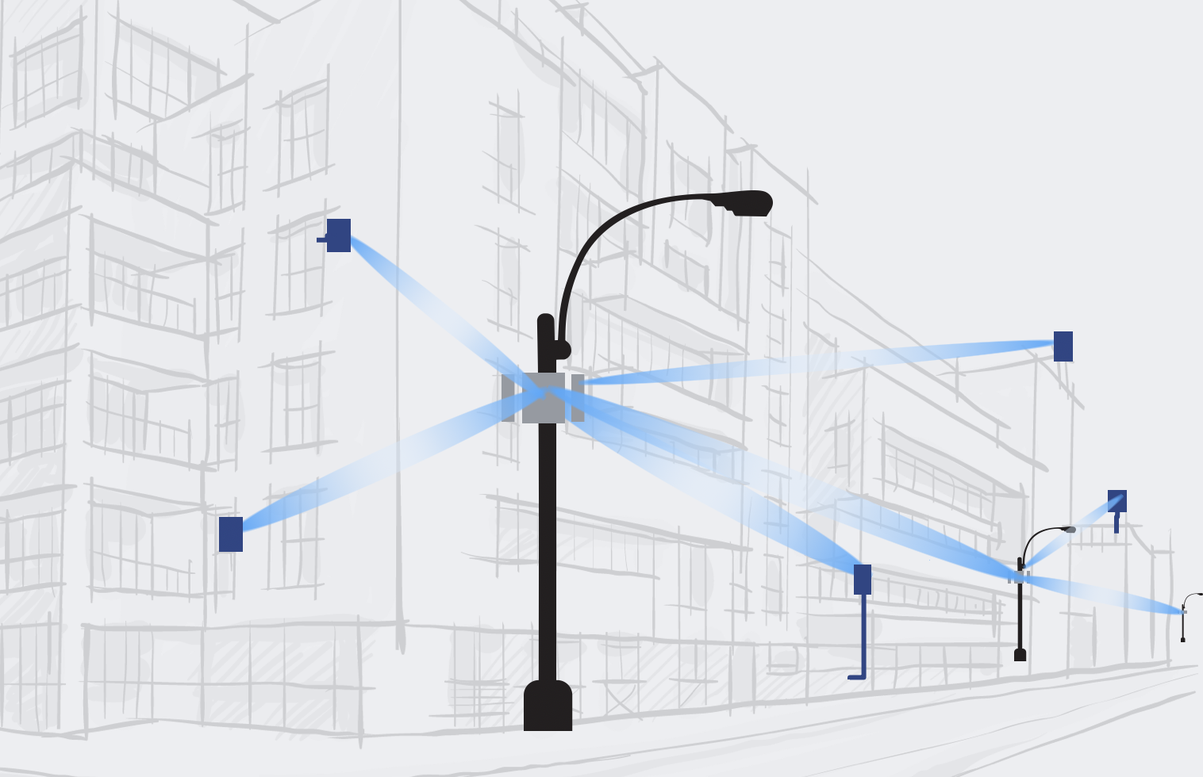
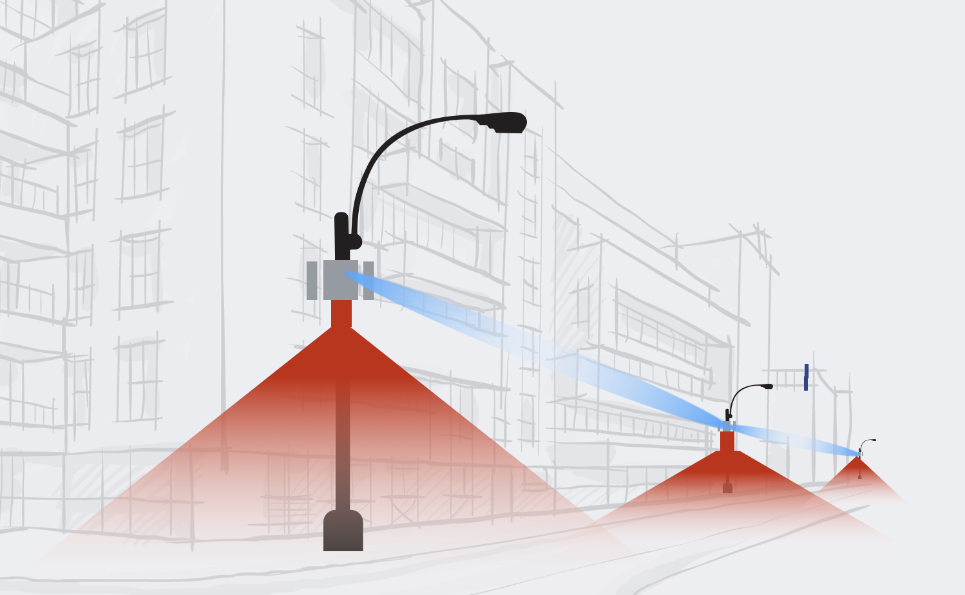
Decoupling beaconing and transmit activity report
DMG Bacon
Sent by AP/PCP only
Using beams optimized for discoverability (admit new STAs for example), information sharing, time synchronization …
  Wide beams and selective directions for example
Using DMG MCS 0
Sent on primary channel
Contents reflect BSS operation
Transmit activity report
Sent by all SP/TDD-SP STAs, independent of network role
  Including non-AP/PCP (e.g., Client Nodes in millimeter-wave distribution use case)
Using the same data (transmit) beam, to protect alien STAs
Transmit schedule and MCS independent of beaconing
  For example, no need to send if there is no transmit activity
Sent on occupied channels
Contents reflect transmit characteristics
  Transmit load (airtime utilization), transmit power, …
Activity report in the same direction as data transmission (using the same beam), sent by all STAs (AP, PCP, non-AP/PCP)
Client
Node (CN)
Non-AP STA
Distribution
Node (DN)
(AP STA)
Client
Node (CN)
Non-AP STA
General beaconing activity for anything (discovery, information sharing, time synchronization ..), sent by AP/PCP only, following general beaconing rules
Distribution
Node (DN)
(AP STA)

Slide 4
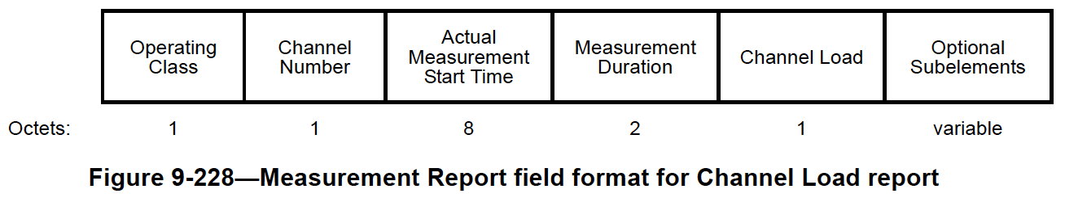

Action frames with similar function: Radio Measurement Report
(Category 5 – Radio Measurement)
Not Public category
Channel load metric is not a function of transmit activity
Radio
Measurement
Report (frame)
Measurement
Report (element)
Measurement Type
= 3 (Channel Load)
Reference: 802.11md Draft 2.4
Channel busy time defined as
when CCA triggered

Slide 5
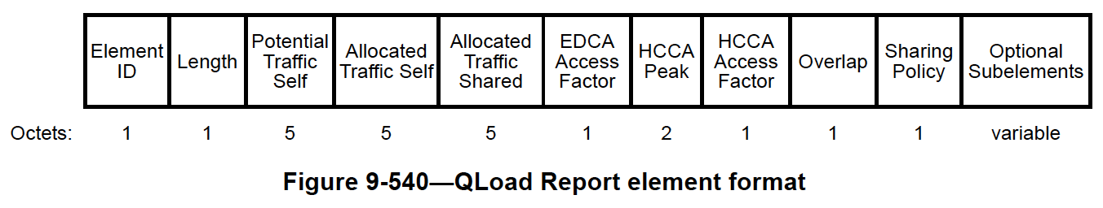
Action frames with similar function: QLoad Report
(Category 4 – Public)
Sent by AP only (meant for AP-AP)
EDCA and HCCA fields and extensions to SP/TDD need to be developed
Information we like to publish is not the crude channel occupancy only
  Radio parameters (TRP), slots, TRN-R…
QLoad
Report
(frame)
QLoad
Report (element)
Measurement Type
= 3 (Channel Load)
Reference: 802.11md Draft 2.4
No subelements defined

Slide 6
New Public Action frame
DMG STA Directional Transmit Activity Report (frame & element)
Public Action frame indicating time, channel and transmission attributes for a given spatial direction; we discuss a tentative formulation
 | Category | Public Action | Timestamp | Operating Class | Channel Bandwidth | Channel Aggregation & Primary Channel | Report Window Start Time | Report Window Duration | DMG STA Directional Transmit Activity Report (element)
Octets: | 1 | 1 | 4/8 | 1 | 1 | 1 | 4 | 4 | Variable
Field | Definition | Example implementation
Timestamp | TSF at the time of transmission
Operating Class Channel Bandwidth Channel Aggregation Primary Channel | Per Table E-1 for DMG (2.16 GHz spacing) (=34) Bitmap defined the same as CH_BANDWIDTH Primary channel of the BSS the device is operating in
Report Window Start Time | Lower 4 octets of the TSF at the beginning of the time period the reported measures apply to | Multiple of 25,600 µs
Report Window Duration | Duration of the time period all reported measures apply to, in µs | Multiple of 25,600 µs
Channel Bandwidth and Channel Aggregation relate to transmit activity during to reporting period, not the frame itself

Slide 7
DMG STA Directional Transmit Activity Report element
Field | Definition, notes | Millimeter-wave Distribution use case Example implementation
Transmit Load | Upper bound on percentage of time transmitting during the observation period; 0 – 255 = 0 – 100% | Sum of actual transmit times (PPDU durations) divided by observation duration
Maximum Transmit Time | Upper bound on continuous transmission time (defined as transmit activity with interframe spacing not exceeding SIFS) during the observation period, in µs | Largest sum of contiguous TDD slots where STA is not assigned a transmit role;200 µs when no better estimate is available, better estimate (tighter bound) available over design iterations
Maximum Quiet Time | Lower bound on maximum quiet time (not transmitting) during the observation period, in µs | Largest sum of contiguous TDD slots where STA is not assigned a transmit role; estimate can be improved (tighter bound) over time
 | Element ID | Length | Element ID Extension | Control | Subelements
Octets: | 1 | 1 | 1 | 1 | Variable
Subelement ID | Name | Extensible
0 | Transmit Activity | Yes
1 | Radio Parameters | Yes
DMG STA Transceiver Parameter element turned into subelement
Transmit PHY parameters can be made more meaningful because they can apply to time of transmitting the frame
 | Subelement ID | Length | Transmit Load | Maximum Transmit Time | Maximum Quiet Time
Octets: | 1 | 1 | 1 | 2 | 2
Field | Definition, notes
TRP | Average TRP during the observation period
G_ADD_SENS | Additional sensitivity at the MCS the frame is transmitted (instead of MCS 0)
 | Subelement ID | Length | TRP | G_ADD_SENS
Octets: | 1 | 1 | 1 | 2

Slide 8
Maximum Transmit Time and Maximum Quiet Time
Example for TDD channel access
Example for non-TDD channel access (potential)
TDD slot schedule during the observation period
Not Assigned
Tx
Not Assigned
Tx
Tx
Tx
Rx
Not Assigned
Rx
Rx
Tx
Maximum Transmit Time
(can be made more accurate by observing PPDU transmissions inside the slots)
Maximum Quiet Time
(can be made more accurate by observing PPDU transmissions in adjacent slots)
observation period
PPDU
Maximum Quiet Time
PPDU
Ack
Maximum Transmit Time

Slide 9
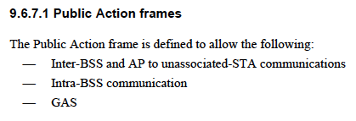
Transmission rules (high-level)
Independent of network role (AP/PCP, non-AP/PCP)
Public Action frame
  Broadcast RA
  Wildcard BSSID (typically, operational BSSID not excluded)
  Class 1, unprotected (not encrypted), can use protected dual category if there is a need
DMG MCS 1 (-68 dBm sensitivity, same as CCA threshold)
  There may be applications (e.g., intra-BSS), where lower or higher MCS can/should be used
Sent in occupied 2.16 GHz channels
  Can be duplicate transmission (does not have to be)
  Channel bandwidth and aggregation fields are for transmit activity, not the frame itself
TRN-R (optional)
Transmit period a dot11 parameter, no transmission if no data

Slide 10
Conclusion
Proposed to decouple beaconing and transmit activity report
Next step is to develop the text

