Slide 1
Preamble Autodetection for 11be
Date: 2019-09-14
Authors:
Name | Company | Address | Phone | Email
Lei Huang | Panasonic Corporation |  |  | lei.huang@sg.panasonic.com
Yanyi Ding
Urabe Yoshio
Rojan Chitrakar

Slide 2
Background
Many contributions have discussed preamble structure and auto-detection scheme for 11be [1]-[4].
It has been proposed that a two-stage autodetection scheme is used for post-HE PPDUs (i.e. EHT PPDUs or beyond) in order to minimize efforts for developing future standards beyond 11be [1][2].
  Stage 1: to identify whether a received PPDU is a post-HE PPDU
  Stage 2: to determine the version of a post-HE PPDU.
We agree the proposed two-stage autodetection scheme is a right direction and this contribution addresses a bit detailed design of the two-stage autodetection scheme.

Slide 3
Two-Stage Autodetection
The two-stage autodetection can be implemented in the following two options:
  Option 1: stages 1 and 2 are performed using two symbols (i.e. SYM1 and SYM2) following the legacy preamble, respectively.
    SYM1 shall be BPSK modulated.
    SYM1 may be a different version of RL-SIG (e.g. inverted L-SIG or sequence masked L-SIG) [3][4] or a signature symbol [5]
    SYM2 contains a few signaling bits to indicate PHY/PPDU version [2]
  Option 2: stages 1 and 2 are performed using a single symbol (i.e. SYM) following the legacy preamble.
    SYM shall be BPSK modulated.
  In our view, Option 2 seems preferable than Option 1 since it enables earlier detection of PHY/PPDU version/format and is addressed in the following.

Slide 4
Autodetection Using a Single Symbol (1/3)
We propose data tones of the SYM are divided into two groups:
  Group 1 consists of N (e.g. N= 24) data tones carrying information for assisting in the identification of a post-HE PPDU
  Group 2 consists of (48-N) data tones carrying a few signaling bits to indicate the version of the identified post-HE PPDU and may also indicate other information, e.g. whether or not HARQ operation is enabled.
    If HARQ operation is disabled for an EHT SU/MU PPDU, the HARQ-SIG field [7] is not present. For proper reception of EHT-STF, it is preferable to have earlier HARQ operation indication.
    In addition, similar to an HE PPDU, the LENGTH field of the L-SIG field in a post-HE PPDU is set to a value which is not divisible by 3, which can be used for differentiation of post-HE PPDU formats.

Slide 5
Auto-detection Using a Single Symbol (2/3)
24 Group 1 data tones are selected such that they are uniformly distributed over frequency domain for better frequency diversity
  The value of a Group 1 data tone is inverted from the value of the corresponding data tone in L-SIG.
Example of Group 1 and Group 2 data tones in SYM:
  Group 1 data tone index (24 tones): {±26, ±24, ±22, ±19, ±17, ±15, ±13, ±11, ±9, ±6, ±4, ±2}
  Group 2 data tone index (24 tones): {±25, ±23, ±20, ±18, ±16, ±14, ±12, ±10, ±8, ±5, ±3, ±1}

Slide 6
Auto-detection Using a Single Symbol (3/3)
Group 2 data tones carry a 12-bit signaling field. For example,
  PHY/PPDU Version (3 bits): indicate the version of a post-HE PPDU
    e.g. 0 for EHT PPDU, 1 to 7 are reserved.
  HARQ Flag (1 bit): indicate whether or not HARQ operation is enabled.
  CRC (2 bits)
  Tail (6 bits)
Transmitter processing of the 12-bit signaling field is similar to L-SIG
  Encode the 12 signaling bits with rate ½ BCC and generate 24 encoded bits.
  Interleave the 24 encoded bits.
  Modulate the 24 interleaved bits with BPSK.
  Mapped the 24 BPSK symbols to the 24 Group 2 data tones.

Slide 7
Example of Detection Procedure at Rx
Step-1: Repetition check on Group 1 data tones of L-SIG and inverted Group 1 data tones of SYM.
Step-2: MRC on Group 1 data tones of L-SIG and inverted Group 1 data tones of SYM and demodulate/decode L-SIG.
Step-3: Content check. For example,
    L-SIG: Rate = 6Mbps, Reserved bit, Parity bit, and L-LENGTH!=3x.
When both steps 1 and 3 pass, 11be or beyond is detected. Otherwise jump back to 11a/n/ac/ax state machine.
This procedure is similar to 11ax and thus has similar detection complexity to 11ax

Slide 8
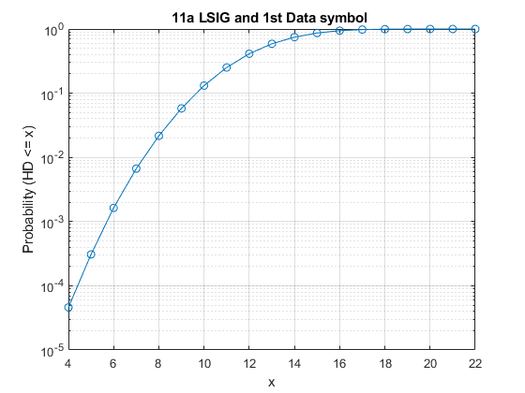
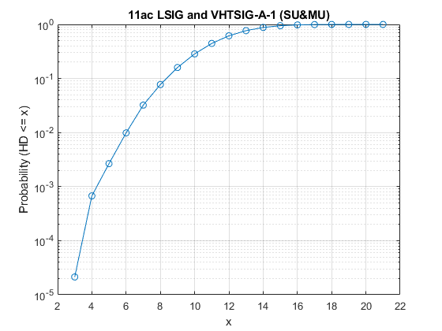
False Detection Analysis
We simulated the distributions of Hamming distance (HD) [6] between Group 1 data tones of 11a L-SIG/11ac L-SIG and inverted Group 1 data tones of 11a first data symbol/11ac VHT-SIG-A1 (3-million cases).
  11a: Minimal HD = 4
  11ac: Minimal HD = 3
If step 1 repetition check has a threshold of 4, the false detection probability at very high SNR is only 4×10⁻⁵ for 11a and 6×10⁻⁴ for 11ac, even without step 3 content check.

Slide 9
Simulation Setting
f_{c} = 5 GHz
20 MHz bandwidth
1/2/4 Tx antennas and 1 Rx antenna
UMi-NLOS and D-NLOS channels (unnormalized)
CSD values per antenna
  [0, -50, -100, -150]ns as in 11ax/11ac
Actual 40ppm CFO and phase/CFO tracking
Actual timing
Frequency domain repetition check based on the HD of coded bits with a threshold of 8 for 11ax and 4 for the proposed scheme

Slide 10
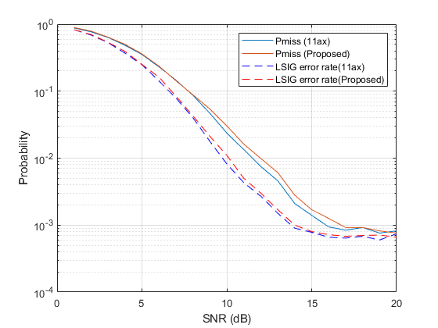
Simulation Results (1×1, UMi-NLOS)
L-SIG error rate gap: 0.4 dB
Pmiss gap: 0.5 dB
(Pfalse = 0)

Slide 11
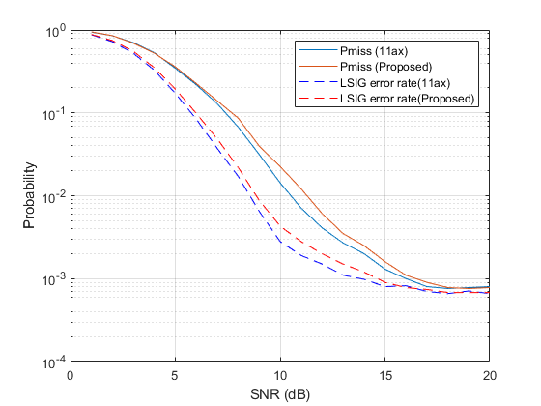
Simulation Results (2×1, UMi-NLOS)
L-SIG error rate gap: 0.4 dB
Pmiss gap: 0.7 dB
(Pfalse = 0)

Slide 12
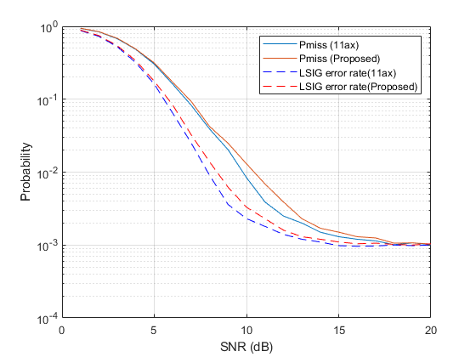
Simulation Results (4×1, UMi-NLOS)
L-SIG error rate gap: 0.5 dB
Pmiss gap: 0.6 dB
(Pfalse = 0)

Slide 13
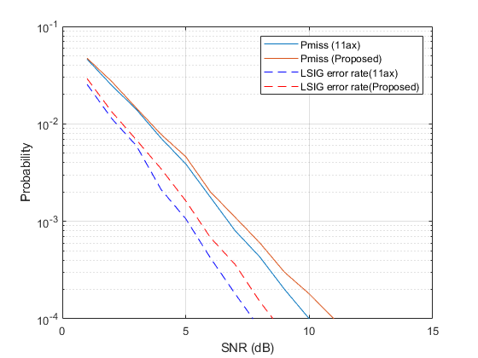
Simulation Results (1×1, D-NLOS)
L-SIG error rate gap: 0.5 dB
Pmiss gap: 0.5 dB
(Pfalse = 0)

Slide 14
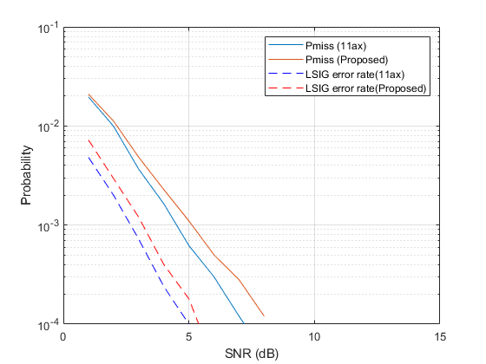
Simulation Results (2×1, D-NLOS)
L-SIG error rate gap: 0.5 dB
Pmiss gap: 0.6 dB
(Pfalse = 0)

Slide 15
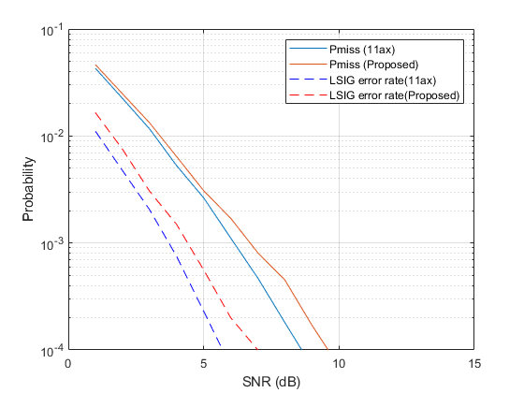
Simulation Results (4×1, D-NLOS)
L-SIG error rate gap: 0.7 dB
Pmiss gap: 0.6 dB
(Pfalse = 0)

Slide 16
Summary
The proposed scheme is backward compatible and has similar complexity to 11ax.
The proposed scheme enables earlier detection of PHY/PPDU version and HARQ-SIG presence.
The performance gap between 11ax and the proposed scheme is not significant in both indoor and outdoor channels.
  The proposed scheme enjoys 1.5x repetition gain and frequency diversity gain.

Slide 17
Reference
11-19-1021-01-00be-preamble-design-harmonization
11-19-1085-00-00be-high-level-eht-preamble-structure
11-19-1099-00-00be-preamble-structure-in-11be
11-19-1142-00-00be-discussion-on-the-preamble-for-11be
11-15-0643-00-00ax-autodetection-with-signature-symbol
11-15-0579-04-00ax-preamble-design-and-autodetection
11-19-0873-01-00be-harq-framing

