Slide 1
Auto-Detection in 11be
Date: 2019-11-10
Authors:
Name | Affiliation | Address | Phone | Email
Hyobin Yim | Newratek |  |  | hb.yim at newratek.com
Si-Chan Noh | Newratek |  |  | sc.noh at newratek.com
Yujin Noh | Newracom |  |  | yujin.noh at newracom.com

Slide 2
Introduction
To support 11be, the basic requirements is backward compatibility and coexistence with legacy device
In [1], [2], EHT preamble design criteria is discussed
Simple implementation
Support future device extend-ability
We consider the signature symbol which has been previously investigated in [3], to classify between legacy PPDU and 11be format including further future amendments
In this contribution, with simulation results, the signature symbol is taken into account to detect 11be format

Slide 3
Signature Symbol in EHT-SIG
L-STF
L-LTF
L-SIG
RL-SIG
EHT-SIG
EHT-SIG
$$⋯$$
Signature symbol
RL-SIG in 11be PPDU format is under discussion
Signature symbol
Signature sequence (e.g., 3-10 bits) in [2], [3]
Reserved bits or control bits (e.g., 2-9 bits)
CRC can include 8 bits
Tail 6 bits
Number of cases of different signature sequence successfully classify the future device
Fixed n bits for signature sequence support $2^{n}$ PPDU format

Slide 4
RL-SIG in 11be PPDU
Assuming RL-SIG is included in 11be PPDU, 11be devices follow the same auto-detection method which has been adopted until 11ax
After conduct the legacy auto-detection method until 11ax, the 11be devices can classify the PPDU format between 11ax and 11be by checking the signature sequence
In this contribution, we consider the same length field of L-SIG in 11be format as 11ax
Length mod 3!==0
Received PPDU
Repetition Threshold > α
N
MRC & Contents check
N
Legacy
Detection
Y
11a
11n
11ac
Signature
Sequence
check
N
11ax
Y
11be

Slide 5
Simulation Configuration
General configuration:
1-4 TX, 1 RX, 1 SS
# of channel realizations: 10,000
DNLOS, UMi-NLOS channels
Channel power distribution with the total power normalized to 1.
Signature symbol
64 FFT, 0.8 us GI, MCS0
10 or 4 signature sequence bits, 2 or 8 reserved bits
8 CRC bits, 6 tail bits
Impairments
Carrier Frequency Offset : fixed 20 ppm
Rx processing:
Actual timing
CFO estimation and compensation in preamble portion

Slide 6
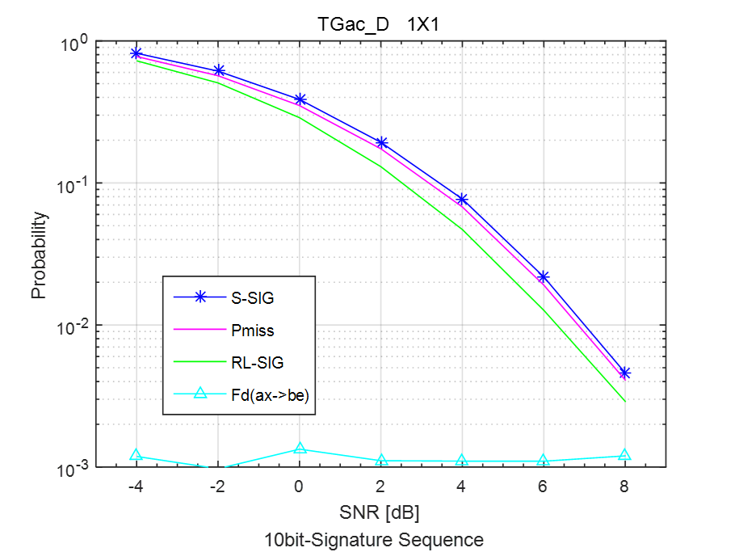
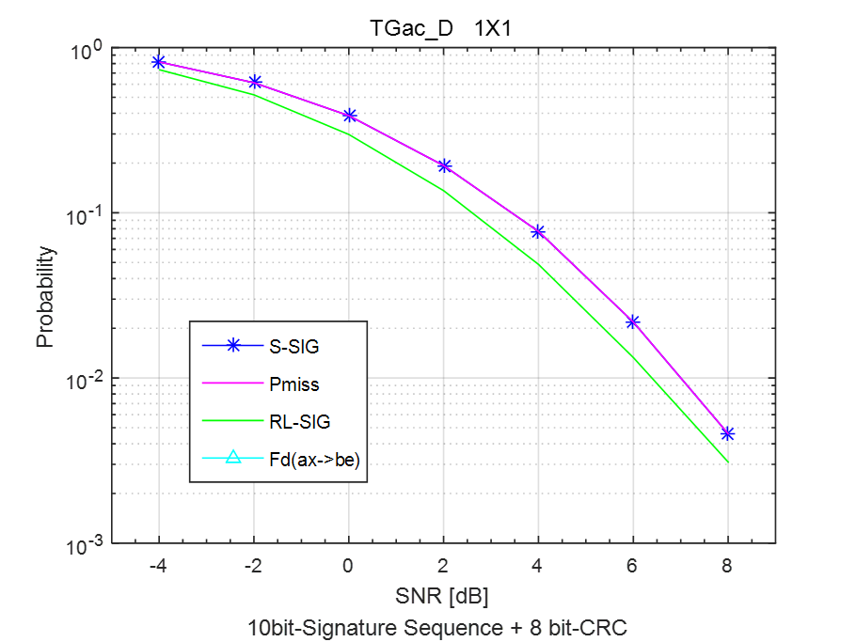
TGac D NLOS (1$×$1)
10 bits in Signature sequence
Probability of false alarm is 10⁻³ without CRC check
Probability of false alarm is below 10⁻⁴ with 8-bit CRC check
CRC check may reduce false alarm rate of 11ax PPDU

Slide 7
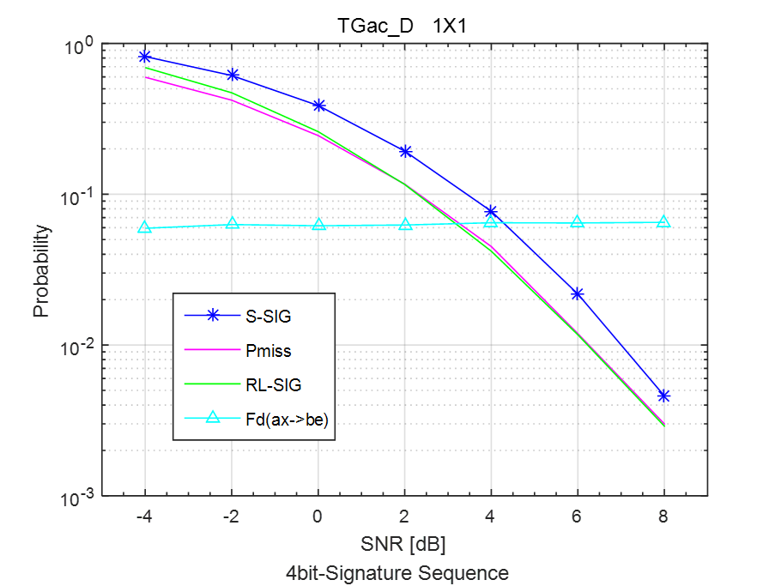
TGac D NLOS (1$×$1)
4 bits in Signature sequence
Probability of false alarm is 10⁻¹ without CRC check
Probability of false alarm is below 10⁻³ with 8-bit CRC check
CRC check may reduce false alarm rate of 11ax PPDU

Slide 8
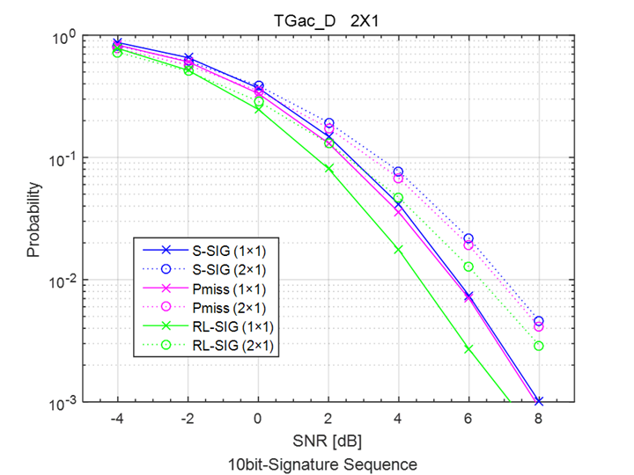
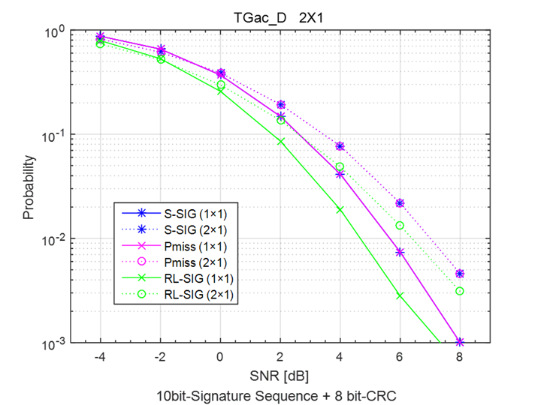
TGac D NLOS (2$×$1)
10 bits in Signature sequence
This scheme shows no serious degradation or other noticeable aspects in multi-antenna transmissions
Without CRC: Compared to 1$×$1, the 2$×$1 has approximately 0.7 dB gain @ 10⁻¹
With CRC : Compared to 1$×$1, the 2$×$1 has approximately 0.7 dB gain @ 10⁻¹
0.7 dB
0.7 dB

Slide 9
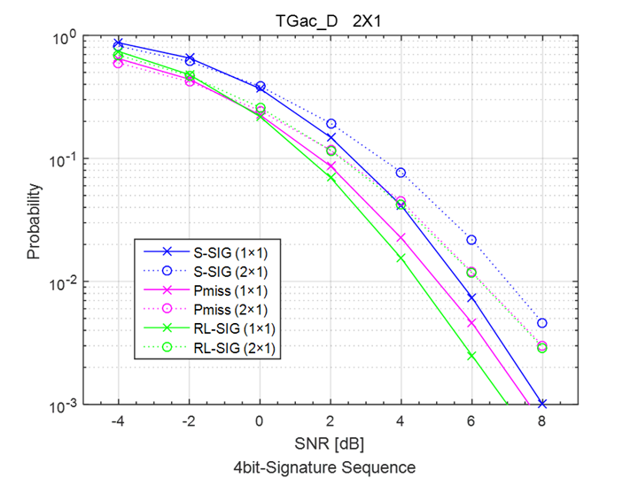
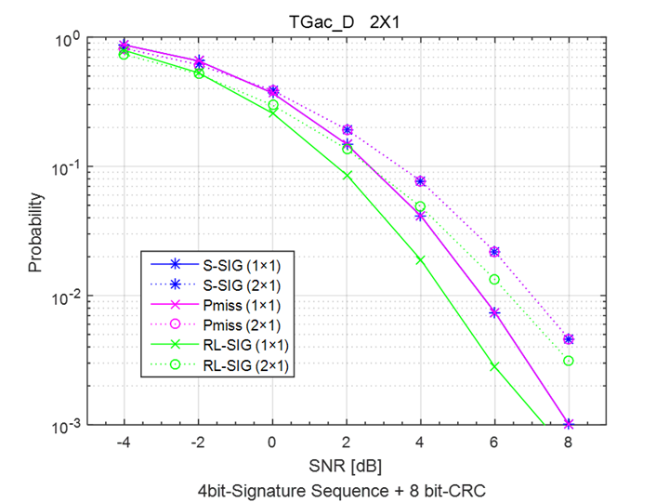
TGac D NLOS (2$×$1)
4 bits in Signature sequence
This scheme shows no serious degradation or other noticeable aspects in multi-antenna transmissions
Without CRC: Compared to 1$×$1, the 2$×$1 has approximately 0.5 dB gain @ 10⁻¹
With CRC : Compared to 1$×$1, the 2$×$1 has approximately 0.7 dB gain @ 10⁻¹
0.5 dB
0.7 dB

Slide 10
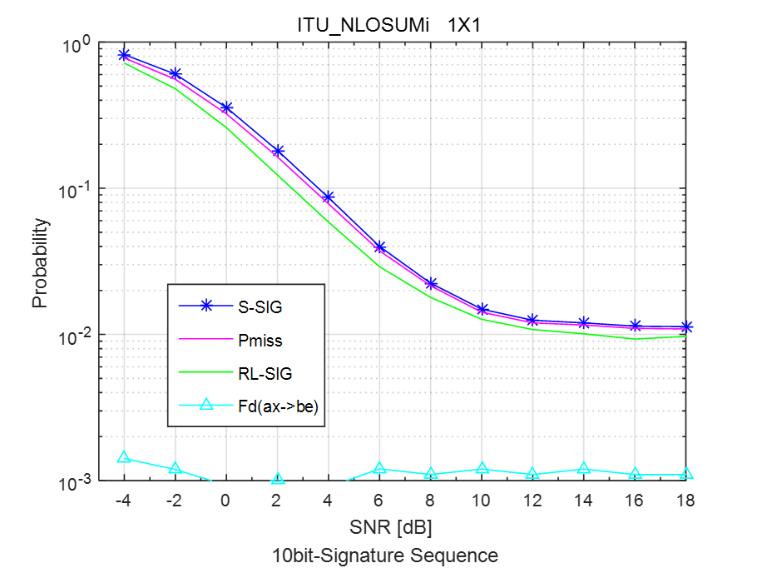
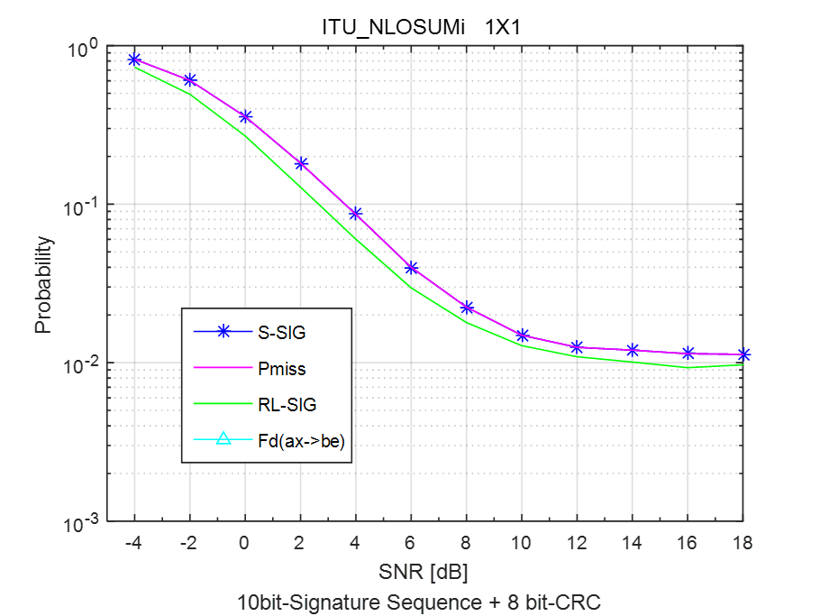
UMi-NLOS (1$×$1)
10 bits in Signature sequence
Probability of false alarm is 10⁻³ without CRC check
Probability of false alarm is below 10⁻⁴ with 8-bit CRC check
CRC check may reduce false alarm rate of 11ax PPDU

Slide 11
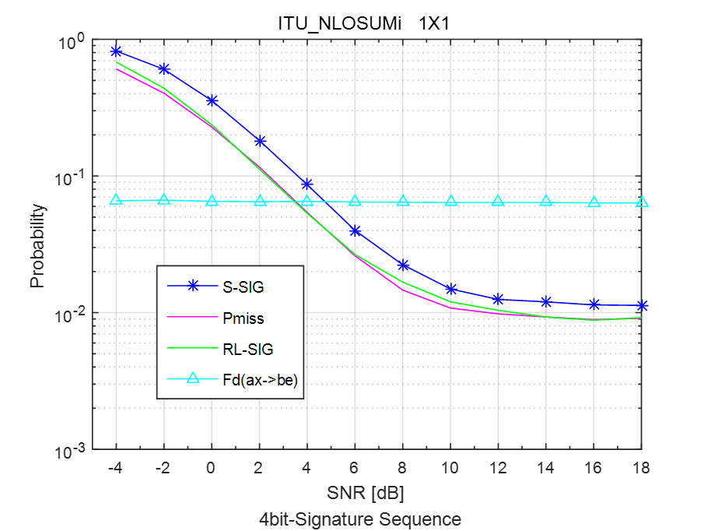
UMi-NLOS (1$×$1)
4 bits in Signature sequence
Probability of false alarm is 10⁻¹ without CRC check
Probability of false alarm is below 10⁻³ with 8-bit CRC check
CRC check may reduce false alarm rate of 11ax PPDU

Slide 12
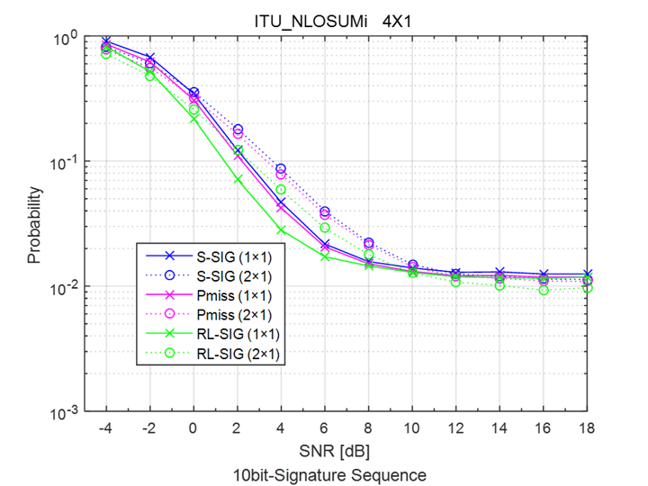
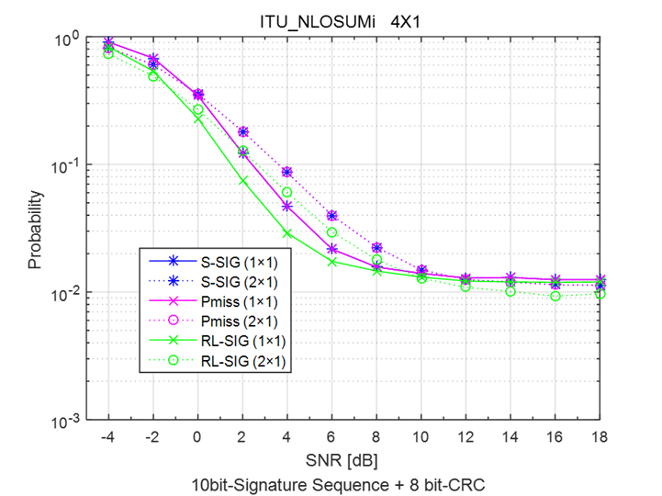
UMi-NLOS (4$×$1)
10 bits in Signature sequence
This scheme shows no serious degradation or other noticeable aspects in multi-antenna transmissions
Without CRC: Compared to 1$×$1, the 4$×$1 has approximately 1 dB gain @ 10⁻¹
With CRC : Compared to 1$×$1, the 4$×$1 has approximately 1 dB gain @ 10⁻¹
1 dB
1 dB

Slide 13
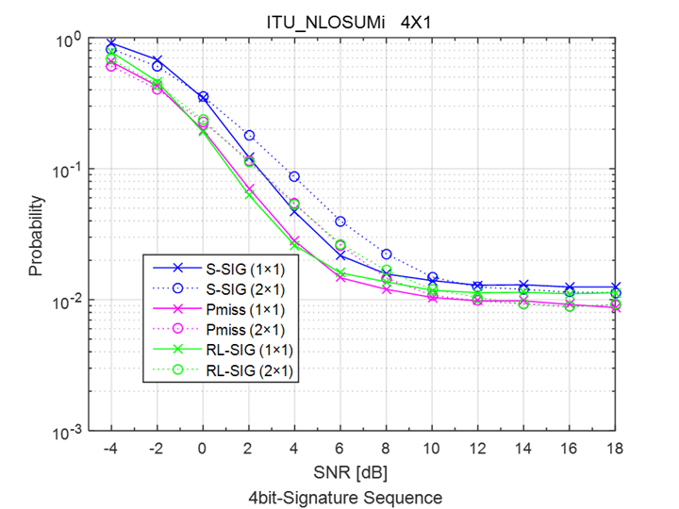
UMi-NLOS (4$×$1)
4 bits in Signature sequence
This scheme shows no serious degradation or other noticeable aspects in multi-antenna transmissions
Without CRC: Compared to 1$×$1, the 4$×$1 has approximately 1 dB gain @ 10⁻¹
With CRC : Compared to 1$×$1, the 4$×$1 has approximately 1 dB gain @ 10⁻¹
1 dB
1 dB

Slide 14
Summary
Signature symbol is simple implementation technology to classify 11be and future standards
Select the signature sequence to detect each format is TBD
The Signature sequence check seems to provide reasonable performance to meet the auto-detection probability

Slide 15
Reference
[1] 11-19/1085r0 High-level EHT Preamble Structure
[2] 11-19/1021r1 Preamble Design Harmonization
[3] 11-15/0643r0 Autodetection with Signature Symbol

Slide 16
APPENDIX

Slide 17
11be and Legacy Format Detection
11a
L-STF
L-LTF
L-SIG
DATA
11n-HT
L-STF
L-LTF
L-SIG
HT-SIG1
HT-SIG2
HT-STF
HT-LTFs, HT-DATA
11n-GT
HT-STF
HT-LTF
HT-SIG1
HT-SIG2
HT-LTFs
HT-DATA
11ac-
VHT
L-STF
L-LTF
L-SIG
VHT-SIGA1
VHT-SIGA2
VHT-STF
VHT-LTFs, VHT-SIGB, VHT-DATA
11ax-
SU/MU/TB
L-STF
L-LTF
L-SIG
RL-SIG
HE-SIGA1
HE-SIGA2
HE-SIGB, HE-STF, HE-LTF, HE-DATA
11ax-
ER SU
L-STF
L-LTF
L-SIG
RL-SIG
HE-SIGA1
HE-SIGA2
HE-SIGA, HE-SIGB, HE-STF, HE-LTF, HE-DATA
11be-
EHT
L-STF
L-LTF
L-SIG
RL-SIG
Signature
EHT-SIG, EHT-STF, EHT-LTF, EHT-DATA
11be-
EHT
L-STF
L-LTF
L-SIG
Signature
EHT-SIG, EHT-STF, EHT-LTF, EHT-DATA
$$⋯$$
$$⋯$$
BPSK
QBPSK
11n-GF: HT-SIG1 QBPSK
11n-HT: LENGTH%3==0, HT-SIG1 and HT-SIG2 QBPSK
11ac VHT: LENGTH%3==0, VHT-SIGA1 BPSK, VHT-SIGA2 QBPSK
11ax SU/MU/TB: LENGTH%3!==0, RL-SIG, HE-SIGA1 and HE-SIGA2 BPSK
11ax ER SU: LENGTH%3!==0, RL-SIG, HE-SIGA1 BPSK, HE-SIGA2 QBPSK
11be EHT: Signature sequence check

