Slide 1
Auto-Detection for 11be
Date: 2019-09-15
Authors:
Name | Affiliation | Address | Phone | Email
Hyobin Yim | Newratek |  |  | hb.yim at newratek.com
Si-Chan Noh | Newratek |  |  | sc.noh at newratek.com
Yujin Noh | Newracom |  |  | yujin.noh at newracom.com

Slide 2
Introduction
To support 11be, the basic requirements is backward compatibility and coexistence with legacy device
In [1], [2], EHT preamble design criteria is discussed
  Simple implementation
  Support future device extend-ability
We consider the signature symbol which has been previously investigated in [3], to classify between legacy PPDU and 11be format including further future amendments
In this contribution, with simulation results, the signature symbol is taken into account to detect 11be format

Slide 3

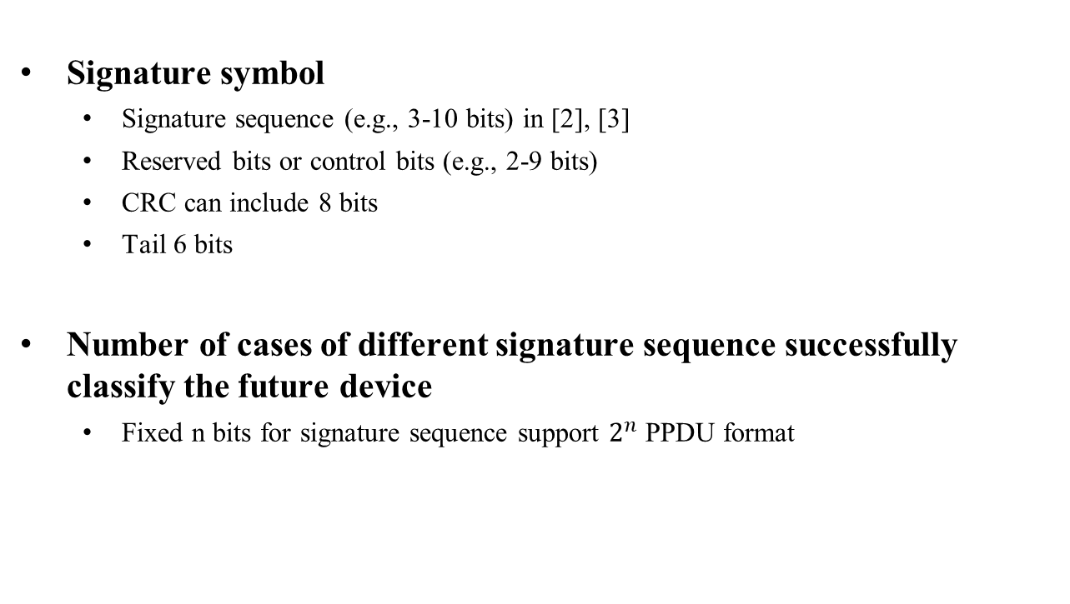
Signature Symbol in EHT-SIG
L-STF
L-LTF
L-SIG
RL-SIG
EHT-SIG
EHT-SIG
$$⋯$$
Signature symbol
Signature symbol
  Signature sequence (e.g., 3-10 bits) in [2], [3]
  Reserved bits or control bits (e.g., 2-9 bits)
  CRC can include 8 bits
  Tail 6 bits
Number of cases of different signature sequence successfully classify the future device
  Fixed n bits for signature sequence support $2^{n}$ PPDU format

Slide 4
Simulation Configuration
General configuration:
  1 TX, 1 RX, 1 SS
# of channel realizations: 10,000
DNLOS, UMi-NLOS channels
  Channel power distribution with the total power normalized to 1.
Signature symbol
  64 FFT, 0.8 us GI, MCS0
  10 or 4 signature sequence bits, 2 or 8 reserved bits
  8 CRC bits, 6 tail bits
Impairments
  Carrier Frequency Offset : fixed 20 ppm
Rx processing:
  Actual timing
  CFO estimation and compensation in preamble portion
  RL-SIG is not considered when detect 11be PPDU format

Slide 5
TGac D NLOS
10 bits in Signature sequence
Probability of false alarm is 10⁻³ without CRC check
Probability of false alarm is below 10⁻⁴ with 8-bit CRC check
CRC check may reduce false alarm rate from legacy PPDU

Slide 6
TGac D NLOS
4 bits in Signature sequence
Probability of false alarm is 10⁻¹ without CRC check
Probability of false alarm is below 10⁻³ with 8-bit CRC check
CRC check may reduce false alarm rate from legacy PPDU

Slide 7
UMi-NLOS
10 bits in Signature sequence
Probability of false alarm is 10⁻³ without CRC check
Probability of false alarm is below 10⁻⁴ with 8-bit CRC check
CRC check may reduce false alarm rate from legacy PPDU

Slide 8
UMi-NLOS
4 bits in Signature sequence
Probability of false alarm is 10⁻¹ without CRC check
Probability of false alarm is below 10⁻³ with 8-bit CRC check
CRC check may reduce false alarm rate from legacy PPDU

Slide 9
Summary
Signature symbol is simple implementation technology to classify 11be and future standards
  Select the signature sequence to detect each format is TBD
The Signature sequence check seems to provide reasonable performance to meet the auto-detection probability

Slide 10
Reference
[1] 11-19/1085r0 High-level EHT Preamble Structure
[2] 11-19/1021r1 Preamble Design Harmonization
[3] 11-15/0643r0 Autodetection with Signature Symbol

Slide 11
APPENDIX

Slide 12


11be and Legacy Format Detection
11a
L-STF
L-LTF
L-SIG
DATA
11n-HT
L-STF
L-LTF
L-SIG
HT-SIG1
HT-SIG2
HT-STF
HT-LTFs, HT-DATA
11n-GT
HT-STF
HT-LTF
HT-SIG1
HT-SIG2
HT-LTFs
HT-DATA
11ac-
VHT
L-STF
L-LTF
L-SIG
VHT-SIGA1
VHT-SIGA2
VHT-STF
VHT-LTFs, VHT-SIGB, VHT-DATA
11ax-
SU/MU/TB
L-STF
L-LTF
L-SIG
RL-SIG
HE-SIGA1
HE-SIGA2
HE-SIGB, HE-STF, HE-LTF, HE-DATA
11ax-
ER SU
L-STF
L-LTF
L-SIG
RL-SIG
HE-SIGA1
HE-SIGA2
HE-SIGA, HE-SIGB, HE-STF, HE-LTF, HE-DATA
11be-
EHT
L-STF
L-LTF
L-SIG
RL-SIG
Signature
EHT-SIG, EHT-STF, EHT-LTF, EHT-DATA
11be-
EHT
L-STF
L-LTF
L-SIG
Signature
EHT-SIG, EHT-STF, EHT-LTF, EHT-DATA
$$⋯$$
$$⋯$$
BPSK
QBPSK
11n-GF: HT-SIG1 QBPSK
11n-HT: LENGTH%3==0, HT-SIG1 and HT-SIG2 QBPSK
11ac VHT: LENGTH%3==0, VHT-SIGA1 BPSK, VHT-SIGA2 QBPSK
11ax SU/MU/TB: LENGTH%3!==0, RL-SIG, HE-SIGA1 and HE-SIGA2 BPSK
11ax ER SU: LENGTH%3!==0, RL-SIG, HE-SIGA1 BPSK, HE-SIGA2 QBPSK
11be EHT: Signature sequence check

