Slide 1
Further Discussion on
Feedback Overhead Reduction
Date: 2020-03-05
Authors:

Slide 2
Introduction
In [1], we showed the benefit of supporting 16 streams
In [2], we showed that beamforming gain of overhead reduction scheme matches with subcarrier level compressed beamforming
In this contribution, we provide our thought further

Slide 3
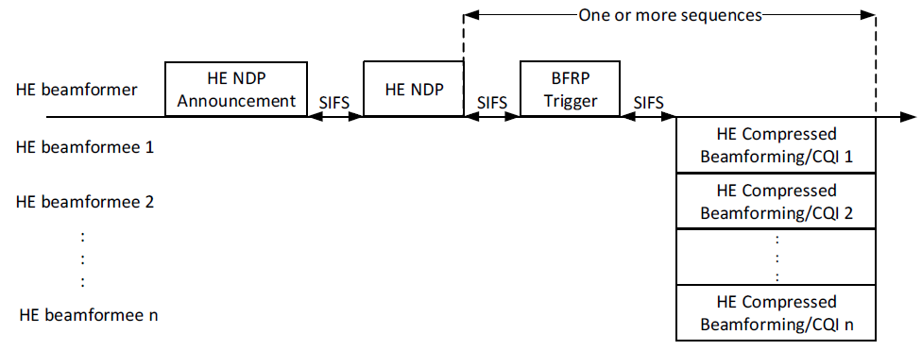
MU Feedback Overhead
We consider following HE MU feedback with 8 STAs
Following is feedback overhead computation
  HE NDP Announcement: 21+4*NumUser(8)=53B, MCS0, Non-HT PPDU: 96us
  HE NDP: 168us (2x HE-LTF)
  BFRP Trigger: 28+6*NumUser(8)=76B, MCS0, Non-HT PPDU: 128us
  SIFS: 3*16=48us
  440us + TB PPDU (8 users with 106-tone RU) (HE Compressed Beamforming)
  See next page for total feedback overhead

Slide 4
Total MU Feedback Overhead
 |  | Total | Nss2, MCS3 | Nss2, MCS4 | Nss2, MCS5 | Nss2, MCS6 | Nss2, MCS7 | Nss2, MCS8 | Nss2, MCS9 | Nss2, MCS10 | Nss2, MCS11
8x2, 80MHz, Ng=4, MU Fine, HE | Baseline | 6752B | 2640us | 1936us | 1584us | 1456us | 1360us | 1232us | 1152us | 1088us | 1024us
16x2, 80MHz, Ng=4, MU Fine, HE | Baseline | 14752B | 5152us | 3600us | 2832us | 2576us | 2368us | 2064us | 1904us | 1760us | 1632us
 | DR, K=8, 5MHz | 9696B | 3568us | 2544us | 2048us | 1872us | 1744us | 1536us | 1440us | 1328us | 1248us
 | DR, K=8, 10MHz | 8224B | 3104us | 2240us | 1808us | 1664us | 1552us | 1376us | 1296us | 1216us | 1136us
 | DR, K=4, 5MHz | 4480B | 1920us | 1456us | 1216us | 1152us | 1088us | 992us | 944us | 896us | 864us
 | DR, K=4, 10MHz | 3616B | 1648us | 1280us | 1088us | 1024us | 976us | 896us | 864us | 816us | 800us
 | 1% Required SNR |  | 4.2dB | 7.3dB | 11.3dB | 12.6dB | 14.0dB | 18.0dB | 19.8dB | 23.6dB | 26.0dB
1% Required SNR computed based on following assumptions: 2Tx STA, 16Rx AP, TGbe channel D [3], packet size 4000B, with all impairments and compensations.
See Appendix for detail dimension reduction (DR) scheme.

Slide 5
MU System Performance
Assume 10dB power difference in downlink and uplink
Best performance chosen from 5ms, 10ms, 20ms and 40ms feedback period for each scheme
In case of 16 antenna MU, feedback periodicity should be 5-10ms
Dimension reduction scheme shows 2-3dB better than conventional compressed beamforming scheme thanks to smaller overhead while maintaining beamforming gain
See appendix for more simulation result

Slide 6
SU Feedback Overhead
We consider following HE SU feedback
Following is feedback overhead computation
  HE NDP Announcement: 21+4*NumUser(1)=25B, MCS0, Non-HT PPDU: 60us
  HE NDP: 168us (2x HE-LTF)
  SIFS: 2*16=32us
  260us + HE SU PPDU (HE Compressed Beamforming)
  See appendix for total feedback overhead

Slide 7
SU System Performance
Assume 10dB power difference in downlink and uplink
Best performance chosen from 5ms, 10ms, 15ms, 20ms, 40ms and 80ms feedback period for each scheme
In case of 16 antenna SU, feedback periodicity can be as large as 15-20ms
In this case, performance gain due to feedback overhead reduction is minimal
See appendix for more simulation result

Slide 8
Revision 1- PER comparison
In addition to throughput comparison, we further evaluated packet error rate comparison including all impairments and compensation method
Following is simulation assumption
  CFO: 20ppm
  PN: 0.2degree at both transmitter (each AP has different PN) and receiver
  Ntx: 16 or 2x8 (two of 8 antenna APs)
  Nrx: 2
  Number of STA: 6 (fixed scheduling)
  MCS 6
  BW: 80MHz or 20MHz
  PPDU length 1500B (for 80MHz) or 15000B (for 20MHz)
  Ng = 4, 8 (not in 11ax) and 16
  All other multi-AP impairments defined in [4]

Slide 9
Simulation Results (PER)
N_{TX} = 16, N_{RX} = 2, 6 STAs fixed allocation, N_{SS} = 2 each total 12 streams, MCS6
N_{TX} = 16 or 2x8, N_{RX} = 2, 6 STAs fixed allocation, N_{SS} = 2 each total 12 streams, MCS6, 1.2ms PPDU length

Slide 10
Discussions
In case of SU, conventional compressed beamforming overhead is not affecting overall performance much
  Feedback periodicity can be longer than MU-MIMO
  Overhead itself is smaller than MU-MIMO feedback
In case of MU, we need an overhead reduction scheme
  In 16x2 MU-MIMO case, overhead reduction scheme provides 2-3dB gain over conventional compressed beamforming feedback
We propose to have an overhead reduction scheme focusing on MU-MIMO feedback with number of stream (Nc) 1-4

Slide 11
Straw Poll #1
Do you support to define a compressed beamforming feedback in 11be for following cases?
  Number of streams: 1-16
  Number of antennas: 2-16
  Note: Compressed beamforming feedback is defined in 19.3.12.3.6 of 802.11-2016. Number of streams is Nc in equation 19-79 of 802.11-2016. Number of antennas is Nr in equation 19-79 of 802.11-2016.

Slide 12
Straw Poll #2
Do you support to define a mechanism to reduce the explicit beamforming feedback overhead for 9-16 antennas in 11be compared to the compressed beamforming feedback defined in 19.3.12.3.6 of 802.11-2016?
  Focusing on MU-MIMO feedback with maximum 4 streams

Slide 13
Reference
[1] 11-18/1575r0, “Further study on potential features”
[2] 11-19/1018r1, “Feedback Overhead Reduction”
[3] 11-19/0719r1, “TGbe channel model document”
[4] 11-19/1597r0, “Cumulative impact of multiple impairments on JT performance”

Slide 14

Dimension Reduction Scheme
Wideband/sub band beamforming feedback combined with subcarrier beamforming feedback with reduced dimension
  Wideband/sub band beamforming matrix could has dimension N_{TX} × K where N_{TX} is Number of transmit antennas and K is design parameter for dimension reduction. This is to project the space of channel H to its K dimensional principal subspace.
  Subcarrier beamforming feedback will have reduced dimension N_{RX} × K
Feedback Wideband beamforming matrix $V_{WB}$ of N_{TX} × K
For each sub carrier/group of subcarriers,
feedback beamforming matrix $V_{sc}$ of N_{RX} × K

Slide 15
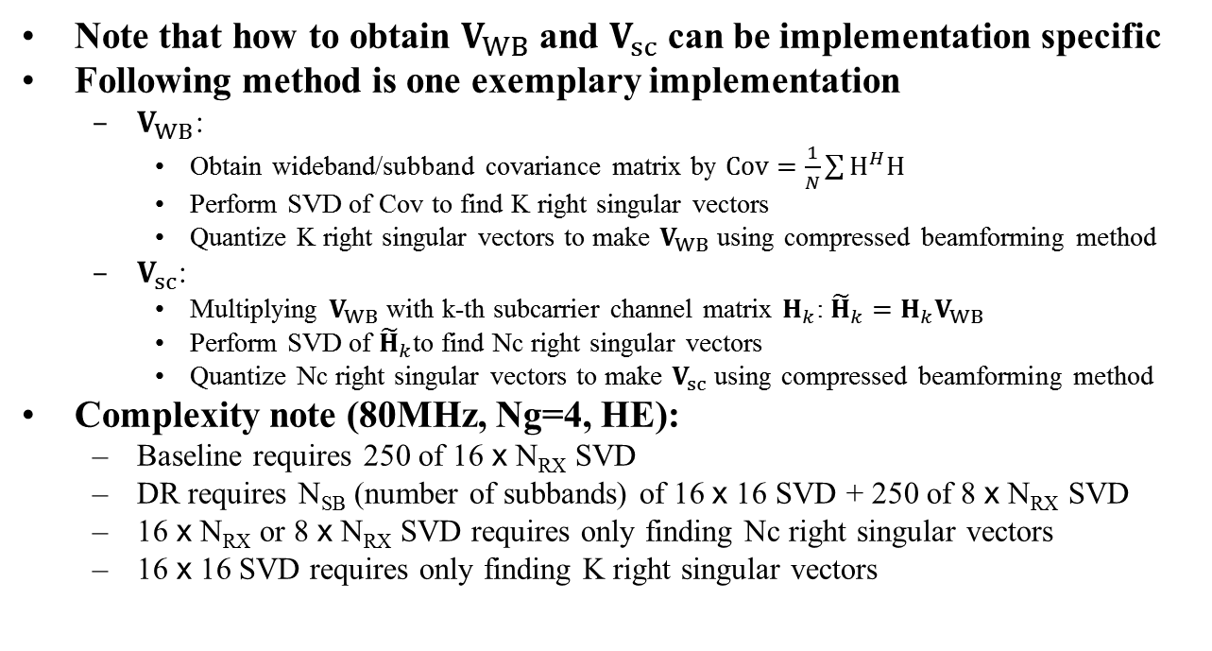
Example Implementation of DR
Note that how to obtain $V_{WB}$ and $V_{sc}$ can be implementation specific
Following method is one exemplary implementation
  $V_{WB}$:
    Obtain wideband/subband covariance matrix by $Cov=\frac{1}{N}\sum{H^{H}H}$
    Perform SVD of Cov to find K right singular vectors
    Quantize K right singular vectors to make $V_{WB}$ using compressed beamforming method
  $V_{sc}$:
    Multiplying $V_{WB}$ with k-th subcarrier channel matrix $H_{k}$: ${\tilde{H}}_{k}=H_{k}V_{WB}$
    Perform SVD of ${\tilde{H}}_{k}$to find Nc right singular vectors
    Quantize Nc right singular vectors to make $V_{sc}$ using compressed beamforming method
Complexity note (80MHz, Ng=4, HE):
  Baseline requires 250 of 16 x N_{RX} SVD
  DR requires N_{SB} (number of subbands) of 16 x 16 SVD + 250 of 8 x N_{RX} SVD
  16 x N_{RX} or 8 x N_{RX} SVD requires only finding Nc right singular vectors
  16 x 16 SVD requires only finding K right singular vectors

Slide 16
Detail MU Simulation Results

Slide 17
Total SU Feedback Overhead
 |  | Total | Nss2, MCS3 | Nss2, MCS4 | Nss2, MCS5 | Nss2, MCS6 | Nss2, MCS7 | Nss2, MCS8 | Nss2, MCS9 | Nss2, MCS10 | Nss2, MCS11
8x2, 80MHz, Ng=4, SU Fine, HE | Baseline | 4064B | 472us | 424us | 408us | 392us | 392us | 376us | 376us | 376us | 360us
16x2, 80MHz, Ng=4, SU Fine, HE | Baseline | 14502B | 808us | 648us | 568us | 552us | 520us | 488us | 472us | 456us | 456us
 | DR, K=8, 5MHz | 5904B | 536us | 472us | 440us | 424us | 408us | 408us | 392us | 392us | 376us
 | DR, K=8, 10MHz | 4984B | 504us | 440us | 424us | 408us | 408us | 392us | 392us | 376us | 376us
 | DR, K=4, 5MHz | 2644B | 424us | 392us | 376us | 376us | 376us | 360us | 360us | 360us | 360us
 | DR, K=4, 10MHz | 2104B | 408us | 376us | 376us | 360us | 360us | 360us | 360us | 360us | 360us
 | 1% Required SNR |  | 4.2dB | 7.3dB | 11.3dB | 12.6dB | 14.0dB | 18.0dB | 19.8dB | 23.6dB | 26.0dB
1% required SNR is from MU feedback result. Difference will be small.

Slide 18
Detail SU Simulation Results

