Slide 1
Discussion on Multiple Frame Transmission in 11bd
Date: 2019-09-16
Authors:
Name | Affiliation | Address | Phone | Email
Insun Jang | LG Electronics | 19, Yangjae-daero 11gil, Seocho-gu, Seoul 137-130, Korea |  | insun.jang@lge.com
Dongguk Lim |  |  |  | dongguk.lim@lge.com
Jinsoo Choi |  |  |  | js.choi@lge.com
Jeongki Kim |  |  |  | jeongki.kim@lge.com
Eunsung Park |  |  |  | esung.park@lge.com
Suhwook Kim |  |  |  | suhwook.kim@lge.com

Slide 2
Introduction
In this contribution, we discuss multiple frame transmission in 11bd

Slide 3
Throughput Enhancement in 11bd
11bd has been trying to improve the performance in terms of throughput and range, mainly at the PHY-level
10MHz/20MHz bandwidth 11bd PPDU format (with RL-SIG and high MCS)
At the MAC level, there are some methods to enhance the throughput, e.g., multiple frame transmission and frame aggregation [1]
We focus on the support of multiple frame transmission in 11bd

Slide 4
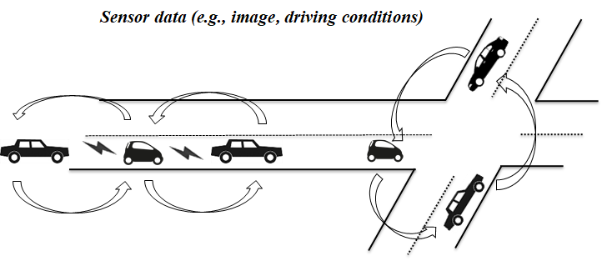
Multiple Frame Transmission
Since 11e, legacy Wi-Fi systems have allowed STAs to exchange multiple frames in a TXOP depending on TXOP limit
Multiple frame transmission can provide several advantages
Reduce channel access delay
Channel usage fairness among STAs (for the same AC)
It would be helpful to support some use cases [2] (e.g., sensor sharing, automated driving, V2V see-through) for requiring the considerable throughput

Slide 5
TXOP limit in 11p
According to 11p, TXOP limit shall be 0 for each AC in OCB mode
“TXOP limit = 0” means the transmission of only one SU PPDU or multiple SU PPDUs only if they’re fragments of an MSDU
11bd STA can have an opportunity to transmit multiple frames in a TXOP, which would require that TXOP limit is set to more than 0

Slide 6
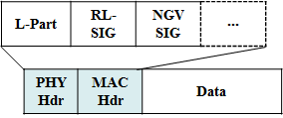
Multiple Frame Transmission in 11bd
OCB Broadcast mode in 11bd
Without Acknowledgement, multiple frames are transmitted with SIFS interval
After transmission, 11bd STA doesn’t know whether frames are received correctly or not
OCB Unicast mode in 11bd
With Acknowledgement and SIFS interval, multiple frames are transmitted
After transmission, 11bd STA can know whether frames are received correctly or not

Slide 7
Issues on Multiple Frame Transmission for OCB broadcast mode
If frames are not transmitted correctly due to the collision, resources are wasted
For example, several 11bd STAs may transmit frames simultaneously

Slide 8
Alternative and STA’s Behavior
As an alternative to improve the reliability by reducing the waste of resources, we can utilize energy detection (ED) channel sensing
How to operate?
Transmitter (TXOP holder)
The transmitter STA first obtain a TXOP before transmitting multiple frames and then transmits the 1st frame
If the state of channel is identified as BUSY during SIFS right after the end of a frame transmission in a TXOP, the transmitter STA doesn’t transmit subsequent frames regardless of the remaining TXOP
Receiver
If the receiver STA receives a frame of the TXOP holder correctly, it saves the address of TXOP holder and TXOP length, and defer channel access until the end of TXOP
During the TXOP, if the receiver STA doesn’t receive a frame during SIFS (+ $α$) right after the end of a frame transmission in a TXOP, it starts channel access regardless of the remaining TXOP

Slide 9
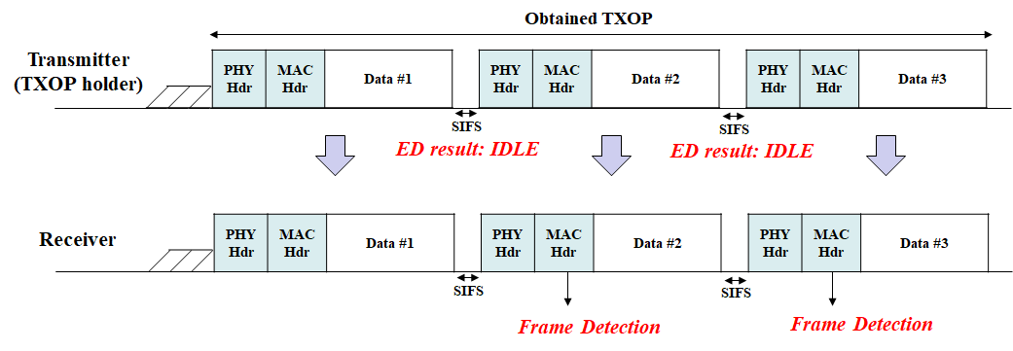
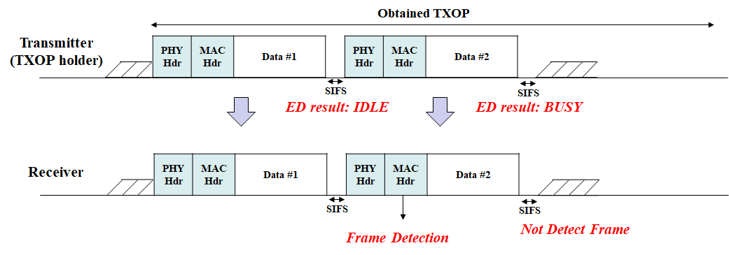
Example of Alternative
All SUCCESS
Case
Partial Fail
Case

Slide 10
Discussion on TXOP limit
TXOP limits can be the same as or different from those legacy Wi-Fi uses according to access category
Upper layer may control the TXOP limit for the fairness depending on channel conditions and allocation, e.g.,
ON/OFF of multiple frame transmission
Adjustment of TXOP limit

Slide 11
Summary
In this contribution, we have discussed multiple frame transmission in 11bd
To enhance throughput, 11bd can support multiple frame transmission in a TXOP
It can be divided into two mode cases, i.e., OCB broadcast mod and OCB unicast mode
In case of multiple frame transmission for OCB broadcast, we introduced an alternative using channel sensing during the interval between frames
It can improve reliability by reducing the waste of resources

Slide 12
SP #1
Do you agree to add the following text into 11bd SFD?
11bd shall support multiple frame transmission in a TXOP when operating on OCB broadcast mode or OCB unicast mode
Y/N/A

Slide 13
SP #2
Do you agree to add the following text into 11bd SFD?
11bd STA as a TXOP holder senses the channel using energy detection (ED) during SIFS right after the end of a frame transmission in a TXOP when operating on OCB broadcast mode
Y/N/A

Slide 14
References
[1] 802.11-19/0375r1 Frame aggregation in P802.11bd
[2] 802.11-19/1342r0 11bd TG Use Cases

