Slide 1
Signaling for Adaptive Repetition of 11p PPDU in 11bd
Date: 2019-09-16
Authors:
Name | Affiliation | Address | Phone | Email
Insun Jang | LG Electronics | 19, Yangjae-daero 11gil, Seocho-gu, Seoul 137-130, Korea |  | insun.jang@lge.com
Dongguk Lim |  |  |  | dongguk.lim@lge.com
Jinsoo Choi |  |  |  | js.choi@lge.com
Jeongki Kim |  |  |  | jeongki.kim@lge.com
Eunsung Park |  |  |  | esung.park@lge.com
Suhwook Kim |  |  |  | suhwook.kim@lge.com

Slide 2
Introduction
TGbd decided to support the adaptive repetition of 11p PPDU when operating on OCB broadcast mode in 10MHz bandwidth [1], [2]
  In this contribution, we call the format including the adaptive repetition of 11p PPDU “repeated PPDU format”
To receive the repeated PPDU efficiently, a signaling for the format is required
  Without signaling, the combining gain cannot be achieved for 11bd STAs
In this contribution, we discuss the signaling and the time gap for the repeated PPDU format
  Signaling includes Signaling information and Signaling method

Slide 3
Signaling Information
There are several possible information for signaling the repeated PPDU format
Repeated Format
  Indicates “Whether this PPDU format is the repeated PPDU format or not”
More r-PPDU
  Indicates “Whether the following PPDU exists or not”
Number of PPDUs
  Indicates “Remaining number of PPDUs”
We can combine “Repeated format” with “More r-PPDU” as an interpretation
  In other words, if repeated format is indicated, it can be also interpreted as the following PPDU exists, otherwise, the following PPDU doesn’t exist

Slide 4
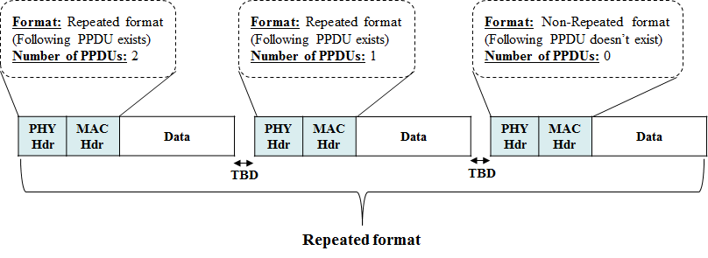
Signaling Information Example
First of all, it would be better to reduce the signaling overhead

Slide 5
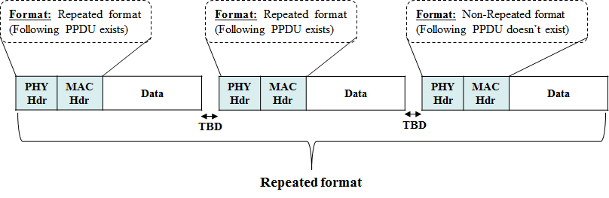
Proposal for Signaling Information
Simple comparison for signaling overhead
We propose to use Repeated format only
  It can indicate the repeated format and the existence of following PPDU
  Only one information minimizes the signaling overhead
Information | Signaling overhead (based on required bits)
Repeated Format | 1bits (including “Whether the following PPDU exists or not”)
Number of PPDUs | >= 1bits (Depending on supported number of repeated PPDUs)

Slide 6
Requirements of Signaling Method
Transmission
  Repeated format shall be transmitted by 11bd STAs only
Reception for 11bd STAs
  PPDUs in Repeated format shall be able to be received (decoded) by 11bd STAs
Reception for 11p STAs
  Each PPDU in Repeated format shall be able to be received (decoded) by 11p STAs, independently

Slide 7

Signaling Method
TGbd decided that Duration/ID field of a frame in an 11p PPDU indicates that transmitter of the PPDU is an NGV capable STA [2]
  Since a transmitter of Repeated format is also an NGV capable STA, Duration/ID field will be specified
Signaling using fields followed by Duration/ID field in MAC header would not be proper because it is redundant, i.e., signaling for repeated PPDU format by itself indicates an NGV capable STA
Not proper

Slide 8
Proposal for Signaling Method
We propose to indicate the signaling information in the Duration/ID field
  It can be associated with the indication of NGV-capability
  It removes the redundancy for indicating NGV capability
We can use two specific values in Duration/ID field, associating Repeated format with NGV capability
  The values shall be less than the interval between PPDUs in the format
    TXOP limit = 0 for 11p, i.e., in a TXOP, only one frame shall be transmitted
  For example, A and B
    A means the following PPDU exists with NGV capability
    B just means NGV capability, which implicitly indicates that the following PPDU does not exist
      B was already included in SFD

Slide 9
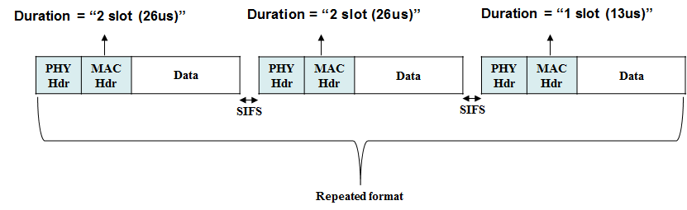
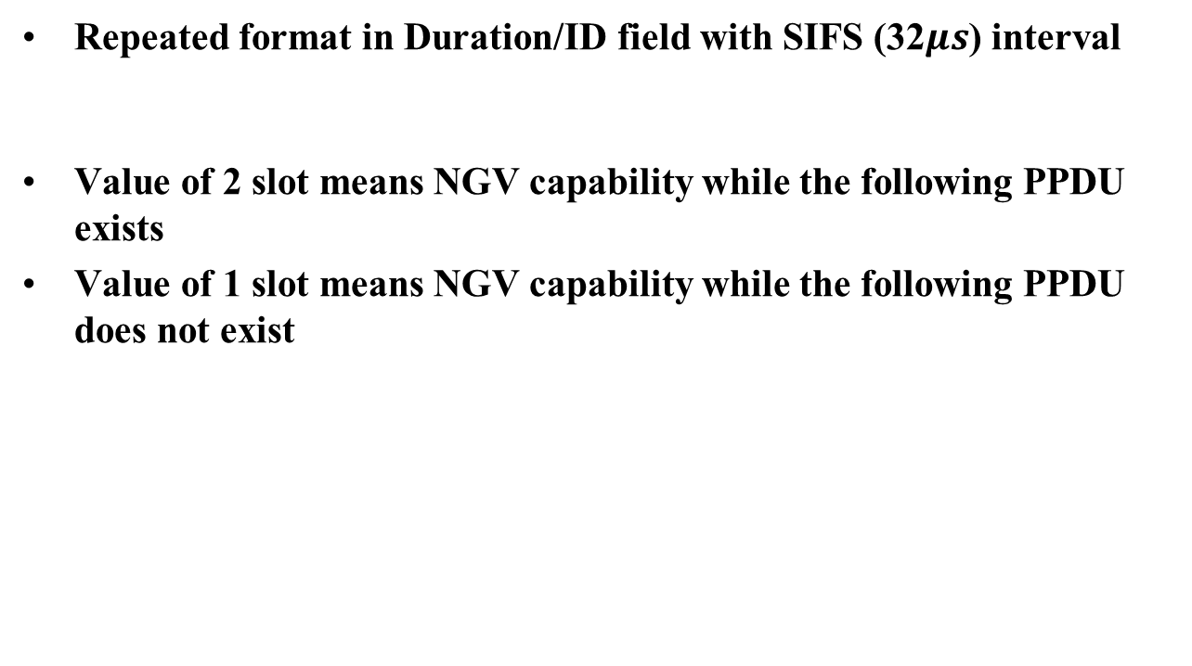
Example of Proposal
Repeated format in Duration/ID field with SIFS (32$μs$) interval
Value of 2 slot means NGV capability while the following PPDU exists
Value of 1 slot means NGV capability while the following PPDU does not exist

Slide 10
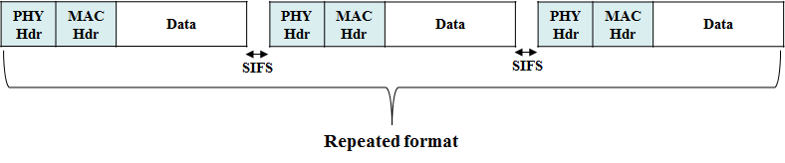
Time Gap between Repeated 11p PPDU
Basically, the time gap should be less than AIFS to avoid the transmission of other STAs during the time gap,
  Legacy Wi-Fi typically uses SIFS interval for multiple frame transmission due to other transmissions of control/management/data frames
It would be proper to use SIFS as the most conservative interval to guarantee the effect of repeated PPDU format
  We cannot expect the future generation of Wi-Fi based V2X (e.g., which frames and which interval will be defined)
We propose to use SIFS as the time gap between repeated 11p PPDU

Slide 11
Summary
In this contribution, we have discussed the signaling method and the signaling information to support the adaptive repetition of 11p PPDU when operating on OCB broadcast mode in 10MHz bandwidth
We proposed to use “Repeated format” including the interpretation of whether the following PPDU exists or not as the signaling information, and indicate it in “Duration/ID field” as the signaling method
  It can reduce the signaling overhead and the redundancy for indicating NGV capability
  It can associate with the indication of NGV-capability
We proposed to use “SIFS” as the time gap between repeated 11p PPDU to guarantee the effect of repeated PPDU format

Slide 12
SP #1
Do you agree to add the following text into 11bd SFD?
  When an 11bd STA transmits repeated 11p PPDUs, each PPDU shall include the information to indicate whether the following PPDU exists or not
Y/N/A

Slide 13
SP #2
Do you agree to add the following text into 11bd SFD?
  When an 11bd STA transmits repeated 11p PPDUs, Duration/ID field of a frame in each PPDU indicates whether the following PPDU exists or not
Y/N/A

Slide 14
SP #3
Do you agree to add the following text into 11bd SFD?
  The time gap between repeated 11p PPDUs is SIFS
Y/N/A

Slide 15
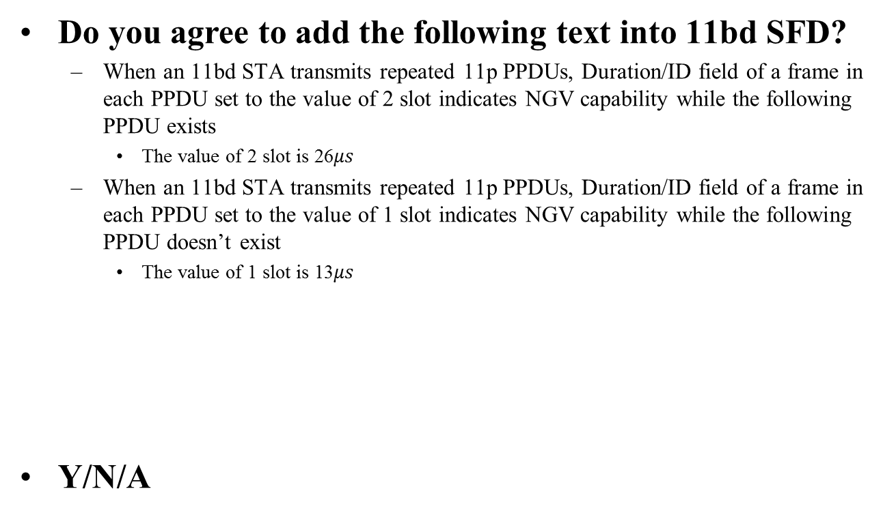
SP #4
Do you agree to add the following text into 11bd SFD?
  When an 11bd STA transmits repeated 11p PPDUs, Duration/ID field of a frame in each PPDU set to the value of 2 slot indicates NGV capability while the following PPDU exists
    The value of 2 slot is 26$μs$
  When an 11bd STA transmits repeated 11p PPDUs, Duration/ID field of a frame in each PPDU set to the value of 1 slot indicates NGV capability while the following PPDU doesn’t exist
    The value of 1 slot is 13$μs$
Y/N/A

Slide 16
References
[1] 802.11-19/1055r1 Adaptive Repetition
[2] 802.11-19/0497r1 802.11bd Specification Framework Document

