Slide 1
Harmonization for 20MHz Channel Access
Date: 2019-09-16
Authors:
Name | Affiliation | Address | Phone | Email
Insun Jang | LG Electronics | 19, Yangjae-daero 11gil, Seocho-gu, Seoul 137-130, Korea |  | insun.jang@lge.com
Dongguk Lim |  |  |  | dongguk.lim@lge.com
Jinsoo Choi |  |  |  | js.choi@lge.com
Jeongki Kim |  |  |  | jeongki.kim@lge.com
Eunsung Park |  |  |  | esung.park@lge.com
Suhwook Kim |  |  |  | suhwook.kim@lge.com

Slide 2
Introduction
There have been several proposals for 20MHz channel access [1]-[4]
  However, any agreements have not been reached
  With this document, we consider harmonization on 20MHz channel access based on members’ opinion/discussion, thus leading to consensus

Slide 3
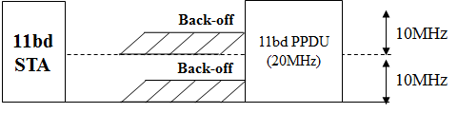
Current Status
Common Preference
  Reducing complexity: Use of a single radio (RF chain, or receiver)
  Two 10MHz sub-channels exist in a 20MHz channel
  Fairness on two 10MHz sub-channels consisting 20MHz channel
    Needs to consider trade-off between fairness and transmission opportunity of 20MHz bandwidth PPDU (i.e., performance of 20MHz transmission)
From our common view, the following channel access is not preferred
  That shall use dual or more radios
  This approach will be excluded in following slides

Slide 4
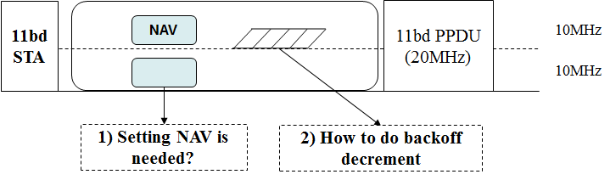
Details for Common Preference
  From “Use of a single radio” and “Two 10MHz sub-channels in a 20MHz channel”, we can draw a conclusion that preamble detection (PD) sensing is used in at least one 10MHz sub-channel
    It means an 11bd STA is capable of setting NAV in at least one 10MHz sub-channel
  From “Fairness on two 10MHz sub-channels”, we can draw a conclusion that two 10MHz sub-channels use the same sensing interval and the same sensitivity level
  Same sensing interval would be AIFS (from existing 10MHz sub-channel access)
  Same sensitivity level would be -85dBm or lower (TBD) (from Motion #6 [6])
Discussion
Points

Slide 5
Considerations on Discussion Points
  Basically, both of fairness and performance of 20MHz are important factors in 20MHz channel access
  Too many weight to one factor rather would deteriorate another factor
  For example, too many weight to the fairness rather decrease the performance of 20MHz transmission
  In other words, the balance between fairness and performance of 20MHz transmission is also important

Slide 6
NAV Setting for Two 10MHz Sub-Channels
  Option 1: NAV setting only for one 10MHz sub-channel
  It would provide fairness equally for one 10MHz sub-channel
  Like legacy Wi-Fi system using wide bandwidth, one 10MHz sub-channel (where NAV is not set) uses guard interval (GI) detection [5] or energy detection (ED)
    Basically, ED/GI sensitivity level is +20/+10dBm higher than PD sensitivity level
  If -85dBm or lower set to them can provide fairness properly to STAs over the channel at the expense of 20MHz transmission
  Option 2: NAV setting for both of 10MHz sub-channels
  It would provide fairness equally for two 10MHz sub-channels
  However, it cannot ensure that NAV setting for both is always possible
    Assuming two 10MHz sub-channels are A and B, during decoding NAV of PPDU in channel A, NAV of another PPDU incoming on channel B cannot be decoded, i.e., cannot set NAV
We prefer Option 1: Because Option 1 can provide the proper fairness by relaxing the sensitivity threshold and sensing interval, and can have a simple implementation while Option 2 has the concern that the case two NAVs cannot be set can occur

Slide 7
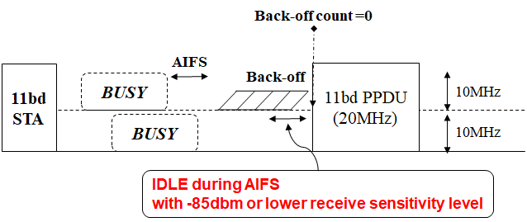
How to Do Back-off Decrement
  Option 1: Based on the channel state of one 10MHz sub-channel
  It follows the backoff procedure of Legacy Wi-Fi system, but AIFS is used instead of PIFS
  Backoff counter decreases depending on the channel state of one 10MHz sub-channel
  When the back-off counter becomes zero and another 10MHz sub-channel was idle during AIFS interval immediately preceding the start of the TXOP with -85dBm or lower receive sensitivity threshold, 20MHz PPDU is transmitted using two 10MHz sub-channels

Slide 8
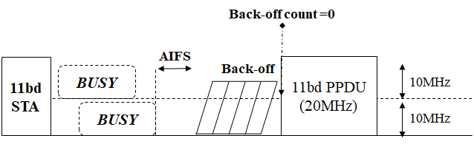
How to Do Back-off Decrement (Cont’d)
  Option 2: Based on the channel state of two 10MHz sub-channels
  It modifies Option 1 with the consideration of additional channel state
  Backoff counter decreases depending on the channel state of two 10MHz sub-channels
    Specific Procedure is needed to be defined
  When the back-off count becomes zero, 20MHz PPDU is transmitted using two 10MHz sub-channels

Slide 9
Discussion on
How to Do Back-off Decrement
  Option 1 can balance the fairness and the performance of 20MHz transmission properly
  Provides fairness equally for 10MHz sub-channel performing back-off
  Provides fairness properly for 10MHz sub-channel not performing back-off
    Uses AIFS in non-backoff channel with -85dBm or receive sensitivity level
    If the channel is BUSY during AIFS, 11bd STA re-starts back-off, which can give an opportunity to access the channel more to 10MHz l1p/11bd STAs
  Option 2 can provide better fairness than Option 1 for 10MHz 11p/11bd STAs
  However, it occurs too long channel access delay, which rather decreases the performance of 20MHz transmission
We prefer Option 1 for balancing the fairness and the performance of 20MHz transmission

Slide 10
Opportunistic 10MHz Transmission
We don’t have strong opinion on opportunistic 10MHz transmission (i.e., 10MHz fallback)
Some concerns should be considered, e.g.,
  Adjacent Channel Interference (ACI)
  Mismatch between upper layer’s indication (i.e., 20MHz transmission) and decisions in 11bd
If some concerns are still unresolved, then it would be better not to permit opportunistic 10MHz transmission

Slide 11
How to Set two 10MHz sub-channels
  As in [1], an 11bd STA can set two 10MHz sub-channels upon request from upper layer
  According to 11p and IEEE 1609, operating channels for channel switching and data transmission are indicated from upper layer using the channel information (e.g., Channel identifier as a parameter which includes Country String, Operating class, Channel Number)
However, we haven’t determined a specific channel access including the role of two 10MHz sub-channels
  We would determine how to set two 10MHz sub-channels after resolving the channel access method

Slide 12
Summary
  We considered harmonization on 20MHz channel access based on members’ opinion/discussion, thus leading to consensus
  Specifically, we divided into two points, i.e., Common preference and Discussion point
  For discussion point, we considered 1) NAV setting for two 10MHz sub-channels and 2) how to do back-off decrement

Slide 13
SP #1
Do you agree to add the following text into 11bd SFD?
  A 20MHz channel includes two 10MHz sub-channels
    11bd STA operating in the 20MHz channel shall be capable of setting NAV in at least one 10MHz sub-channel
    Two 10MHz sub-channels shall use the same sensing interval and the same receive sensitivity level, i.e.,
      Sensing interval is AIFS[AC] where AC is the access category for the frame to be transmitted
      Receive sensitivity level is -85dBm or lower
Y/N/A

Slide 14
SP #2
Do you agree to add the following text into 11bd SFD?
  11bd STA operating in the 20MHz channel shall contend for only one 10MHz sub-channel
    Note that it means that the STA shall maintain and decrement the backoff counter depending on the channel state of only one 10MHz sub-channel and shall be capable of setting NAV in only one 10MHz sub-channel
Y/N/A

Slide 15
SP #3
Do you agree to add the following text into 11bd SFD?
  To transmit 20MHz bandwidth PPDU, an 11bd STA shall perform the following action,
    When the backoff counter of one 10MHz sub-channel becomes zero and another 10MHz sub-channel was idle during AIFS[AC] interval immediately preceding the start of the TXOP with -85dBm or lower receive sensitivity threshold, 20MHz PPDU is transmitted using two 10MHz sub-channels
      AC is the access category for the frame to be transmitted
Y/N/A

Slide 16
References
[1] 802.11-19/1103r0, 20MHz Channel Access in 11 bd: Follow-up
[2] 802.11-19/1156r0, 20MHz channel usage options
[3] 802.11-19/1105r0, Study on 20MHz Channel Access Schemes
[4] 802.11-19/1076r0, medium access with 20MHz BW
[5] 802.11-10/0744r1, Improved CCA for 80 and 160 MHz BSSs
[6] 802.11-19/0514r6, Motion Booklet for IEEE 802.11 TGbd

