Slide 1
NGV 20MHz Spectrum Mask and OFDM Numerology: Followup
Date: 2019-09-16
Authors:

Slide 2
Introduction
20MHz spectrum mask and OFDM numerology was discussed in previous meetings [1, 2].
Straw poll indicates that relaxed mask @f5 (20MHz) frequency point is a preferred option.
We propose the xdB value of relaxation.

Slide 3
20MHz Mask: Recap
Good margin compared to 11p 20MHz mask.
Difficult to meet the tight mask @+/-20MHz frequency.
  Need >6dB more suppression from PA to temperature sweep and max-hold measurment.

Slide 4
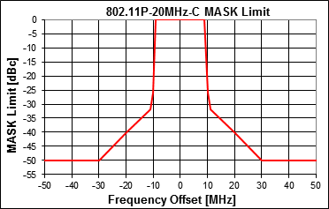
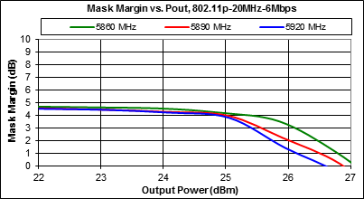
20MHz Spectrum from Skyworks
Skyworks DSRC PA measurement data also shows that there is about 4~4.5dB margin (pwr < 25dBm) compared to 11p 20MHz Class C Mask.
Compared with 10dB extra suppressed in the potential tight mask, the spectrum of PA output waveform is short of ~6dB.

Slide 5
Spectrum Masks Relaxation
xdB
  Based on our measurement and Skyworks data: x > 6dB.

Slide 6
20MHz Spectrum Mask: Class C
 | Permitted power spectrum density, dBr
 | +/-4.5 MHz offset (+/-f1) | +/-5 MHz offset (+/-f2) | +/-5.5MHz offset (+/-f3) | +/-10MHz offset (+/-f4) | +/-15MHz offset (+/-f5)
11p 10MHz | 0 | -26 | -32 | -40 | -50
 | +/-9 MHz offset (+/-f1) | +/-10 MHz offset (+/-f2) | +/-11MHz offset (+/-f3) | +/-20MHz offset (+/-f4) | +/-30MHz offset (+/-f5)
11p 20MHz | 0 | -26 | -32 | -40 | -50
 | Permitted power spectrum density, dBr
 | +/-9.5 MHz offset (+/-f1) | +/-10 MHz offset (+/-f2) | +/-10.5MHz offset (+/-f3) | +/-15MHz offset (+/-f4) | +/-20MHz offset (+/-f5) | +/-25MHz offset (+/-f6)
11bd 20MHz: Mask 1 | 0 | -26 | -32 | -40 | -50 | -50
11bd 20MHz: Mask 2 | 0 | -26 | -32 | -40 | -50 + xdB | -50

Slide 7
ACI Penalty Analysis: 10MHz Channel
  xdB = 6, ACI power increase 0.2dB
  xdB = 8, ACI power increase 0.35dB
  xdB = 10, ACI power increase 0.48dB

Slide 8
11bd 20MHz Mask 2: Class C
A relaxed 20MHz spectrum mask:
  similar spectrum leakage level to adjacent channel as 10MHz spectrum mask
  relaxed the mask by xdB at +/-20MHz (f5).
Choice of relaxation amount:
  Option A: 6dB (barely meet the Class C mask)
  Option B: 8dB (~2dB margin, may allow higher max tx power)
  Option C: 10dB (~4dB margin, may allow higher max tx power)

Slide 9
Reference
[1] Rui Cao and etc., “PHY Numerology Discussions”, IEEE 802.11-19/0686.
[2] Rui Cao and etc., “NGV 20MHz OFDM Numerology Discussions”, IEEE 802.11-19/1072.

Slide 10
Straw Poll 1
Do you agree that the 11bd 20MHz class C spectrum mask shall be defined as?
Option A:
Option B:
Option C:
Abstain:
 | Permitted power spectrum density, dBr
 | +/-9.5 MHz offset (+/-f1) | +/-10 MHz offset (+/-f2) | +/-10.5MHz offset (+/-f3) | +/-15MHz offset (+/-f4) | +/-20MHz offset (+/-f5) | +/-25MHz offset (+/-f6)
Option A | 0 | -26 | -32 | -40 | -44 | -50
Option B | 0 | -26 | -32 | -40 | -42 | -50
Option C | 0 | -26 | -32 | -40 | -40 | -50

Slide 11
Straw Poll 2
Do you agree to add the following text into Section 3 of SFD?
11bd 20MHz PPDU Data symbol shall use 11ac 40MHz OFDM downclock by 2?
Y:
N:
Abstain:

Slide 12
Appendix

Slide 13
Spectrum Masks Relaxation: one side
xdB

