Slide 1
Virtual BSS for Multi-AP Coordination Follow-up
Date: 2019-09-15
Authors:

Slide 2
TGbe Multi-AP Coordination
Multi-AP Coordination is a candidate feature being discussed in TGbe group
There are many categories of multi-AP coordination including joint processing, coordinate OFDMA, null forming, coordinated beamforming, AP selection, etc.
In both downlink and uplink, the AP(s) used may vary dynamically based on link quality, load balancing, etc. [1][2][3][4]

Slide 3
Multi-AP Coordination Requirements
Seamless exchange of frames between STA and coordinating APs without negotiation overhead
Simultaneous connectivity with multiple APs
Secure connection between STA and coordinating APs
Single authentication and association state
Encryption for different flavors of multi-AP transmission
In this presentation, we focus on the authentication and association

Slide 4
802.11 Authentication Recap
Network discovery
802.11 open authentication
802.11 association
802.1X/SAE/FILS authentication
Skipped if pre-shared keys
Master session key generated
Master keys for unicast (PMK) and group addressed (GMK) frames at AP and STA
4-way handshake
AP and STA confirm they have same PMK
Temporal keys generated (PTK, GTK, IGTK)

Slide 5
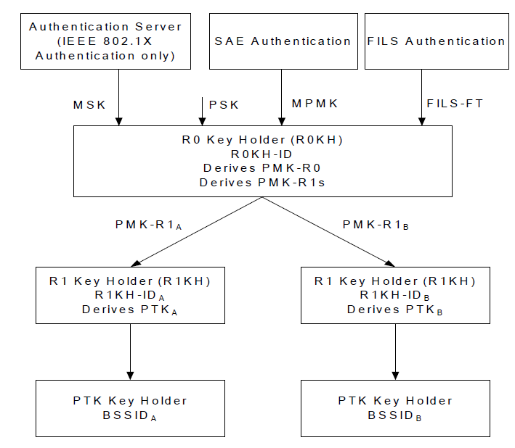
802.11r Mobility Domain Recap (1/2)
Protocols for reducing security overhead in roaming
Assumes WLAN Controller securely connected to APs
Full authentication performed at initial association with mobility domain
Fast BSS transition (FT) key hierarchy
PMK-RO at WLAN controller, separate PMK for each AP
WLAN Controller
WLAN
Controller
AP 1
AP 2
Mobility
Domain
AP 1
AP 2
STA

Slide 6
802.11r Mobility Domain Recap (2/2)
Full authentication during initial association with mobility domain
PMK-RO generation at WLAN controller
PMK-R1s derived and distributed to APs
4-way handshake
Temporal keys generated with only the associated AP
Fast transition protocols
802.11 authentication frames enriched with new IEs
Temporal keys generated with target AP
Is 802.11r sufficient for EHT Multi-AP?
No simultaneous connection to multiple APs
However, we can extend/re-use FT protocols

Slide 7
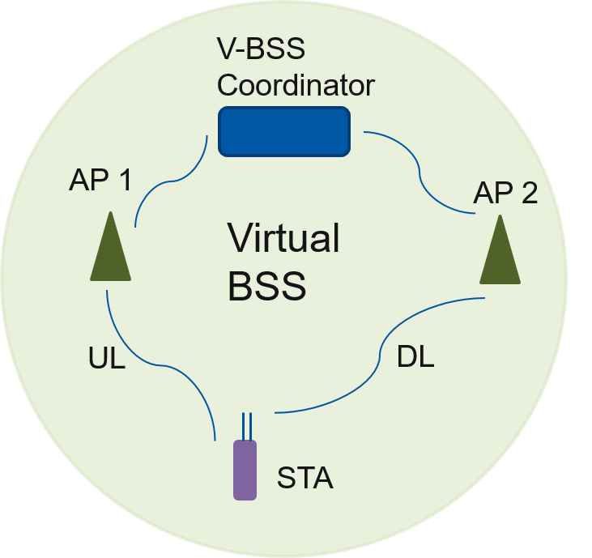
Virtual BSS
Infrastructure BSS with a group of APs coordinated by V-BSS coordinator
Seamless transmission of data frames to and from multiple APs
Presented in July meeting [3]
Dynamic AP selection by STA and V-BSS Coordinator
Transparent data reception
Single association and authentication state maintenance
Focus of this presentation

Slide 8
Virtual BSS Initial Association
Virtual BSS operation advertised in Beacons, Probe Response, (Re) Assoc Response
Open authentication and association performed with a specific AP of Virtual BSS
Association Request indicates request to join the Virtual BSS
Association Response includes V-BSS Coordinator key holder ID
Used to generate PMK at STA and V-BSS Coordinator similar to 802.11r PMK-R0
Temporal key generation depends on the Virtual BSS architecture
Partition of functionalities between the V-BSS Coordinator and APs
Virtual BSS Authentication modes
Option 1: Temporal key generation with V-BSS Coordinator
Option 2: Temporal key generation with individual APs
Selected mode needs to be indicated to STAs joining the Virtual BSS
Example: Association Response

Slide 9
Option 1: Temporal Key generation with V-BSS Coordinator
Temporal keys generated between STA and V-BSS Coordinator using PMK-Coordinator
V-BSS Coordinator performs data encryption and decryption
APs serve as a relay forwarding packets to and from V-BSS coordinator and STA
Derives PTK

Slide 10
Option 2: Temporal Key generation with individual APs
PMK-AP derived from PMK-Coordinator and distributed by V-BSS Coordinator to APs
STA can generate temporal keys with multiple APs of Virtual BSS
802.11r protocols can be extended for the key generation with the individual APs
Separate keys maintained for each AP
Corresponding keys used for communication between STA and AP
Dynamic AP selection limited to the subset with whom temporal keys are generated

Slide 11
Multi-AP Coordination Capability
Category | Temporal keys with V-BSS Coordinator | Temporal keys with individual APs
Coordinated OFDMA | ✓ | ✓
Coordinated Beamforming | ✓ | ✓
Null Forming | ✓ | ✓
Joint AP Transmission | ✓ | X
In joint AP transmission, multiple APs transmit exact same data to STA

Slide 12
Further Consideration
Security assessment of Virtual BSS Authentication modes
Addressing for transparent data reception
Secure channel between the V-BSS Coordinator and APs
Data flow between the STA and Virtual BSS

Slide 13
Summary
To achieve seamless transmission of frames between STAs and APs participating in Multi-AP Coordination, security framework needs important consideration
Presented Virtual BSS association protocol
Depending on Virtual BSS architecture partition, temporal key generation can be performed directly with V-BSS Coordinator or with individual APs

Slide 14
References
[1] 11-19/1019, “Virtual BSS for Multi AP Coordination”
[2] 11-19/0089, “Distributed MU-MIMO Architecture Design Considerations”
[3] 11-19/0804, “Multi-AP Transmission Procedure”
[4] 11-19/1129, “Consideration on Multi-AP Coordination”

