Slide 1
Virtual BSS for Multi-AP Coordination Follow-up
Date: 2019-09-15
Authors:

Slide 2
TGbe Multi-AP Coordination
Multi-AP Coordination is a candidate feature being discussed in TGbe group
There are many categories of multi-AP coordination including joint processing, coordinate OFDMA, null forming, coordinated beamforming, AP selection, etc.
In both downlink and uplink, the AP(s) used may vary per-frame based on link quality, load balancing, etc.

Slide 3
Multi-AP Coordination Requirements
Seamless exchange of frames between STA and coordinating APs without negotiation overhead
Simultaneous connectivity with multiple APs
Secure connection between STA and coordinating APs
Single authentication and association state
Encryption for different flavors of multi-AP transmission
Existing mechanisms that can be re-used for above requirements?

Slide 4
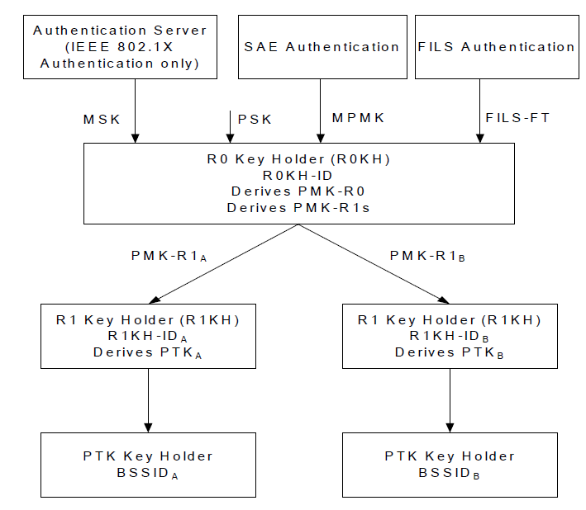
802.11r Mobility Domain
Introduced the concept of Mobility Domain for fast BSS transition (FT)
Full authentication during initial association with mobility domain
PMK-RO generation with WLAN controller
Temporal keys generated with a single AP
Fast transition handshake mechanisms for roaming
Temporal keys generated with target AP
Is 802.11r sufficient?
Simultaneous connectivity to multiple APs not enabled
NOTE: Temporal keys refer to PTK, GTK, IGTK

Slide 5
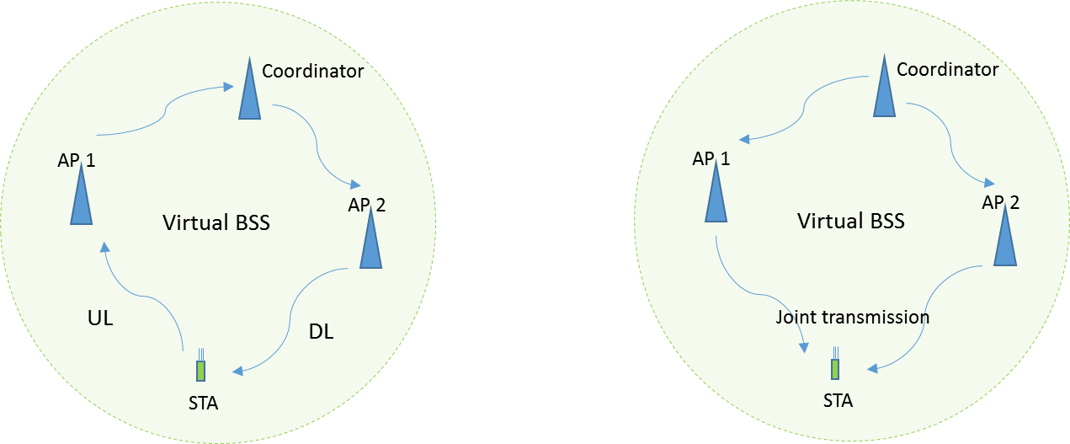
Virtual BSS
Infrastructure BSS with a group of APs coordinated by V-BSS coordinator
Seamless transmission of data frames to and from multiple APs
Some aspects were discussed in [1]
Dynamic AP selection by STA and V-BSS Coordinator
Transparent data reception
Single association and authentication state maintenance
Focus of this presentation

Slide 6
Virtual BSS Initial Association
Virtual BSS operation advertised in Beacons, Probe Response, (Re) Assoc Response
Open authentication and association performed with a specific AP of Virtual BSS
Association Response includes V-BSS Coordinator key holder ID
Used to generate PMK at STA and V-BSS Coordinator similar to 802.11r PMK-R0
Temporal key generation depends on the partition of functionalities between the V-BSS Coordinator and the APs
Option 1: Temporal key generation with V-BSS Coordinator
Option 2: Temporal key generation with individual APs

Slide 7
Option 1: Temporal Key generation with V-BSS Coordinator
Temporal keys generated between STA and V-BSS Coordinator using PMK-Coordinator
V-BSS Coordinator takes on more responsibility including data encryption and decryption
APs serve as a relay forwarding packets to and from V-BSS coordinator and STA

Slide 8
Option 2: Temporal Key generation with individual APs
PMK-AP derived from PMK-Coordinator and distributed by V-BSS Coordinator to APs
STA can generate temporal keys with multiple APs of Virtual BSS
802.11r mechanisms can be re-used for the key generation with the individual AP
Separate keys maintained for each AP
Corresponding keys used for communication between STA and AP
Dynamic AP selection limited to the subset with whom temporal keys are generated

Slide 9
Multi-AP Coordination Capability
Category | Temporal keys with V-BSS Coordinator | Temporal keys with individual APs
Coordinated OFDMA | ✓ | ✓
Coordinated Beamforming | ✓ | ✓
Null Forming | ✓ | ✓
Joint AP Transmission | ✓ | X

Slide 10
Further Consideration
Security assessment of the Virtual BSS concept
Addressing for transparent data reception
Secure channel between the V-BSS Coordinator and APs
Data flow between the STA and Virtual BSS
Protocols and management

Slide 11
Summary
To achieve seamless transmission of frames between STAs and APs participating in Multi-AP Coordination, security framework needs important consideration
Presented potential mechanism for Virtual BSS association
Temporal key generation can be performed
with V-BSS Coordinator or
with individual APs

Slide 12
References
[1] 11-19/1019r0, “Virtual BSS for Multi AP Coordination”
[2] 11-19/0089r1, “Distributed MU-MIMO Architecture Design Considerations”

