Slide 1
Wi-Fi Sensing: Cooperation and Standard Support
Date: 2019-09-06
Authors:

Slide 2
Introduction
In our previous contribution to WNG [1], we introduced Wi-Fi sensing, discussed use cases and requirements, and demonstrated technical feasibility.
  Discussion aligned with that presented in [2].
  Other presentations on the topic will be made this week.
This presentation extends the discussion in [1] and covers:
  Background
  Results of measurement campaigns
    Need for collaboration in Wi-Fi sensing
  Standard gaps
  Conclusions and proposed next steps

Slide 3
Wi-Fi Sensing
Wi-Fi sensing is the use, by one or more STAs, of Wi-Fi signals to detect features of intended subject(s) in a given environment.
  Features: motion, presence or proximity, gesture, people counting, geometry, velocity, etc.
  Subject: object, human, animal, etc.
  Environment: Within a few centimeters/meters of a device, room, house/enterprise, etc.
Wi-Fi sensing does not assume that the intended subject carries a device with Wi-Fi functionality.
The STA that transmits a Wi-Fi signal may or may not be the same as the STA that performs the Wi-Fi sensing function.

Slide 4
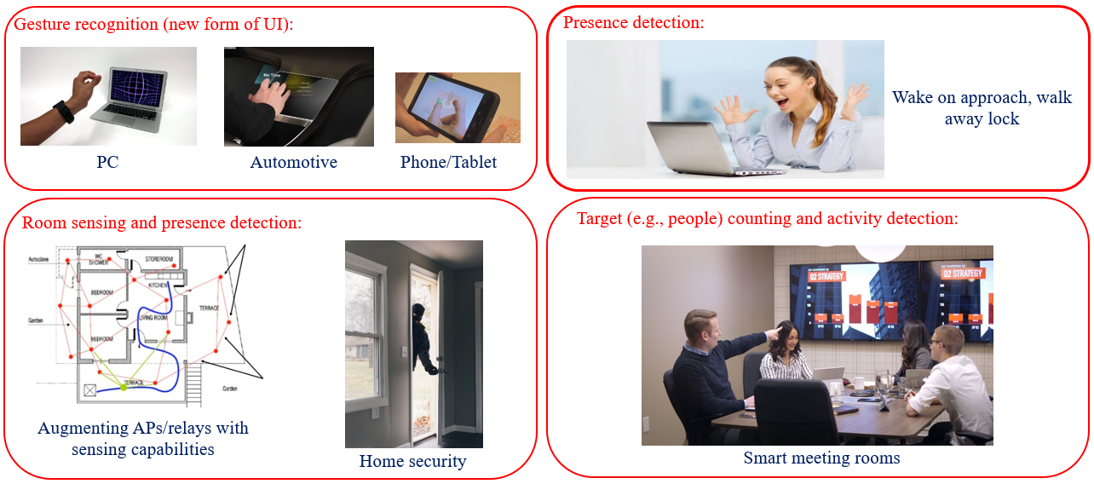
Wi-Fi Sensing: Examples of Applications

Slide 5
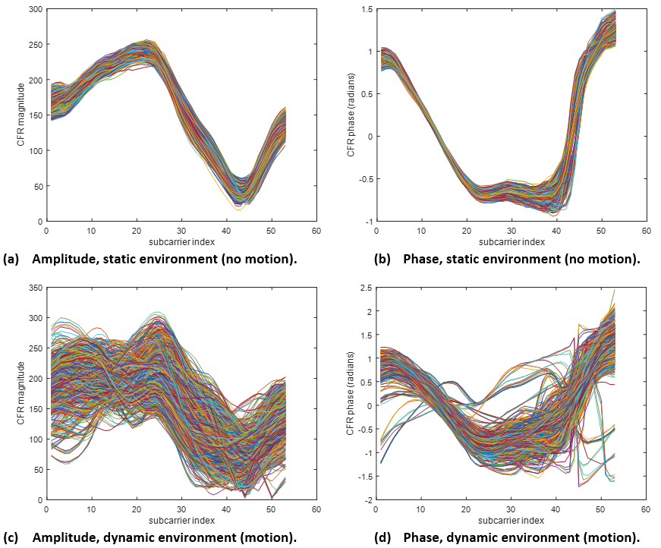
Using Wi-Fi for Sensing
Figures show the amplitude and phase of channel estimates obtained with multiple PPDUs over time (~3 minutes). Each curve corresponds to one PPDU. Top row: no motion. Bottom row: motion in the room (one person randomly walking).
Technical principle behind Wi-Fi sensing is to track channel estimates obtained when decoding Wi-Fi packets over time, and to detect/classify changes that indicate an event of interest.
Detection of some features require machine learning, but many can be achieved without it.

Slide 6

Technical Approach
To test feasibility and evaluate the need for standard support, we implemented a method that relies solely on STA diversity.
Core algorithm makes use of the covariance matrix of multiple channel estimates obtained over time to determine motion in the link.
Algorithm has 3 phases
  Measurement capture
  Motion detection
  Sensing algorithm
Phase 1: Measurement capture and conditioning
Phase 2: Motion detection
E-metric
Phase 3: Sensing algorithm

Slide 7
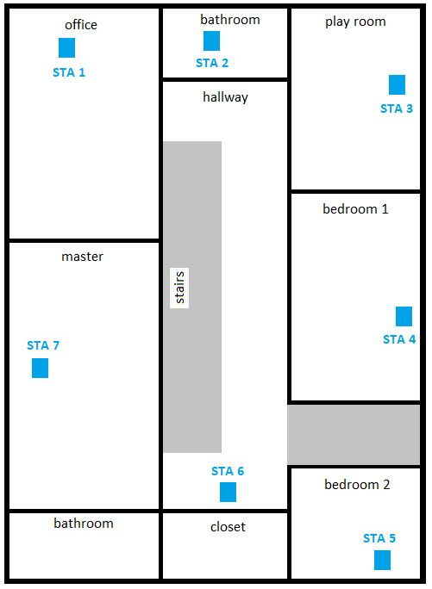
Testbed – Home Environment
We performed extensive measurement campaigns to evaluate the need for collaboration in Wi-Fi sensing.
Set up:
  Wi-Fi networks operating co-channel (5 GHz, channel 44)
  Client laptop operating in sniffer mode
  Brand name APs with chipsets coming from different vendors
  Stationary devices

Slide 8
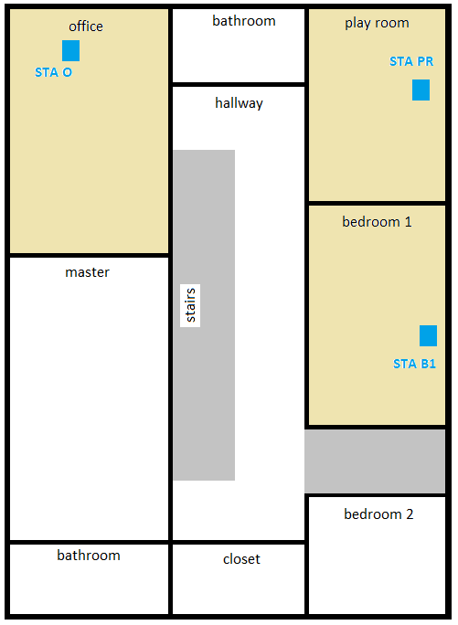
Testbed
In all experiments here presented,
Goal: Detect motion and identify where (e.g., in which room) it happens.
For ease of presentation and analysis, only three STAs are considered: STA O, STA PR, and STA B1.
Experiments considered:
  Experiment 1: TX STA diversity, single subject
  Experiment 2: RX STA diversity, single subject
  Experiment 3: TX STA and RX STA diversity, multiple subjects
For experiments 1 and 2, the following hypotheses are considered:
  No motion
  Motion at office only
  Motion at play room only
  Motion at bedroom 1 only

Slide 9
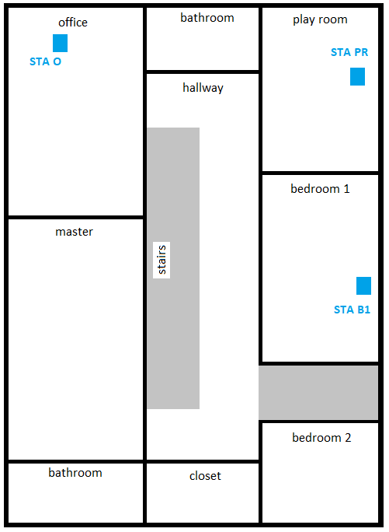
Experiment 1
To exemplify the impact of movement in different rooms to the link, we plot the measured E-metric values for the different hypotheses as a function of time.
  E-metric: Measure of time variability of the link.

Slide 10
Experiment 1
With appropriate training/calibration, it is possible to develop statistical classifiers that take the calculated E-metric values over time and make a decision on the presence and location of a subject.
predicted
0.9329
 | No motion | Office | Bedroom 1 | Play room
No motion | 0.9409 | 0.0017 | 0.0262 | 0.0312
Office | 1.127e-4 | 0.4887 | 0.4442 | 0.0670
Bedroom 1 | 1.745e-4 | 0.2747 | 0.6941 | 0.0310
Play room | 0.0147 | 0.1369 | 0.0795 | 0.7689
actual
Example – Confusion matrix: The system mistakes movement in the play room as movement in bedroom 1 with a probability equal to 0.0795.
0.9688
With one transmitter, it may not be possible to differentiate whether motion is close to the transmitter, close to the receiver, or somewhere along the link.

Slide 11
Experiment 1 – TX STA Diversity
Links with the same RX but different TXs likely have different sensing characteristics. In principle, improved performance may be obtained by appropriately combining such links.
  We call this technique transmit STA diversity.

Slide 12
Experiment 1 – TX STA Diversity
As seen below, as expected, the second (black) link has different characteristics from the first (blue) one.
  Example: The black link allows for accurate detection and classification of motion in bedroom 1.
 | No motion | Office | Bedroom 1 | Play room
No motion | 0.6353 | 0 | 0.3643 | 0.0004
Office | 0 | 0.6252 | 0.0069 | 0.3679
Bedroom 1 | 0.0510 | 0.0049 | 0.8924 | 0.0517
Play room | 0.0001 | 0.4906 | 0.0267 | 0.4826

Slide 13
Experiment 1 – TX STA Diversity
By assuming that the hypotheses are equally likely and that decisions made using each link are conditionally independent,
and using a MAP classifier, we fuse the data provided by each link and obtain:
$$P\left(motion|link 1, link 2\right)=\frac{P\left(link 1|motion\right)P\left(link 2|motion\right)P\left(motion\right)}{P\left(link 1, link 2\right)}$$
 | No motion | Office | Bedroom 1 | Play room
No motion | 0.9603 | 0 | 0.0393 | 0.0004
Office | 0 | 0.9265 | 0.0069 | 0.0666
Bedroom 1 | 0.0017 | 0.0548 | 0.9416 | 0.0018
Play room | 0.0005 | 0.2106 | 0.0263 | 0.7626
By exploiting TX STA diversity, the average probability of correct classification increases from 0.691 (1 TX) to 0.898 (2 TXs) – a relative improvement of 30%.
It is important to keep in mind, however, that all links with a common receiver have a common “observation point.” Additional gains are expected with the use of receive STA diversity.

Slide 14
Experiment 2
Assume that sensing measurements are now taken by STA B1, as shown in the figure to the left.
Because measurements are now taken by a different point (with a different “perspective”), results obtained have different characteristics, as shown below. We call this receive STA diversity.
 | No motion | Office | Bedroom 1 | Play room
No motion | 0.7791 | 0.2189 | 0.0004 | 0.0017
Office | 0.0292 | 0.9682 | 0.0024 | 0.0002
Bedroom 1 | 0 | 0 | 0.9640 | 0.0360
Play room | 0 | 0 | 0.2529 | 0.7471
The system now misclassifies movement in the play room as movement in bedroom 1 often. In the first configuration, this error was rarely made. Instead, the most likely error was misclassifying the same movement as movement in the office.

Slide 15
Experiment 2 – RX STA Diversity
By employing the same classifier previously formulated, we fuse the data provided by each receiver and obtain:
 | No motion | Office | Bedroom 1 | Play room
No motion | 0.9992 | 0.0004 | 0.0005 | 0
Office | 0.0069 | 0.9905 | 0 | 0.0026
Bedroom 1 | 0.0001 | 0 | 0.9432 | 0.0566
Play room | 0.0004 | 0 | 0.0264 | 0.9732
88.1%
97.6%
65.6%

Slide 16
Experiment 3
Using the same devices and configurations as before, we also evaluated the case when 2 people were present in the subject environment.
New sets of hypotheses:
  No motion
  Motion at office only
  Motion at play room only
  Motion at bedroom 1 only
  Motion at both office and play room
  Motion at both office and bedroom 1
  Motion at both play room and bedroom 1

Slide 17
Experiment 3
When STA O is the sensing receiver
 | No | O | PR | B1 | O + PR | O + B1 | PR + B1
No | 1 | 0 | 0 | 0 | 0 | 0 | 0
O | 0 | 0.4989 | 0.0134 | 0.0009 | 0.2131 | 0.1465 | 0.1272
PR | 0 | 0.0066 | 0.9783 | 0.0002 | 0.0061 | 0.0026 | 0.0061
B1 | 0 | 0.0003 | 0.0031 | 0.9881 | 0 | 0.0008 | 0.0076
O + PR | 0 | 0.3215 | 0.0158 | 0.0002 | 0.3642 | 0.1099 | 0.1882
O + B1 | 0 | 0.1558 | 0.0004 | 0.0011 | 0.0359 | 0.5992 | 0.2077
PR + B1 | 0 | 0.1855 | 0.0109 | 0.0077 | 0.1267 | 0.2988 | 0.3703
When STA B1 is the sensing receiver
 | No | O | PR | B1 | O + PR | O + B1 | PR + B1
No | 0.9998 | 0.0002 | 0 | 0 | 0 | 0 | 0
O | 0 | 1 | 0 | 0 | 0 | 0 | 0
PR | 0 | 0 | 0.9747 | 0.0133 | 0.0104 | 0 | 0.0016
B1 | 0 | 0 | 0.0047 | 0.3344 | 0.2480 | 0.2054 | 0.2074
O + PR | 0 | 0 | 0.0019 | 0.1240 | 0.7726 | 0.0690 | 0.0323
O + B1 | 0 | 0 | 0 | 0.1156 | 0.1938 | 0.4435 | 0.2470
PR + B1 | 0 | 0 | 0.0001 | 0.1130 | 0.0728 | 0.1394 | 0.6747

Slide 18
Experiment 3
The data in the previous slide shows a great example of RX STA diversity.
  When STA O is the sensing receiver, the system has difficulty in distinguishing hypotheses that include motion in the office.
  When the sensing receiver is STA B1, the system has difficulty in distinguishing hypotheses that include motion in bedroom 1.
By combining data obtained with two receivers, performance is improved:
87.1%
71.4%
51.6%
Improvement obtained with TX STA and RX STA diversity in this more complex application was larger than before.
For example, relative improvement of the 2TX,2RX case over the 1TX,1RX case was about 70%, while in experiment 2 was about 50%.

Slide 19
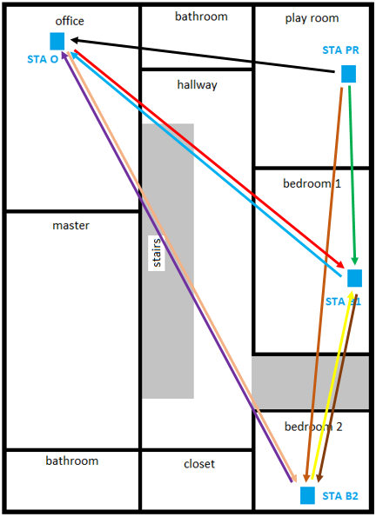
Experiment 3
To gain insight into the impact of the number of STAs in sensing performance, we repeated experiment 3 with 4 devices. The new station is located in bedroom 2 (STA B2).
As shown below, TX STA and RX STA diversity is very important in sensing applications similar to the one considered here (wide coverage, unknown number of subjects).
99.2%
95.3%
82.7%

Slide 20
Summary: STA Diversity in Wi-Fi Sensing
For a large number of Wi-Fi sensing applications, STA diversity in transmission and reception is key.
  Ability to characterize the environment from multiple points-of-view, focal points
    Better understanding of the environment and subjects
  Sense the environment at positions that are potentially closer to subject
  Improve coverage
    Lack of knowledge about subject’s position
  Increase robustness to poor geometry
  More observations necessary to, for example, differentiate multiple subjects and allow for subject tracking

Slide 21
Need for Standard Support
Standard support is necessary to
  Increase efficiency and reliability of Wi-Fi sensing applications
  Enable several and diverse use cases
As demonstrated in this presentation, Wi-Fi sensing may be improved with TX STA and RX STA diversity, which requires standard support. Other sensing-related aspects that require standard support include
  Negotiation of sensing parameters and schedule
  Transmission characteristics of PPDUs used for sensing
  Power save (e.g., not rely on the opportunistic reception of packets)
  Protocol flow that efficiently supports unique and fundamental characteristics of Wi-Fi sensing

Slide 22
Conclusions and Next Steps
There is much interest in the industry on Wi-Fi sensing.
In this presentation, we showed that standard support is necessary for Wi-Fi sensing.
We recommend the creation of a TIG at this session (and possibly a Study Group in November) to advance Wi-Fi sensing by means of
  Identifying Wi-Fi sensing use cases and applications of interest
  Identifying technical gaps in 802.11 that would have to be addressed to efficiently and reliably support Wi-Fi sensing
  Raising awareness and understanding of a potential study group

Slide 23
SP
Would you support the creation of a TIG on Wi-Fi sensing?
Yes
No
Abstain

Slide 24
References
[1] "Wi-Fi sensing: Usages, requirements, technical feasibility and standards gaps," doc. IEEE 802.11-19/1293r0.
[2] "Wi-Fi sensing," doc. IEEE 802.11-19/1164r0.

