Slide 1
WG11 Opening Report Snapshot Slides September 2019
Date: 2019-09-15
Authors:

Slide 2
Abstract
This presentation contains the IEEE 802.11 WG snapshot slides for the September 2019 session:
Editors Meeting ANA AANI SC ARC SC (Acrhitecture) Coex SC PAR Review SC WNG SC (Wireless Next Generation) JTC1 TGmd (Maintenance) TGax (High Efficiency WLAN) TGay (Next Generation 60 GHz) TGaz (Next Generation Positioning) TGba (Wake-Up Radio) TGbb (Light Communication) TGbc (Broadcast Serverices) TGbd (Next Gen V2X) TGbe (Extremely High THroughput) RCM TIG (Random and Changing MAC addresses)

Slide 3
Editors Meeting: Agenda for 2019-09-17
Roll Call / Contacts / Reflector
Go round table and get brief status report
Draft Numbering
802.11 Mandatory Draft Review before SB
REVmd MDR report 19/260
TGax MDR report 19/1015
11ba/11az amendment order
WG Style Guide for 802.11 09/1034r14
Review WG Style Guide
Notes:
July 2007

Slide 4
ANA Status
The latest database is 11-11/0270r49 (September 2019)
Changes since last meeting:
TGax renaming following MDR.
TGmd allocation.
Pending changes:
None

Slide 5
802.11 AANI SC – September 2019
Goals:
Review: the AANI SC Background and Status
Continue Discussion on Proposal for: Interworking between IEEE 802.11 WLAN/3GPP 5G Core Network Report See contribution 11-19/1529 “Objective and scope of technical report on interworking between 5G core network and WLAN”
802.11ax IMT-2020 simulation results: 11-19/1522 “Simulation Evaluation of 802.11ax for IMT-2020 eMBB Dense Urban Scenario”
Report status of: “Press release” on 802.11ax IMT-2020 performance
Report status of ITU-R, IMT-2020 status
Agenda: See 11-19/1415 for additional background and details
AANI SC is scheduled to meet for 2 sessions: Mon: PM2, Thu: AM1
Note: Nendica: “IEEE 802 network enhancements for the next decade” Industry Connections Activity is meeting in Edinburgh this week (two meeting slots), one slot allows for a virtual meeting: Thursday PM2 (16:00-18:00) in Hanoi, Song Lo Room [Studio 5].

Slide 6
802.11 ARC – September 2019
Meeting slots: Tuesday PM2, Wednesday AM1, Thursday PM2
Agenda items:
Update on external coordination/monitoring:
IEEE 1588, 802.1AS (802.1ASrev) and use of 802.11 FTM
IETF/802 coordination
Consider 802.11 in a Deterministic Network
“What is an ESS?”: 11-18/1051r7
“What is a STA?” (per REVmd discussion: 11-19/0106r0)
Annex G (purpose and value?, work to update or work to deprecate?)
MLME-RESET, versus MLME-JOIN and MLME-START (and MLME-SCAN?)
AP/DS/Portal architecture and 802 concepts
Other TG new architecture concepts:
TGbe (EHT) multi-band/multi-link operation architecture
TGbc (Broadcast) unassociated broadcast, broadcast reception
Monitor TGbd’s activities in support of IEEE 1609

Slide 7
The IEEE 802.11 Coex SC will formally meet twice in Hanoi in Sept 2019
The Coex SC is working based on agreed goals
Discuss the use of PD, ED or other 802.11 coexistence mechanisms with the goal of promoting “fair” use of unlicensed spectrum
Promote an environment that allow IEEE 802.11ax “fair access” to global unlicensed spectrum
The Coex SC is formally meeting twice this week
Coex SC meeting on Wed PM1
Coex SC meeting on Thu PM1

Slide 8
The IEEE 802.11 Coex SC will focus on issues highlighted in Coex Workshop
Agenda items (11-19-1446) to be addressed include:
Future of Coex SC
State of LAA deployment
Coex Workshop documentation & surveys
Discussion of prioritised issues highlighted in surveys
Review of recent & planned ETSI BRAN activities
Review recent 3GPP RAN/RAN1 activities
Motions (Thu PM1 only, if required)
Possible LS’s to 3GPP RAN1, ETSI BRAN and Workshop invitees

Slide 9
PAR Review SC Chair: Jon Rosdahl
Not meeting this week
Will meet in Nov 2019 to review proposed PAR documents.
Upcoming Submission deadlines are
WG PAR submission to 802 EC: 11 Oct 2019
WG PAR Submission to NesCom: 17 Sept 2019 (for NesCom Nov mtg)
WG PAR Submission to NesCom for Continuous Process telecon approximately Nov 5 2019
Notes:
May 2008
Page 9

Slide 10
802.11 WNG – September 2019
Tuesday 17 September AM1 (08:00-10:00) & PM3 (19:30-21:30)
Announcements
Presentations
“Wi-Fi Sensing: Cooperation and Standard Support” – Claudio Da Silva (Intel)
“Wi-Fi Sensing: follow up” – Tony Xiao Han (Huawei)
“Wi-Fi Sensing in 60GHz band” – Alecs Eitan (Qualcomm)
"Wi-Fi sensing: Some important use cases, possible realizations, and the need of standardization“ – Oscar Au (Origin Wireless)
“Wi-Fi Sensing Application: Multipath Enhanced Device Free Localization” – Paul Unterhuber (German Aerospace Center – DLR)
Plans for November 2019
Chair will make a call for presentations in advance
Adjourn
Current agenda is document 11-19/1414r2

Slide 11
IEEE 802 JTC1 SC will meet only once in Hanoi in Sept 2019
Agenda items (11-19-1354) addressed this week (Tue PM1) will include “the usual”:
Review extended goals
Review status of SC6 interactions
Review liaisons of drafts to SC6
Review notifications of projects to SC6
Review status of 60 day/FDIS ballots
Review SC6 activities
None
The meeting will be relatively light

Slide 12
IEEE 802 has 94 standards in or through the PSDO pipeline
WG | Completed | In-process
802.1 | 28 | 13
802.3 | 15 | 9
802.11 | 9 | 11
802.15 | 2 | 1
802.16 | 0 | 0
802.21 | 3 | 0
802.22 | 3 | 0
All | 60 | 34
FDIS ballots
802.11ak/aq/AJ waiting for FDIS ballot start

Slide 13
TGmd – Revision Project – September 2019
Overall Status: LB236 on P802.11REVmd D2.0 passed with 92% approval, 723 comments
D2.0 incorporates all approved amendments
Approximately 60 comments remain to be resolved
Since July 2019 meeting
Seven teleconferences and an Ad-hoc meeting were held to continue comment resolution
September 2019 meeting goals (6 timeslots):
Complete LB236 comment resolution
Plans for September - November 2019: comment resolution on recirculation LB comments
Agenda: 11-19-1374

Slide 14
IEEE 802.11ax – September 2019
Complete the resolution of all comments submitted on LB 238 (draft D4.0) and start a new 15-day WG LB.
238 CIDs were waiting for resolutions after the July meeting.
Completed the resolution of a number of CIDs during the TG teleconferences between July and September.
Approve the new revision of the TG Coexistence Assurance document.
https://mentor.ieee.org/802.11/dcn/16/11-16-1348-06-00ax-coexistence-assurance.docx
Agenda for this meeting is available in document 11-19/1409.
https://mentor.ieee.org/802.11/dcn/19/11-19-0983-00-00ax-tgax-july-2019-meeting-agenda.pptx

Slide 15
TGay – September 2019
Overall Status: LB242 on P802.11ay D4.0 passed with 98% approval, with 64 comments
5 comments remain to be resolved after the end of the July plenary
Since July 2019 plenary
3 teleconferences were held to continue comment resolution
September 2019 interim meeting goals (2 timeslots):
Complete LB242 comment resolution: 1 CID to be resolved, 1 CID to be revised
Consider draft readiness for the third working group recirculation letter ballot
Agenda: 11-19-1384

Slide 16
NGP TG AZ – Sep. 2019 TGaz Next Generation Positioning
Current status:
In comment resolution coming from successful Initial WG Ballot.
TG had a 3 day ad-hoc hosted by Broadcom and had 6 telecons since the July meeting.
Roughly ~120 technical comment resolutions were generated and reviewed – expected to be considered for adoption this week.
Published two new drafts:
D1.4 available on mentor incorporating comment resolutions from the Vienna meeting.
Upcoming milestones/approved plan:
Continue with comment resolution.
Projected to go to a recirculation ballot coming from Sep. meeting (50% probability)

Slide 17
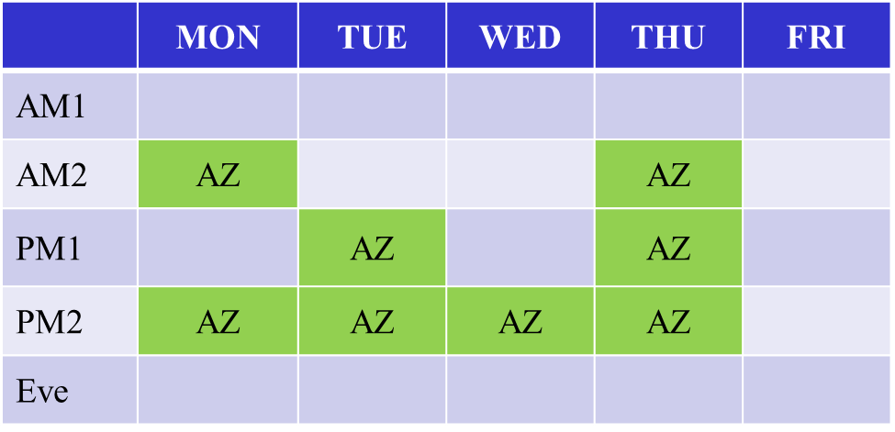
NGP TG AZ – Sep. 2019 TGaz Next Generation Positioning
Agenda:
Expected to meet for 8 meeting slots this week.
Refer to submission 11-19/1360.

Slide 18
TGba (Wake-up Radio)
From the last F2F meeting
Continued comment resolution on D3.0 (LB241)
Remaining CIDs after the conference calls: 28
Plan for this meeting
Complete comment resolution on TGba D3.0 (LB241) and generate TGba D4.0
Approve WG recirculation letter ballot
Review TG timeline
Agenda can be found in doc: IEEE 802.11-19/1418

Slide 19
802.11 TGbb
TGbb will discuss:
Draft D0.1 Table of Content
Evaluation Framework document
Hear PHY proposals
Hear MAC proposals
Conference call schedule
Timeline
Six (6) meeting slots for the Sept. 2019 session
Mon – AM2, PM1 ; Tue – PM1, PM2 ; Wed – AM1 ; Thur – AM2
Proposed Agenda in doc. 11-19/1413

Slide 20
IEEE 802.11 TGbc Broadcast Services Chair: Marc Emmelmann
Progress since July 2019:
1 telephone conference
Submission on SFD text
Discussion on Call for Submissions
July Goals:
Discuss and approve SFD text and Draft Submissions
3 Meeting slots: Mon PM2; Tue AM2; Thu AM1
Agenda: 11-19/1426
Meeting / Chairs slides: 11-19/1427

Slide 21
Snapshot of IEEE 802.11 TGbd Sep 2019
Since the Jul 2019 meeting
Meeting minutes was available
Jul meeting minutes
1 teleconferences were held
One presentation regarding 20 MHz channel access was presented and
Timeline updated was discussed.
teleconference minutes
Goal of 2019 Sep meeting
5 sessions scheduled for TGbd during Jul meeting including two adhoc sessions
Approve updated FRD and SFD
Complete presentations submitted for the week
Run motions for updating FRD and SFD.
Approval of spec skeleton
Timeline udpate
Agenda for TGbd Sep meeting is available as in the latest revision of 11-19/1412

Slide 22
IEEE 802.11be – September 2019
From July F2F meeting
Approved the following TGbe documents
Channel Model, Functional Requirements, and Specification Framework
Discussed 22 technical submissions covering a wide range of topics
Multi-AP coordination, PHY, multi-link operation, HARQ, and MIMO
Held a joint session with IEEE802.1/TSN covering
Intro to IEEE802.1 TSN, par of the picture for TSN+Wireless,
TSN for .11 with potential extensions, and improving WLAN reliability
Goals for September F2F meeting
Discuss creation of ad-hoc groups
E.g., number of ad-hocs, chairs, etc.
Presentation of technical submissions
Agenda is available in 11-19/1397

Slide 23
IEEE 802.11 RCM TIG – September 2019
Working on the draft report:
Skeletal outline posted in doc. 11-19/1442r0.
Discussion on headlines.
Discussion on content.
Goals (in order of importance): find use-cases, collect discussions from fact-finding, develop recommendations(?).
Agenda/chair deck for this meeting is available in doc. 11-19/1420r0.
Three sessions scheduled in the week :
Tue 17 Sep PM1 and EVE
Thu 19 Sep AM1
Notes:
doc.: IEEE 802.11-12/xxxxr0
November 2010
Bruce Kraemer (Marvell)
Page 23

