Slide 1
1st Vice Chair Report - Sept 2019 - Hanoi
Date: 2019-09-16
Authors:

Slide 2
Abstract
Agenda Items for 1st Vice Chair –
Monday:
M3.3 II Other WG meeting plans
M3.4 II Meeting room locations
M3.5 II Meeting registration
M3.6 II Recording attendance
M3.7 II File server
M3.8 II Breakfast, breaks, Social logistics
M3.9 II Next Session reminder
Friday:
  F3.1.1 II WG Straw Poll regarding this session location
  F3.1.2 DT Future venues status and discussion

Slide 3
Monday–
802.11 Opening Plenary
802.11 First Vice Chair Report

Slide 4
Event Conduct and Safety Statement
IEEE believes that science, technology, and engineering are fundamental human activities, for which openness, international collaboration, and the free flow of talent and ideas are essential. Its meetings, conferences, and other events seek to enable engaging, thought-provoking conversations that support IEEE’s core mission of advancing technology for humanity. Accordingly, IEEE is committed to providing a safe, productive, and welcoming environment to all participants, including staff and vendors, at IEEE-related events.

Slide 5
Event Conduct and Safety Statement
IEEE has no tolerance for discrimination, harassment, or bullying in any form at IEEE-related events. All participants have the right to pursue shared interests without harassment or discrimination in an environment that supports diversity and inclusion. Participants are expected to adhere to these principles and respect the rights of others.
IEEE seeks to provide a secure environment at its events. Participants should report any behavior inconsistent with the principles outlined here, to onsite staff, security or venue personnel, or toeventconduct@ieee.org.

Slide 6
M3.3 Other WG meeting plans
802.1 802.3 802.11 802.15 802.18 802.19 802.24
Only Wireless Groups here this week, 802.1 and 802.3 meet next week.
Treasurer Report: EC-19/0136r1
Patent policy (in IEEE-SA bylaws), patent policy materials (slide set), and antitrust guidelines

Slide 7
Housekeeping Notes from
MTG Events

Slide 8

MEETING APP – how to download
Go to Play Store or App Store
Find and Install: The Event App by EventsAir
Event Code: 802interimhanoi
Click on AGENDA to see the combined schedule.
To personalise your agenda and save the sessions you want to attend, please log in using your details on the back of your name badge.
Details on how to download the app are also at the registration desk.

Slide 9
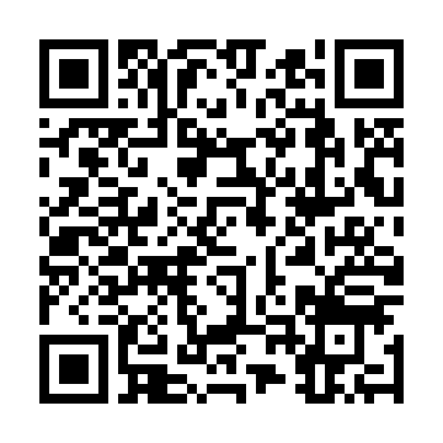

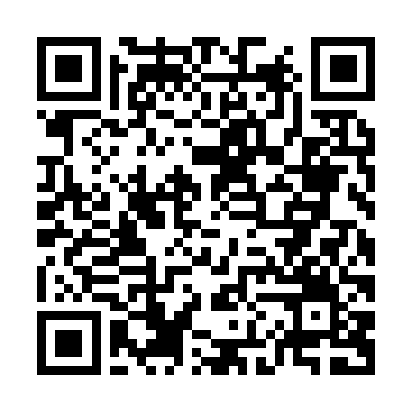

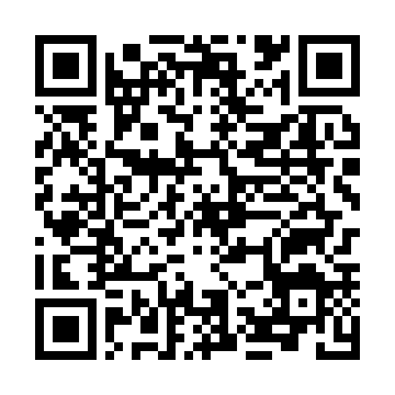

PROGRAM APP
https://touchpoint.eventsair.com/attendeeapp/ieee802-2019/802interimhanoi/
https://itunes.apple.com/us/app/the-event-app-by-eventsair/id1142851582?ls=1&mt=8
https://play.google.com/store/apps/details?id=com.eventsair.attendeeapp

Slide 10

NAME BADGE
- The Wireless details and Meeting App login information is available on the back of your name badge

Slide 11
MEALS
- Breakfast is included in your room rate if you booked via the Marriott Hotel link
- Morning and Afternoon tea will be served in the foyer
- Lunch will be available from 1200 – 1330 in the JW Cafe

Slide 12

MEALS
- DIETARY REQUIREMENTS: all dietary requirements have been communicated to the hotel. All foods are labelled and if you have any queries please see the waitstaff or please see Manoj who will be in the JW Café during lunch and can help with requests!

Slide 13
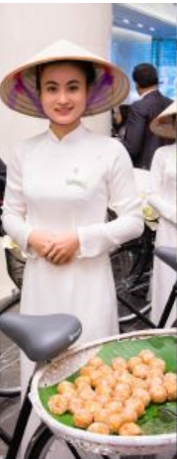
WEDNESDAY SOCIAL
BIA HOI THEME DINNER
Wednesday September 18, 2019
Date: Wednesday September 18, 2019
Time: 6.30pm
Venue: Lakeside, JW Marriott (inside if rain)
Entertainment: Local Vietnamese Entertainment
Dress code: Casual
The social will include local Vietnamese food and Bio Hoi BBQ buffet, which will be complimented by 2 hours of free flow drinks including local beer, wine and Botanical Garden Cocktails and fresh juices.
The Entertainment will include Vietnamese Lion Dancers and traditional Vietnamese band.
We look forward to a fun evening and seeing you there.

Slide 14
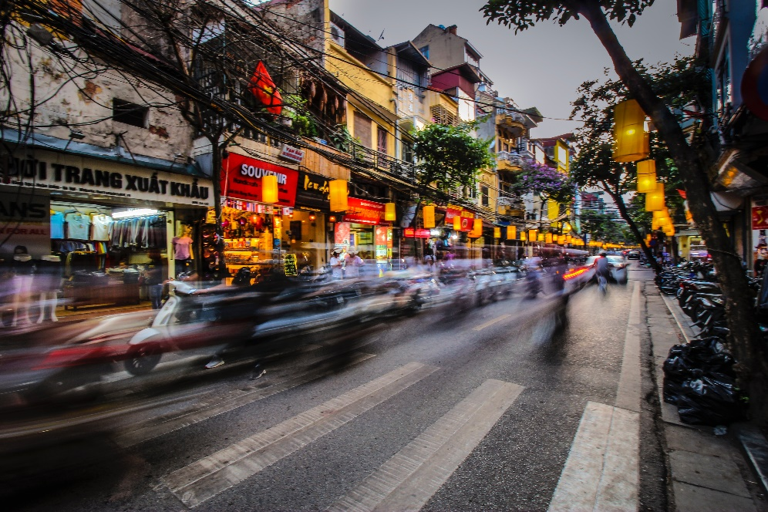
SIGHTSEEING/TOURS
EXPERIENCE VIETNAM
Let Viet At Halong Charm Guide You
Come and chat with Viet at the registration desk. Viet has wealth of knowledge about local restaurants, quick tours or assist with building a whole itinerary for you.

Slide 15

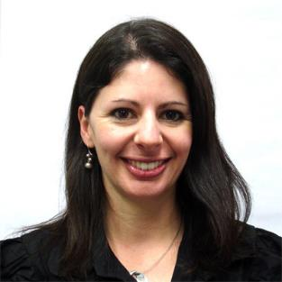
Any Questions
Please see Daniel or Sara on the registration desk!

Slide 16
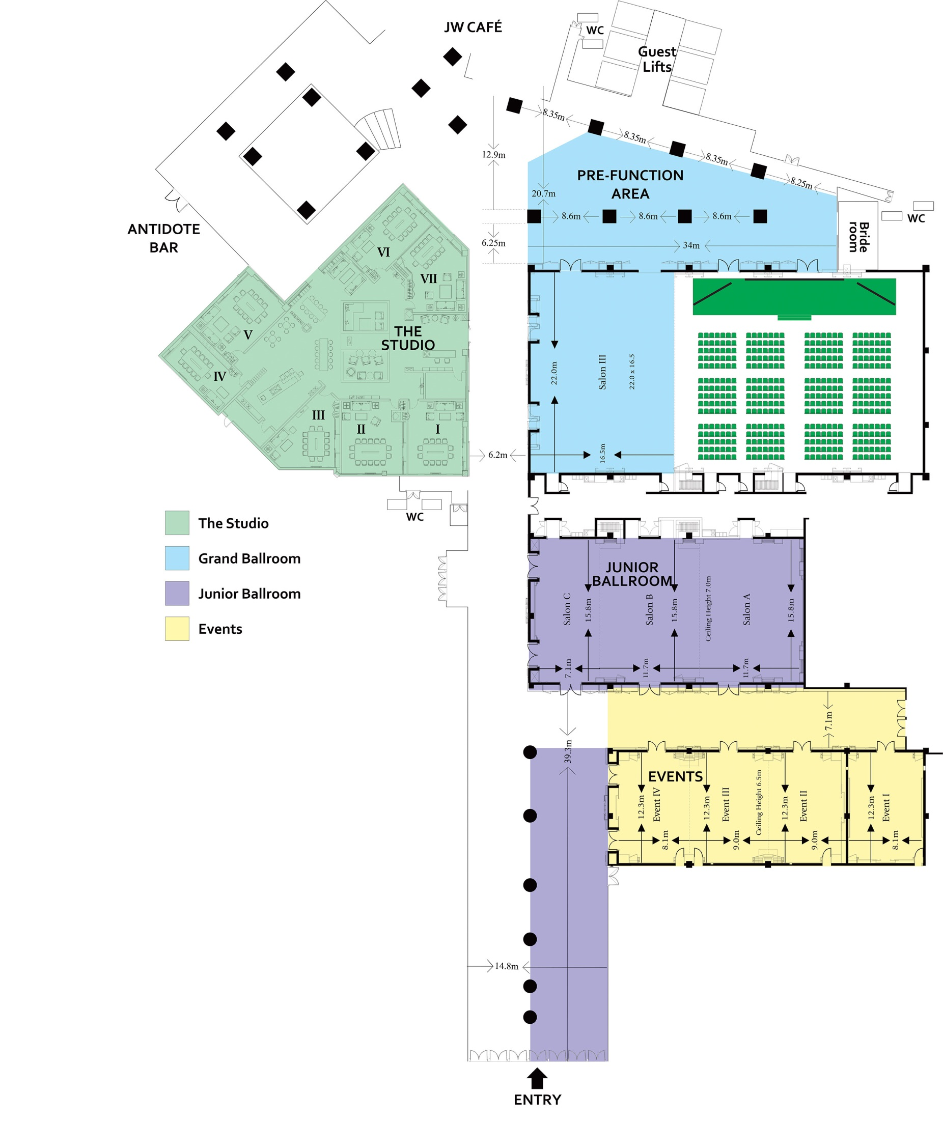

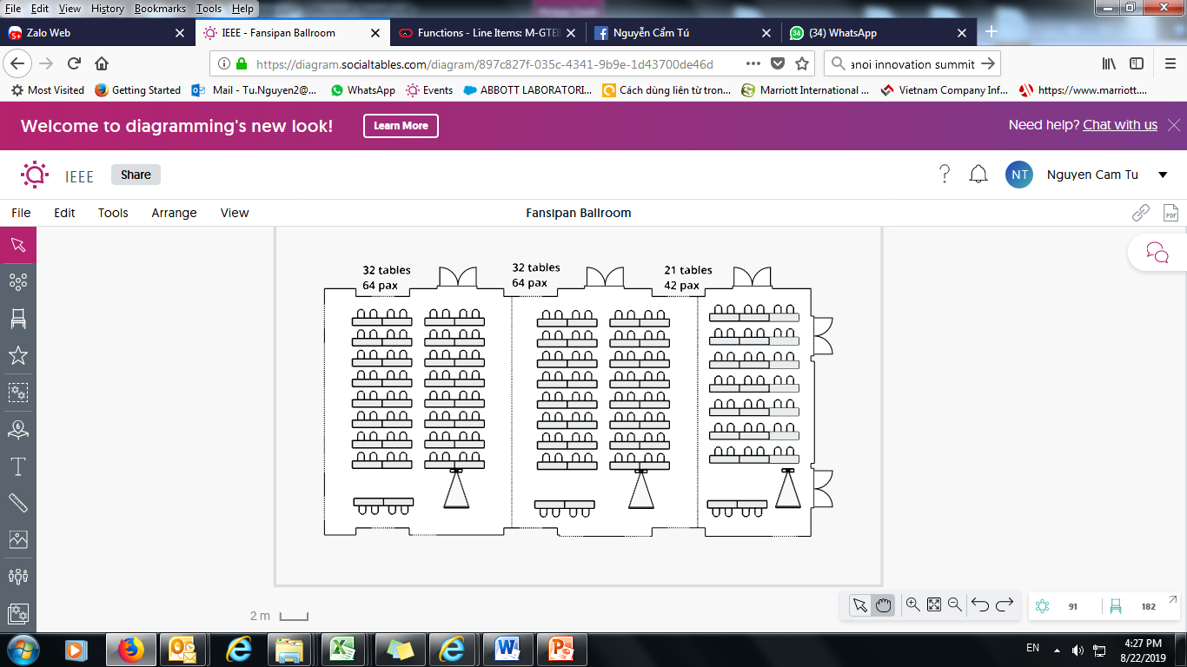
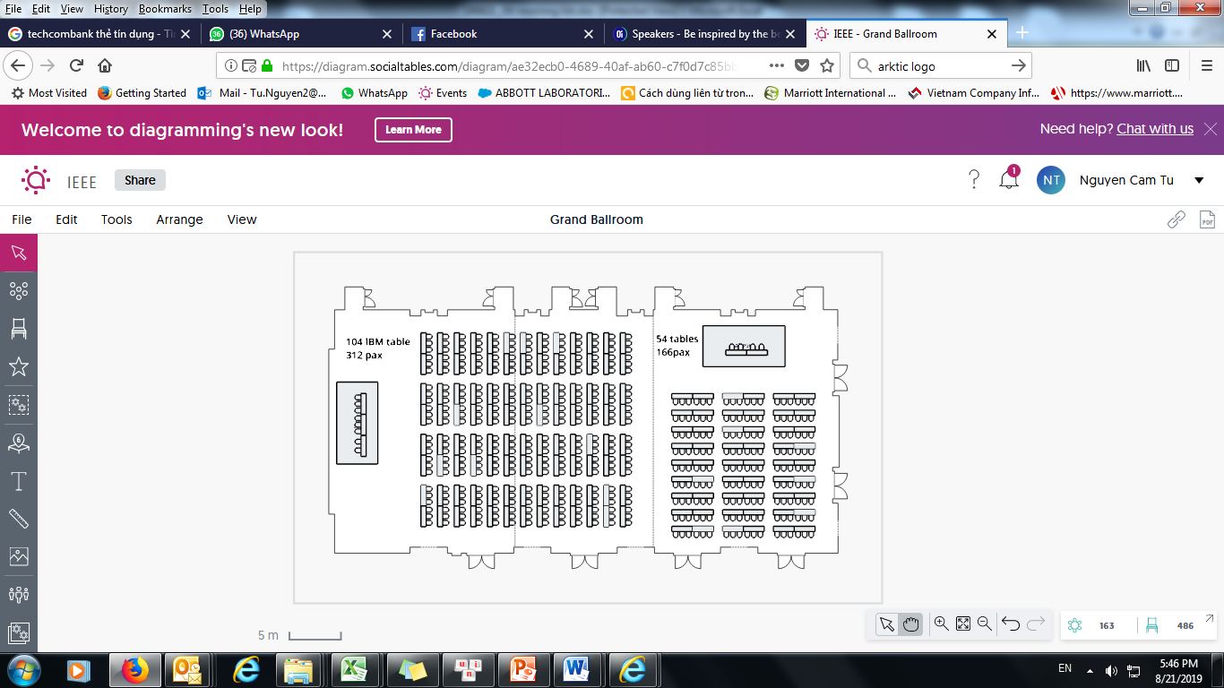
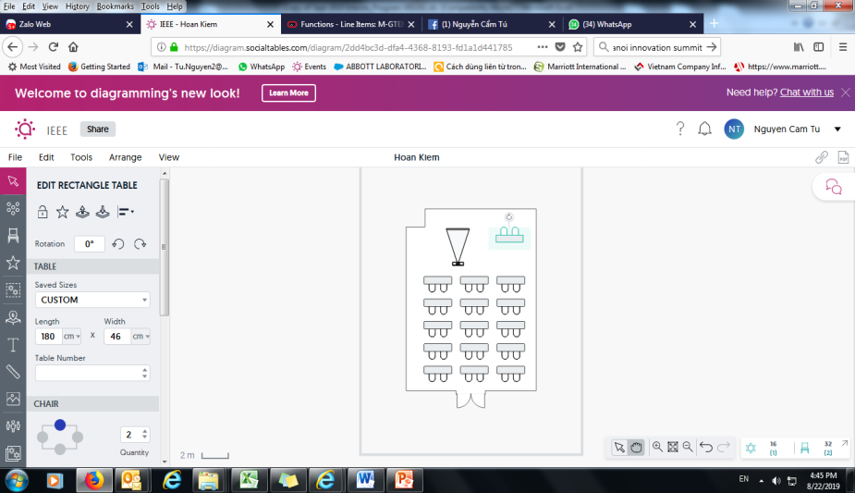
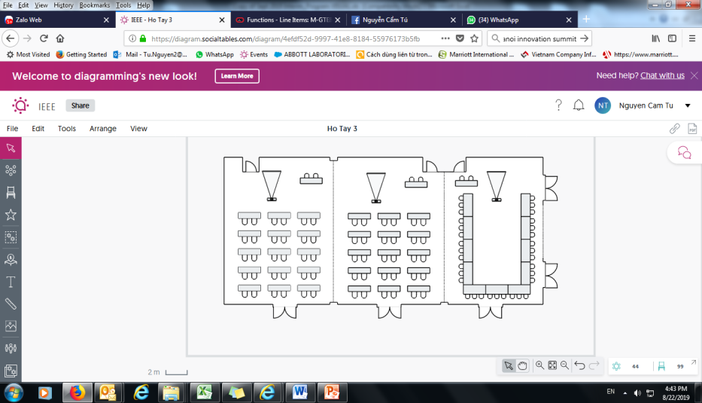
JW Marriot Hanoi Floor G

Slide 17
2019 Future Sessions
2019 Future Sessions
November 10-15, Hilton Waikoloa Village, Kona, HI, USA

Slide 18
Online Calendar Schedule
The WG meetings can also be added to your calendar.
802.11 WG meeting calendar is here: http://schedule.802world.com/ics/show?group=11
Other WGs and the 802 EC calendar are also available.
Note: the schedule on this calendar will be updated as will IMAT.

Slide 19
M3.6 II Meeting Registration
 | Primary | Secondary
802.11 - WLAN | 232 | 58
802.15 - WPAN | 37 | 68
802.18 R-Reg | 5 | 30
802.19 Coexistence | 3 | 46
802.24 - Smart Grid | 1 | 4
None | 1 | 0
Total | 279

Slide 20
M3.7 Recording attendance
It is a requirement that attendees record their participation at an 802.11 session and declare their affiliation. This record is usually made using the IMAT attendance system.
  If you wish to participate without recording attendance, send an email per session to the WG 2nd vice chair declaring your participation and affiliation. You cannot gain or maintain 802.11 voting membership using this method.
You must record 75% attendance of required 802.11 slots in a session for that session to count towards gaining or maintaining 802.11 voting membership
  You need a single IEEE-SA web account
    The IEEE SA web account requires a working email address
    do not remove your email address from the account
  Use the email address associated with that web account when registering attendance
    If you change email addresses, update the web account, don’t create a new web account, or your membership status may not be calculated properly
  Record attendance using this URL: IMAT.IEEE.ORG/

Slide 21
M3.8 Local File Document Server information
Links for Attendance, Documents, Registration and information about the session can be found at ieee802.linespeed.io (we recommend creating a bookmark).
Accessible from the Local Wi-Fi network:
SSID: IEEE802 -- Password: ieeeieee

Slide 22
3.9 Next Session reminder
Next 802 Plenary:
November 10-15, 2019
Hilton Waikoloa Village, Kona, HI, USA
    Registration and Event Information https://www.regonline.com/november2019ieee802plenary
Notes:
Also please let your groups know that by July 11th we have to have at least 60% of our blocked booked or we lose part of our remaining block.

Slide 23
802.11 Mid-Week Plenary
Agenda Items:
2.5 – Announcements
5.1 – Room Change Reports

Slide 24
W5.1 Room Change Requests
Release:
Additions:

Slide 25
802.11 WG Closing Plenary
Agenda Items:
3.1.1 – Straw Poll
3.1.2 -- Future venues status and discussion

Slide 26
F3.1.1 -Straw Poll regarding this meeting location
Straw Polls:
How many people would like to come back to this venue?
  Yes -- No

Slide 27
F3.1.2: Future Venue Insight
2019 Future Venues
November 10-15, Hilton Waikoloa Village, Kona, HI, USA

Slide 28
References
Plenary Meeting Status File: EC-16/66r10
https://mentor.ieee.org/802-ec/dcn/16/ec-16-0066-10-00EC-802-plenary-future-venue-contract-status.xlsx

