Slide 1
Revisiting the 20/40/80 MHz Tone Plan
Date: 2019-11-10
Authors:
Name | Affiliations | Address | Phone | Email
Brian Hart | Cisco Systems | 170 W Tasman Dr, San Jose CA 95134 |  | brianh@cisco.com
Notes:
September 2012

Slide 2
Situation A
11ax developed a tone plan optimized for throughput and the presence of the central RU26, with one distinct tone plan per bandwidth
At the development time, certain ultimate 11ax features were unknown, unclear or TBD:
  20 MHz-only STAs
  STAs reducing their BW for power savings
  Preamble-puncturing
This tone plan is implemented in all 11ax devices
802.11 has performed do-overs in the past
  e.g. 11ac simplified the pilot tone design wrt 11n

Slide 3
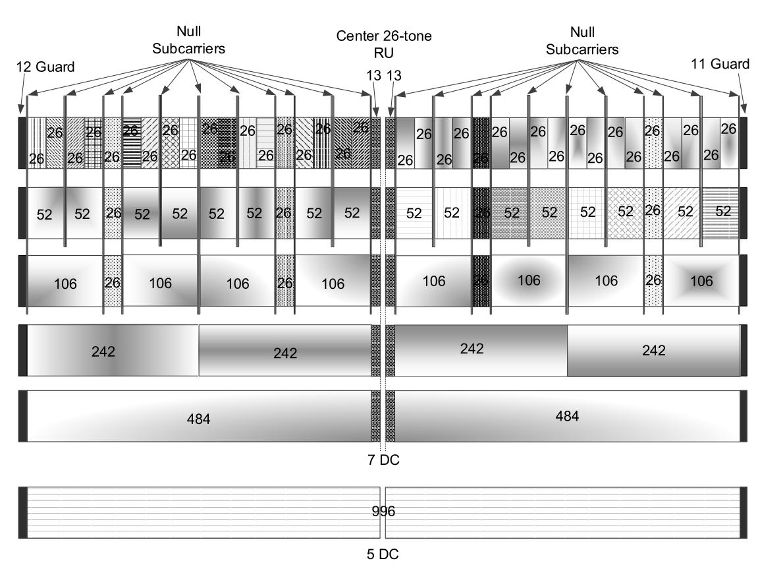
Problem A
Certain RUs are close to a
band edge or near a DC tone,
and these RUs are unavailable
to:
  20 MHz-only STAs
  STAs reducing their BW for power
  savings
  Preamble-puncturing (edge RUs only)
i.e. very difficult for a scheduler
to allocate
For example, for each row of the figure, when these RUs are unallocated, there is an efficiency loss of [19 24 35 2.5 2.5 0]%
Conversely, any new plan without these disadvantages will be a new tone plan, so 11be devices must implement both 11ax and 11be tone plans

Slide 4
Situation B
OFDMA provides maximum efficiency when UL/DL OFDMA always spans the BSS’s operating bandwidth.
A normal STA operating with 80 MHz bandwidth can participate in the P80 of the TX/RX of 80/160/80+80 MHz OFDMA PPDUs
A 20 MHz operating STA can optionally participate in the P20 of the TX/RX of a 40/80/160 MHz transmission
Further 11ax defined the optional Subchannel Selective Transmission (SST) feature
  A 20 MHz-only STA or 20 MHz operating STA that supports SST can occupy any 20 MHz and can participate in the TX/RX of OFDMA PPDUs of any bandwidth
  A normal STA that supports SST can occupy any 80 MHz within 160/80+80 MHz

Slide 5
Problem B
Worst case scenario that wastes minimal spectrum: 20M STAs in 20M PPDU, 40M STAs in 40M PPDU, 80M STAs in 80M PPDU
STAs operating in lower bandwidths may be incapable of participating in wider bandwidth PPDUs, increasing overheads
  Because tone plan makes it much harder!
  And no solution exists for 40 MHz STAs!
Even if capable, lack of support of SST causes a pile-up on P20 meaning S20/S40/S80 are under-utilized.
Best case scenario: 40MHz STAs don’t play nice
Pile-up on P20
Without SST, a huge amount of spectrum
is under-utilized
40MHz STA
One PPDU
One PPDU
20MHz STA
One PPDU
80MHz STA
One PPDU
One PPDU
160MHz STA
One PPDU
320MHz STA?
One PPDU

Slide 6
Overarching Goal
Will be vital for 160 and 320MHz
Whatever a STA’s capability
  20 MHz only, 160 MHz
Whatever a STA’s power saving mode
  20 / 40 / 80 /160 MHz
Whatever subchannel the STA is parked on (P20 or another via SST or similar)
  P20 / S20 / 20 MHz in S40 / 20 MHz in S80 / 20 MHz in S160
Whatever is the EHTMU or EHTTB transmission bandwidth determined by the AP
  20 / 40/ 80 / 160 / 320 MHz
Whatever subchannels need to be punctured
  20 / 40 / 60 / 80 / 100 / 120 …
… the 802.11be PHY must define mandatory modes that enable the STA to participate in the transmission.

Slide 7
Helpful Technology: A Better Tone Plan
Design Principles
Seek a 20MHz-aligned tone plan with a much reuse and symmetry
  For different bandwidths
  With respect to 11ax
Design a tone plan for a 20 MHz tile and replicate it to 40 and 80 MHz
  Works equally well for 80+80, 160, 160+160, 320 MHz and so forth
To support TX/RX with 20/40/80 MHz BWs centered on any 20/40/80 MHz channel,
  The tone plan includes DC tones every n*10 MHz,
  The tone plan generally avoids RUs that near a 20 MHz boundary
To avoid inefficiency, a new RU, RU18, is defined to occupy the otherwise-unused subcarriers between adjacent 20 MHz tiles
  Not used at the band-edge
  Still has room for 5 DC subcarriers for 40 and 80 MHz STAs
The RU size is selected to maximize commonality with existing RUs
  This is possible for the larger RUs but not all of the smaller RUs

Slide 8
Helpful
Technology
The 20 MHz tile (top right) is colored cyan
The extended 20 MHz tile (right) merges the left and/or right guard tones with an RU and is colored green
The guard and DC tones are white; the null tones are black
RU18 is colored yellow. RU18 and 5DC tones replace the guard tones between two 20 MHz tiles
Extreme consistency across 20 MHz tiles and PPDU bandwidths

Slide 9
Helpful Technology: RU Details
RU / nUsedTones | nDataTones | nPilotTones | Reuses existing blocks? | Efficiency wrt 80M 11ax STAs in 80M BSS | Efficiency wrt 20M 11ax STAs in 80M BSS
RU18 | 16 | 2 | N | N/A | N/A
RU28 | 26 (or 24) | 2 (or 4) | N (or Y) | 99.1% | 122.2%
RU56 | 52 | 4 | Y (11n/ac) | 99.1% | 131%
RU114 | 108 | 6 | Y (11n/ac) | 97.4% | 149%
RU230 | 222 | 8 | N | 97.5% | 100%
RU484 | 468 | 16 | Y | 99.2% | 101.7%
RU996 | 980 | 16 | Y | 100% | 100%
This is remarkably beautiful
The largest RUs are unchanged from 11ax
For the corner case of all STAs operating at 80 MHz, the efficiency of the tone plan is very similar to 11ax
For a poor case of all 20MHz-only STAs with SST, the tone plan is never worse and up to 49% more efficient than 11ax
For the worst case of all 20 MHz-operating STAs, easily augmented with SST in 11be due to the more favorable tone plan, the tone plan is approx. 300% more efficient than 11ax

Slide 10
Conclusion
We identify limitations with 11ax OFDMA that will only get worse with 320 MHz
We identify that the 11ax tone plan for 20/40/80 MHz is part of the problem
We propose new, helpful technology: an alternative tone plan that is very well matched to:
  20MHz-only STAs + STAs that reduce their bandwidth for power saving reasons + Preamble puncturing + SST
  This tone plan is much simpler than the 11ax tone plan, due to its very high degree of consistency and symmetry
But, the overarching goal is to ensure that any STA can participate in any OFDMA transmission under all circumstances

Slide 11
Backup

Slide 12
Strawpoll 1
Do you support that:
Whatever a STA’s capability
Whatever a STA’s power saving mode
Whatever subchannel the STA is parked on (P20 or another via SST or similar)
Whatever is the EHTMU or EHTTB transmission bandwidth determined by the AP
Whatever subchannels need to be punctured
… the 802.11be PHY must define mandatory modes of operation that enable the STA to participate in the transmission?
Y / N / A

Slide 13
Strawpoll 2
Do you support that the 11be tone plan should be designed to improve support, with respect to the 11ax tone plan, for 20 MHz-only STAs, preamble puncturing and STAs that reduce their operating bandwidth below the BSS operating bandwidth?
Y / N / A

Slide 14
Just the Figures …

