Slide 1
Revisiting the 20/40/80 MHz Tone Plan
Date: 2019-09-06
Authors:
Name | Affiliations | Address | Phone | Email
Brian Hart | Cisco Systems | 170 W Tasman Dr, San Jose CA 95134 |  | brianh@cisco.com
Notes:
September 2012

Slide 2
Situation
11ax developed a tone plan optimized for throughput and the presence of the central RU26, with one distinct tone plan per bandwidth
At the development time, certain ultimate 11ax features were unknown, unclear or TBD:
  20 MHz-only STAs
  STAs reducing their BW for power savings
  Preamble-puncturing
This tone plan is implemented in all 11ax devices
802.11 has performed do-overs in the past
  e.g. 11ac simplified the pilot tone design wrt 11n

Slide 3
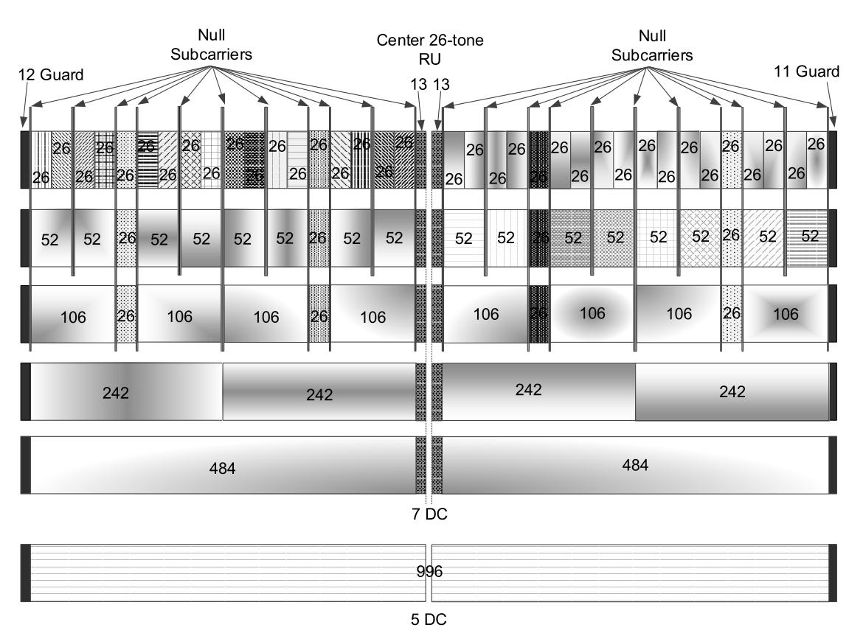
Problem
Certain RUs are close to a
band edge or near a DC tone,
and these RUs are unavailable
to:
  20 MHz-only STAs
  STAs reducing their BW for power
  savings
  Preamble-puncturing (edge RUs only)
i.e. very difficult for a scheduler
to allocate
For example, for each row of the figure, when these RUs are unallocated, there is an efficiency loss of [19 24 35 2.5 2.5 0]%
Conversely, any new plan without these disadvantages will be a new tone plan, so 11be devices must implement both 11ax and 11be tone plans

Slide 4
Solution: Design Principles
Seek a streamlined tone plan with a very high degree of reuse
  For different bandwidths
  With respect to 11ax
Design a tone plan for a 20 MHz tile and replicate it to 40 and 80 MHz
  Works equally well for 80+80, 160, 160+160 MHz and so forth
The tone plan includes DC tones every n*10 MHz, to support RXs with 20/40/80 MHz BWs centered on any 20/40/80 MHz channel
To avoid inefficiency, a new RU, RU18, is defined to occupy the otherwise-unused subcarriers between the 20 MHz tiles
  Not used at the band-edge
  Still has room for 5 DC subcarriers for 40 and 80 MHz STAs
The RU size is selected to maximize commonality with existing RUs
  This is possible for the larger RUs but not all of the smaller RUs

Slide 5
Solution
The 20 MHz tile (top right) is colored cyan
The extended 20 MHz tile (top right) merges the left and/or right guard tones with an RU and is colored green
The guard and DC tones are white; the null tones are black
RU18 is colored yellow. RU18 and 5DC tones replace the guard tones between two 20 MHz tiles
Extreme consistency across 20 MHz tiles and PPDU bandwidths

Slide 6
Solution: RU Details
RU / nUsedTones | nDataTones | nPilotTones | Reuses existing blocks? | Efficiency wrt 80M 11ax STAs in 80M BSS | Efficiency wrt 20M 11ax STAs in 80M BSS
RU18 | 16 | 2 | N | N/A | N/A
RU28 | 26 (or 24) | 2 (or 4) | N (or Y) | 99.1% | 122.2%
RU56 | 52 | 4 | Y | 99.1% | 131%
RU114 | 108 | 6 | Y | 97.4% | 149%
RU230 | 222 | 8 | N | 97.5% | 100%
RU484 | 468 | 16 | Y | 99.2% | 101.7%
RU996 | 980 | 16 | Y | 100% | 100%
This is remarkably beautiful
The largest RUs are unchanged from 11ax
For the corner case of all STAs operating at 80 MHz, the efficiency of the tone plan is very similar to 11ax
For the worst case of all STAs operating at 20 MHz, the tone plan is never worse and up to 49% more efficient than 11ax

Slide 7
Conclusion
We propose a do-over of the tone plan for 20/40/80 MHz
This tone plan is very well matched to:
  20MHz-only STAs
  STAs that reduce their bandwidth below 80 MHz for power saving reasons
  Preamble puncturing
This tone plan is much simpler than the 11ax tone plan, due to its very high degree of consistency and symmetry
As a TG, we reflexively prefer an legacy-based design because it is already-implemented yet, when the gains and simplicity are high, we have chosen a different, simpler path in the past.
This is the last chance to upgrade the tone plan, since whatever we pick will be reused for 11bv, 11cg, 11ct …

Slide 8
Backup

