Slide 1
July 2019
Privacy protection in Wi-Fi analytics systems
Date: 2019-07-17
Authors:
Name | Affiliation | Contact
Mathieu Cunche | Univ. Lyon, INSA Lyon, Inria, CITI | mathieu.cunche@insa-lyon.fr
Slide <number>
Mathieu Cunche
Notes:
doc.: IEEE 802.11-yy/xxxxr0
Month Year
John Doe, Some Company
Page <number>

Slide 2
July 2019
Abstract
Systems collecting network information for analytics and tracking purposes have been used for some time. Data collected by those systems can result in privacy threats and may be conflicting with data protection regulations.
Slide <number>
Mathieu Cunche
Notes:
doc.: IEEE 802.11-yy/xxxxr0
Month Year
John Doe, Some Company
Page <number>

Slide 3
July 2019
Privacy protection principles
Desirable privacy enhancing features in any data collection system
User information
Consent & Opt-out
Data anonymization
Slide <number>
Mathieu Cunche
Notes:
doc.: IEEE 802.11-yy/xxxxr0
Month Year
John Doe, Some Company
Page <number>

Slide 4
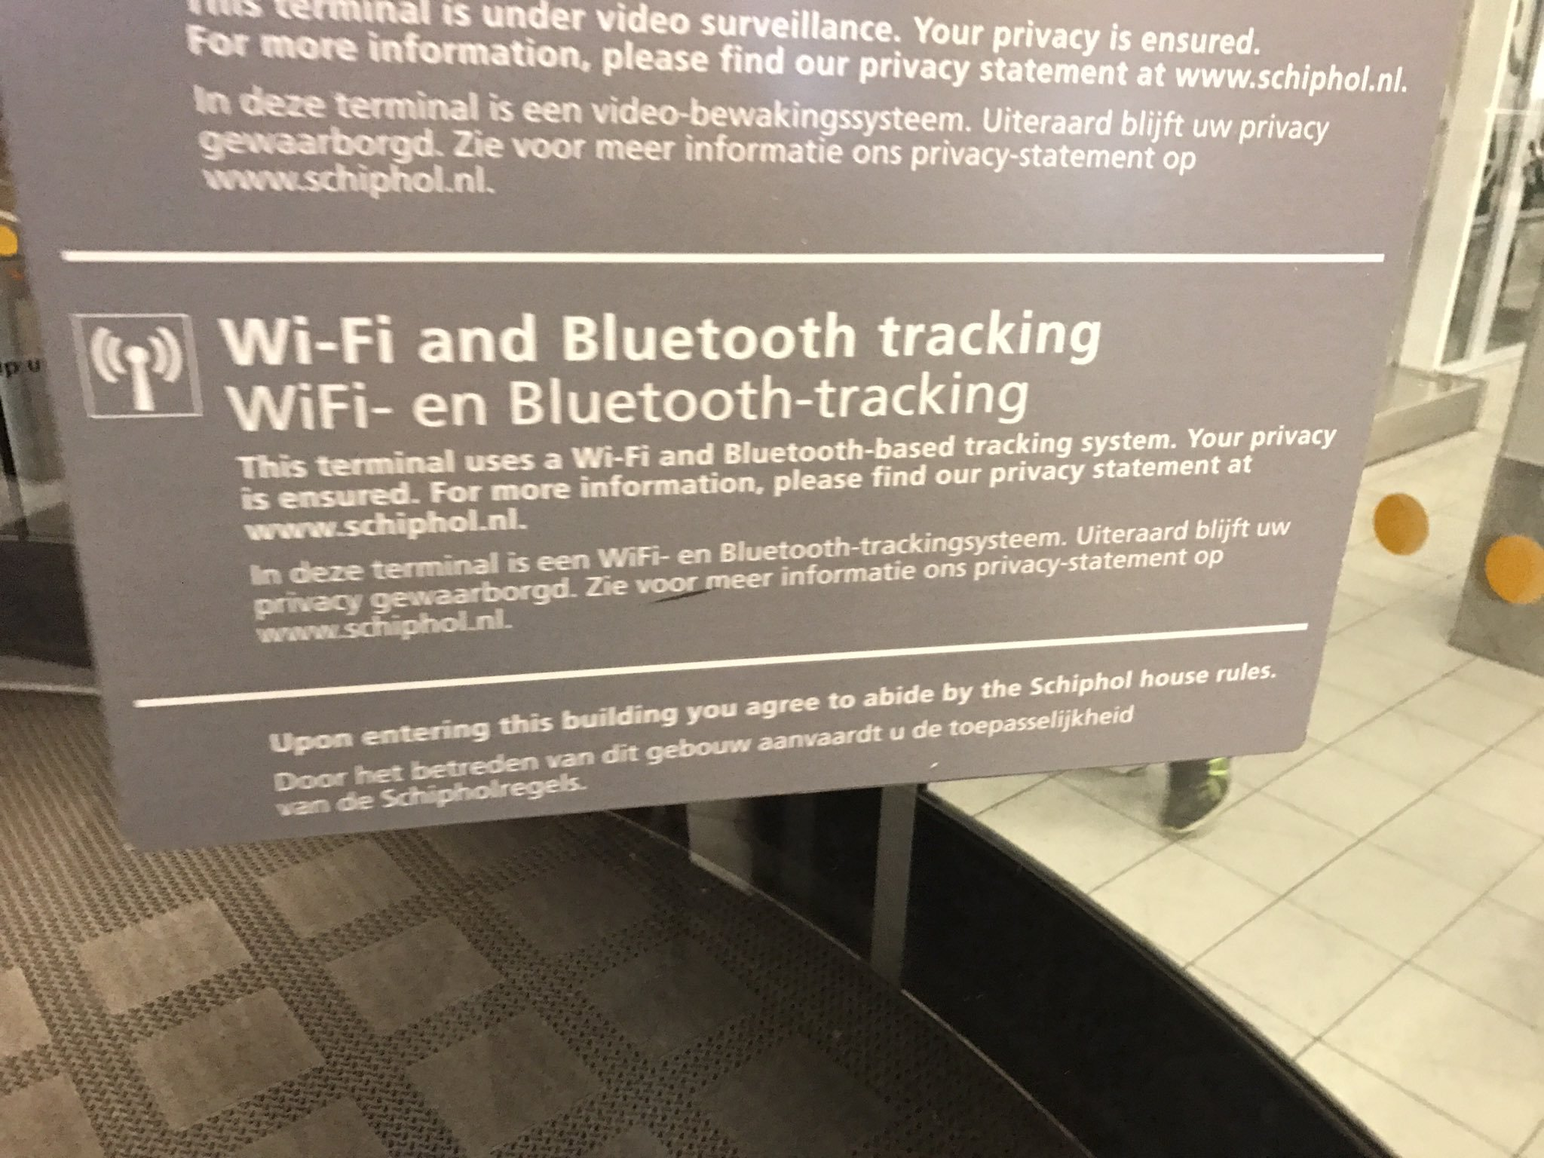
July 2019
Subject Information
State of the art subject information in Wi-Fi tracking
Slide <number>
Mathieu Cunche
Notes:
doc.: IEEE 802.11-yy/xxxxr0
Month Year
John Doe, Some Company
Page <number>

Slide 5
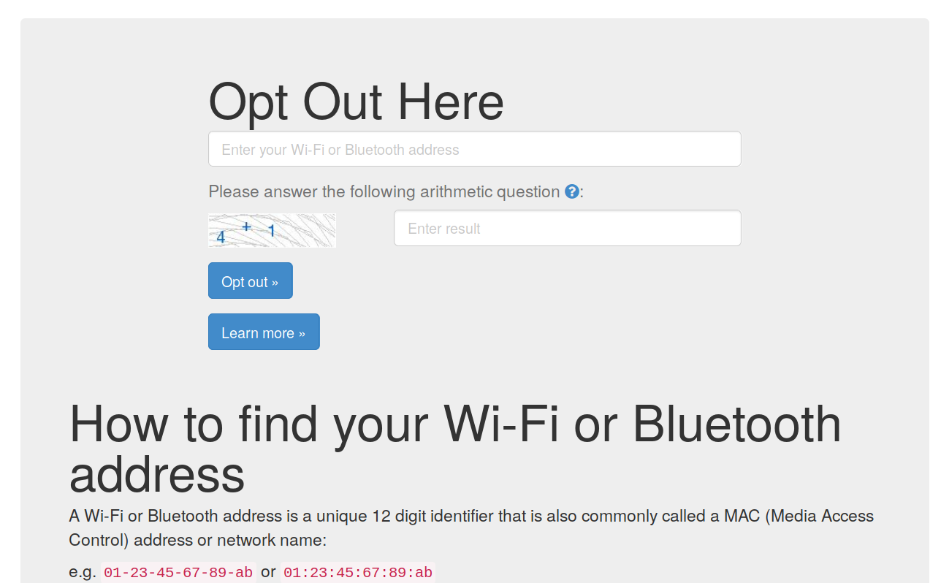
July 2019
Consent & Opt-out
Consent is never asked
Opt-out solution may be offered (e.g. https://optout.smart-places.org)
Slide <number>
Mathieu Cunche
Notes:
doc.: IEEE 802.11-yy/xxxxr0
Month Year
John Doe, Some Company
Page <number>

Slide 6
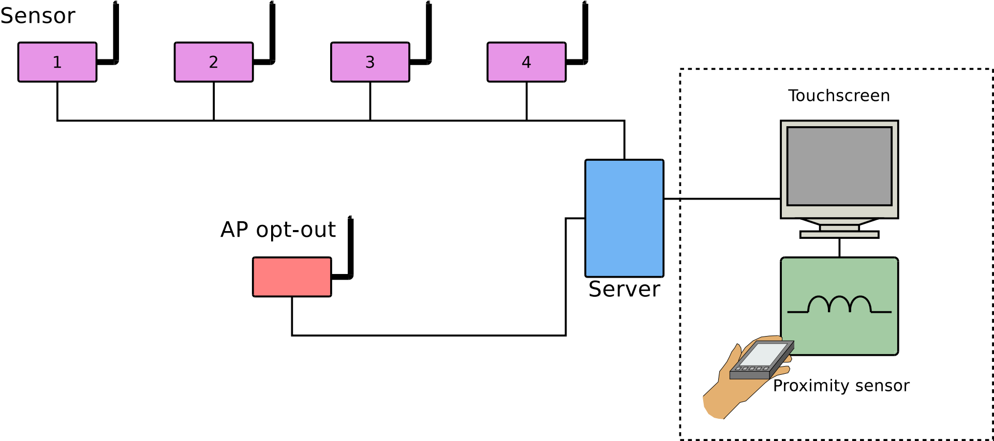
July 2019
Wombat: An experimental Wi-Fi tracking system
Detects Wi-Fi devices and collect mobility data
Deployed as demonstrator at Cité Des Sciences et de l’Industrie (Paris) for 1 year
Slide <number>
Mathieu Cunche
Notes:
doc.: IEEE 802.11-yy/xxxxr0
Month Year
John Doe, Some Company
Page <number>

Slide 7
July 2019
Wombat: Wi-Fi based opt-out mechanism
Dummy AP with explicit SSID, e.g. "Wi-Fi Do not track"
  User connect to AP to opt-out
  MAC address of STA collected during Association process
  MAC address added to a black-list
  Data coming from black-listed devices is dropped
Slide <number>
Mathieu Cunche
Notes:
doc.: IEEE 802.11-yy/xxxxr0
Month Year
John Doe, Some Company
Page <number>

Slide 8
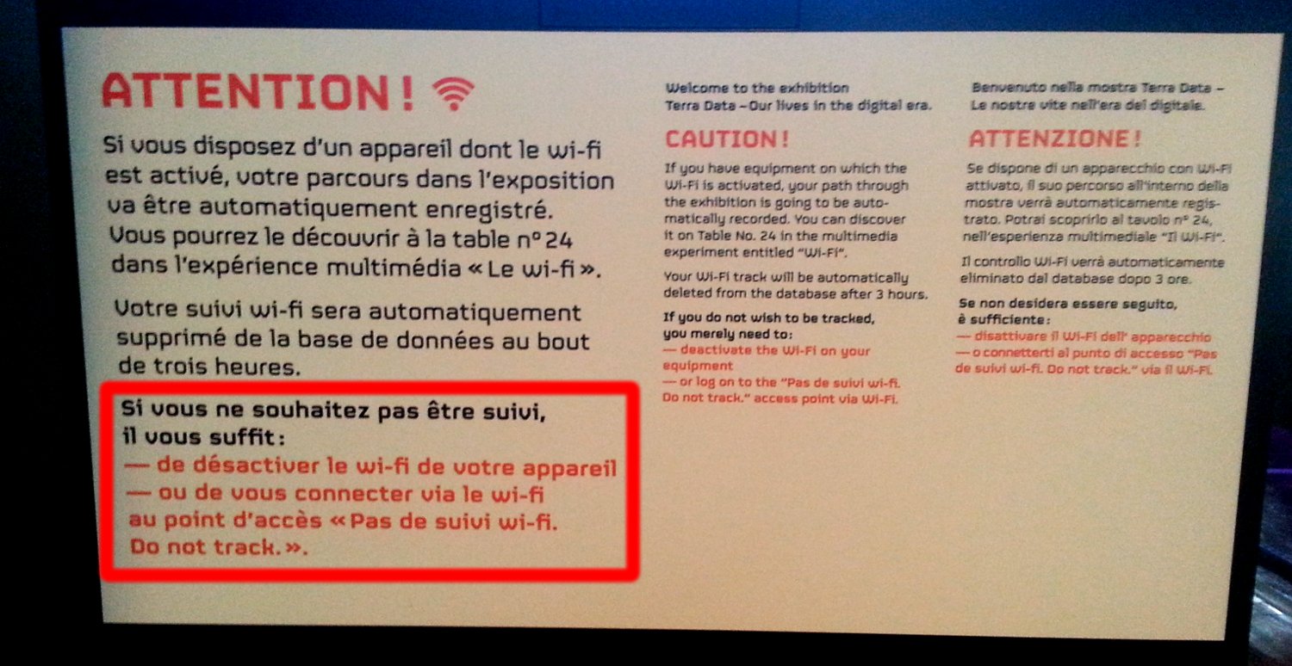
July 2019
Wombat: Wi-Fi based opt-out mechanism
Slide <number>
Mathieu Cunche
Notes:
doc.: IEEE 802.11-yy/xxxxr0
Month Year
John Doe, Some Company
Page <number>

Slide 9
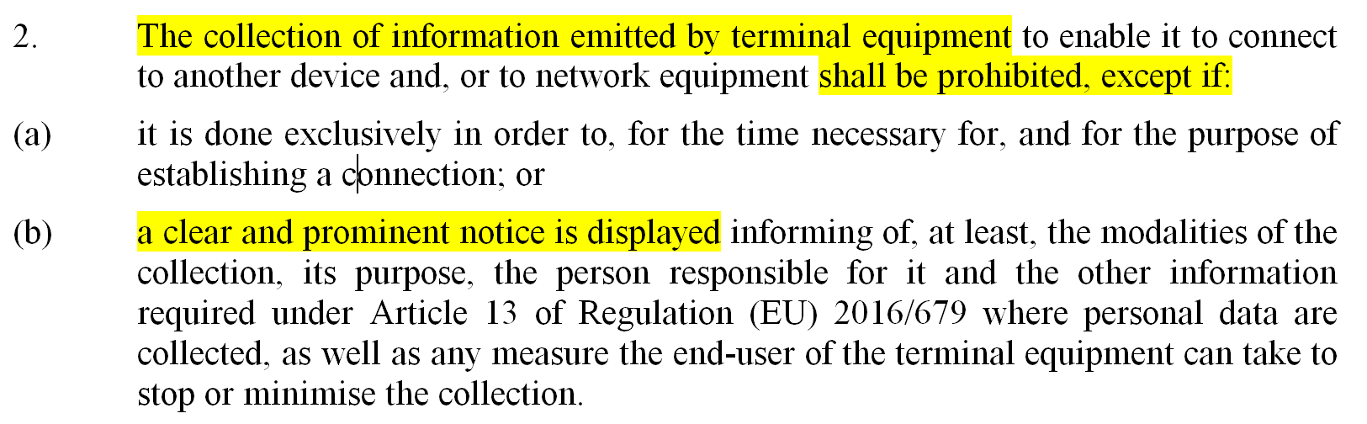
July 2019
Consent in new regulations
Opt-out is not a valid solution under GDPR: prior consent is required
  e-Privacy directive may relax this requirement
  How to to collect consent in Wi-Fi tracking context ?
Slide <number>
Mathieu Cunche
Notes:
doc.: IEEE 802.11-yy/xxxxr0
Month Year
John Doe, Some Company
Page <number>

Slide 10
July 2019
Framework for information and consent
Leverage discovery mechanism of wireless technologies (802.11, BLE)
Tracking system broadcast information
  Data collected, privacy policies, data controler coordinates ...
  Data carried in Vendor/Manufacturer specific fields
Subject connect to communicate consent
Slide <number>
Mathieu Cunche
Notes:
doc.: IEEE 802.11-yy/xxxxr0
Month Year
John Doe, Some Company
Page <number>

Slide 11
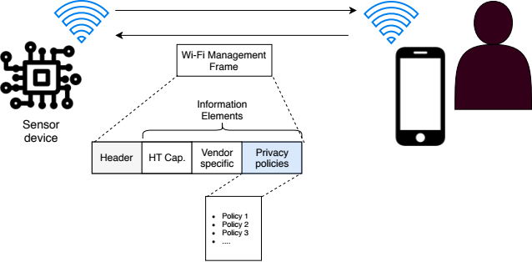
July 2019
Framework for information and consent
Slide <number>
Mathieu Cunche
Notes:
doc.: IEEE 802.11-yy/xxxxr0
Month Year
John Doe, Some Company
Page <number>

Slide 12
July 2019
Data anonymization
Wi-Fi presence data should must be anonymized
Hashing the identifiers (MAC addr.) do not work
  Simple hashing can be reversed
  Still considered by some as sufficient
Slide <number>
Mathieu Cunche
Notes:
doc.: IEEE 802.11-yy/xxxxr0
Month Year
John Doe, Some Company
Page <number>

Slide 13
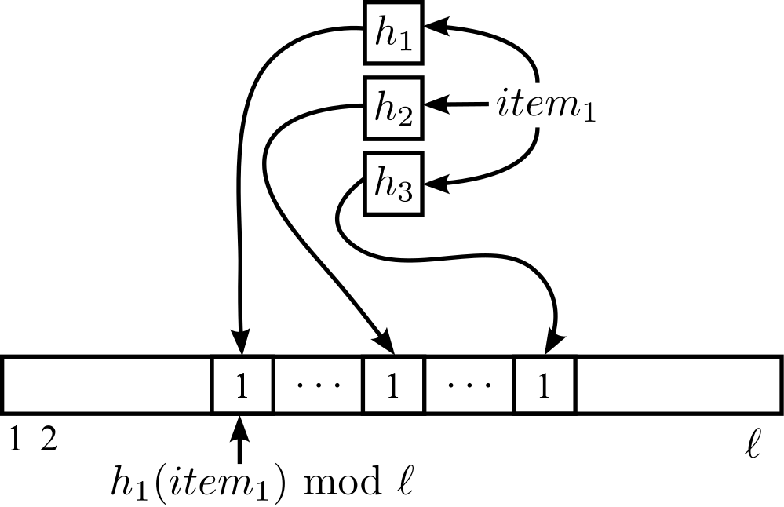
July 2019
Datastructures with Differential Privacy
Bloom-Filter supporting cardinal estimation
Perturbation to enforce Differential Privacy
Slide <number>
Mathieu Cunche
Notes:
doc.: IEEE 802.11-yy/xxxxr0
Month Year
John Doe, Some Company
Page <number>

Slide 14
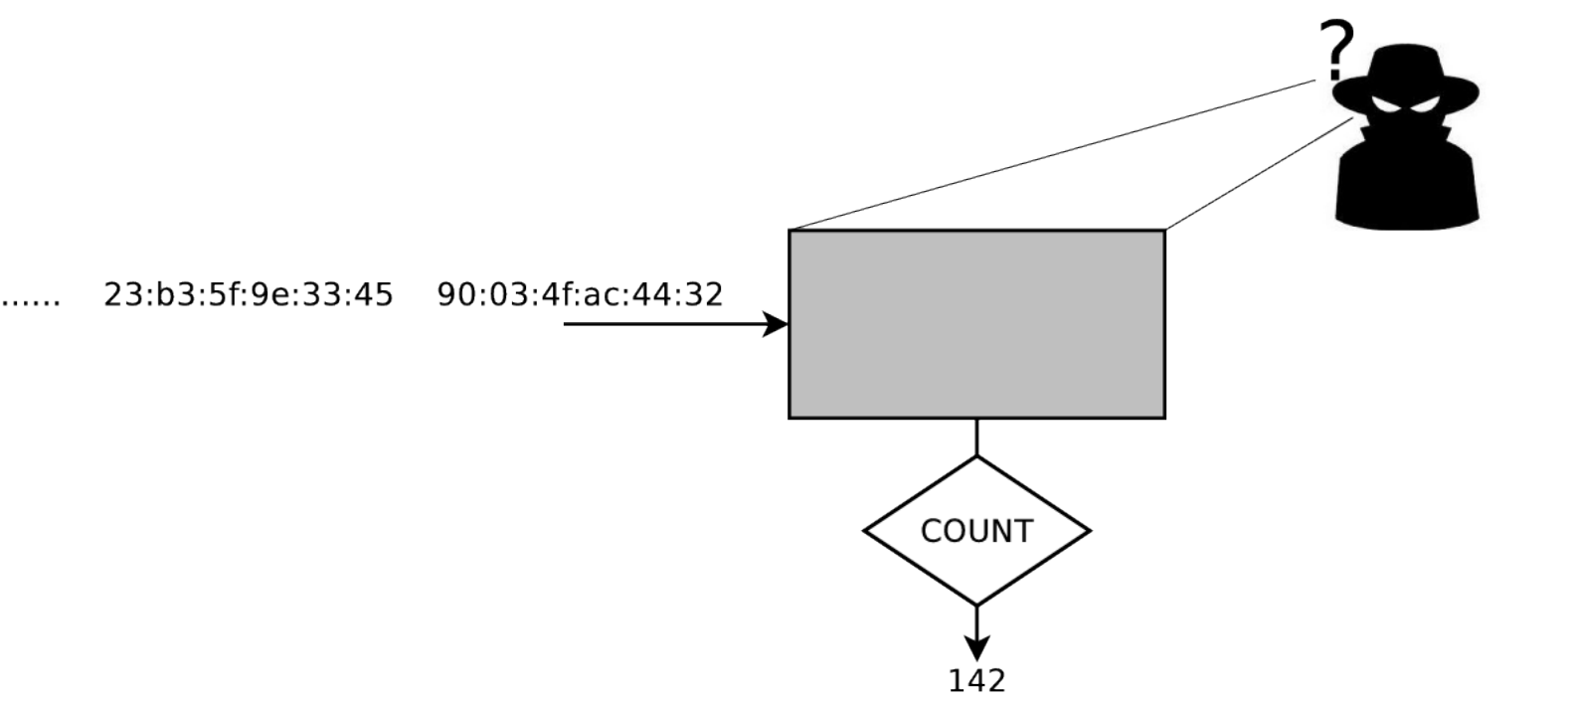
July 2019
Datastructures with Differential Privacy
No information about single identifiers can be learned from the datastructure
Estimation of the number of stored identifier is possible
Slide <number>
Mathieu Cunche
Notes:
doc.: IEEE 802.11-yy/xxxxr0
Month Year
John Doe, Some Company
Page <number>

Slide 15
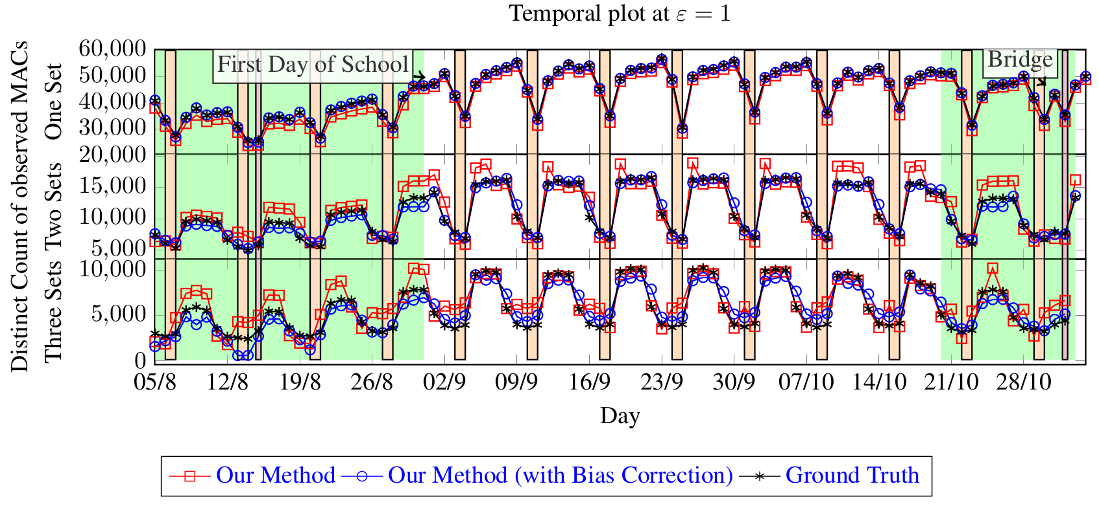
July 2019
Datastructures with Differential Privacy
Evaluation on a real world data set of MAC addr.
Slide <number>
Mathieu Cunche
Notes:
doc.: IEEE 802.11-yy/xxxxr0
Month Year
John Doe, Some Company
Page <number>

Slide 16
July 2019
Datastructures with Differential Privacy
Strong privacy requirements (GDPR ...)
May seem difficult or impossible to implement
But technical solutions may be possible ...
Some are currently being developed
  Exception in regulations are not necessarily required (e.g. ePrivacy 8-b)
Slide <number>
Mathieu Cunche
Notes:
doc.: IEEE 802.11-yy/xxxxr0
Month Year
John Doe, Some Company
Page <number>

Slide 17
July 2019
References
Levent Demir, Mathieu Cunche, and Cédric Lauradoux. “Analysing the privacy policies of Wi-Fi trackers”. In: Workshop on Physical Analytics. Bretton Woods, United States: ACM, June 2014. doi: 10.1145/2611264.2611266
Célestin Matte and Mathieu Cunche. “Wombat: An experimental Wi-Fi tracking system”. In: 8e édition de l’Atelier sur la Protection de la Vie Privée (APVP). Correncon, France, July 2017. url: https://hal.inria.fr/hal-01679007
Mathieu Cunche, Daniel Le Métayer, and Victor Morel. “A Generic Information and Consent Framework for the IoT”. In: TRUSTCOM 2019 - 18th IEEE International Conference on Trust, Security and Privacy in Computing and Communications. 2019. url: https://hal.inria.fr/hal-02166181
Mohammad Alaggan, Mathieu Cunche, and Sébastien Gambs. “Privacy-preserving Wi-Fi Analytics”. en. In:Proceedings on Privacy Enhancing Technologies 2018.2 (Apr. 2018), pp. 4–26. doi: 10.1515/popets-2018-0010.
Slide <number>
Mathieu Cunche
Notes:
doc.: IEEE 802.11-yy/xxxxr0
Month Year
John Doe, Some Company
Page <number>

