Slide 1
July 2019
The pitfalls of address randomization in wireless networks
Date: 2019-07-17
Authors:
Name | Affiliation | Contact
Mathieu Cunche | Univ. Lyon, INSA Lyon, Inria, CITI | mathieu.cunche@insa-lyon.fr
Slide 1
Mathieu Cunche
Notes:
doc.: IEEE 802.11-yy/xxxxr0
Month Year
John Doe, Some Company
Page 1

Slide 2
July 2019
Abstract
Address randomization has been adopted by vendors as a technique to protect users against passive tracking. This anti-tracking mechanism can be undermine by some elements of transmitted frames. Those issues should be carefully considered by developers.
Slide 1
Mathieu Cunche
Notes:
doc.: IEEE 802.11-yy/xxxxr0
Month Year
John Doe, Some Company
Page 1

Slide 3
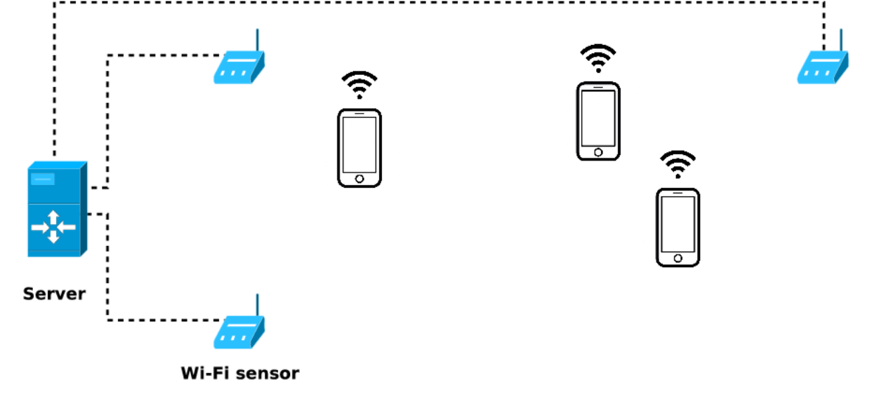
July 2019
Tracking people using radio signals
Set of sensors capturing identifiers found in frames
User detection and tracking
Slide 1
Mathieu Cunche
Notes:
doc.: IEEE 802.11-yy/xxxxr0
Month Year
John Doe, Some Company
Page 1

Slide 4
July 2019
Discovery protocols in wireless networks
Discovery frames: probe requests / advertising packets
Slide 1
Mathieu Cunche
Notes:
doc.: IEEE 802.11-yy/xxxxr0
Month Year
John Doe, Some Company
Page 1

Slide 5
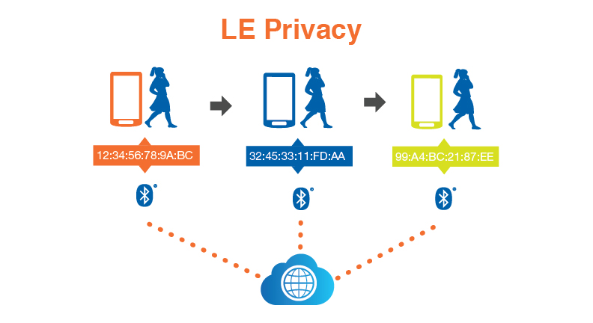
July 2019
Address randomization
Adoption of address randomization
Random WiFi addresses implemented in major systems (iOS, Android, Windows, GNU/Linux)
Random BLE addresses since version 4.2 of Bluetooth
Slide 1
Mathieu Cunche
Notes:
doc.: IEEE 802.11-yy/xxxxr0
Month Year
John Doe, Some Company
Page 1

Slide 6
July 2019
Model
Attacker model:
Capabilities: Monitor the wireless channel(s)
Objective: track a device over time by linking frames
Slide 1
Mathieu Cunche
Notes:
doc.: IEEE 802.11-yy/xxxxr0
Month Year
John Doe, Some Company
Page 1

Slide 7
July 2019
Secondary Stable Identifiers
Secondary stable identifiers: several byte-long fields whose value is constant across frames
Slide 1
Mathieu Cunche
Notes:
doc.: IEEE 802.11-yy/xxxxr0
Month Year
John Doe, Some Company
Page 1

Slide 8
July 2019
Secondary Stable Identifiers
WPS UUID in Wi-Fi frames
A 128 bits UUID derived from the MAC address
Slide 1
Mathieu Cunche
Notes:
doc.: IEEE 802.11-yy/xxxxr0
Month Year
John Doe, Some Company
Page 1

Slide 9
July 2019
Synchronization issues
All identifiers must be rotated together with the device address
Those change must be synchronized ...
Otherwise the identifier can be used to trivially link two consecutive addressesA 128 bits UUID derived from the MAC address
Slide 1
Mathieu Cunche
Notes:
doc.: IEEE 802.11-yy/xxxxr0
Month Year
John Doe, Some Company
Page 1

Slide 10
July 2019
Synchronization issues
Ex.: Bad synchronization of Nearby Id in Apple Handoff (BLE)
Slide 1
Mathieu Cunche
Notes:
doc.: IEEE 802.11-yy/xxxxr0
Month Year
John Doe, Some Company
Page 1

Slide 11
July 2019
Predictable fields
Predictable field: a fields whose value can be computed from the previous occurrences(s)
Slide 1
Mathieu Cunche
Notes:
doc.: IEEE 802.11-yy/xxxxr0
Month Year
John Doe, Some Company
Page 1

Slide 12
July 2019
Predictable fields
Ex.: sequence number field in early implementations of address randomization
Slide 1
Mathieu Cunche
Notes:
doc.: IEEE 802.11-yy/xxxxr0
Month Year
John Doe, Some Company
Page 1

Slide 13
July 2019
Content based fingerprinting
Fingerprint: set of stable fields that can be used to identify a device
Slide 1
Mathieu Cunche
Notes:
doc.: IEEE 802.11-yy/xxxxr0
Month Year
John Doe, Some Company
Page 1

Slide 14
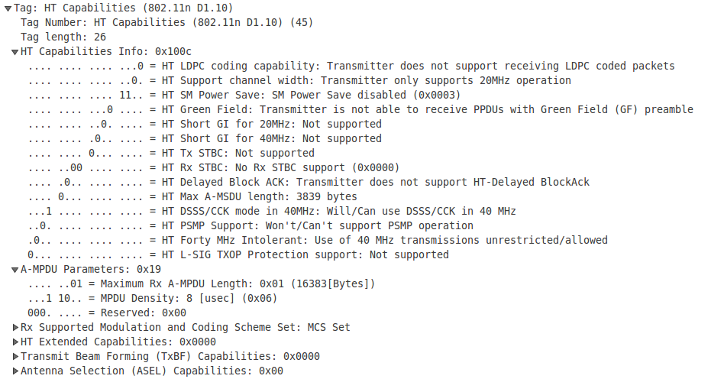
July 2019
Content based fingerprinting
Ex.: Wi-Fi information elements in probe requests
Slide 1
Mathieu Cunche
Notes:
doc.: IEEE 802.11-yy/xxxxr0
Month Year
John Doe, Some Company
Page 1

Slide 15
July 2019
Active attacks
Attacker allowed to capture, replay, forge frames
Ex.: Revisited Karma Attack
Attack: set up Karma AP and wait for devices to reveal their MAC addr
Slide 1
Mathieu Cunche
Notes:
doc.: IEEE 802.11-yy/xxxxr0
Month Year
John Doe, Some Company
Page 1

Slide 16
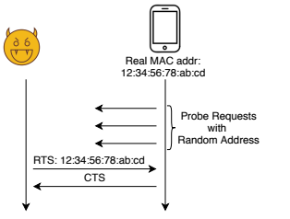
July 2019
Active attacks
Ex.: Send control frame attacks
Send RTS frame to the target real MAC addr; it will respond if in range
Slide 1
Mathieu Cunche
Notes:
doc.: IEEE 802.11-yy/xxxxr0
Month Year
John Doe, Some Company
Page 1

Slide 17
July 2019
Technical countermeasures
Identifiers
Remove them or rotate them with device address
Predictable fields
Reset to random value when rotating device address
Content-based fingerprinting
Reduce content to bare minimum
Timing-based fingerprinting
Introduce randomness in timings
Replay attacks
Timestamps and authentication
Slide 1
Mathieu Cunche
Notes:
doc.: IEEE 802.11-yy/xxxxr0
Month Year
John Doe, Some Company
Page 1

Slide 18
July 2019
Lessons learned
Bugs: new mechanisms integrated in already complex systems
Lack of specifications: no specification for address randomization in Wi-Fi
Specifications:
Too much freedom given to vendors ? (Vendor specific fields)
Privacy is not always considered
Interactions with privacy and security researchers could be improved
Slide 1
Mathieu Cunche
Notes:
doc.: IEEE 802.11-yy/xxxxr0
Month Year
John Doe, Some Company
Page 1

Slide 19
July 2019
Manufacturer specific data
Manufacturer/Vendor Specific Data: fields dedicated to carry custom data
Available in BLE and Wi-Fi
Up to 32 bytes of data for custom applications
Used to implement Proximity Protocols
Custom protocols for close range applications
Google Nearby, Apple Continuity, Microsoft CDP ...
Activity transfer, pairing, Instant Hotspot
No specification/restriction on their content
Source of major privacy and security issues in BLE
Slide 1
Mathieu Cunche
Notes:
doc.: IEEE 802.11-yy/xxxxr0
Month Year
John Doe, Some Company
Page 1

Slide 20
July 2019
Manufacturer specific data
Manufacturer/Vendor Specific Data: fields dedicated to carry custom data
Available in BLE and Wi-Fi
Up to 32 bytes of data for custom applications
Used to implement Proximity Protocols
Custom protocols for close range applications
Google Nearby, Apple Continuity, Microsoft CDP ...
Activity transfer, pairing, Instant Hotspot
No specification/restriction on their content
Source of major privacy and security issues in BLE
Slide 1
Mathieu Cunche
Notes:
doc.: IEEE 802.11-yy/xxxxr0
Month Year
John Doe, Some Company
Page 1

Slide 21
July 2019
Conclusion
Address Randomization is hard
Complex protocols and a lot of freedom left to vendors
Wireless networks are affected by other privacy issues
Activity inference, inventory attacks, leaks of private data ...
Issues that are likely to grow …
Growing number of connected objects using wireless communications (IoT, wearables …)
Growing number of the applications and use cases (smarthome, health, V2X, …)
Growing number of number of standards and protocols (LPWAN, 802.11p, Z-Wave, Zigbee, LPD433 ...)
Slide 1
Mathieu Cunche
Notes:
doc.: IEEE 802.11-yy/xxxxr0
Month Year
John Doe, Some Company
Page 1

Slide 22
July 2019
References
Julien Freudiger. “How talkative is your mobile device?: an experimental study of Wi-Fi probe requests”. In: Proceedings of the 8th ACM Conference on Security & Privacy in Wireless and Mobile Networks. ACM, 2015, p. 8
Mathy Vanhoef et al. “Why MAC Address Randomization is Not Enough: An Analysis of Wi-Fi Network Discovery Mechanisms”. In: Proceedings of the 11th ACM on Asia Conference on Computer and Communications Security. ASIA CCS ’16. New York, NY, USA: ACM, 2016, pp. 413–424. isbn: 978-1-4503-4233-9.
Jeremy Martin, Travis Mayberry, et al. “A Study of MAC Address Randomization in Mobile Devices and When it Fails”. In: Proceedings on Privacy Enhancing Technologies (Mar. 2017), pp. 268–286. (Visited on 03/10/2017)
“Saving Private Addresses: An Analysis of Privacy Issues in the Bluetooth-Low-Energy Advertising Mechanism”. In: (2019). Under review and embargo due to responsible disclosure
Jeremy Martin, Douglas Alpuche, et al. “Handoff All Your Privacy: A Review of Apple’s Bluetooth Low Energy Implementation”. In:arXiv:1904.10600 [cs] (Apr. 2019). arXiv: 1904.10600. url: http://arxiv.org/abs/1904.10600
Slide 1
Mathieu Cunche
Notes:
doc.: IEEE 802.11-yy/xxxxr0
Month Year
John Doe, Some Company
Page 1

