Slide 1
Performance aspects of Multi-link operations
Date: 2019-09-05
Authors:
Name | Affiliations | Address | Phone | Email
Dmitry Akhmetov | Intel
Laurent Cariou
Notes:
September 2012

Slide 2
Motivation for Multi-link operation.
New wireless devices are expected to have multi-band/channel capabilities
These new devices will/may be able to operate on different channels/band independently
  Independent channel access
  Independent TX / RX operation
  Unified TX/RX buffers for smooth and speedy operations
Benefits
  Increased/improved throughput
    Gain scales proportionally to a number of links
  Improved end-to-end latency
  Potentially data/mgmt plane separation
  Potential for link aggregation
  Enable new use cases
EHT MLLE 1
STA
STA
Link 1
Link 2
EHT MLLE 2
STA
STA

Slide 3
Multi-link operation assumptions and classification
Assumptions
  A multi-link capable device perform channel access on multiple channels independently
  A multi-link device after obtaining TXOP on multiple bands/channels can transmit frames to the receiver(s) over multiple links
Classification based on channel access type
  Synchronous operation
  Asynchronous operation
  Semi-Asynchronous operation

Slide 4
Classification: Completely synchronous
(S)ingle (P)rimary (C)hannel, SPC
TXOP
TXOP
TXOP
STA 1
band 1
3
2
1
0
2
1
0
3
2
1
0
busy
busy
TXOP
busy
STA 2
band 2
Perform contention on primary channel
Do energy detect for PIFS on a secondary channel
  If IDLE – transmit over two channels
  If BUSY – transmit on primary only

Slide 5
Classification: Completely asynchronous,
(M)ultiple (P)rimary (C)hannels, MPC
TXOP
busy
TXOP
STA 1
band 1
3
2
1
0
9
8
7
6
5
4
3
2
1
0
busy
TXOP
TXOP
TXOP
STA 2
band 2
2
1
0
3
2
1
0
4
3
2
1
0
Perform contention independently on both links
Transmit/receive independently on both links

Slide 6
Classification: Semi-asynchronous
(J)oin (M)ultiple (P)rimary (C)hannels, JMPC
band 1
TXOP
TXOP
TXOP
TXOP
STA 1
3
2
1
0
9
8
7
6
5
4
3
2
1
0
band 2
busy
TXOP
TXOP
busy
STA 2
2
1
0
4
3
2
1
0
7
6
Perform contention independently on each link
If one channel/link won contention - verify status of a another channel/link
  If another link is in IDLE/Contention state – transmit jointly
  Otherwise transmit using on available link only

Slide 7
Extra clarification on used classification
Word “synchronous” refers strictly to obtaining channel access/initiating TXOP at the same time on more than one link
  Synchronous operation
    Access obtained on primary link/channel only, initiation of TXOP on both link only when secondary link if PIFS IDLE
  Asynchronous operation
    TXOP initiation on more than one sink is completely independent, no synchronization at all
  Semi-Asynchronous operation
    Channel access attempts are independent, but TXOP initiation on both links can be artificially synchronized in case if one link/channel complete contention and another is either in IDLE state or in active contention state.

Slide 8
DL case. Simulation setup.
SU HE, 2x2x80, MCS11
BSS TXOP limit 5.4ms
OBSS TXOP limit: uniformly distributed for each TXOP between 1 and 5.4ms
No TXOP bursting
RTS/CTS on
AMPDU size: 256
EHT AP
EHT STA
AP1
STA1
OBSS AP1
OBSS STA 1
OBSS AP n
OBSS STA n
Link 1
OBSS AP 2
OBSS STA2
OBSS AP 2n
OBSS STA 2n
AP2
STA2
Link 2
BSS load: UDP traffic in DL direction with load of
  Case 1: 300Mbps, e.g. 25% of MCS11 rate; Case 2: 600Mbps, e.g. 50% of MCS11 rate; Case 3: 1200Mbps, e.g. 100% of MCS11 rate
For each case vary number of OBSSes from 0 to 10
  Each OBSS has bidirectional UDP traffic with total load 120Mbps ( e.g.10% MCS11 rate)
All BSSes are in ED/PD range of each other
Metrics of interest
  Throughput
  # of synchronous/asynchronous operations ( simultaneous TXOP start)

Slide 9
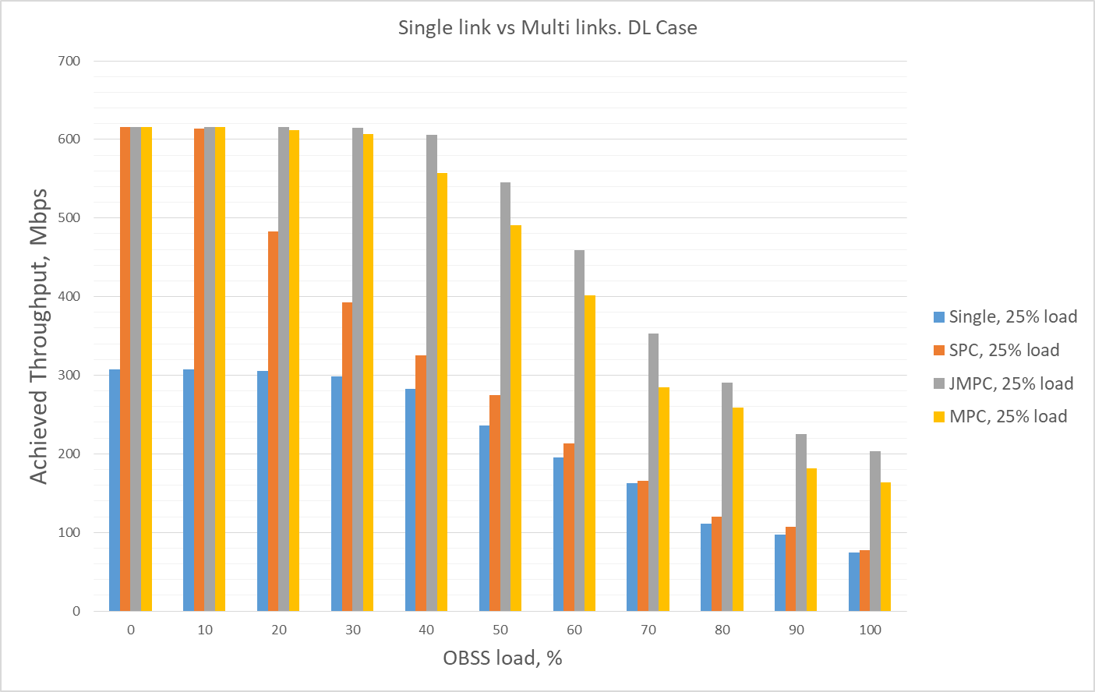
Single link vs Multi-link. DL case

Slide 10
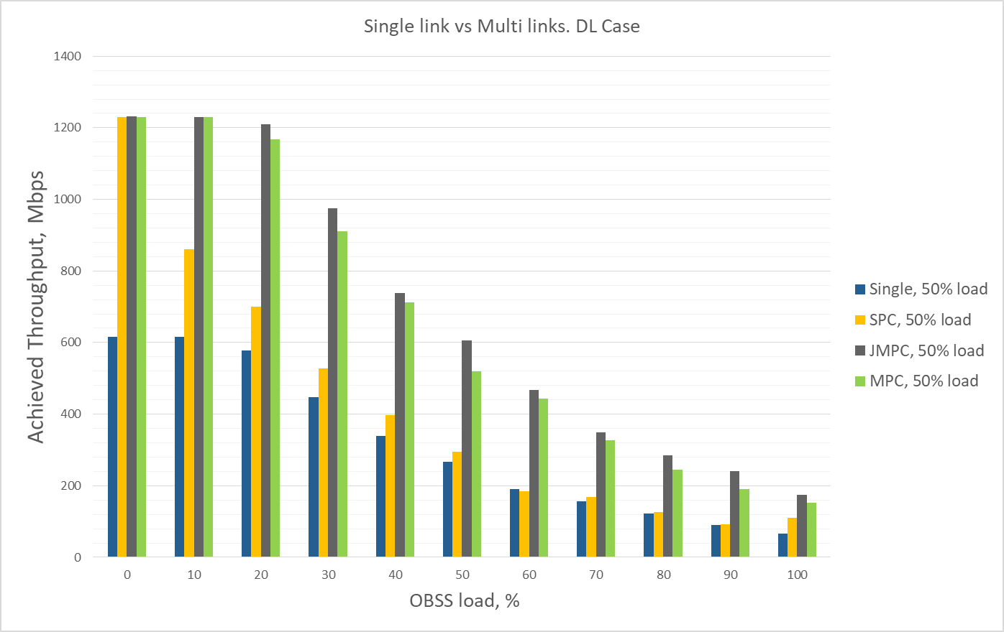
Single link vs Multi-link. DL case

Slide 11
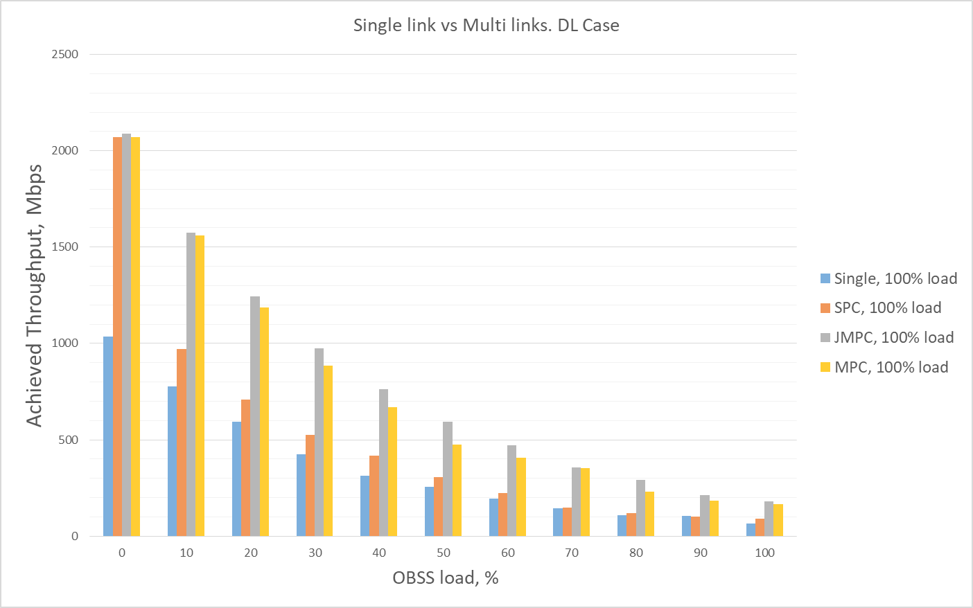
Single link vs Multi-link. DL case

Slide 12
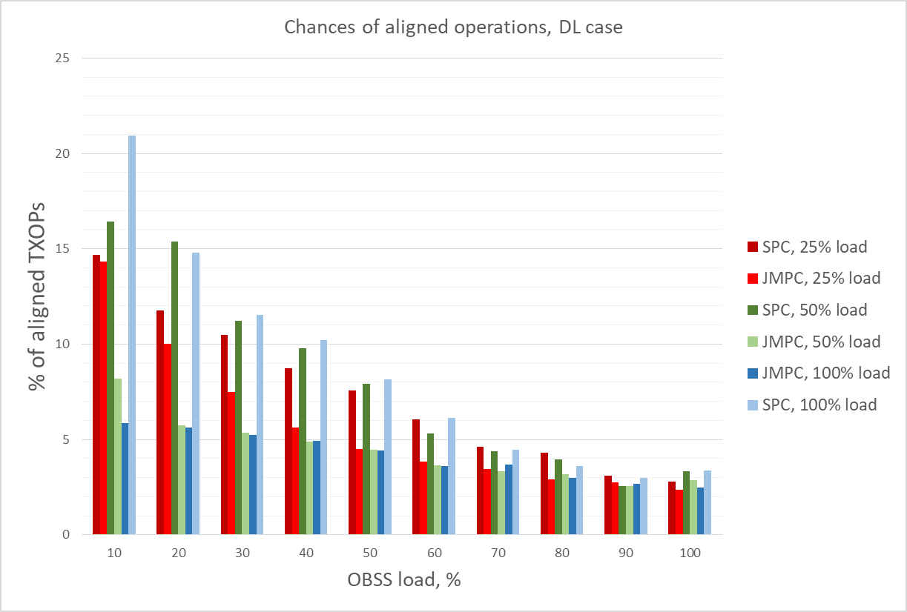
Chances of synchronous operation.
Notes:
This is going to be changed to show % of “synchronous operations”

Slide 13
DL/UL mix case
SU HE, 2x2x80, MCS11
BSS TXOP limit 5.4ms
OBSS TXOP limit: uniformly distributed for each TXOP between 1 and 5.4ms
No TXOP bursting
RTS/CTS on
BA Bitmap – 256
EHT AP
EHT STA
AP1
STA1
OBSS AP1
OBSS STA 1
OBSS AP n
OBSS STA n
Link 1
OBSS AP 2
OBSS STA2
OBSS AP 2n
OBSS STA 2n
AP2
STA2
Link 2
BSS load: bidirectional UDP traffic in with a load of
  Case 1: 300Mbps, 25% of MCS11 rate, Case 2: 600Mbps, 50% of MCS11 rate; Case 3: 1200Mbps, 100% of MCS11 rate
For each case vary number of OBSSes from 0 to 10
  Each OBSS has bidirectional UDP traffic with total load 120Mbps ( or 10% MCS11 rate)
All BSSes are in ED/PD range of each other
Metrics of interest
  Throughput
  # of synchronous/asynchronous operations ( simultaneous TXOP start)

Slide 14
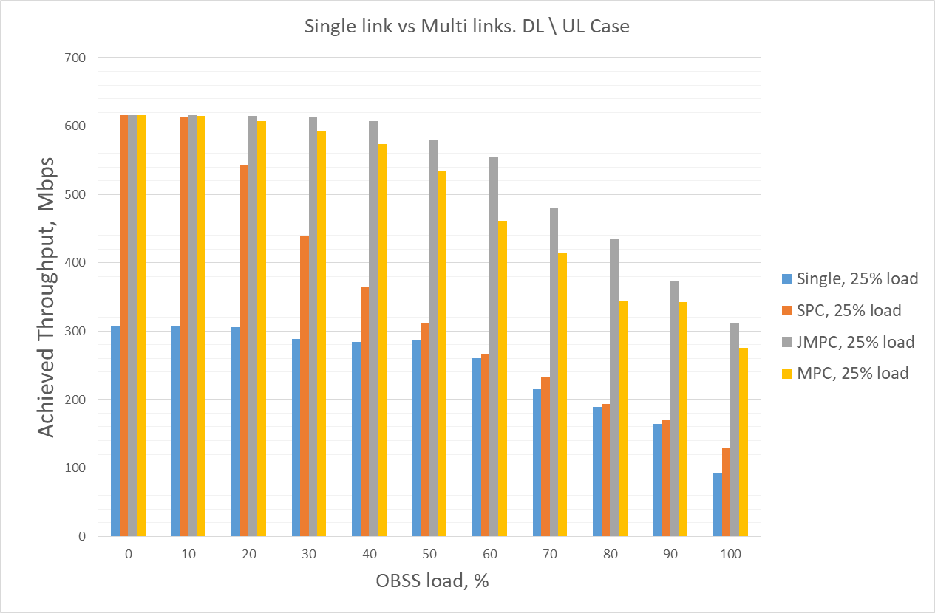
Single link vs Multi-link. DL/UL mix case

Slide 15
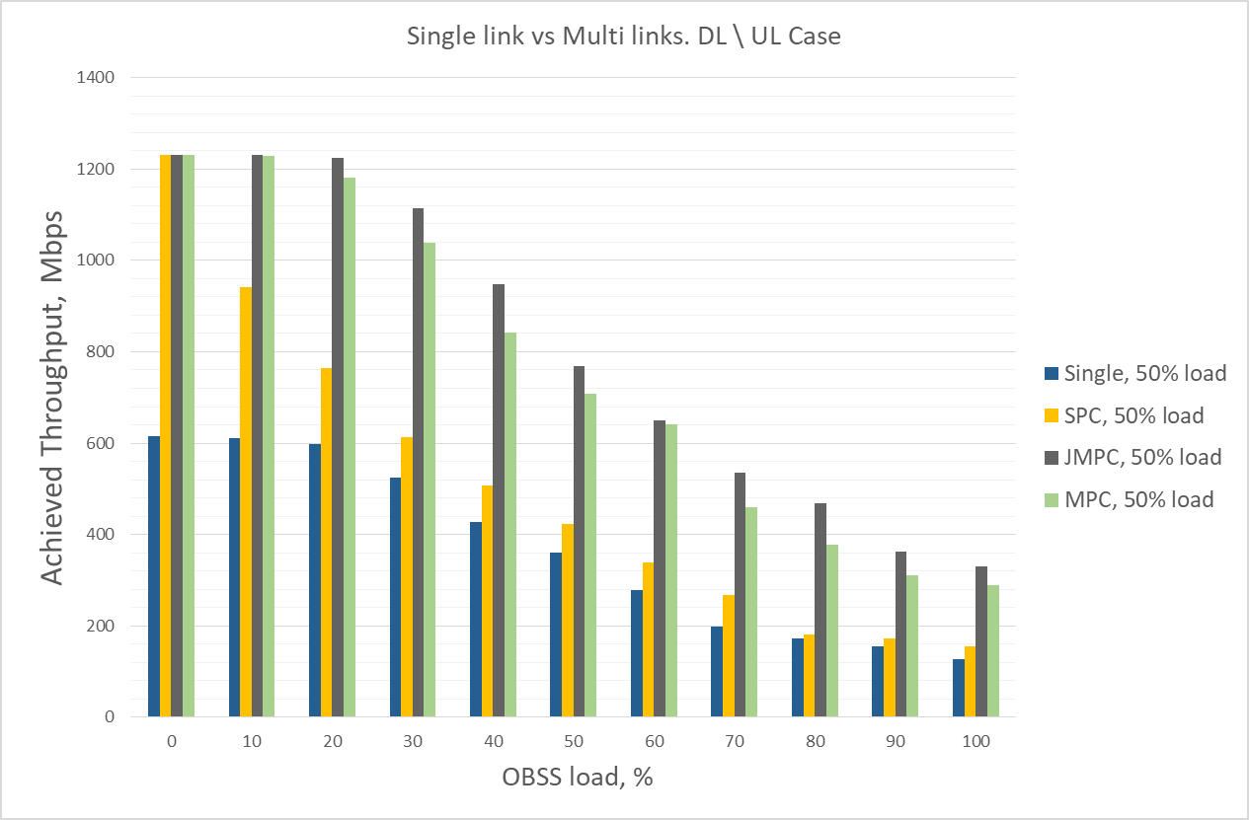
Single link vs Multi-link. DL/UL mix case

Slide 16
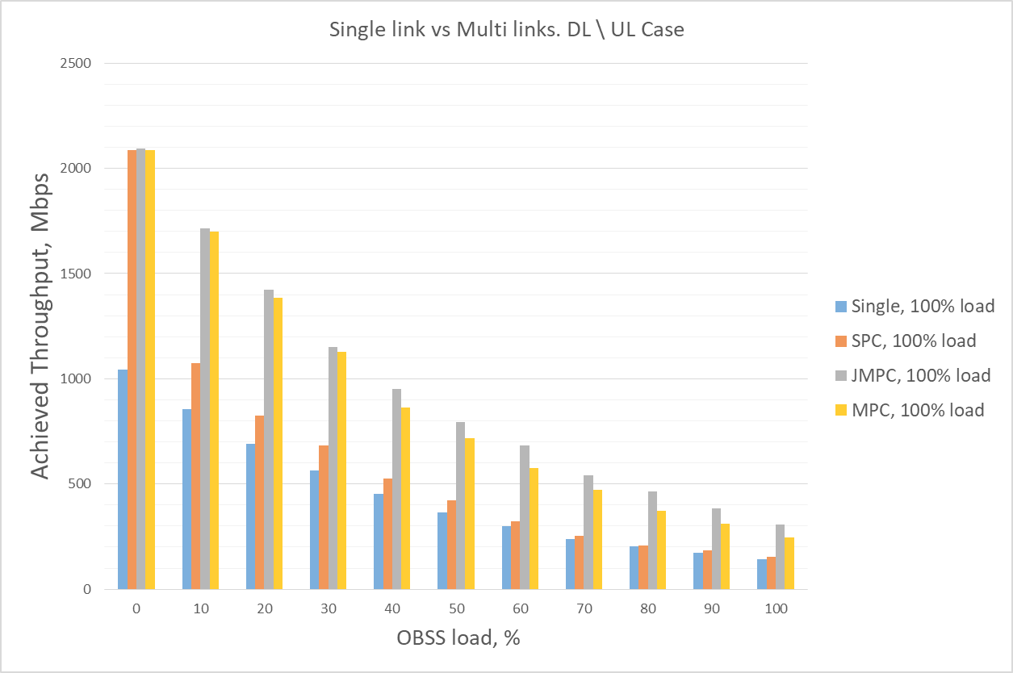
Single link vs Multi-link. DL/UL mix case

Slide 17
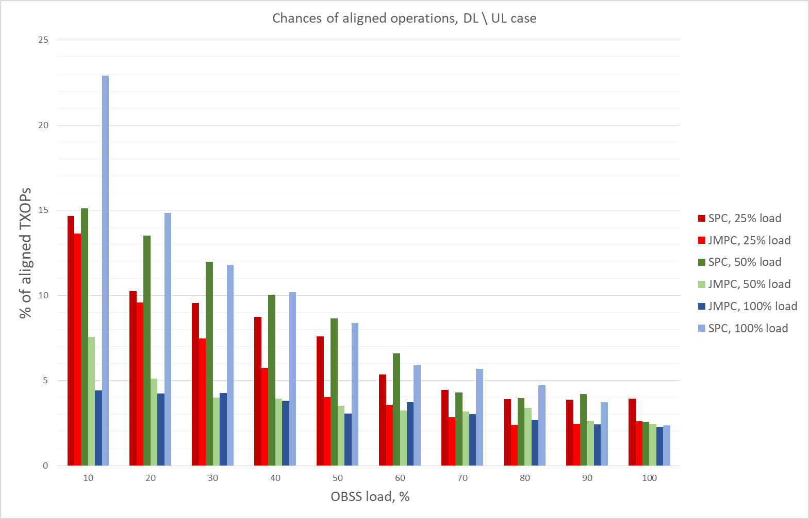
Chances of synchronous operation, DL / UL mix case.

Slide 18
Conclusion
2 links is definitely better than 1 link
  Depending on a type of operation and network load 2x gain (or more) can be easily achieved
  The gain remain mostly constant for all modes of operation except synchronous which quickly drops from 2x to 1.2x
JMPC operation outperform on average all other modes but
  Brings uncertainty in terms of fairness
  Brings complexity in implementation
  Chances for synchronous operations on two bands (i.e. to obtain channel at the same time) are not high
    Quickly drop to ~5% and below as the load and number of contending devices increases
MPC operation performs very close to best performance and is therefore the preferred solution
  without the fairness issues
  does not require any extra work to implement/support
Average performance gain from multi-link operation
  MPC mode of operation: DL case - 2.07x; DL / UL mix case - 2.02x
  SPC mode of operation: DL case: 1.27x; DL / UL mix case: 1.29x
  JMPC mode operation: DL case: 2.28x; DL / UL mix case: 2.22x
SPC mode of operation performs very poorly, except when there’s no OBSSs/light load on the second link
  Not a good solution to consider
For the future simulation we will concentrate on MPC operations only

