Slide 1
Performance aspects of Multi-link operations
Date: 2019-07-01
Authors:
Name | Affiliations | Address | Phone | Email
Dmitry Akhmetov | Intel
Notes:
September 2012

Slide 2
Motivation for Multi-link operation.
STA 1
New wireless devices are expected to have multi-band/channel capabilities
These new devices will/may be able to operate on different channels/band independently
Independent channel access
Independent TX / RX operation
Unified TX/RX buffers for smooth and speedy operations
Benefits
Increased/improved throughput, better load handling
Improved end-to-end latency
Data/mgmt plane separation
Potential for link aggregation
Enable new use cases
Link 1
Link 2
STA 2

Slide 3
Multi-link operation benefits
STA 1
Obvious throughput performance numbers
Mediatek in their simulations claim throughput gain of up to 2x-5x gain depending on link load & configuration
Qualcomm in their simulations claim 1.1x-2.3x depending on links load
Simple math says you can have 2x more water over 2 pipe than over 1 pipe
Scales linearly with number of pipes
Our internal simulations show the same 2x throughput gain over two links
2x in ideal case
Less with extra load on each link
Expected delay gain
Theoretically up to 2x reduction of ETE delay but practically less
Link 1
Link 2
STA 2

Slide 4
Multi-link operation assumptions and classification
Assumptions
A multi-link capable device perform channel access on multiple channels independently
A multi-link device after obtaining TXOP on multiple bands/channels can transmit frames to the receiver(s) over multiple links
Classification
Synchronous operation
Asynchronous operation
Semi-Asynchronous operation
Restricted operations

Slide 5
Classification: Completely synchronous
Existing 80+80 type operation
TXOP
TXOP
TXOP
AP1
band 1
3
2
1
0
2
1
0
3
2
1
0
busy
busy
TXOP
busy
AP2
band 2
Good old “where is my secondary channel” style
Perform contention on primary channel
Do energy detect on secondary
If IDLE – transmit over two channels
If BUSY – transmit on primary only

Slide 6
Classification: Completely asynchronous
TXOP
busy
TXOP
AP1
band 1
3
2
1
0
9
8
7
6
5
4
3
2
1
0
busy
TXOP
TXOP
TXOP
AP2
band 2
2
1
0
3
2
1
0
4
3
2
1
0
Perform contention independently on both links
Transmit/receive independently on both links

Slide 7
Classification: Semi-asynchronous
band 1
TXOP
TXOP
TXOP
TXOP
AP1
3
2
1
0
9
8
7
6
5
4
3
2
1
0
band 2
busy
TXOP
TXOP
busy
AP2
2
1
0
4
3
2
1
0
7
6
Perform contention independently
If one channel/link won contention it can invite another link into the transmission opportunity
If second link is in IDLE/Contention state – transmit jointly
Otherwise transmit using one link only

Slide 8
DL case. Simulation setup.
AP1 and AP2 on separate non-overlapping channels with 1 associated STA each
SU HE, 2x2x80, MCS11
BSS load: UDP traffic in DL direction with load of
Percentage of MCS11 @ 2x2x80 rate (of ~1.2Gbps) : 25% - 300Mbps, 50% - 600Mbps and 100% - 1.2Gbps
1 to 10 OBSSes with bidirectional UDP traffic with total load pre OBSS of 10% of MCS11 at each channel
Each OBSS consist of 1 AP and 1 STA
TXOP limit of 5.4ms
Randomized TXOP limit for OBSS, uniformly distributed between 1ms and 5.4ms
No TXOP bursting
Metrics of interest
Throughput
# of synchronous/asynchronous operations and ratio of the two
Synchronous operation – simultaneous transmission start on both links

Slide 9
Naming convention
Single
Single link operation
Sync
Single link 80+80 type operation
Async
Fully asynchronous operation
Join
Semi-asynchronous operation

Slide 10
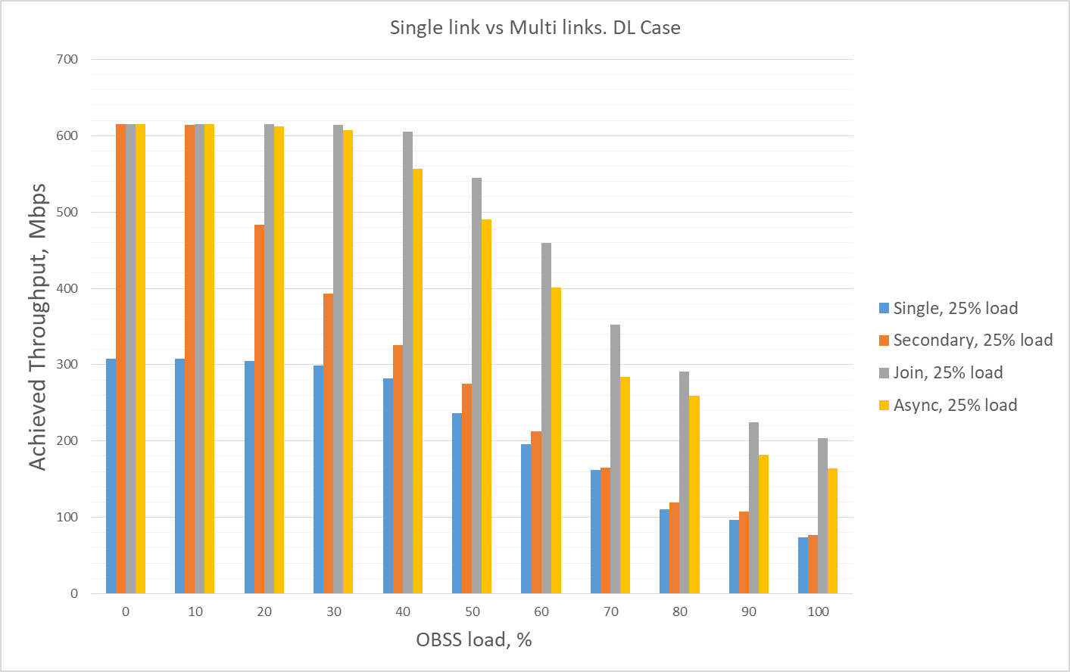
Single link vs Multi-link. DL case

Slide 11
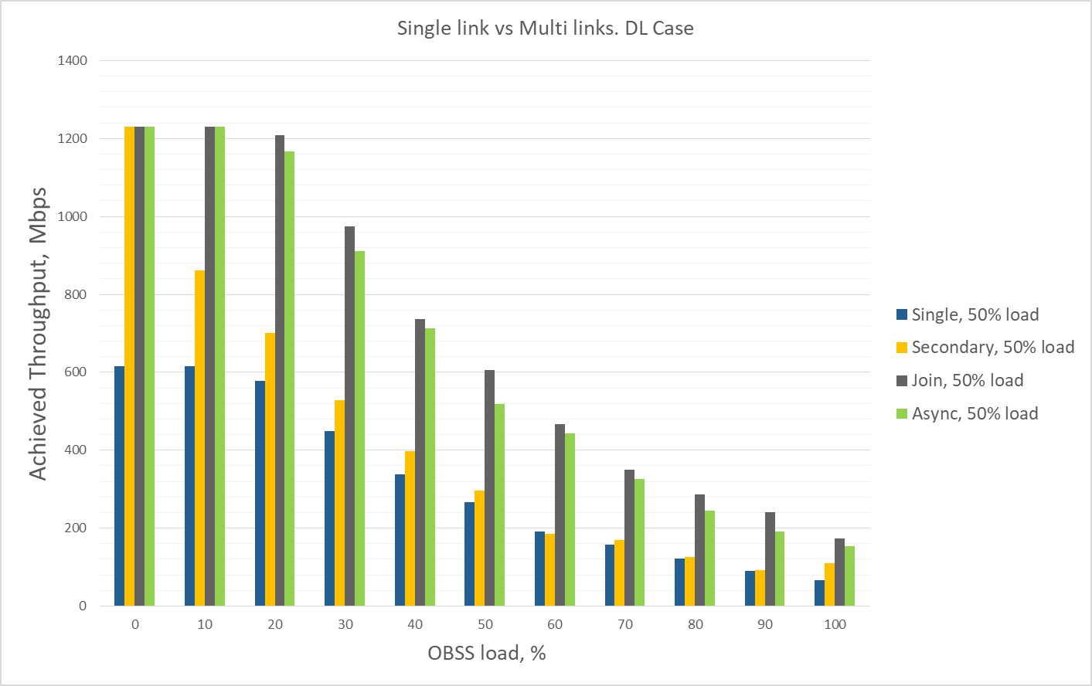
Single link vs Multi-link. DL case

Slide 12
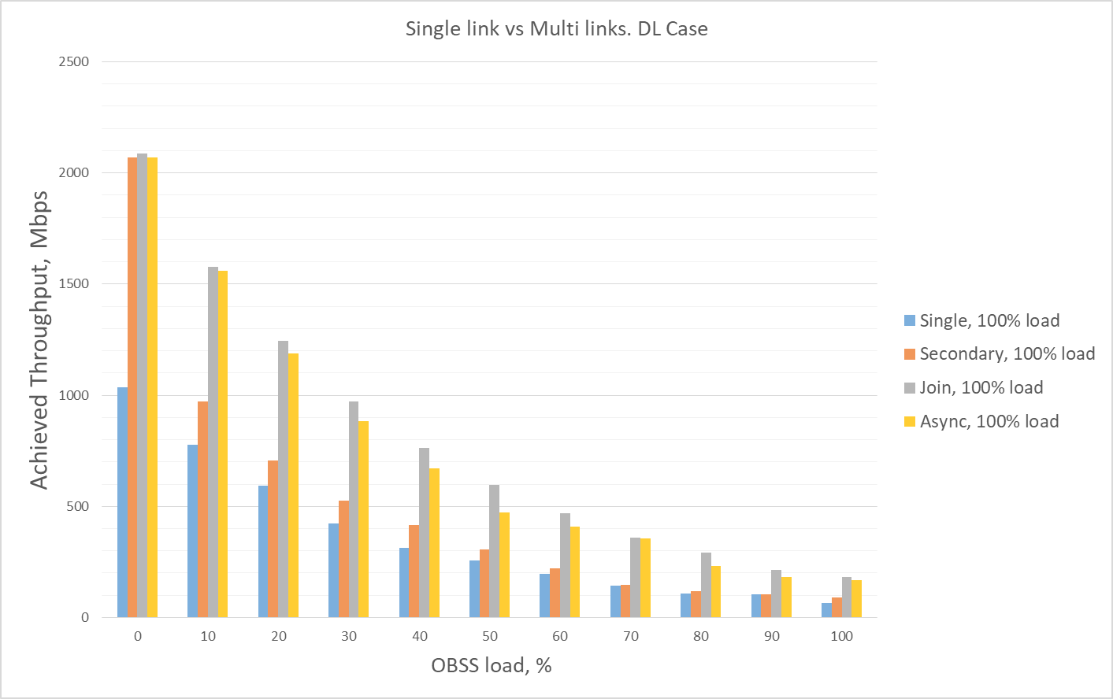
Single link vs Multi-link. DL case

Slide 13
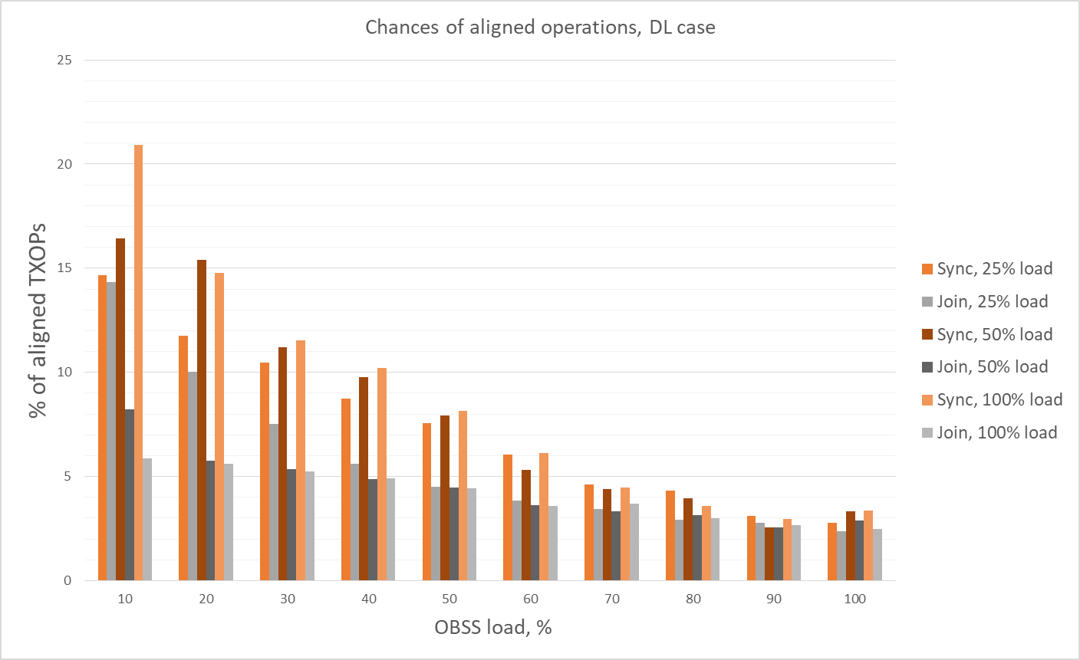
Chances of synchronous operation.
Notes:
This is going to be changed to show % of “synchronous operations”

Slide 14
DL / UL case. Simulation setup.
AP1 and AP2 on separate channels with 1 associated STA each
SU HE, 2x2x80, MCS11
BSS load: symmetrical UDP traffic in DL and UL direction with total BSS load of
Percentage of MCS11 @ 2x2x80 rate (of ~1.2Gbps)
25% - 300Mbps, 50% - 600Mbps and 100% - 1.2Gbps
1 to 10 OBSSes with bidirectional UDP traffic with load of 10% of MCS11 at each channel
Each OBSS consist of 1 AP and 1 STA
TXOP limit of 5.4ms
Randomized TXOP limit for OBSS, uniformly distributed between 1ms and 5.4ms
No TXOP bursting
Metrics of interest
Throughput
# of synchronous/asynchronous operations and ratio of the two
Synchronous operation – simultaneous transmission start on both links

Slide 15
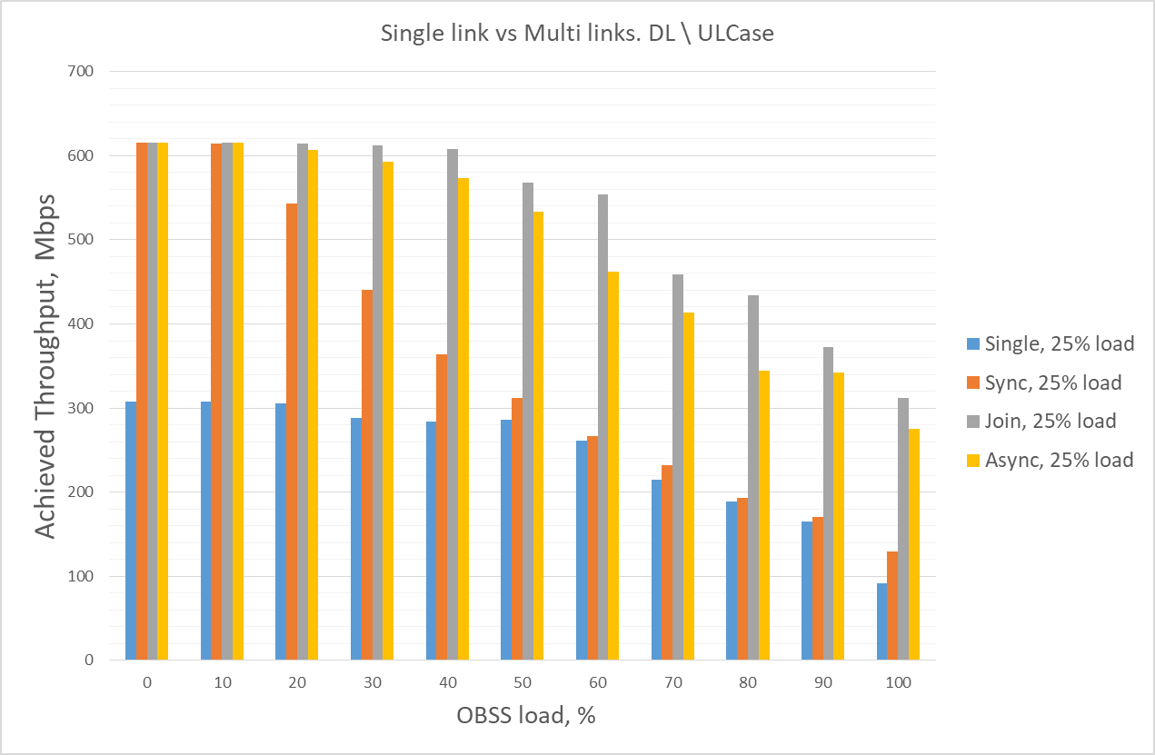
Single link vs Multi-link. DL/UL mix case

Slide 16
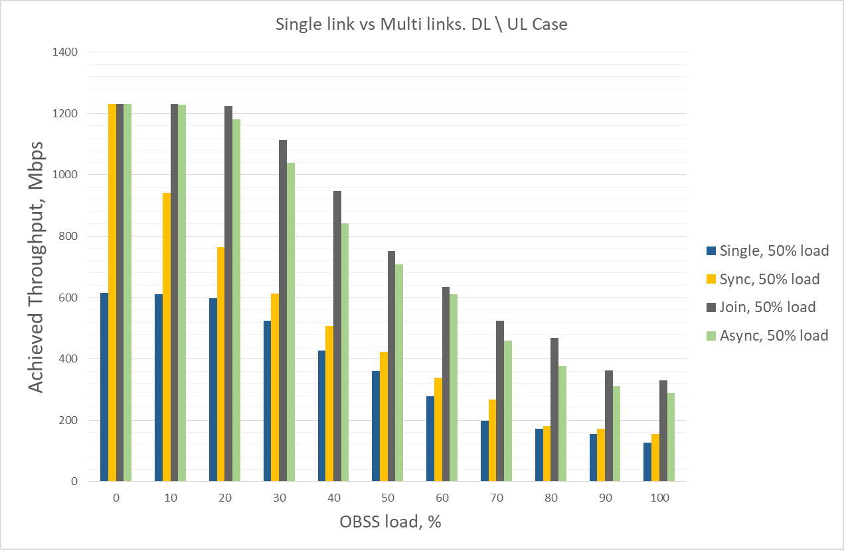
Single link vs Multi-link. DL/UL mix case

Slide 17
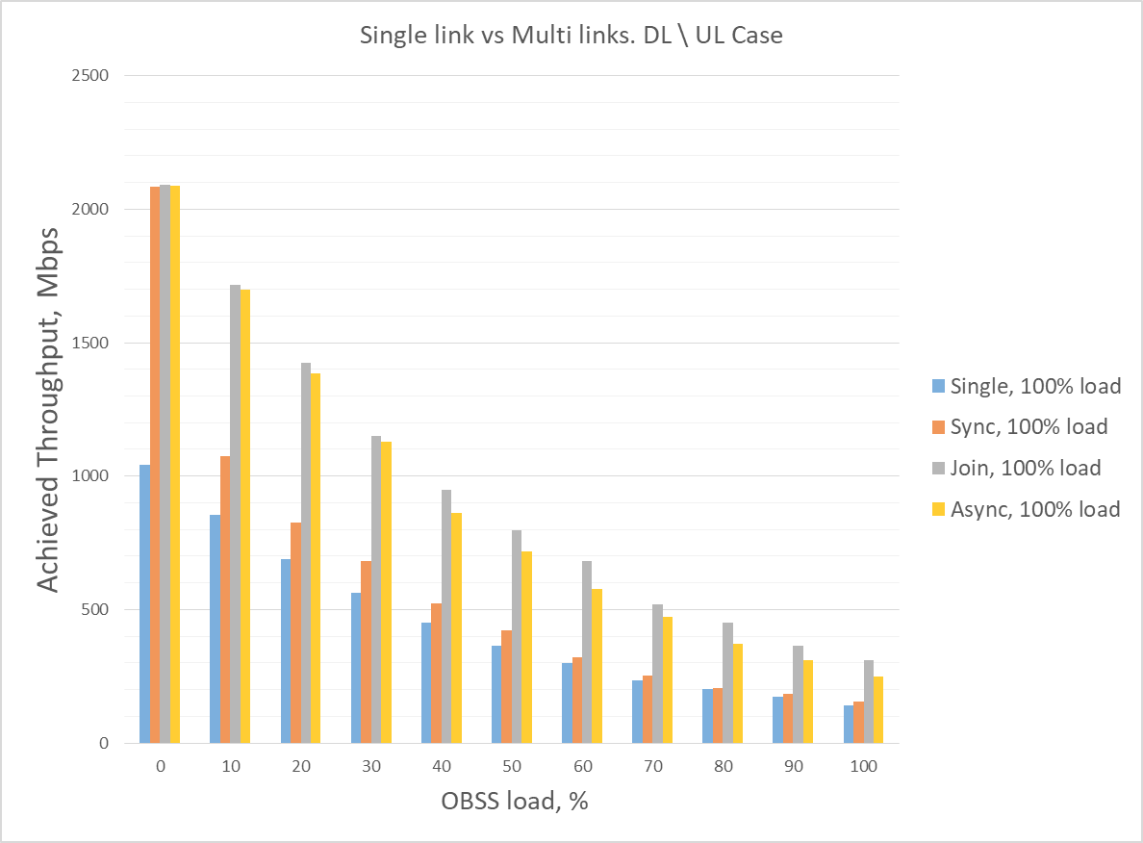
Single link vs Multi-link. DL/UL mix case

Slide 18
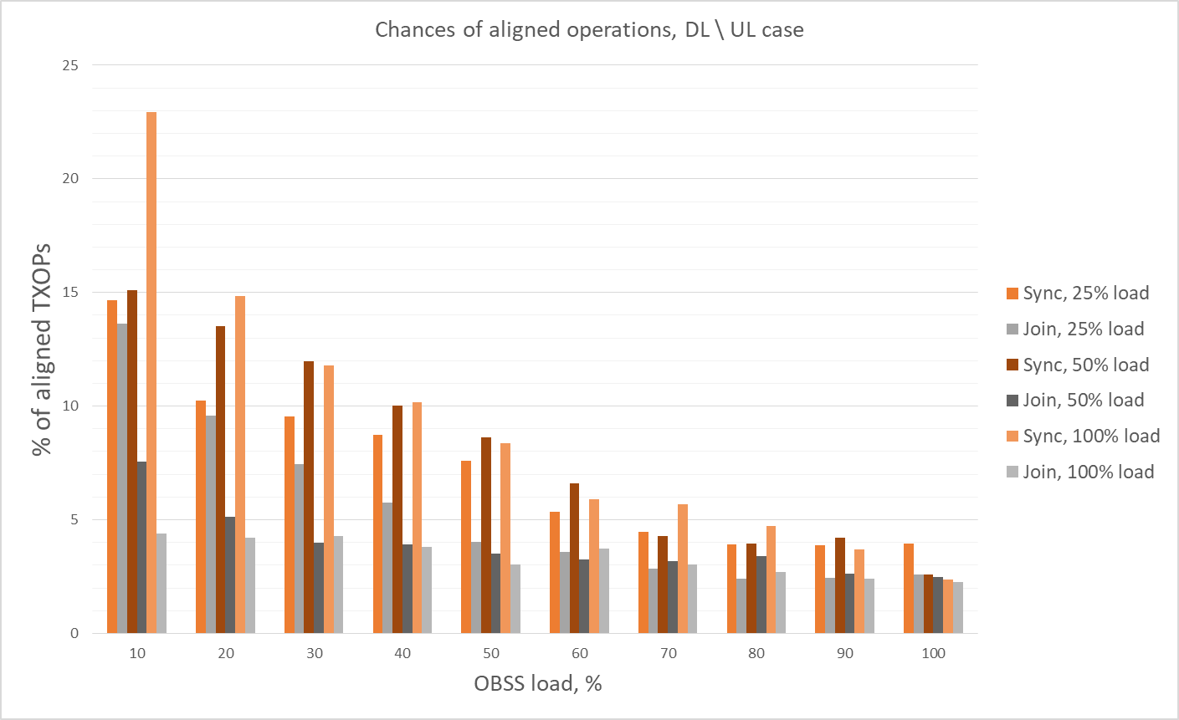
Chances of synchronous operation, DL / UL mix case.

Slide 19
Intermediate conclusion
2 links is definitely better than 1 link
With lightly loaded networks 2x gain can be achieved
The gain decreases with the increase of a load
Semi-asynchronous operation outperform on average all other modes
Chances for synchronous operations (concurrent) on two bands (i.e. to obtain channel at the same time) are not high
Quickly dropping to ~5% and below as the load increases

Slide 20
Complicated life of a device with co-located radios
May need to impose constraints on concurrent TX/RX operations on different bands
For, example, interference across links/radios - TX on band 1 can impact radio on band 2 (and vice versa).
Devices radio capabilities / implementation may not allow for concurrent operation
No TX operation is possible on band1 if band 2 is busy with RX operation and vice versa
TXOP
TXOP
band 1
Tx data
Rx ack
Tx data
Rx ack
Tx data
Rx ack
AP1
3
2
1
0
5
4
3
2
1
0
TXOP
TXOP
band 2
Tx data
Rx ack
Rx data
Tx ack
Tx
Rx
Tx data
Rx ack
Tx data
Rx ack
AP2
3
2

Slide 21
Simulation setup.
Traffic load, PHY config, etc. is the same as before
Semi-synchronous with restrictions mode of operation – “restricted join”
Asynchronous with restrictions mode of operation – “restricted async”
Channel access rules / TX operations restrictions/constraints
Device has to meet the constraints by truncating or deferring own TX operations
Suspend\restart backoff during possible overlapping operation
If the other Device in TX state, limit own TX duration to match end of the other AP transmission

Slide 22
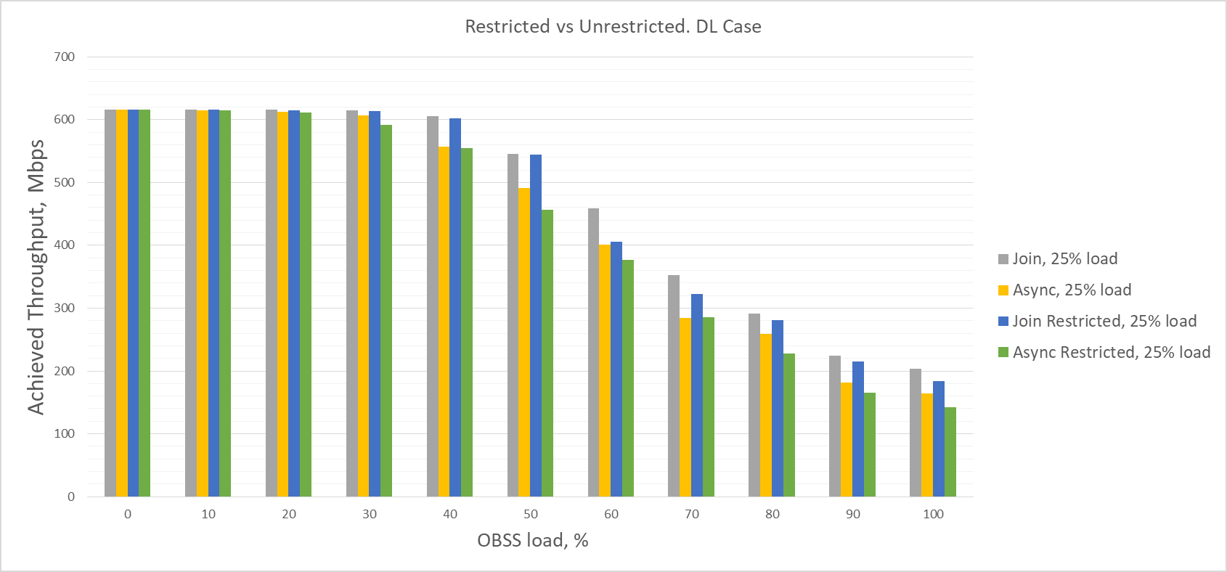
Restricted vs Unrestricted. DL case

Slide 23
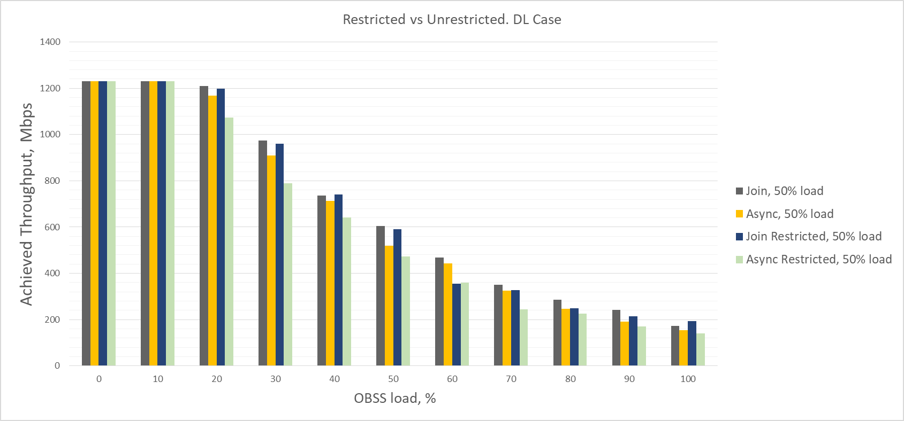
Restricted vs Unrestricted. DL case

Slide 24
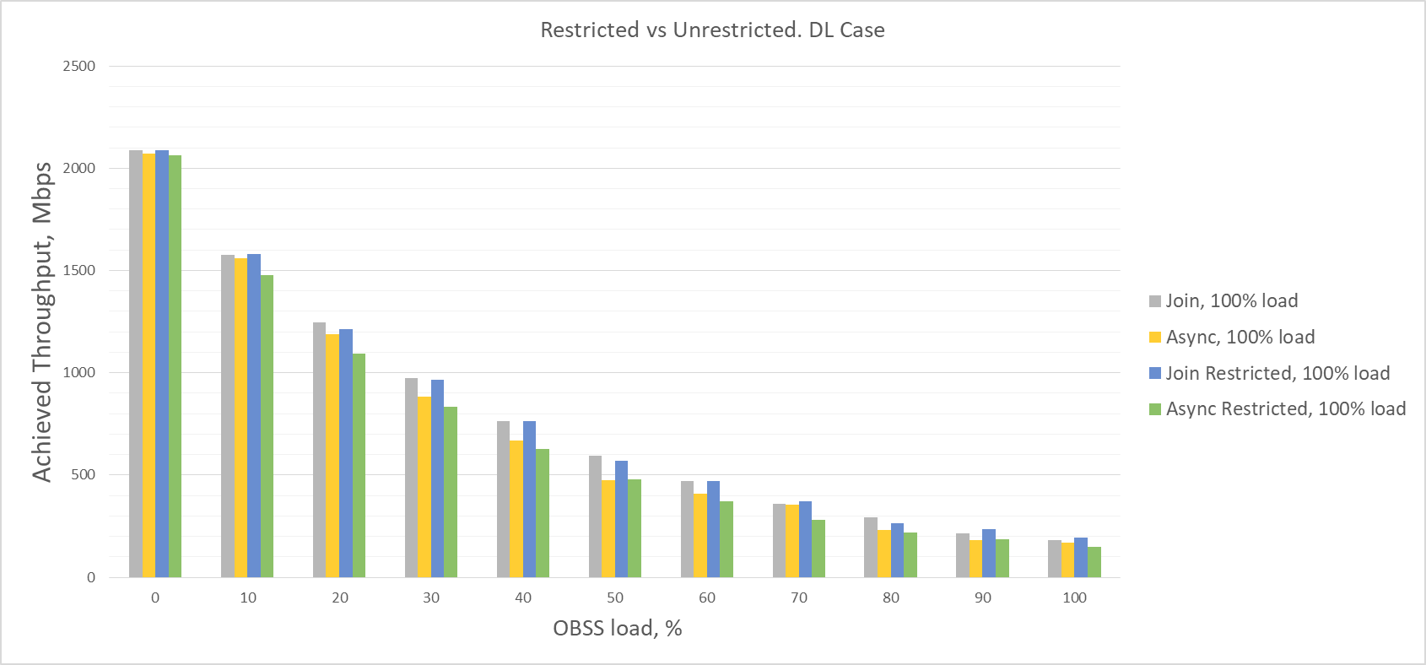
Restricted vs Unrestricted. DL case

Slide 25
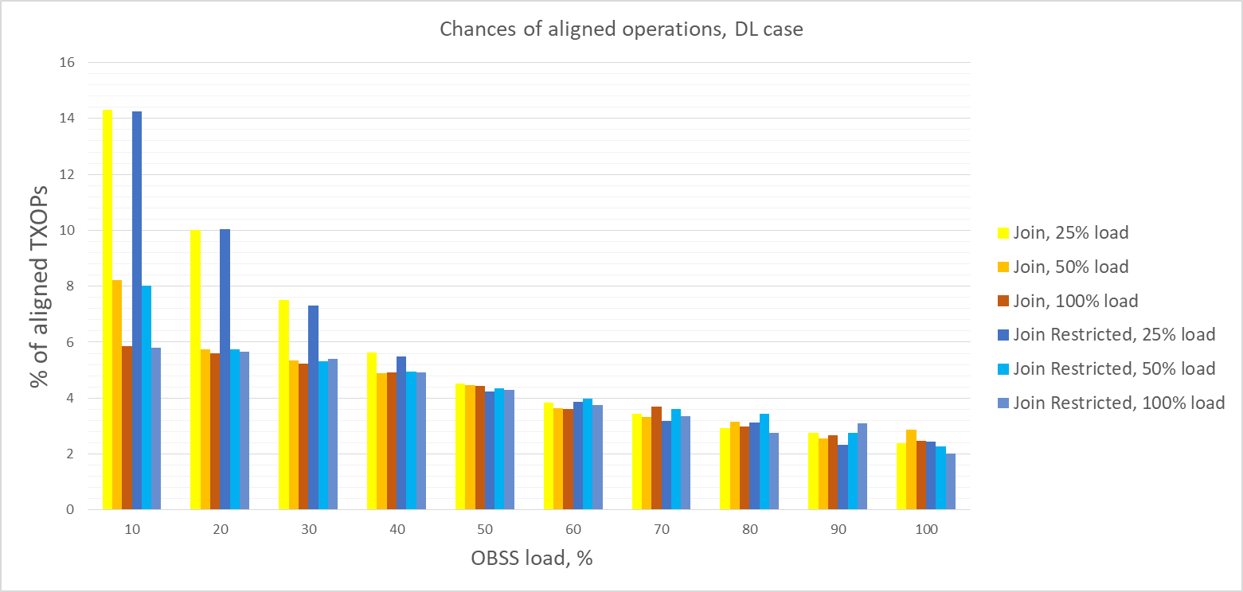
Chances of synchronous operation

Slide 26
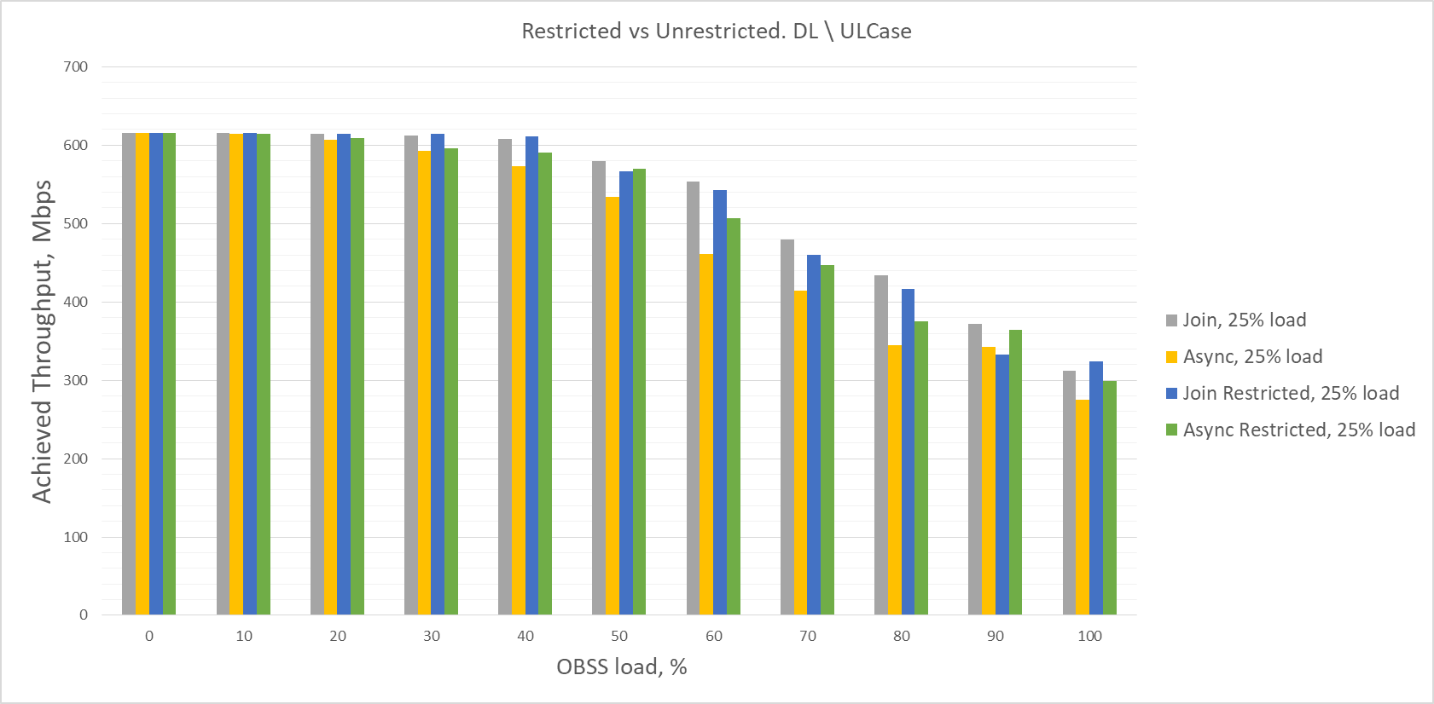
Restricted vs Unrestricted. DL/UL mix case

Slide 27
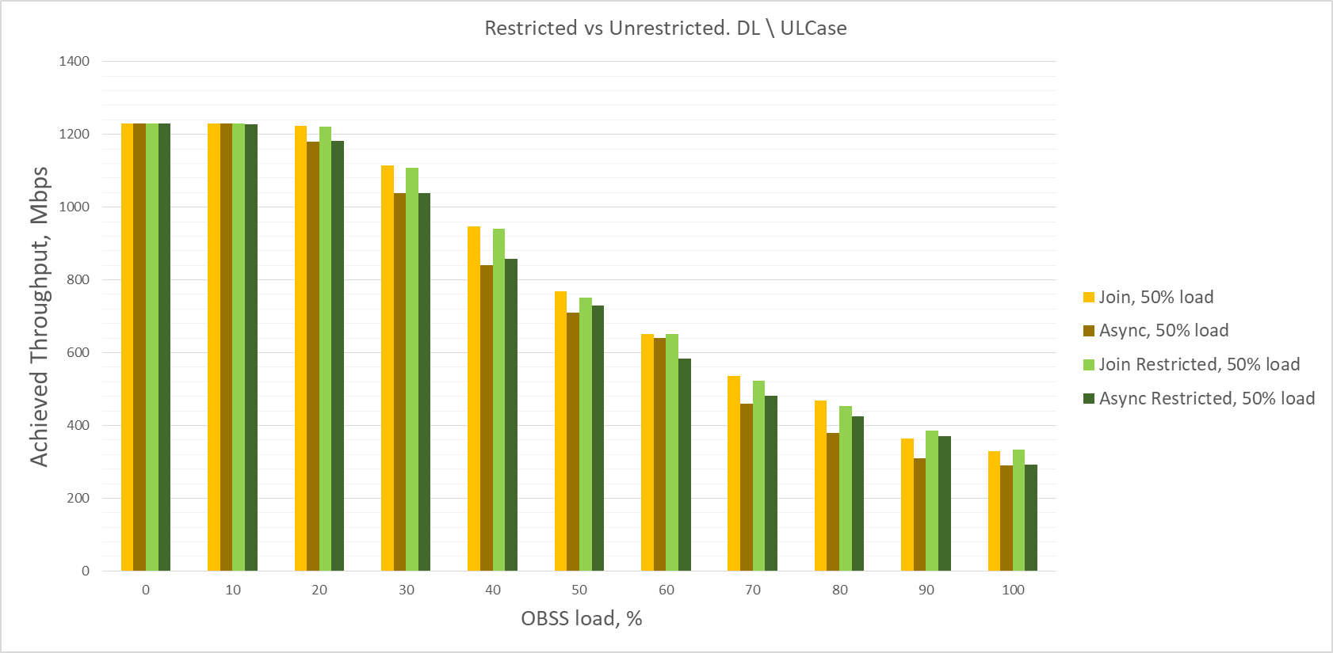
Restricted vs Unrestricted. DL/UL mix case

Slide 28
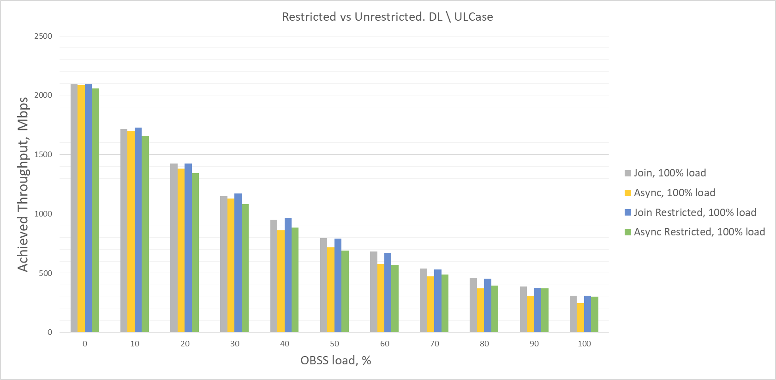
Restricted vs Unrestricted. DL/UL mix case

Slide 29
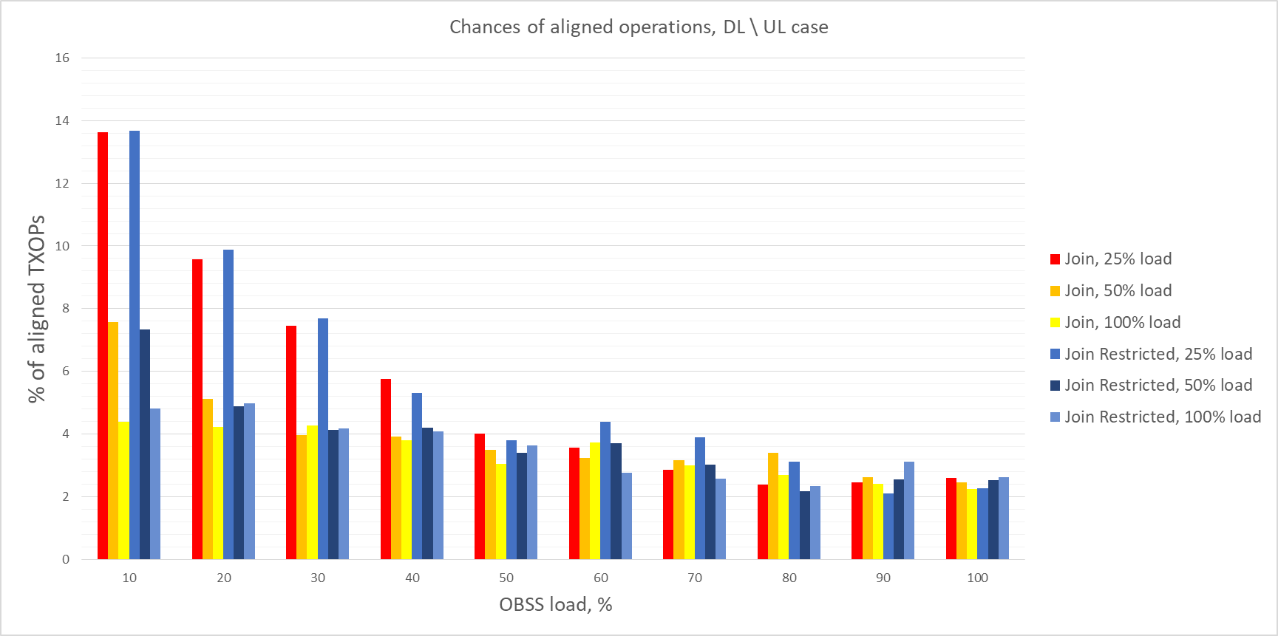
Chances of synchronous operation

Slide 30
Conclusion
For STAs without Tx/Rx constraints, asynchronized access performs very well, as expected
For STAs that have Tx/Rx constraints, asynchronized access with restrictions preform much better than fully synchronized access
Average performance gain from multi-link operation
Asynchronous operation, DL case: 2.07x
Asynchronous operation, DL / UL mix case: 2.02x
Semi-asynchronous operation, DL case: 2.28x
Semi-asynchronous operation, DL / UL mix case: 2.22x
Restricted asynchronous operation, DL case: 1.91x
Restricted asynchronous operation, DL / UL mix case: 2.09x
Restricted semi-synchronous operations , DL case : 2.22x
Restricted semi-synchronous operations , DL / UL mix case : 2.21x
Completely synchronous operation, DL case: 1.27x
Completely synchronous operation, DL / UL mix case: 1.29x

