Slide 1
TSN support in 802.11 and potential extensions for TGbe
Date: 2018-09-10
Authors:

Slide 2
Abstract
TGbe/EHT has defined worst-case latency and jitter improvements are part of its scope to address TSN applications as well as integration with Ethernet TSN
This presentation provides an overview of the use cases/requirements, existing 802.11 capabilities defined to support 802.1 TSN standards and future extensions to be considered in TGbe/EHT.

Slide 3
Outline
TSN background
Wireless TSN use cases and requirements
802.11 support for 802.1 TSN
Extensions for wireless TSN support in 802.11be

Slide 4
TSN (Time Sensitive Networking) Background
TSN capabilities enable managed networks that provide the following features for time-critical data streams:
  Time synchronization between network nodes and hosts
  Timeliness (bounded latency)
  High reliability (very low packet loss)
  Coexistence of time-critical and other traffic types (e.g. best-effort) on the same network

Slide 5
From Wired (Ethernet) to Wireless TSN
The IEEE 802.1 TSN Task Group develops standards to enable TSN features over IEEE 802 networks (e.g. Ethernet/802.3, Wi-Fi/802.11)
A TSN Domain (wired and wireless) is a managed (protected) domain
Admission control is required
The network is provisioned to serve end-to-end TSN streams
The CUC/CNC are responsible for user and network configuration (e.g. as defined in 802.1Qcc)
TSN Talker
TSN Listener
CUC: Central User Configuration
CNC: Central Network Configuration
Unique characteristics of wireless media: links have variable capacity and are subject to noise and interference (especially in unlicensed bands)

Slide 6
Wireless TSN Applications
AV
Industrial
Automotive
Conference rooms, production rooms, concerts, etc.
Flexible factories (Industry 4.0), automation, mobile robots, AGVs, etc.
In-vehicle HMI, multimedia, telematics
Wireless enables flexibility, lower maintenance costs (wire replacement) and mobility
Main networking/connectivity requirements:
Time synchronization (~1 µsec or better )
Bounded (low) latency (average is NOT the issue, need worst-case bounds)
High reliability (low packet loss)

Slide 7
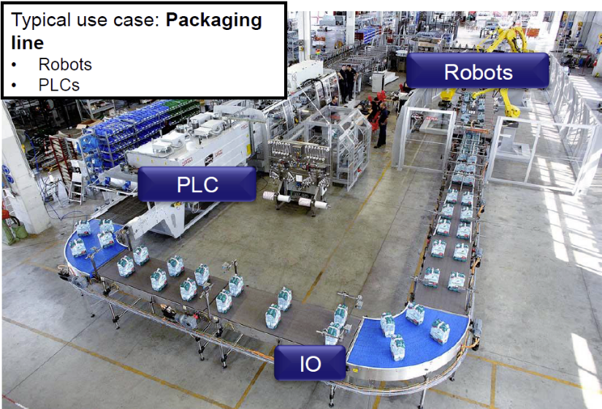
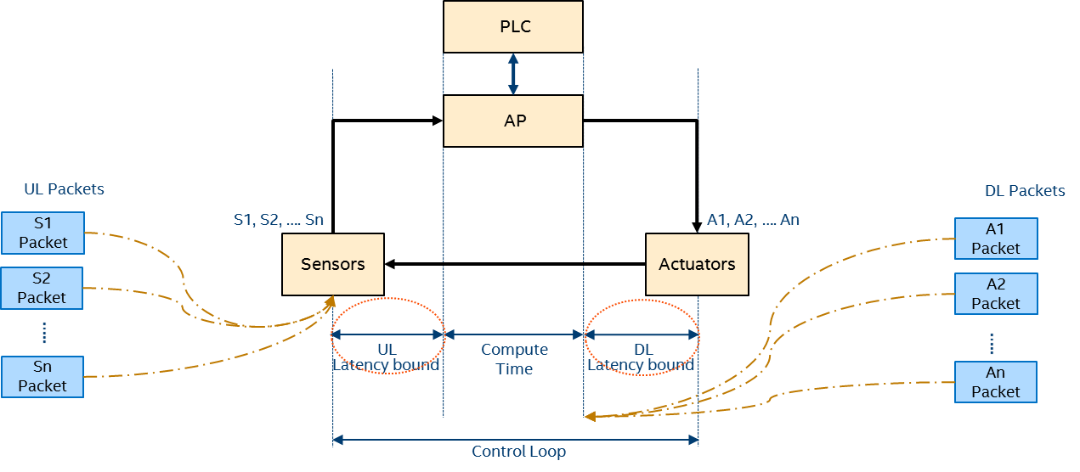
Example Use Case: Industrial Control System
Packets delivered after the deadline are considered lost
Source: National Instrument/TTTech presentation, TSNA 2016
Latency, jitter and packet loss can cause instability of the system
Low latency and high reliability enable the system to operate faster and without interruptions → direct business value

Slide 8
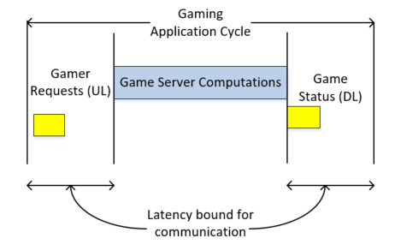
Low (worst-case) latency is also a requirement for other emerging applications
Real-time mobile, console and cloud gaming
Latency/jitter cause lagging/bad user experience

Slide 9
RTA TIG use cases and requirements
RTA TIG report doc.#: 11-18-2009
Use cases |  | Intra BSS latency/ms | Jitter variance/ms [4] | Packet loss | Data rate/ Mbps
Real-time gaming [2] |  | < 5 | < 2 | < 0.1 % | < 1
Cloud gaming [15] |  | < 10 | < 2 | Near-lossless | <0.1 (Reverse link) >5Mbps (Forward link)
Real-time video [3] |  | < 3 ~ 10 | < 1~ 2.5 | Near-lossless | 100 ~ 28,000
Robotics and industrial automation [1] | Equipment control | < 1 ~ 10 | < 0.2~2 | Near-lossless | < 1
 | Human safety | < 1~ 10 | < 0.2 ~ 2 | Near-lossless | < 1
 | Haptic technology | <1~5 | <0.2~2 | Lossless | <1
 | Drone control | <100 | <10 | Lossless | <1 >100 with video
^{[1]}
The main issue is worst-case latency
Real-time applications need both low latency and low jitter
Higher reliability is also an important new requirement

Slide 10
IEEE 802.1 Time Sensitive Networking (TSN)
Standard Ethernet with synchronization, small and/or fixed latency, and extremely low packet loss
TSN Std Components
Time synchronization:
Time Synchronization (802.1AS)
Ultra reliability:
Frame Replication and Elimination (P802.1CB)
Path Control and Reservation (802.1Qca)
Per-Stream Filtering and Policing (802.1Qci)
Reliability for time sync (P802.1AS-Rev)
Synchronization
√ 802.1AS over 802.11
Timing Measurement (TM)
Fine Timing Measurements (FTM)
Reliability
Reliability
Latency
Bounded low latency:
Time-Aware traffic shaping (802.1Qbv)
Preemption (802.1Qbu/802.3br)
Cyclic Scheduling (802.1Qch)
Asynchronous Scheduling (802.1Qcr)
Resource Mgmt
Dedicated resources
Stream Reservation Protocol (802.1Qat)
TSN configuration (P802.1Qcc)
YANG (P802.1Qcp)
Link-local Registration Protocol (P802.1CS)
Zero congestion loss
Credit: János Farkas, Ericsson
√ 802.11aa (SRP over 802.11 for AV)
√ 802.11ak (802.11 links in an 802.1Q LAN)
TSNA Conference 2017
These TSN Capabilities are the main gaps that need further support from Wireless Media:
Ongoing work in 5G NR URLLC (Rel. 16)
Opportunity to leverage 802.11ax and include further support in 802.11be
New capabilities to manage bounded latency/reliability over wireless may also be needed

Slide 11







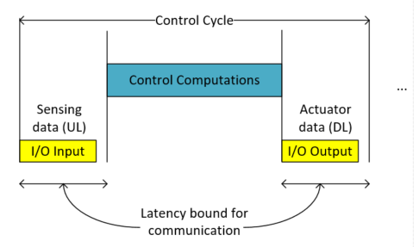
TSN Time Synchronization over 802.11
      TSN applications and protocols to operate on single reference clock across multiple nodes/hosts in the network
TSN Switch
802.11 Wireless TSN Link
TSN Talker
TSN-enabled
Access Point
TSN Listener
(Wi-Fi Client)
A PLC’s control cycle needs to be synchronized with other PLCs/Sensors/Actuators
TSN Time-Aware protocols (e.g. Qbv) operate based on the same reference clock to ensure data delivery aligned with the timing requirements of the applications

Slide 12
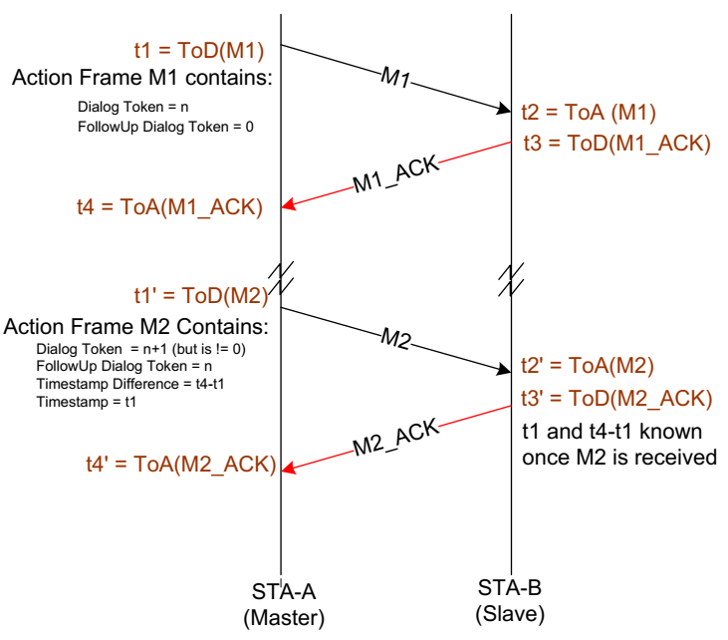
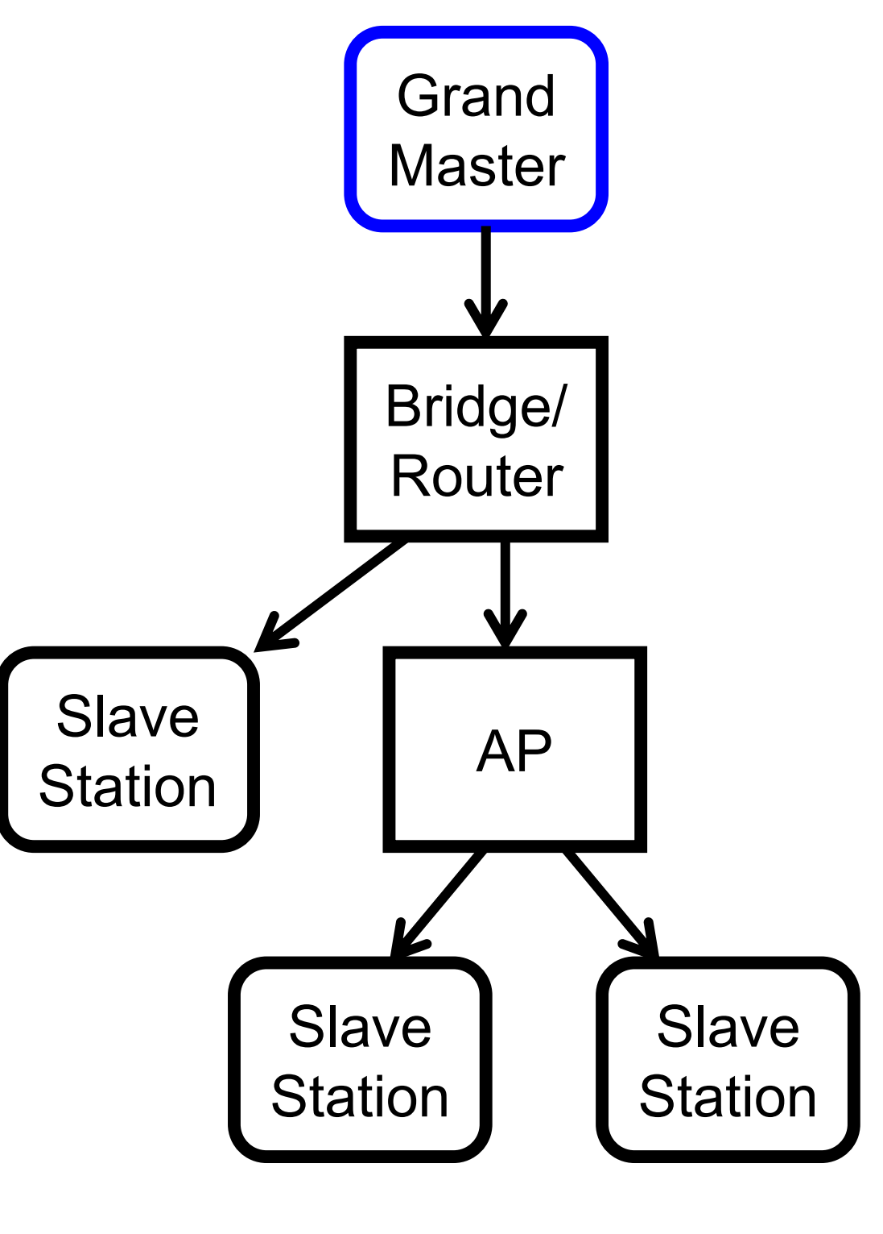
802.1AS-based Time Synchronization over 802.11
802.1AS enables the distribution of a single, accurate, time reference across the network (one time reference for the entire TSN domain)
  802.11 defined MAC specific support for 802.1AS (e.g. Timing Measurement and Fine Timing Measurement)
  802.1AS time synch over 802.11 ( defined in the IEEE 802.11-2012 spec)
802.11 Timing Measurement frames are used to compute:
LinkDelay = [(t4-t1)-(t3-t2)]/2
  NeighborRateRatio (PPM offset to neighbor) = (t1’-t1)/(t2’-t2)
  TimeOffset = [(t2-t1)-(t4-t3)]/2
Ref: K. Stanton, Tutorial: The Time-Synchronization Standard from the AVB/TSN suite IEEE Std 802.1AS™-2011, IEEE 802 Plenary, July 2014

Slide 13
Time-Aware Shaping (802.1Qbv) over Wireless
A Time-aware (Qbv) scheduler defines when gates open/close to ensure time-sensitive frames are not interfered by other traffic
AP
A Qbv schedule can operate on top of one of the 802.11 MAC modes (e.g. EDCA, 802.11ax Trigger based access)
The 802.11 network must execute the schedule and deliver frames with bounded latency. Support for exchanging Qbv schedules over the air is also needed.
Randomness in the 802.11 MAC (e.g. due to contention) will impact achievable latency bounds and capacity/efficiency
A scheduled operation (e.g. based on 802.11ax triggered access) can provide more predictable latencies/higher efficiency
Queues/Traffic Classes
T
T
T
T
Shared medium
T
T
T
T
T
T
T
T
STA 1
STA 2

Slide 14
Bounded latency performance can be enhanced in 802.11
Congestion due to contention within a BSS and across OBSSs causes variations in channel access latency
  EDCA has been successful in resolving contention, but it cannot provide hard bounds on latency/jitter, especially under congestion
TSN requires a managed network approach:
  802.11be can provide the tools to manage the network to address the bounded latency/jitter performance under managed OBSS operation
  This will enable 802.11 to support wireless TSN use cases in private network environments (e.g. enterprise, factories, etc.)

Slide 15
Managed OBSS Scenario in 802.11be
Assumptions:
APs are under the control of a single entity and coordination is feasible
Interference from unmanaged STAs/OBSSs can be minimized (network wide admission control and other management tools can be applied)
Traffic patterns:
  Predictable time-sensitive flows (require bounded latency/jitter with high reliability)
  Unpredictable/bursty traffic (non-time-sensitive, but low latency is desirable)
802.11be Multi-AP and multi-band enhancements can include the coordination protocol and security procedures to enable a Managed OBSS scenario, e.g.
Enable managed APs form a coordination group with a Coordinator AP, and establish a security relationship between Coordinator AP and Coordinated APs
Potential managed OBSS scenarios: enterprise, factory, some home deployments

Slide 16
Enhancements to support TSN-grade bounded latency in 802.11be
Time-sensitive traffic identification and requirements (within and across BSSs)
  Protocol enhancements to announce time-sensitive requirements and get confirmation of service
Efficient scheduled operation for predictable time-sensitive traffic
  Enable AP to control contention within the BSS with Trigger-only access and extend capability to multiple managed OBSSs
  Mechanisms to control contention when EDCA is used (e.g. limit TXOP duration/contending STAs)
Traffic isolation mechanisms (time-sensitive network slicing)
  It is relatively easy to schedule resources to serve predictable time-sensitive traffic
  But the network must also support a mix of predictable (time-sensitive) and unpredictable traffic (best-effort, other non-time-sensitive) efficiently
    Need mechanisms to “protect” time-sensitive traffic from other traffic/STAs
    Need to allow STAs (with unpredictable traffic) to indicate resource requests, traffic description updates, power save state changes, buffers reports
    Need efficient recovery mechanisms (transmission errors, busy NAV during allocation, …)
Multi-AP resource coordination across managed OBSSs

Slide 17
Simulation results: Example TSN performance in a managed BSS Scenario
Latency bounds can be provided with high reliability with (1) Traffic identification and (2) Trigger-based access in a managed BSS scenario
Example traffic model
Channel access modes:
802.11ax Multi-user Trigger-based only with time-sensitive scheduling optimizations
Capacity = number of STAs that can be supported with a given latency bound (1 – 3 msec) and 99.999% reliability
PDR: Packet Delivery Ratio (fraction of packets successfully delivered within the latency bound)
Assumptions:
20 MHz channel, SISO, 100 Bytes packets, Channel model E, STAs randomly distributed in a 50 m radio, latency-optimized scheduling strategy.

Slide 18
Additional TSN capabilities
Although low latency is a primary target, reliability is equally important for TSN applications
  Data must be delivered within the deadline with high reliability
  Redundancy through multiple links is used to increase reliability in wired (Ethernet) TSN (e.g. defined in 802.1CB)
Once latency bounds and reliability targets are met
  It is important to maximize the capacity of the network (for both time-critical and other traffic) → business viability
  Frame preemption enables lower worst-case latency and higher efficiency (802.1Qbu/802.3br)

Slide 19
Redundancy and Interference Management
Some applications require extremely high reliability (many 9’s)
  Redundant links (as defined in 802.1CB) are used in Ethernet to recover from device and medium errors
  Significant reliability gap to overcome in 802.11, especially given the potential for interference in unlicensed bands
Multiple links/APs/channels can be leveraged for redundancy
  Mechanisms to isolate (“protect”) time-sensitive devices/traffic from other traffic can reduce managed interference (i.e. from managed devices)
Redundancy is needed to recover from unmanaged interference
  Redundant transmissions can ensure data is delivered if link performance is degraded due to interference (e.g. from rough devices)
  Detecting and managing interference will also be important

Slide 20
Preemption (802.1Qbu/802.3br)
Large frame transmissions increase worst-case latency for time-sensitive frames
Time-sensitive frame arrival
A guard band (GB) of the size of the largest (BE) fame is needed before the scheduled period starts → less efficient/reduced capacity
Increased worst-case latency
Guard band
Best-Effort frame
BE transmission
Preemption reduces worst-case latency for time-sensitive frames and increases efficiency (smaller guard band for scheduled traffic)
Time-sensitive frame arrival
Low latency (cut-through) performance for time-sensitive traffic
Frag1
Frag2
802.3br defines MAC enhancements to support preemption in Ethernet
Define and handle express and preemptable frames
Arbitrate between express (time-sensitive) and preemptable frames
Preserve frame integrity (fragmentation/reassembly)
802.11 support for preemption could be considered

Slide 21
Conclusions
TSN support in 802.11 should continue to be aligned/integrated with 802.1 TSN standards
  802.11be provides the opportunity to enable the next set of TSN capabilities that address latency and reliability performance vectors
802.11be can enable the tools to achieve bounded latency in managed scenarios
  Enable the possibility to control the behavior of contending devices
  Multi-link/AP capabilities and support for time-aware (Qbv) scheduling
Reliability enhancements are needed to ensure the latency performance can be maintained in the presence of interference
  Multi-AP and multi-channel/bands can be leveraged for redundancy
Efficiency will be important to enable practical/viable deployments
  Preemption and other efficiency enhancements (e.g. reduced overhead, especially, for small packets) may also be considered

Slide 22
References
Doc#: 802.11-18-2009r6
Doc#: 802.11-18/1892r0
Doc#: 802.11-19/0373r0

