Slide 1
An Empirical Model for the Realistic Generation of CAM in Vehicular Networks
Authors:
Date: 2019-07-15

Slide 2
Abstract
The Car2Car Communication Consortium has performed a set of evaluation measurements to get an overview over the statistics of CAM messages in real implementations and deployments
CAM messages are non-deterministic in time and size
  Period varies from 1Hz to 10Hz depending on the generation rules based on speed, heading and acceleration
  Size varies from around 200 bytes to up to more than 700 Bytes depending on the environment and security content
Based on this measurement a simulation model has been developed and the results are introduced in this presentation
A realistic performance simulation need to take these variations into account and can use the proposed models

Slide 3
Overview
Introduction
Cooperative Awareness Messages
Empirical CAM traces
Proposed Model
Validation
Conclusions

Slide 4
Introduction
Fundamental mechanism to support V2X networks.
  Frequent transmission of CAM (Cooperative Awareness Messages).
Simplified models for CAM generation are normally used.
  Fixed size and generation interval.
  Periodic and aperiodic models proposed by 3GPP still not realistic.
Obtained results and conclusions can be significantly affected.
  Channel load generated can significantly change.
  Channel access schemes can be importantly affected.
    E.g. LTE-V Mode 4 can be affected by non-periodic transmissions.

Slide 5
Introduction
Proposal: empirical model for the realistic generation of CAMs.
  Allows generating realistic CAM interval and size.
  Takes into account correlation between consecutive CAMs.
  Takes into account cross correlation between interval and size.
Based on real traces collected by Volkswagen and Renault.
  Urban, suburban and highway scenarios.
All models will be available to download
Rafael Molina-Masegosa, Miguel Sepulcre, Javier Gozalvez, Vincent Martinez, Friedbert Berens,
“An Empirical Model for the Realistic Generation of Cooperative Awareness Messages in Vehicular Networks”,
Submitted to IEEE Transactions on Vehicular Technology.

Slide 6
Cooperative Awareness Messages
CAM generation rules defined by ETSI:
  CAM generation interval between 100ms and 1s.
  CAM generation conditions depend on vehicle dynamics:
    Position change > 4 m.
    Speed change > 0,5 m/s.
    Heading change > 4º.
    Time elapsed since last CAM > 1 second.
  Generation conditions checked every T_CheckCamGen.
CAM generation interval is variable and multiple of T_CheckCamGen

Slide 7
Cooperative Awareness Messages
CAM format defined by ETSI:
  Mandatory: ITS PDU header, Basic Container and HF Container.
  Optional: LF Container and Special Vehicle Container.
CAM size changes because…
  HF Container has 40% of optional Data Elements.
  LF Container includes the PathHistory which is variable in size.
  Security information (e.g. certificates) is not always transmitted.
CAM size can change between 200 and 800 Bytes

Slide 8
Empirical CAM traces
Obtained in real-world experiments by VW and Renault [1].
  Urban, suburban and highway in standard traffic conditions.
Volkswagen, highway
[1] CAR 2 CAR Communication Consortium, “Survey on ITS-G5 CAM statistics,” TR2052, V1.0.1, Dec. 2018

Slide 9
Empirical CAM traces
PDF of CAM sizes in highway scenario.
  Differences between two car manufacturers due to different profiles.
  High variability of the CAM size.
  Most values concentrated around certain CAM sizes, S.
S = {200, 300, 360, 455} Bytes
S = {200, 330, 480, 600, 800} Bytes
Renault, highway
Volkswagen, highway

Slide 10
Empirical CAM traces
PDF of CAM generation interval in highway scenario (VW).
  CAM interval is a multiple of T_CheckCamGen = 100ms.
  Small jitter approximately between -10ms and 10ms.
    Due to e.g. processing, encoding and other tasks.
    Similar probability distribution in all traces.
Volkswagen, highway
Volkswagen, highway

Slide 11
Empirical CAM traces
PDF of CAM size and interval in highway scenario (VW).
  Certain correlation between CAM size and generation interval.
  CAM size depends on the current CAM generation interval.

Slide 12
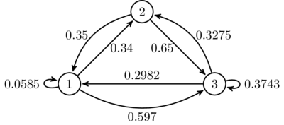
Proposed Model
    Defined as a discrete-time Markov chain.
      Discrete-time random process with different states.
      Each state characterized by a CAM size and generation interval.
      Every time a new CAM is transmitted, the state changes randomly.
      Probability of moving to a given state depends on the present state.
      Example: State 1 = (200Bytes, 100ms), State 2 = (200Bytes, 400ms), State 3 = (400Bytes, 200ms)

Slide 13
Proposed Model
    Model characterized by:
      State space and transition matrix.
    State space:
      G = {g₁,g₂,…} is the set of possible CAM generation intervals.
      S = {s₁,s₂,…} is the set of possible CAM sizes.
      N = {(g₁,s₁), (g₁,s₂), …} is the state space with |N|=|G|·|S| elements.
States
 | 1 | 2 | 3 | 4 | 5 | 6 | 7 | 8 | …
Size (Bytes) | 200 | 300 | 360 | 455 | 200 | 300 | 360 | 455 | …
Generation interval (ms) | 100 | 100 | 100 | 100 | 200 | 200 | 200 | 200 | …

Slide 14
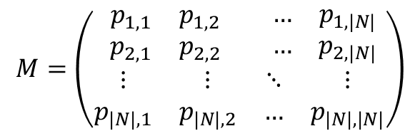

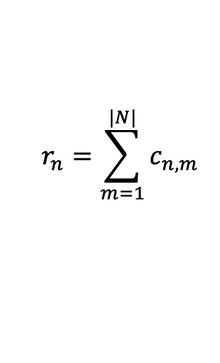
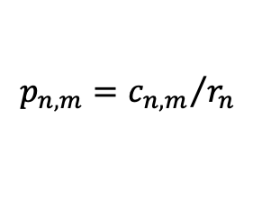
Proposed Model
    Transition matrix:
      p_{n,m} : probability to move from current state n to a next state m.
      Calculated by parsing the traces:
        Count the transitions between states n and m:
        Calculate normalization factor:
        Calculate the transition probability as:
$$M=\left(\begin{matrix}\begin{matrix}p_{1,1} & p_{1,2} \\ p_{2,1} & p_{2,2}\end{matrix} & \begin{matrix}… & p_{1,|N|} \\ … & p_{2,|N|}\end{matrix} \\ \begin{matrix}⋮ & ⋮ \\ p_{|N|,1} & p_{|N|,2}\end{matrix} & \begin{matrix}⋱ & ⋮ \\ … & p_{|N|,|N|}\end{matrix}\end{matrix}\right)$$
$$c_{n,m}$$
$$r_{n}=\sum_{m=1}^{|N|}{c_{n,m}}$$
$$p_{n,m}={c_{n,m}}/{r_{n}}$$

Slide 15
Proposed Model
    Eight CAM generation models have been generated:
    Independent models for CAM sizes and intervals also available:
      Eight additional models that generate CAM sizes.
      Eight additional models that generate CAM intervals.
 | Volkswagen | Renault
Urban | ✓ | ✓
Sub-urban | ✓ | ✓
Highway | ✓ | ✓
Universal | ✓ | ✓

Slide 16
Proposed Model
    Parametrization:
      All models with G = {100, 200, 300,…,1000} ms.
      Volkswagen models with S = {200, 300, 360, 455} Bytes.
      Renault models with S = {200, 330, 480, 600, 800} Bytes.
    Jitter:
      Gaussian distribution with zero mean and a std deviation as: (see table)
 | Scenario | Standard deviation (ms)
VW | Urban | 3,235
 | Sub-urban | 3,814
 | Highway | 3,444
 | Universal | 3,553
Renault | Urban | 2,817
 | Sub-urban | 2,769
 | Highway | 2,711
 | Universal | 2,783

Slide 17
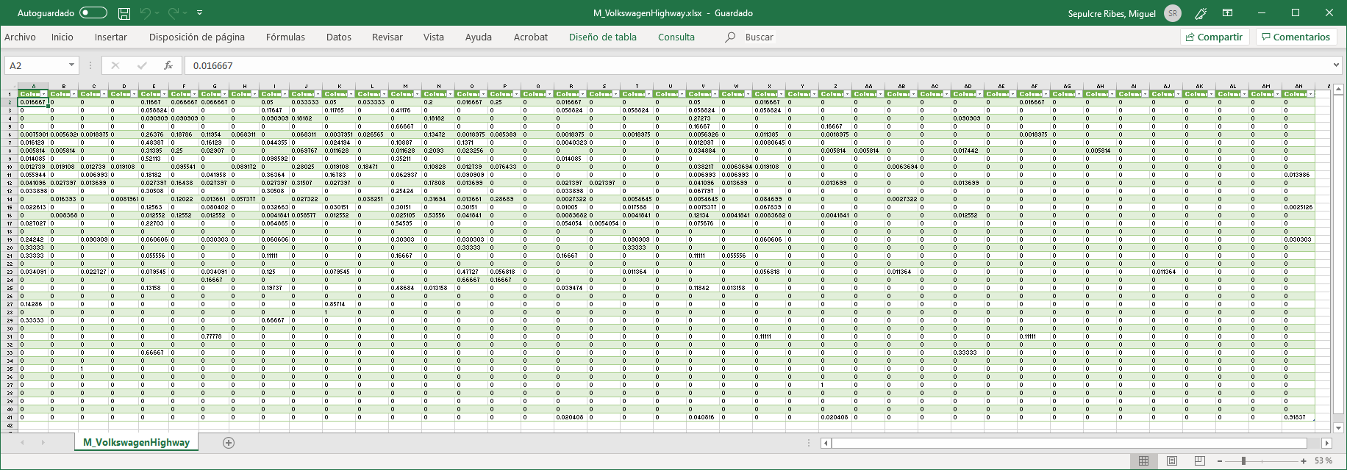
Proposed Model
    Example: transition matrix M for Volkswagen in highway (40x40).
      40 states: 4 sizes x 10 intervals

Slide 18
Validation
    Proposed models are used to generate 10⁶ CAMs:
  Select next state based on current state and transition matrix.
  Identify next CAM size associated to the next state.
  Identify next CAM generation interval associated to the next state.
  Add a random jitter to the CAM generation interval.

Slide 19
Validation
Volkswagen, highway
    Example of CAM sizes and intervals generated with the model:

Slide 20
Validation
    Comparison of PDF of CAM size and interval (Renault, highway):
Empirical traces
Generated traces

Slide 21
Validation
    Statistical difference between generated and original traces:
      High similarity of the PDF of the CAM size and generation interval.
      Validates proposed models and methodology.
OEM | Scenario | D_{KL}(P||Q) | δ(P,Q)
Volkswagen | Urban | 2.742 × 10⁻⁵ | 0.0008
 | Suburban | 3.835 × 10⁻⁴ | 0.0055
 | Highway | 4.742 × 10⁻⁵ | 0.0014
 | Universal | 5.568 × 10⁻⁵ | 0.0017
Renault | Urban | 2.824 × 10⁻⁴ | 0.0018
 | Suburban | 3.291 × 10⁻⁴ | 0.0015
 | Highway | 2.505 × 10⁻⁴ | 0.0018
 | Universal | 1.627 × 10⁻⁴ | 0.0015
      D_{KL}(P||Q) or KL divergence: amount of info lost when Q is used to approximate P.
      δ(P,Q) or total variation distance: largest possible difference between probabilities.

Slide 22
Conclusions
Simplified models for CAM generation can affect results.
  Effect on channel load generated.
  Effect on channel access schemes, such as LTE-V Mode 4.
Proposed empirical models for realistic CAM size and interval:
  Obtained from real CAM traces provided by VW and Renault.
  Urban, suburban and highway scenarios.
  Will be freely available to download and use.
Next steps:
  Performance comparison of ITS-G5 including IEEE802.11bd and LTE-V Mode 4.

