Slide 1
Implicit sounding overhead analysis
Date: 2019-07-14
Authors:
Name | Affiliation | Address | Email
Sigurd Schelstraete | Quantenna Communications | 1704 Automation Parkway, San Jose, CA 95131, USA | sschelstraete@quantenna.com
Imran Latif |  |  | ilatif@quantenna.com
Debashis Dash |  |  | ddash@quantenna.com
Huizhao Wang |  |  | hwang@quantenna.com

Slide 2
Introduction
Current 802.11 sounding protocols are based on sounding followed by explcit sounding feedback
These explicit protocols can take up a lot of airtime
Implicit sounding [1, 2] has been suggested as a way to reduce sounding overhead
This submission provides an analysis of overhead incurred by different sounding schemes

Slide 3
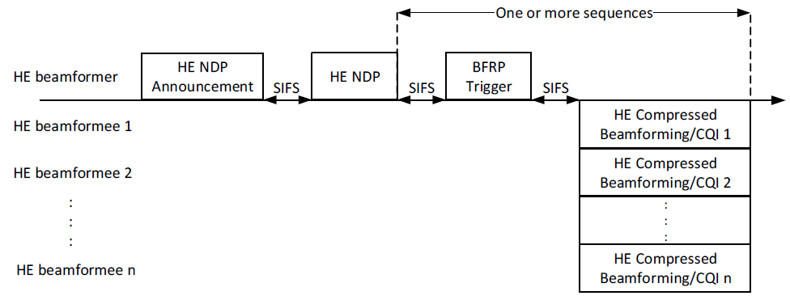
Current sounding protocols
SU-type feedback
MU-type feedback

Slide 4
Content of HE compressed Beamforming frame
Exact number of bits depends on channel dimensions
N_{c}: #feedback streams
N_{s}: #sounded streams
N_{a}: # angles in V-matrix compression (see next slide)
b_{φ}, b_{ψ}: compression parameters
Only for MU-type feedback

Slide 5
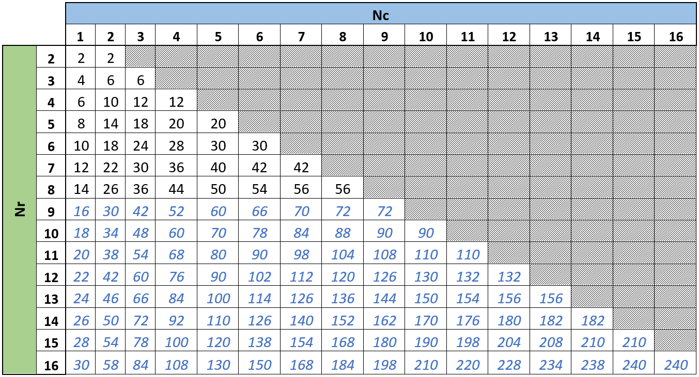
Values of N_{a}
Number of angles (Na) as function of Nc and Nr
802.11ax only defines up to N_{r} = 8
802.11be may go up to N_{r} = 16

Slide 6
Implicit sounding
Implicit sounding has been proposed as an alternative
Beamformer requests NDP from Beamformee
This allows estimation of the BFee → BFer channel
Derive BFer → BFee channel from this estimate
Requires calibration at AP side [3]
Potential to reduce airtime overhead
Basic scheme:

Slide 7
Implicit sounding (2)
Can be extended to receive multiple NDPs simultaneously
Either multiplexed in MU-MIMO or e.g. tone-interleaved
Sounded clients should have similar receive powers
If not, multiple successive implicit soundings can still be used

Slide 8
Additional considerations
Power differences between UL and DL
Client transmit power can be lower than AP transmit power
Could reduce the quality of the channel estimate
This can be compensated for by repeating the training signals

Slide 9
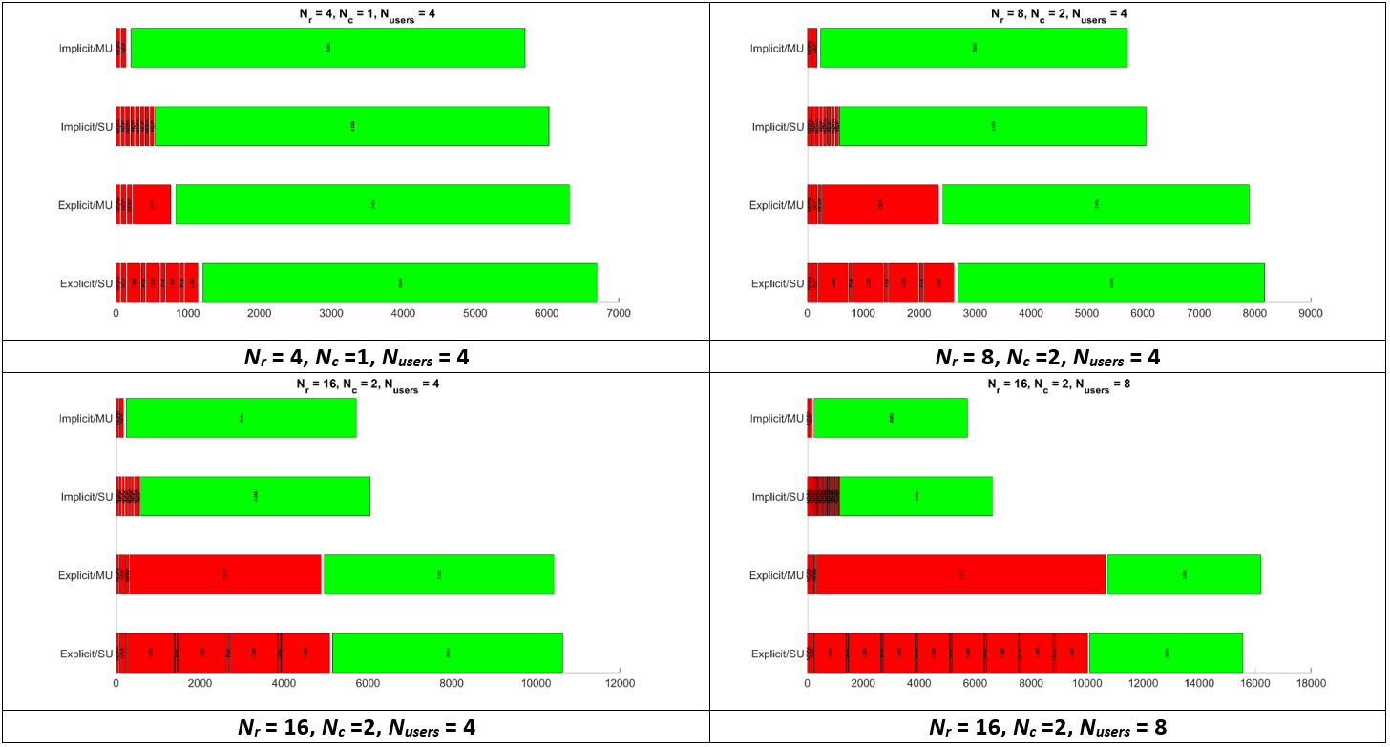
Some examples: overhead vs. frame

Slide 10
Observations on explicit feedback
MU (OFDMA) does not always provide significant improvement for high-dimensional cases
OFDMA does not reduce the amount of airtime needed for data transmission
When protocol overhead is not dominant, MU sounding feedback does not provide much improvement
MU feedback may be worse than SU feedback because of OFDMA inefficiencies in spectrum allocation and padding
MU-type feedback is not the ultimate solution for reducing sounding overhead

Slide 11
Simulation results
Numerical examples to estimate time needed for sounding and feedback exchange
Assumptions:
#sounding streams: 4, 8, 16
N_{RX}: 1, 2, 4
Number of users: 4, 8
N_{g}: 4
MCS: 2
BW: 80 MHz
HE-LTF repeated 4 times for implicit sounding
Assume OFDMA for MU-type feedback
HE-LTF mode: 2x, GI: 0.8 μsec

Slide 12
Four different schemes simulated
“SU sounding”
“MU sounding”
“Implicit (successive)”
“Implicit (MU)”

Slide 13
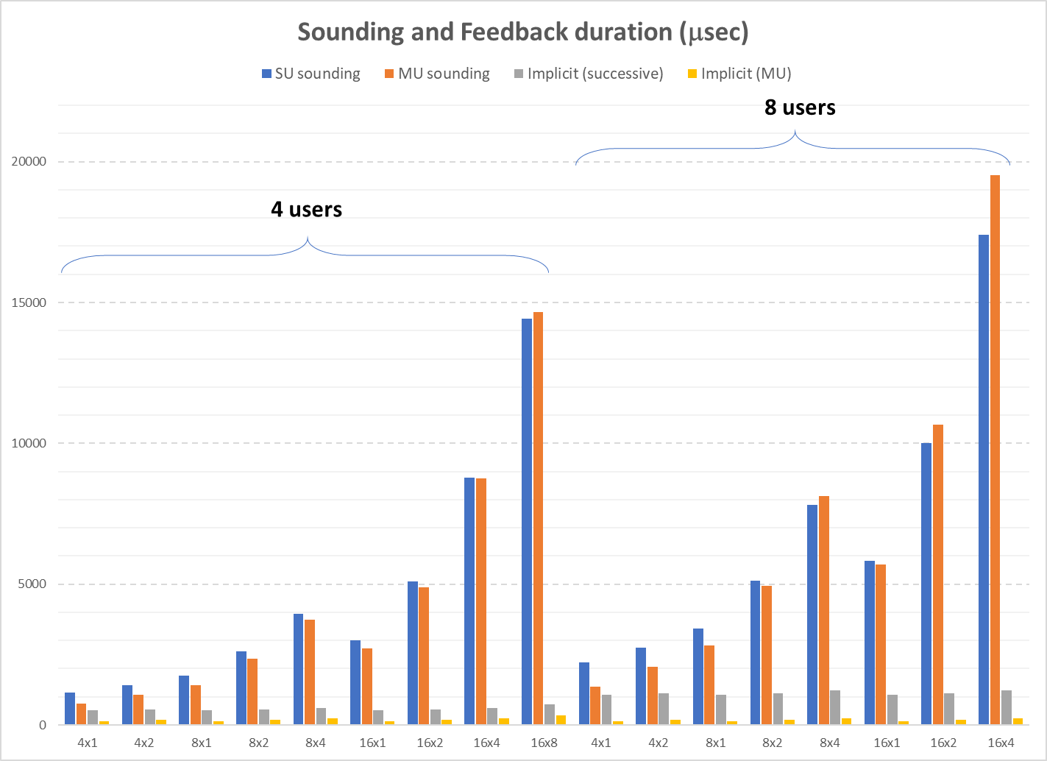
Numerical data – sounding and feedback absolute time

Slide 14
Analysis
Explicit sounding takes up significant airtime for high-dimensional channels
Not much difference between successive SU soundings and MU-type sounding (OFDMA) for high-dimensional channels
Even with repeated training symbols, airtime taken by implicit sounding is an order of magnitude lower

Slide 15
Numerical data – sounding and feedback relative overhead
What really matters is the total airtime overhead of channel sounding
Needs to be considered in network context. Different scenarios will yield different answers
To allow us to quantify overhead, we use the following metric:
Sounding overhead relative to single frame transmission
$\frac{T_{sounding}+T_{feedback}}{T_{sounding}+T_{feedback}+T_{frame}}$
overhead if we sounded the channel right before transmission and used the results only for precoding of the subsequent frame
Not necessarily directly representative of network overhead, but allows quantitative comparison between sounding schemes

Slide 16
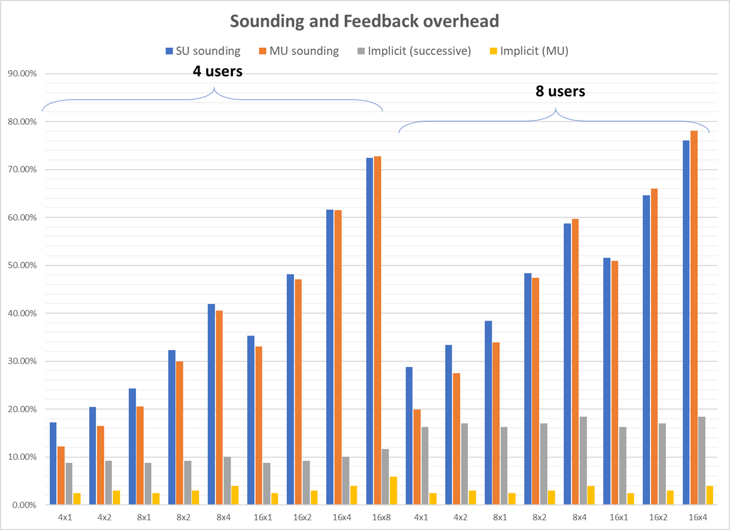
Numerical data – sounding and feedback relative overhead (2)
Data

Slide 17
Analysis
Overhead is extremely high for high-dimensional channels (8 or 16 sounded streams)
Overhead of implicit channel sounding is significantly lower
Even low enough to allow per-packet sounding

Slide 18
Conclusions
Implicit channel sounding offers significant potential for sounding overhead reduction
Proposal:
Add Implicit sounding as an optional sounding mechanism for reducing sounding overhead
Maintain Explicit sounding as the mandatory mechanism for backwards compatibility

Slide 19
Straw Poll
Do you agree to add Implicit Channel Sounding as an optional sounding mechanism in 802.11be?

Slide 20
References
[1] MU sounding improvements, IEEE 802.11-18/1191
[2] Implicit Channel Sounding in IEEE 802.11, IEEE 802.11-19/0768
[3] Implicit Channel Sounding in IEEE 802.11 (Feasibility Study), IEEE 802.11-19/0767

