Slide 1
Wider Bandwidth Channel Access in EHT
Date: 2019-07-15
Authors:

Slide 2
Introduction
TGbe has discussed new band/channel operations as follows:
  1) Wider bandwidth operation in a single BSS [1-3]
    Upto 320MHz per BSS
    The operating bandwidth may be non-contiguous and located in different bands
      E.g., partially at 5GHz and partially at 6GHz
  2) Multilink operation throughout multiple BSSs within a device [1, 4, 5]
    A multilink management entity handles unified operation of multiple BSS
This contribution focuses on the wider bandwidth channel access in a single EHT BSS

Slide 3
Existing Behavior for Wide Bandwidth Channel Access
A BSS can have its operating channel width at most 160 MHz
  20/40/80/160 MHz
  Non-contiguous BW operation is allowed in the same band (80+80)
Channel access based on primary channel
  When the Backoff counter reaches to zero and the primary channel is idle, STA can access the channel
Based on the CCA.indication, STA determines the transmission bandwidth
  Occupying non-primary channels if the channel is idle for PIFS before the transmission
  Legacy CCA indication: Primary/Secondary/Secondary 40/Secondary 80
  HE CCA indication: Per 20MHz bitmap
    Based on the bitmap, HE STA may perform preamble puncturing

Slide 4
Wider Bandwidth Channel Access in EHT BSS (1)
An EHT BSS can have the operation channel width upto 320MHz
Channel access behavior for the BW greater than 160MHz hasn’t been defined
Following the existing channel access logic, we can consider two approaches as follows
1) Defining Secondary 160 CCA.indication
  STA transmits with 320MHz BW if all the secondary/secondary 40/80/160 channels are idle
2) Extending per 20MHz CCA bitmap and defining more preamble puncturing patterns for 320MHz BW

Slide 5
Wider Bandwidth Channel Access in EHT BSS (2)
1) Defining Secondary 160 CCA.indication
  Pros: Simple implementation, low H/W requirement
  Cons 1) Spectral efficiency can be severely degraded
  Cons 2) Less flexibility in the operating channel selection
    The operating channel width is limited to 320MHz if it is greater than 160 MHz
2) Extending per 20MHz bitmap and defining more preamble puncturing patterns for 320MHz BW
  Pros: Better spectral efficiency
  Cons: More H/W requirement and more complicated preamble design
In the next slide, we propose another method for wider BW channel access:
  Compromising the trade off between spectral efficiency and complexity
  Enabling more flexible operating channel selection

Slide 6
Extended Channel Set
The operating channel width of EHT BSS may consist of two sets of channels
  Primary channel set
    Beacon will be transmitted only in the primary 20 of the primary channel set
    Inherits all baseline channel operations
    Legacy STAs operate only in the primary channel set
  Extended channel set
    An EHT AP may announce the extended channel set
      An EHT STA may negotiate the use of extended channel set
    The extended channel set reuses the baseline CCA.indication design
      As well as the preamble puncturing pattern
    The bandwidth of the extended channel set may not be the same with the primary channel set
      E.g., 80+160
Primary channel set
P20
S20
S40
Primary channel set
P20
S20
S80
S40
Extended channel set
P20
S20
Extended channel set
P20
S40
S20
S40
S80
S80

Slide 7
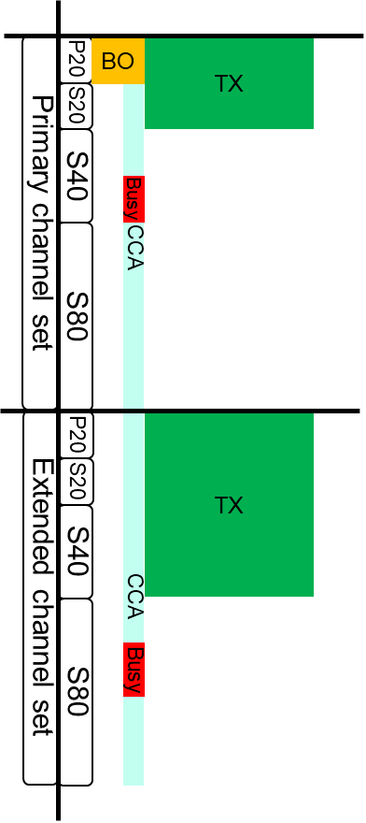
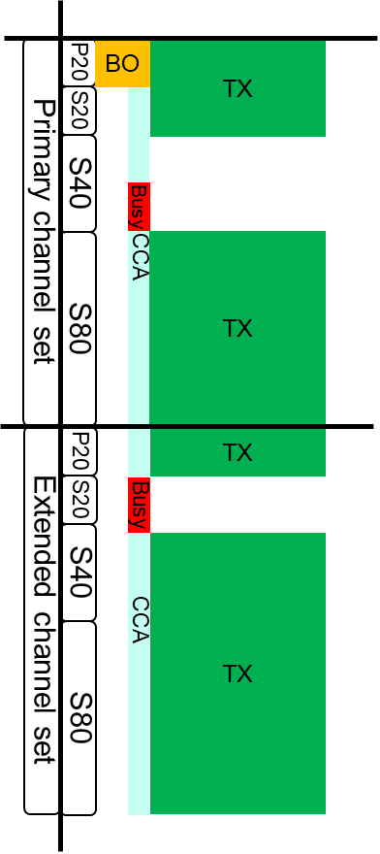
Wider Bandwidth Channel Access for EHT STA
EHT STA performs EDCA in the primary 20 of the primary channel set
If the backoff counter reaches to zero, the EHT STA performs CCA within both the primary channel set and the extended channel set
  Within PIFS immediately preceding the start of the TXOP
The STA determines the transmission bandwidth for both sets independently based on the CCA.indication
  Preamble puncturing may be applied for both sets
    May reuse the existing 160MHz puncturing patterns

Slide 8
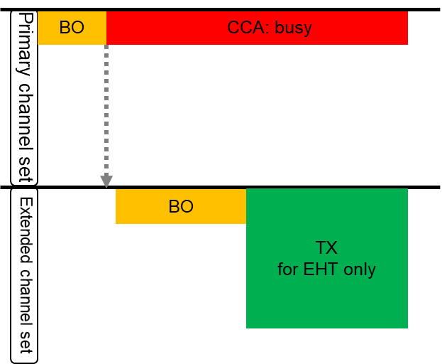
Further Consideration for Increasing Spectral Efficiency
If the primary channel set is not available, we may allow EHT STA to use the extended channel set temporarily
  The primary channel for the extended channel set may be defined
  EHT STA may perform EDCA in the primary 20 of the extended channel set
The extended channel set operation is allowed under TBD conditions that guarantee
  Not to affect legacy STAs operation in the BSS
    EHT STA should return to the primary channel set immediately after the primary channel becomes idle
    Hidden terminal needs to be considered
  Not to damage the fairness among other legacy OBSSs severely
    Channel access intensity needs to be handled

Slide 9
Discussion on the Extended Channel Set
The proposed extended channel set is beneficial:
  Much greater spectral efficiency than secondary 160 CCA.indication
  Able to support various operation channel widths
    160MHz: 80/80, 240MHz: 80/160, 320MHz: 160/160
  Possible to reuse the existing signaling and schemes
    CCA.indication, preamble puncturing pattern, RU allocation in the preamble
  Further enhancing the spectral efficiency for EHT STAs
    Allowing channel access in the extended channel set only
It doesn’t mean that the proposed method is used exclusively:
  Depending on the capability and negotiation, STA may use secondary 160 CCA.indication
  More preamble puncturing patterns can be defined within 160MHz

Slide 10
Summary
In this contribution, we have discussed wider bandwidth channel access for EHT BSS
We have proposed that:
  The operating channel of an EHT BSS consists of two sets of channels
    Primary channel set, Extended channel set
  STA performs EDCA in the primary 20 of the primary channel set
  The transmission bandwidth is determined independently in both sets
    Reusing the existing CCA.indication
  EHT STA may perform EDCA in the extended channel set
    Only when the primary channel is not available
    Under additional TBD conditions

Slide 11
Reference
[1] 11-18-1231-06-0eht-eht-draft-proposed-par
[2] 11-19-0754-00-00be-11be-peak-data-rate-analysis
[3] 11-19-0778-00-00be-consideration-on-320mhz-bandwidth-and-16-spatial-streams
[4] 11-19-0822-00-00be-extremely-efficient-multi-band-operation
[5] 11-19-0823-00-00be-multi-link-aggregation

