Slide 1
Link Performance Models for System Level Simulations in LC
Date: 2019-07-17
Authors:

Slide 2
Abstract
The objective of this presentation is to describe an efficient approach for obtaining system level simulation results using a PHY layer abstraction in a timely and computationally efficient fashion.
The considered approach is focused on an OFDM-based system and relies on the accurate mapping of the SINRs of the used sub-carriers during an OFDM symbol to an effective SINR denoted as${ SINR}_{eff}$.
The${ SINR}_{eff}$ accurately captures/approximates the PER performance metric based on a predetermined table which maps the${ SINR}_{eff}$ to a value of PER for a AWGN channel.

Slide 3
Outline
Introduction
A Generic System Level Simulator
A Generic Link Level Simulator
Calculation of the ${ SINR}_{eff}$
Model Functions
An Approach for Using the CESM method in LC
An Approach for Using the MIESM method in LC
Why the EESM Approach is Directly Applicable to LC
Conclusions

Slide 4
Introduction (1)
The complete characterization of the performance of a LC system involves both link and system level simulation results.
In a link level simulator, the performance of a transceiver (or a small number of transceivers) is obtained by considering a detailed description of the underlying PHY layer architecture. This is undertaken for a number of channel realizations.
In contrasts, a system level simulator produces results that characterize the whole system performance of a network of Access Points (APs) serving a large number of STAs assuming a holistic approach. In practice, a metrics, such as AP throughput, for multiple APs (with multiple transceivers) are produced for the whole system performance characterization.

Slide 5
Introduction (2)
Clearly, the complete link level performance characterization of the multiple transceivers of a system level simulator is only possible via massive computational resources in a lengthy process.
Thus, an accurate abstraction of the link level performance is required for reducing the required computational and time resources in a system level simulator.
The presented approach has been used extensively from IEEE 802.11. The most recent example is the Mutual Information Effective SINR Metric (MIESM) method used for the evaluation of 802.11ax [1].
The rest of this contribution aims to provide a methodology for accelerating the system level simulations of a LC system by assuming PHY layer abstractions.

Slide 6
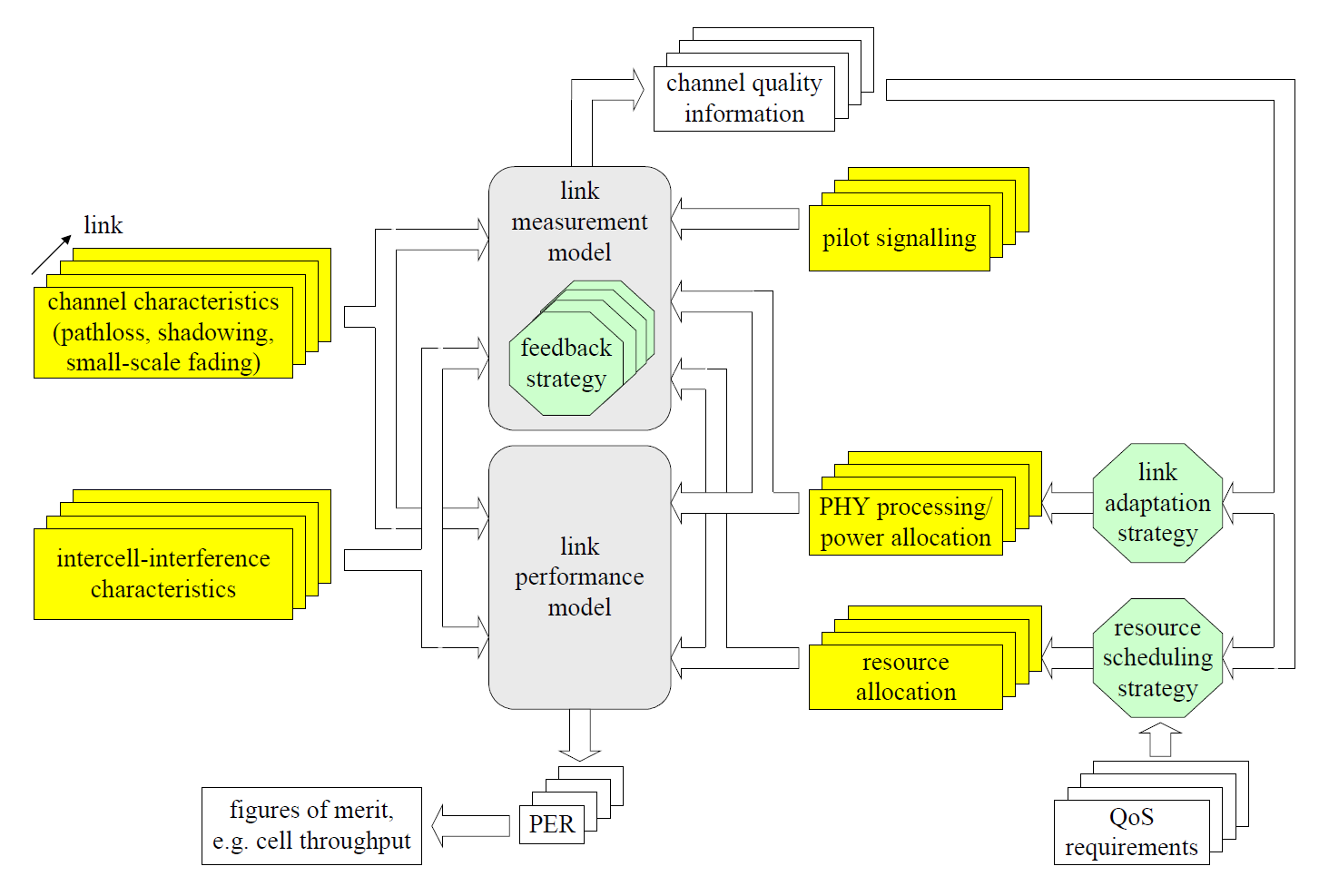
A Generic System Level Simulator
In [3], the following schematic for an RF dynamic system level simulator is presented:
Connection between the link and system level simulators

Slide 7
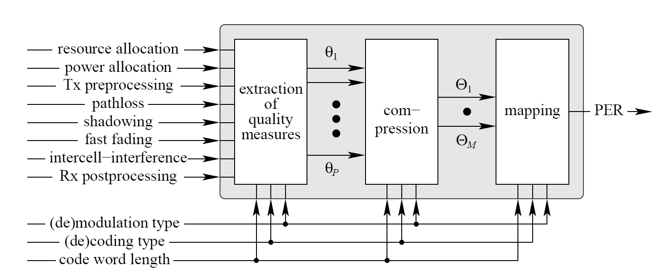
A Generic Link Level Simulator
In [3], the following general performance model for RF communication has been adopted:
A model for LC needs to consider only the characteristics of an optical channel.
In an OFDM-based system, a natural selection for the quantities of $θ_{p}, p=1,…,P$ is the ${SINR}_{p}$ per subcarrier.
Consequently, the effective ${SINR}_{eff}$ can be also a natural selection for the result of a compression process.

Slide 8
Calculation of the Effective ${ SINR}_{eff}$
The most common approach in literature expresses the ${ SINR}_{eff}$ as [2,3]:
$${SINR}_{eff}=aI^{−1}\left(\frac{1}{P}\sum_{p=1}^{P}{I\left(\frac{{SINR}_{p}}{b}\right)}\right),$$
where:
$I\left(.\right)$ is a model specific function
$I^{−1}\left(.\right)$ is the inverse of I
$a$ and $b$ are parameters that allow the model adaption to consider MCS (modulation coding scheme.)

Slide 9
Model Functions
In literature, the following model functions have been considered for RF communication:
Obviously, the use of CESM and MIESM in LC needs to consider the special characteristics of the wireless optical channel.
In addition, in MIESM approach further details, such that the type of coding, reception method, etc, of the considered PHY needs to be taken into account.
Name | Acronym | Formula
Capacity Effective SINR Metric | CESM | $$I\left(γ\right)=\log_{2}\left(1+γ\right)$$
Exponential Effective SINR Metric | EESM | $$I\left(γ\right)=e^{−γ}$$
Mutual Information Effective SINR Metric | MIESM | $$I\left(γ\right)=𝕀_{m}(γ)$$

Slide 10
An Approach for using the CESM method in LC
From [4], the following bounds can be used assuming an average power constraint, $𝒜,$ and peak power constraint, $ℰ$(including the LC channel).
For, $0<a<\frac{1}{2}$ , where, $a=\frac{𝒜}{ℰ}$:
$C\left(𝒜,ℰ\right)≥\frac{1}{2}log\left(1+𝒜^{2}\frac{e^{2aμ^{∗}}}{2πeσ^{2}}\left(\frac{1−e^{μ^{∗}}}{μ^{∗}}\right)\right)$
$C\left(𝒜,ℰ\right)≤\frac{1}{2}log\left(1+a\left(1−a\right)\frac{𝒜^{2}}{σ^{2}}\right)$
$μ^{∗}$ is the unique solution of $a=\frac{1}{μ^{∗}}−\frac{e^{{−μ}^{∗}}}{1−e^{{−μ}^{∗}}}$
For, $\frac{1}{2} ≤a≤1$:
$C\left(𝒜,ℰ\right)≥\frac{1}{2}log\left(1+\frac{𝒜^{2}}{2πeσ^{2}}\right)$
$C\left(𝒜,ℰ\right)≤\frac{1}{2}log\left(1+\frac{𝒜^{2}}{4σ^{2}}\right)$
$σ^{2}$ is the variance of a zero mean Gaussian random variable (thermal and ambient noise).

Slide 11
An Approach for using the MIESM method in LC
In [4], the mutual information is bounded assuming an average power constraint, $𝒜$, and peak power constraint, $ℰ$, (when the optical channel is considered) as:
$$𝕀\left(X;Y\right)≥\frac{1}{2}log\left(1+\frac{e^{2h\left(X\right)}}{2πeσ^{2}}\right).$$
Here, $h\left(X\right)=−E\left[log\left(f_{X}(X)\right)\right]$ is the differential entropy and $f_{X}(x)$ the probability density function (PDF) of $X$.
In [4], the provided capacity bounds are derived assuming different suboptimal PDFs for $X$(channel input).
Thereover, if $𝕀\left(X;Y\right)$, as given before, is used for quantifying (lower bounding) the mutual information, the results obtained with CESM and MIESM will be the same for the same selection of PDFs of $X$.
A alternative approach is to use the mutual information per coded bit by considering a specific Modulation and Coding Scheme (MCS) and reception type.

Slide 12
Why the EESM Approach is Directly Applicable to LC
The derivation of the ${ SINR}_{eff}$ for the EESM approach is based on the [2,5]:
Chernoff bound
Union bound method for calculating the error probability of coded transmission.
Using the previous basis, the authors of [2,5] express the calculations of the ${ SINR}_{eff}$ as:
$${SINR}_{eff}=a_{m}a_{c}\ln\left(\frac{1}{P}\sum_{p=1}^{P}{e^{\frac{{SINR}_{p}}{a_{m}a_{c}}}}\right),$$
where, $a_{m},$ and, $a_{c},$ are adjusting factors for the $M$-ary constellation and coding rate, respectively.
Clearly, the previous steps are directly applicable to any intensity modulation scheme and thus to LC.

Slide 13
Conclusions
The time acceleration and computational simplification of the heavy system level simulations of a LC system can be done via the PHY layer abstraction.
In this contribution, the well known methods for PHY abstraction, CESM, EESM, and MIESM were presented. It was concluded that only the methods of EESM can be directly migrated from the evaluation of an RF system to the evaluation of a LC system.
The evaluation of a LC system using the methods of CESM and MIESM requires the careful use of the corresponding information-theoretic results for LC.

Slide 14
References
[1] 802.11-14/0571r12, “11ax Evaluation Methodology”, Ron Porat, et al.
[2] Lei Wan, Shiauhe Tsai and M. Almgren, "A fading-insensitive performance metric for a unified link quality model," IEEE Wireless Communications and Networking Conference, 2006, Las Vegas, NV.
[3] K. Brueninghaus et al., "Link performance models for system level simulations of broadband radio access systems," 2005 IEEE 16th International Symposium on Personal, Indoor and Mobile Radio Communications, Berlin, 2005.
[4] A. Lapidoth, S. M. Moser and M. A. Wigger, "On the Capacity of Free-Space Optical Intensity Channels," in IEEE Trans. on Information Theory, vol. 55, no. 10, pp. 4449-4461, Oct. 2009.
[5] Ericsson, “Effective-SNR Mapping for Modeling Frame Error Rates in Multiple-State Channels”, 3GPP2-C30-20030429-010

