Slide 1
TGbb PHY proposal
Date: July 12, 2019
Authors:

Slide 2
Abstract
This presentation aims to provide a suggestion on the integration of a PHY layer that could enable existing .11 PHY specifications to be applied for LC and create agreement on:
Common-mandatory PHY,
Electrical spectrum masks, and
Common spectrum (light color).

Slide 3
Introduction
TGbb pre-proposal was discussed in doc. 11-19/0388r0 and doc. 11-19/0847r0.

Slide 4
Characteristics of LC PHYs
LC requires a non-negative and real-valued baseband-signal.
Bipolar signals can be turned non-negative by adding a DC-bias before transmission.
It is removed by using a high-pass filter before reception.
optical
channel
TX
DSP
+
Driver & LED
Photo-diode
High-pass
RX
DSP
DC

Slide 5
Use existing 802.11 PHYs for LC
Complex OFDM-baseband signals are real-valued after up-conversion to the carrier frequency f_{c}.
For LC, one could simply change f_{c} to a low carrier (“low IF”), yielding a real-valued baseband signal.
Data
IFFT
CP
Up-con-
version
Re(.)
LED
f_{c}

Slide 6
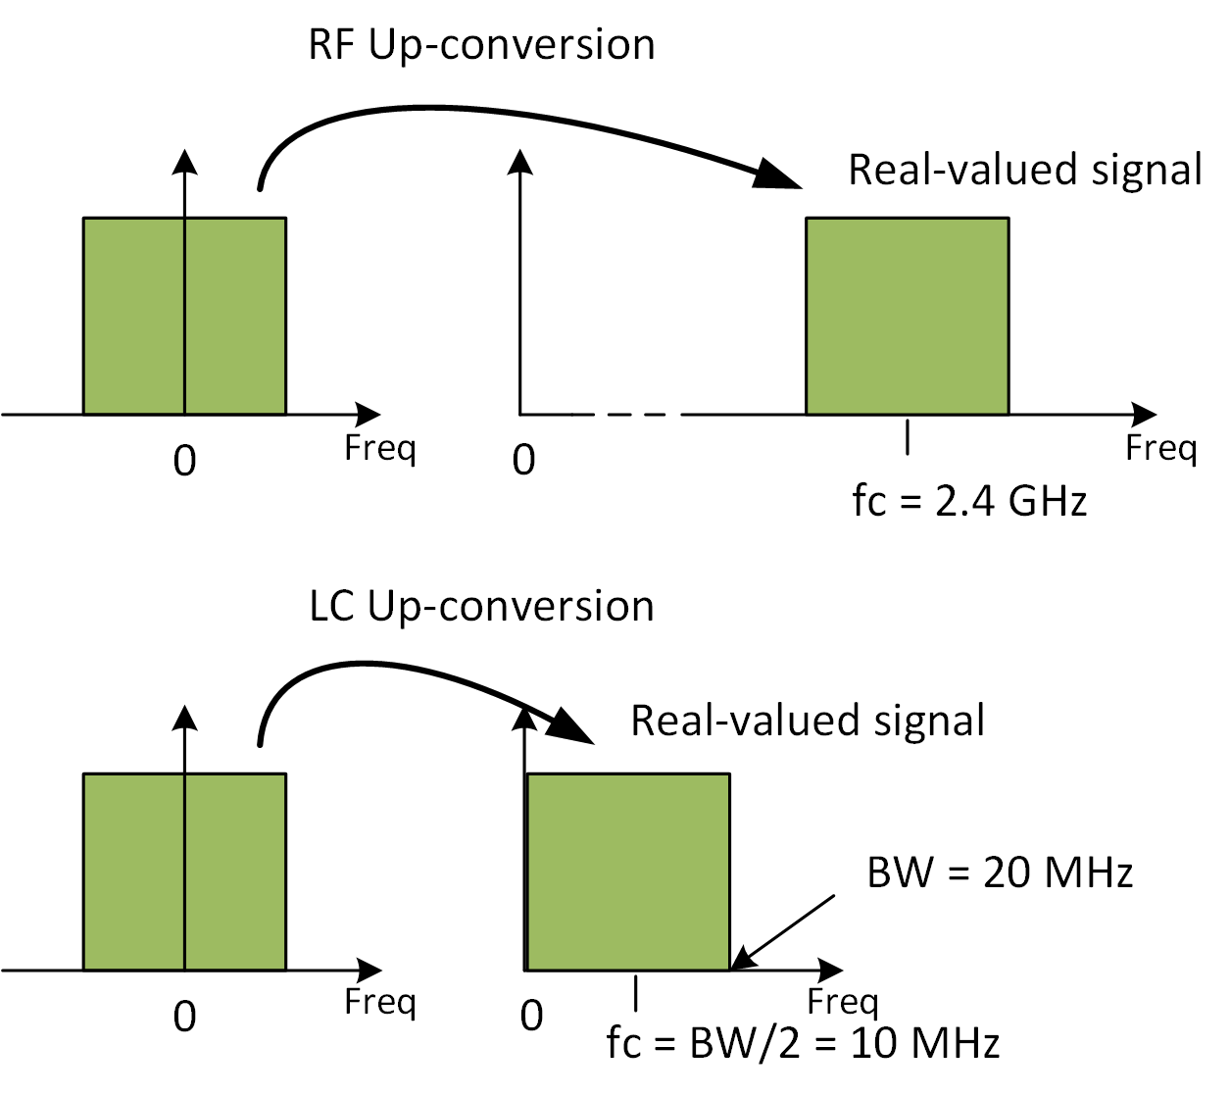

Using existing 802.11 PHYs for LC
RF frontend up-converts
baseband signals onto e.g.
f_{c}=2.4 GHz.
LC frontend up-converts
baseband onto low IF e.g.
f_{c}=BW/2 + Δ.
  Δ is to be agreed depending on signal mask design.
This way, any complex-valued baseband signal (i.e. any existing IEEE 802.11 PHY) can be used to facilitate LC.
Δ
f_{c}=BW/2 + Δ

Slide 7
Use existing and LC-optimized PHY under 802.11 MAC
802.11 MAC could integrate existing and optimized PHY
Use existing 802.11ax PHY as a common, mandatory OFDM PHY.
Negotiate the use of the LC-optimized PHY if both devices have that capability.
802.11
MAC
Existing
PHY for LC
LC-Optimized
PHY

Slide 8
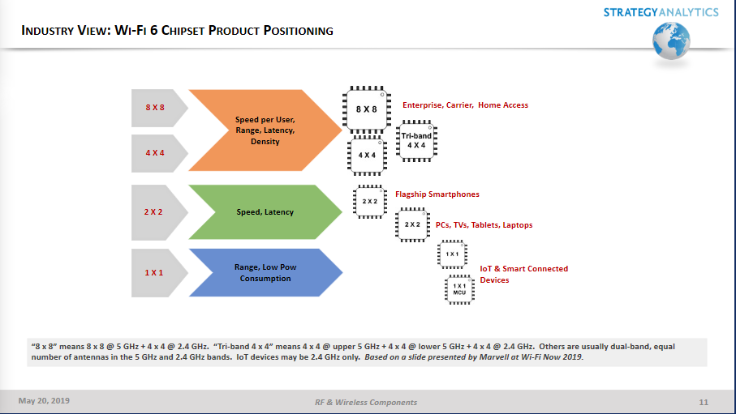
Wi-Fi 6 – chipsets range

Slide 9
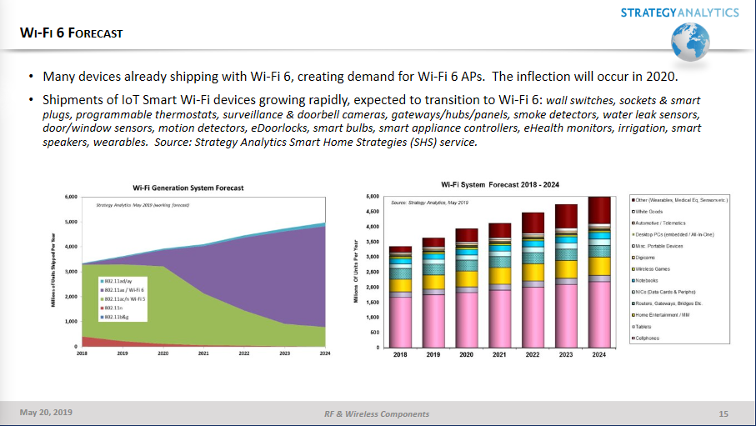
Wi-Fi 6 – chipsets availability
TGbb completion

Slide 10
11ac vs. 11ax MAC comparison
 | IEEE 802.11ac | IEEE P802.11ax
HCF | Yes. | Yes. - MU EDCA mode added in order to enhance QoS
OBSS | - OBSS scan before setting BSS. - Channel switch/selection to implement spatial reuse. The new BSS may select the same primary channel identical to the primary channel of any one of the existing BSSs. | - All BW used. - BSS color tag in PHY header. - OBSS scan for each PPDU.
Power saving | - STAs decide to Doze. - Doze during each TXOP. | AP tells STAs to enter power saving modes.
Other benefits |  | OFDMA to increases user data rates and reduces latency.
 |  | Support large amount of active users.

Slide 11
PROPOSAL: Use 11ax PHY as one of the operating modes for TGbb
Straw Poll:
11ax (High efficiency PHY specification) is to be considered as one of the operating modes for TGbb
Result (Y/N/A): 17 / 1 / 6

Slide 12
Spectrum mask (11ax – 20MHz)

Slide 13
Spectrum mask (11ax – 40MHz)

Slide 14
Spectrum mask (11ax – 80MHz)

Slide 15
Spectrum mask (11ax – 160MHz)

Slide 16
Spectrum mask (11ax – 80+80MHz)

Slide 17
PROPOSAL: Baseband spectrum mask
NOT RUN – Straw Poll:
Should the mandatory baseband spectrum masks for the 802.11 PHY modes as described in Slides 12-16 be accepted for TGbb?
Y/N/A

Slide 18
PROPOSAL: Baseband center frequencies
NOT RUN – Straw Poll:
TGbb should set the mandatory, common-mode centre frequencies as follows:
  20 MHz for a 20 MHz baseband signal
  40 MHz for a 40 MHz baseband signal
  80 MHz for a 80 MHz baseband signal
  160 MHz for a 160 MHz baseband signal
  80 MHz and 160 MHz for an 80 + 80 MHz baseband signal
that would be equivalent to the -28 dBr spectrum mask for the relevant signals.
Y/N/A

Slide 19
PROPOSAL: Wavelength
NOT RUN – Straw Poll:
The mandatory wavelength for the 802.11bb be set to cover 850nm up to 900nm?
Y/N/A

