Slide 1
Improved Preamble Puncturing in 802.11be
Date: 2019-11-06
Authors:

Slide 2
Background
In the current 802.11ax standard there are 4 options (defined in HE-SIG-A for MU PPDU) for defining the preamble puncturing (SIG-B puncturing) when 80MHz or 160/80+80 MHz channel is defined
These 4 options refer only to the segment in which the primary channel is located
In the other segment (for BW>80MHz) puncturing is implicitly indicated in SIG-B (by using “242-tone RU empty”).
Puncturing is not supported in SU-PPDU due to the absence of SIG-B; therefore SU-PPDU must be transmitted on the entire available contiguous BW
In this presentation, we show some simulation results that demonstrate the improvement in channel utilization when applying an improved preamble puncturing in various network scenarios in 160MHz BW

Slide 3
Background
  Preamble Puncturing in 11ax
  802.11ax preamble puncturing improves the channel utilization compared with previous 802.11 standards in which puncturing is not employed
  The channel utilization improvement is achieved by leveraging the characteristics of OFDMA in order to transmit over a wide BW with 20MHz resolution
  This way, 20MHz portions of the channel that are unavailable (e.g. occupied by other transmitters) may be skipped (punctured)

Slide 4
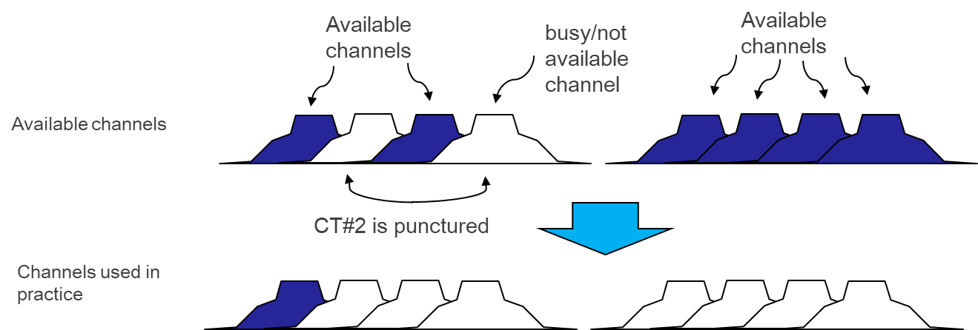
Preamble Puncturing in 11be
  Nevertheless, the preamble puncturing may be further improved in 2 cases:
  Improve support in MU-PPDU
    If the secondary 20MHz channel and the 4th 20MHz channel within the primary segment are simultaneously not available, content-channel 2 cannot be transmitted, therefore the BW reduces to 20MHz
    We suggest to overcome this by allowing all (or most of the) available BW when the above situation occurs

Slide 5
Preamble Puncturing in 11be
  Add support in SU-PPDU
    SU-PPDU does not include SIG-B, nor does it include puncturing signaling in the BW field within SIG-A
    This means that SU-PPDU must be transmitted on the entire available contiguous BW
    We suggest to improve the channel utilization in SU-PPDU by adding puncturing capability to it as well. For example, use bitmap to indicate the punctured channels.
Available channels
Channels used in practice
(available contiguous BW)

Slide 6
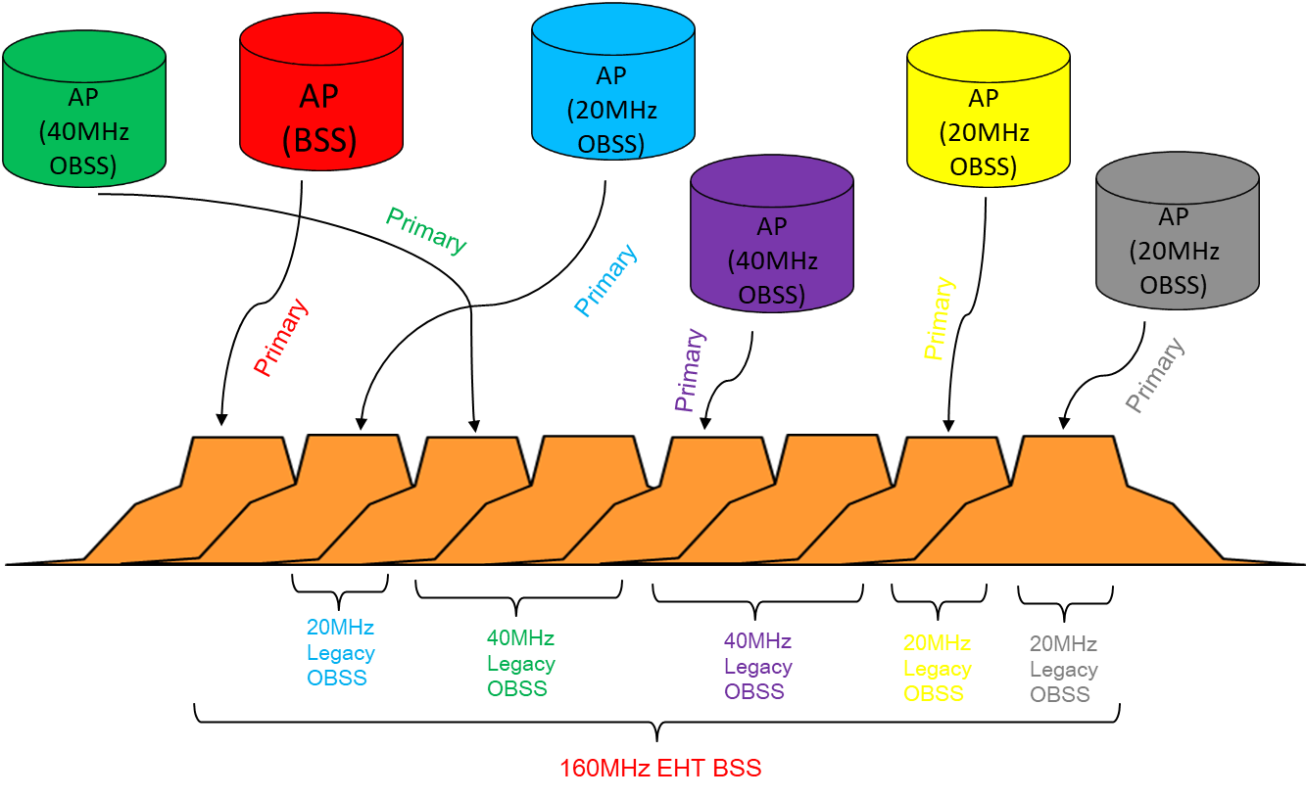
Improved Preamble Puncturing: Potential Gains
  In order to evaluate the potential gain when more flexible puncturing is supported, we ran a system level simulation
  We defined several simulation scenarios in which the BSS AP (which is the “AP under test”) is located near several OBSS transmitters
  Assumptions:
    Each of OBSS APs serves 1-3 clients and may be any Legacy 802.11 (a/g, n, ac)
    The puncturing structure may change rapidly (hence is referred to as “flexible”), even on any PPDU, especially in a dense environment where many STAs “compete” for the channel resources

Slide 7
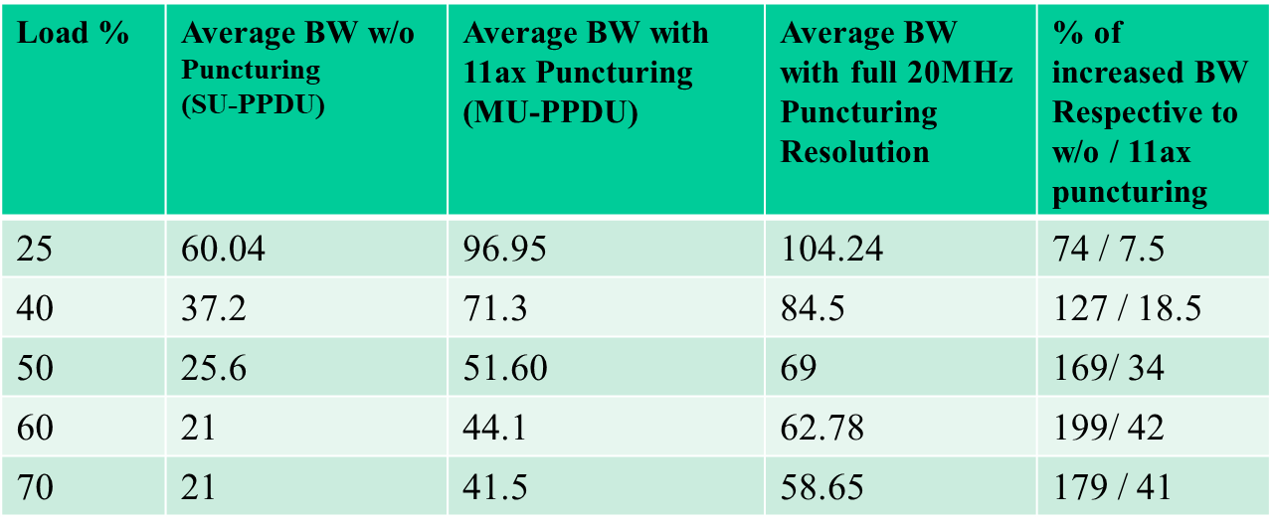
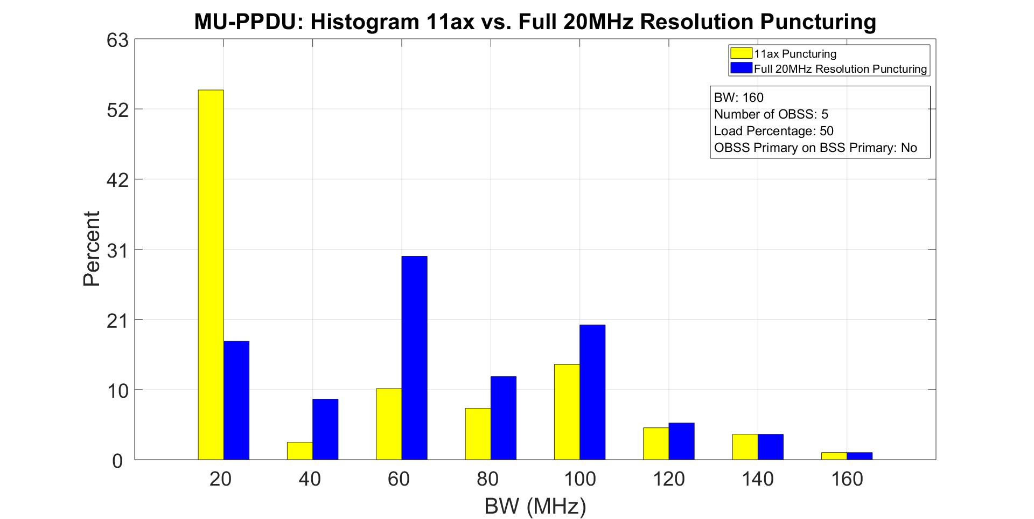
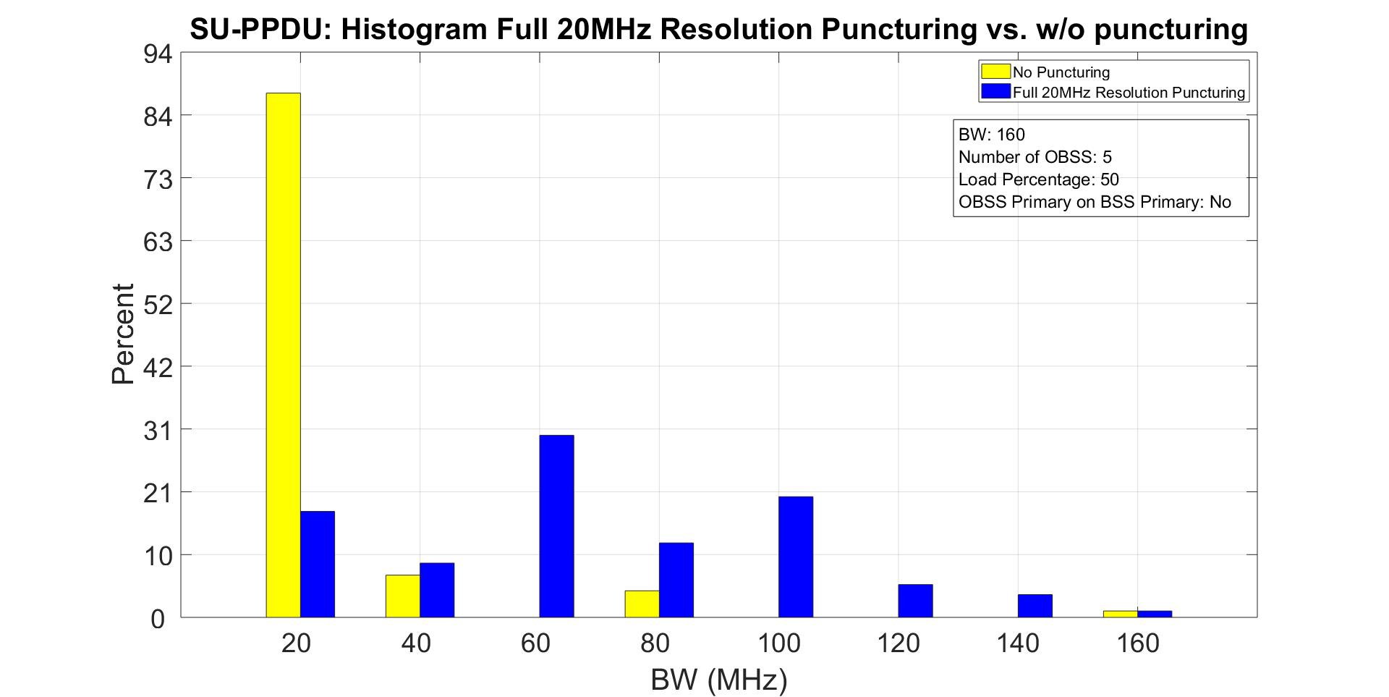
Simulation Results: 20MHz Resolution
  Significant channel utilization gain

Slide 8
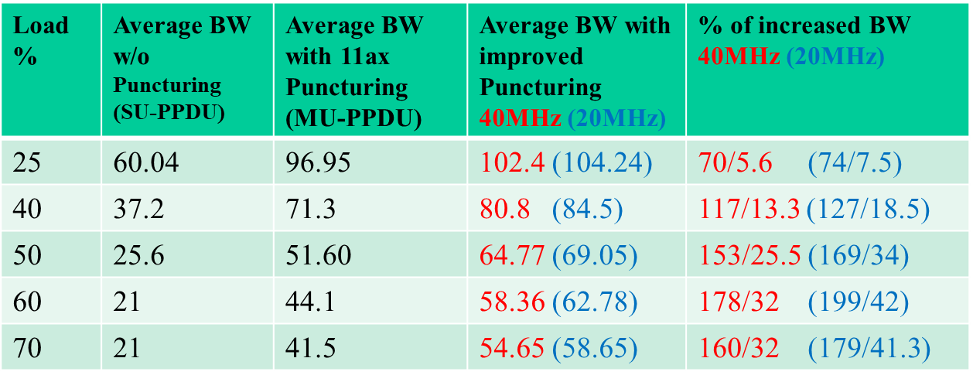
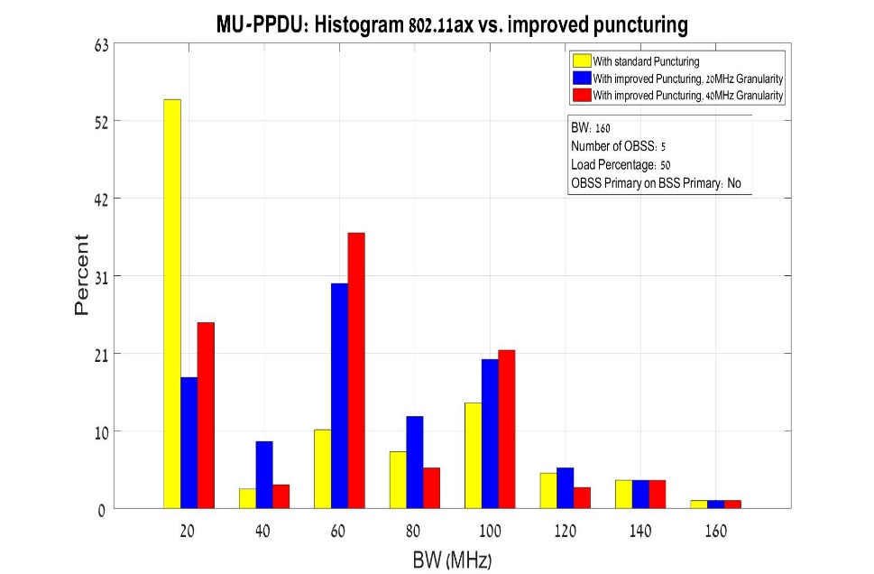
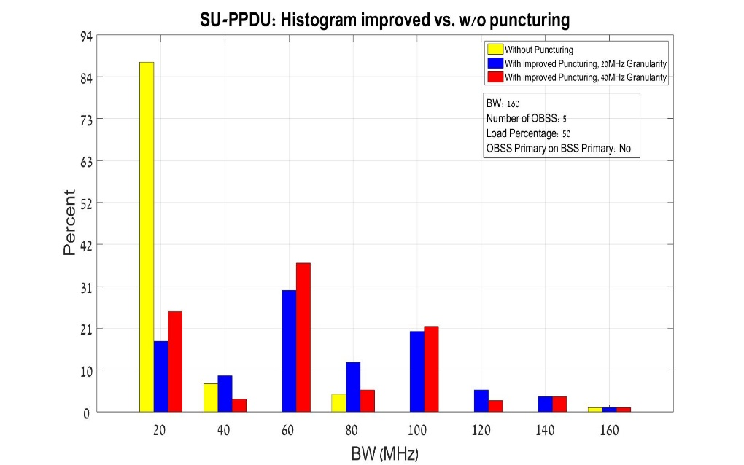
Simulation Results: 40MHz Resolution
  Channel utilization gain is still significant enough even when puncturing granularity is increased to 40MHzs.

Slide 9
Conclusions
We presented simulation results that show a significant gain in channel utilization when using a more effective channel puncturing than is used in 11ax
For BW=160MHz, a dramatic gain was achieved for SU-PPDU while significant gain was achieved for the MU-PPDU case as well. It is reasonable to assume that higher gain may be achieved for BW>160MHz
Further work should be done in order to define the necessary additional signaling to support the above puncturing

Slide 10
Straw Poll 1
Do you support to have preamble puncture mechanism for EHT PPDU transmitting to multiple users?
Y/N/A 32/0/9

Slide 11
Straw Poll 2
Do you support to have a preamble puncture mechanism for EHT PPDU transmitted to a single STA?
Y/N/A 29/0/14

