Slide 1
Wi-Fi sensing
Date: 2019-07-15
Authors:
Name | Affiliation | Address | Phone | Email
Tony Xiao Han | Huawei Technologies Co. Ltd | F1, Huawei Base, Shenzhen, China |  | Tony.hanxiao@huawei.com
Rui Du
Chenchen Liu
Meihong Zhang
David Xun Yang

Slide 2
Outline
1. What is Wi-Fi sensing?
2. Why considering Wi-Fi based sensing?
3. Use cases of Wi-Fi sensing
4. Current status of Wi-Fi sensing
5. Technology and standardization gaps
6. Summary
7. References

Slide 3
1. What is Wi-Fi sensing?
Wi-Fi sensing definition
  Using Wi-Fi devices/network to measure/determine the presence, range, angle, and/or velocity of passive/non transceiver objects.
Key point
  Using Wi-Fi
    Use Wi-Fi devices/network
    Reuse existing Wi-Fi protocols (e.g., trigger based transmission)
    Still … there are technology and standardization gaps (see section 5) with respect to existing technologies in IEEE 802.11
  Passive/non transceiver objects
    The object, which is the target of measurement/detection, is not required to carry any hardware/transceiver device (i.e., is not required to be equipped with a cooperative device).
  Wi-Fi sensing is not within the scope of 802.11az
  802.11az is for measuring/determining the range, angle, and/or velocity of active/transceiver devices
  In other word, the object, which is the target of measurement/detection, is required to carry a hardware/transceiver device (i.e., is required to be equipped with a cooperative device).

Slide 4
2. Why considering Wi-Fi based sensing?
  Comparing with other technology (e.g., acoustic) based sensing, the advantages of Wi-Fi based sensing
  Reuse of connectivity technology (i.e., Wi-Fi) for sensing will shorten and simplify technology development
  Wi-Fi is almost ubiquitous in many indoor environments (e.g., home, malls, retail chains, airport). Combining sensing with Wi-Fi could also make sensing function ubiquitous.
  Adding sensing as an additional function into Wi-Fi, will be beneficial for the Wi-Fi ecosystem.
  Challenges of Wi-Fi sensing
  Wi-Fi network is designed originally for data transmission, without considering about sensing function.
  Hence, some modifications may be needed for Wi-Fi standard.
    See Section 5 (Technology and Standardization gaps) for details.

Slide 5
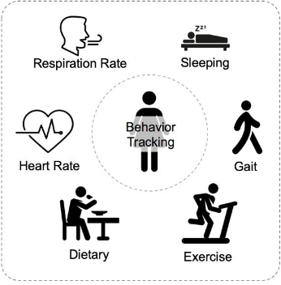
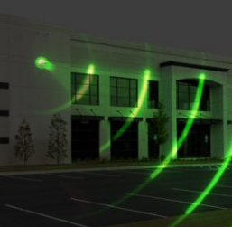

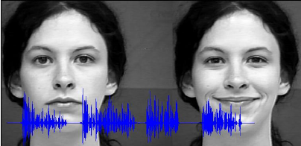
3. Use cases of Wi-Fi sensing (1/4)
    Smart home, Room sensing
  Home monitoring: monitoring daily movements and health conditions of human beings, such as walk (gait), sleep, fall, breath, heartbeats.
  Home security: detecting intruders approaching house/home.
  Energy management: based on the results of Wi-Fi sensing, optimize smart thermostat settings, automatically adjust lighting
  Emotional recognition: based on breath, heartbeats and/or facial analysis
https://www.nwsystemsgroup.com/wp-content/uploads/2018/07/building-exterior-radar-technology.jpg
https://www.smart-energy.com/wp-content/uploads/2016/10/energy-management-systems.jpg
https://www.cse.ust.hk/~qianzh/research/sensing-2.jpg
https://www.researchgate.net/profile/Leon_Rothkrantz2/publication/228774612/figure/fig1/AS:300794202083332@1448726334409/The-Web-based-emotion-recognition-system-performs-analysis-on-both-audio-and-video-data.png

Slide 6
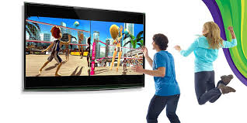

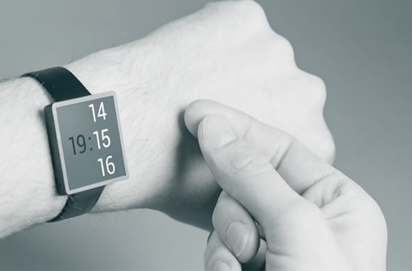
3. Use cases of Wi-Fi sensing (2/4)
    Interactive gaming/control
  Playing game with body movement
  Controlling smart devices by body movement and gesture
http://4.bp.blogspot.com/-_krIAHPdn-8/T02hISBvOnI/AAAAAAAAA1A/jAufr2N8k4c/s1600/Kinect%2BGames.jpg
https://www.pressebox.com/pressrelease/gb-pronova-gmbh/HoloPro-and-the-magic-of-interactive-control/boxid/129647#
https://ksassets.timeincuk.net/wp/uploads/sites/54/2015/06/soli5-2-620x349.jpg

Slide 7
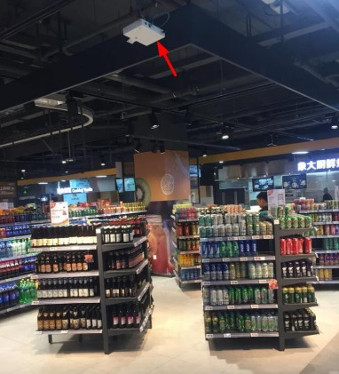
3. Use cases of Wi-Fi sensing (3/4)
    Location in store
  The user is going around in the store, and does not need to carry a Wi-Fi device
  Wi-Fi sensing is used to indicate whether the user is moving, or whether the user is stopped in front of some products
  Wi-Fi sensing is used to determine, e.g., the number of users facing a specific product, the time duration of the user stopped in front of a specific product
http://img.wezhan.cn/content/sitefiles/88646/images/12157659_%E8%B6%85%E5%B8%82%E5%AE%9A%E4%BD%8D3.jpeg
Note: This use case is modified based on the usage model No.11 for 11az [1], which require the user to wear a Wi-Fi device.

Slide 8
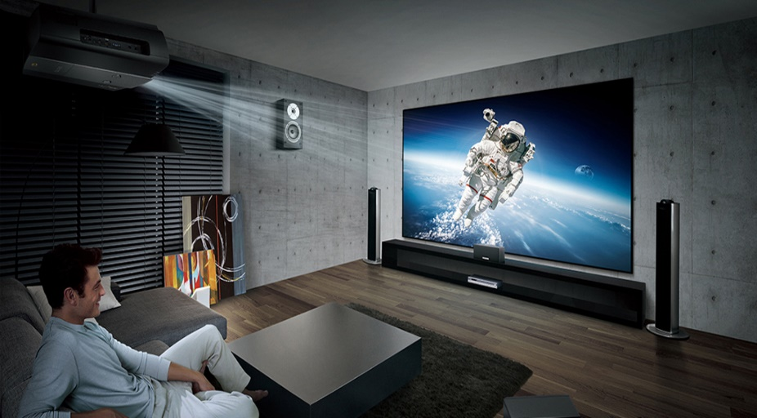
3. Use cases of Wi-Fi sensing (4/4)
    Audio with user tracking (Follow-me sound)
  The user does not need to wear a Wi-Fi device.
  The user’s position is continuously monitored.
  The audio system adjusts the speaker settings according to the user’s position and movement for immersive sound experience.
https://uppic-fd.zol-img.com.cn/g5/M00/0D/0A/ChMkJllWFZuIdf9SAAOoPtMQwRcAAdx4wF6HpAAA6hW306.jpg
Note: This use case is modified based on the usage model No.2 for 11az [1], which require the user to wear a Wi-Fi device.

Slide 9
4. Current status of Wi-Fi sensing
WBA: A new proposal about Wi-Fi sensing [2]
Radar related description was adopted by 11ay
Now, discussion for something more and something new
Initial Radar discussion in 11ay [3-5]
Standard activities
Industry activities
2018.10
11
12
2019.1
2
3
4
5
6
7
Snapdragon™ 855 is released, with “Always-on Wi-Fi sensing”
Project Soli got FCC’s approval to operate miniature radar-based sensors at higher power levels [7]
Now
    Current status
  Oct 2018, a new proposal about Wi-Fi sensing was submitted in WBA [2]
  Nov 2018, there was an initial radar discussion in 11ay [3-5]
  Dec 2018, Snapdragon™ 855 is released, with a feature called “Always-on Wi-Fi sensing” [6]
  Jan 2019, Radar related description was adopted by 11ay
  Jan 2019, Project Soli got FCC’s approval to operate miniature radar-based sensors at higher power levels [7]
  More startups are using Wi-Fi to do sensing [8]
  Lots of academic research papers using commercial off-the-shelf Wi-Fi (below 7GHz) for sensing researches and applications [9]
  Now, we are here to discuss something more and something new

Slide 10
5. Technology and standardization gaps
  Target frequency bands could be
  Sub 7GHz: e.g., 802.11 n/ac/ax/be in 2.4/5/6GHz
  Above 7GHz: e.g., 802.11 ad/ay/… in 60GHz
  Technology and standardization gaps - PHY
  New signal/waveform design for sensing purpose
  Mono-static / Bi-static / multi-static based schemes (See Appendix I for definition)
  Other?
  Technology and standardization gaps - MAC
  Mechanism for low-overhead channel response measurement
  Specific sensing frame definition
  Sensing procedures/protocols design, could be new or existing procedures/protocols
  Coexistence schemes
  Other?

Slide 11
6. Summary
  In this presentation, the following topics are discussed
  Definition, Advantage, Use case, and Current status of Wi-Fi sensing
  Technology and standardization gaps for Wi-Fi sensing
  To enable richer Wi-Fi applications and the growth of Wi-Fi ecosystem, maybe now is the right time for the group to take the next step for Wi-Fi sensing, and this could be done in a dedicated Study Group.

Slide 12
7. References
    [1] 11-16-0137-04-00az-ngp-use-case-document.pptx
    [2] https://wballiance.com/wi-fi-sensing-new-style/
    [3] 11-18-2094-00-00ay-wlan-radar.pptx
    [4] 11-18-2095-01-00ay-wlan-radar-annex.docx
    [5] 11-19-0080-00-00ay-further-discussion-for-wlan-radar.pptx
  [6] https://www.qualcomm.com/products/snapdragon-855-mobile-platform
  [7] https://techcrunch.com/2019/01/02/us-fcc-approves-google-soli-project/
  [8] https://www.cognitivesystems.com/
  [9] Jiang, Hongbo, Chao Cai, Xiaoqiang Ma, Yang Yang, and Jiangchuan Liu. "Smart home based on WiFi sensing: A survey." IEEE Access 6 (2018): 13317-13325.

Slide 13
Straw poll 1
  Do you think “Wi-Fi sensing” would be an interesting topic for 802.11 to study?
  Yes:
  No:
  Abstain:

Slide 14
Straw poll 2
  Do you support the formation of a new 802.11 Study Group to develop PAR and CSD for “Wi-Fi sensing” technologies?
  Yes:
  No:
  Abstain:
Notes:
PAR: Project Authorization Request
CSD: criteria for standards development

Slide 15
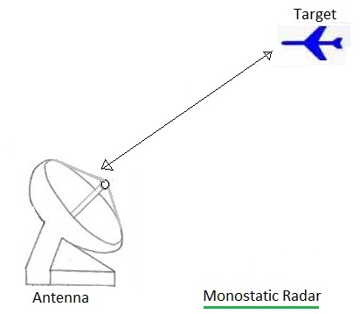
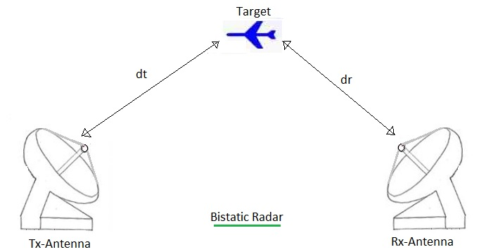
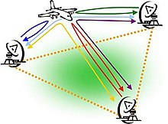
Appendix I: Different types of radar
    Monostatic radar is a type of radar in which the transmitter and receiver are collocated.
    Bistatic radar is the name given to a radar system comprising a transmitter and receiver that are separated by a distance comparable to the expected target distance.
    A system containing multiple spatially diverse Monostatic radar or Bistatic radar components with a shared area of coverage is called Multistatic radar.
Multistatic Radar
http://www.rfwireless-world.com/Terminology/Monostatic-radar-vs-Bistatic-radar.html
https://en.wikipedia.org/wiki/Multistatic_radar

