Slide 1
Proposal on Interworking between IEEE 802.11 WLAN and 3GPP 5G Core Network
Date: 2019-07-12
Authors:

Slide 2
Abstract
This document introduces WLAN interworking to 3GPP 5G core network in
terms of control and data plane, ATSSS function and QoS management.
It is expected that WLAN interworking to 5G core network improves data throughput rate for increasing data traffic need and provides QoS management for time sensitive services. For intensive study, we propose to develop technical report on WLAN interworking to 5G core network.
* ATSSS: Access Traffic Steering, Switching & Splitting

Slide 3
Introduction
3GPP 5G communication network will support multi-RAT including non-3GPP access techniques.
3GPP already have released 5G core architecture to have multiple interfaces with 3GPP access type or non-3GPP access type.
IEEE 802.11 access techniques need to provide interface and communication protocols to be interworked with 5G core network

Slide 4
5G Architecture Reference Model
5G System architecture supports signalling and data connectivity using Service Based Interface(SBI), separate Control Plane (CP) and Data Plane(DP)
UE: User Equipment
AN: Access Network
UPF: User Plane Function
AMF: Access & Mobility Management
SMF: Session Management Function
NSSP: Network Slice Selection Policy
NEF: Network Exposure Function
NRF: Network Repository Function
PCF: Policy Control Function
UDM: Unified Data Management
AF: Application Function
5G system architecture (3GPP TS 23.501)

Slide 5
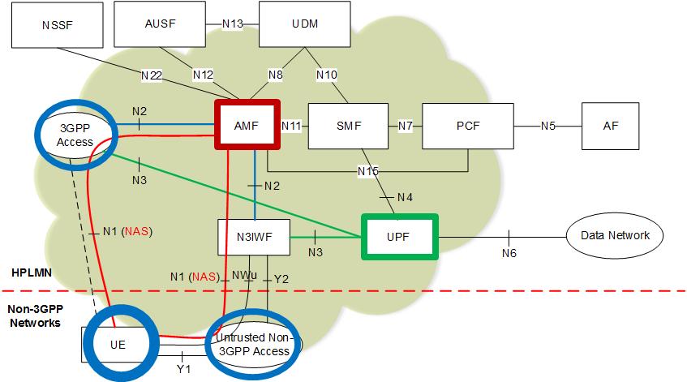
WLAN Interworking with 5G Core Network
N3IWF provides interworking between WLAN access network and 5G core network
NAS signalling to AMF is supported in 3GPP and Non 3GPP access network
N3IWF: N3 Inter-Working Function
NAS: Non-Access Stratum

Slide 6
WLAN Interworking in Control Plane
UE executes Registration procedures by using EAP-5G signalling
UE initially gets IP address and establishment on IPsec Security Association(SA)
NAS messages between UE and AMF are carried over IPsec Security Association(SA)
EAP: Extensible Authentication Protocol
NAS: Non-Access Stratum
UE: User Equipment
Control Plane between UE and N3IWF (3GPP TS 23.501)

Slide 7
WLAN Interworking in Data Plane
Packet data unit is exchanged between UE and UPF in IPsec Tunnel Mode
Large GRE packets are fragmented by the "inner IP" layer
UDP protocol may be used below the IPsec layer to enable NAT traversal
UPF: User Plane Function
GRE: Generic Routing Encapsulation
NAT: Network Address Translation
Data Plane between UE and N3IWF (3GPP TS 23.501)

Slide 8
3GPP ATSSS(Access Traffic Steering, Switching & Splitting)
3GPP supports ATSSS between 3GPP and non-3GPP access networks
ATSSS can enable traffic selection, switching and splitting between 5G and WLAN
Support of Multi-Access PDU Sessions (3GPP TR 23.793)

Slide 9
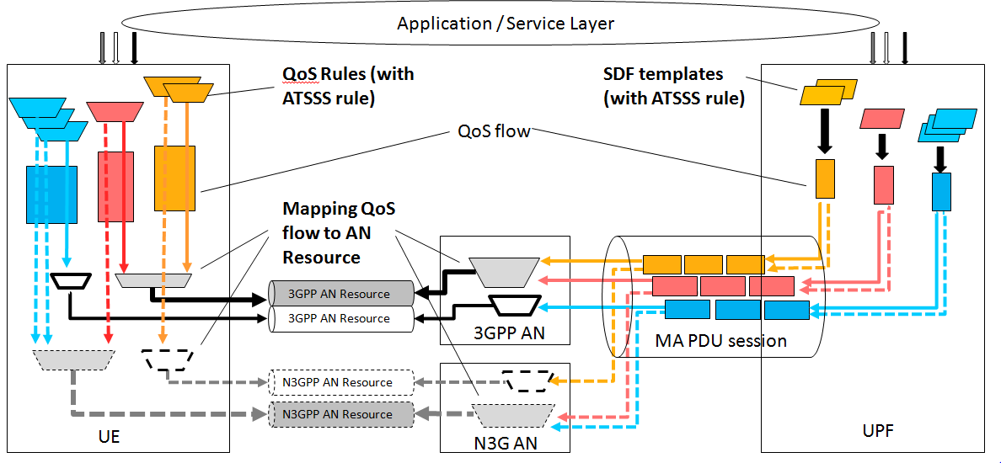
WLAN Interworking with QoS Management
ATSSS Policy Enforcement function in SMF is responsible for ATSSS policies enforcement and session management of all PDU sessions between 5G core and UE
Policy Enforcement function can also provide ATSSS PDU session related rules to UE during PDU session establishment and PDU session modification

Slide 10
WLAN Access Reference Points for Data Plane
Y1 interface is PHY/MAC of WLAN, which is the scope of WLAN
Y2 interface is wired communication protocol between WLAN access network and N3IWF for the transmission of NWu traffic, which is the scope of WLAN
Y1 Interface
Y2 Interface

Slide 11
WLAN Access Reference Points for Control Plane
NWu establishes secure tunnel(s) between the UE and N3IWF so that NAS signalling or session control messages are carried over IPsec Security Association(SA)
The upper layer of IEEE 802.11 PHY/MAC shall support NWu interface
Control signaling

Slide 12
Interworking Subjects between WLAN and 5G
Provide reference architecture on interworking between WLAN and 5G core network
Define data plane between WLAN access network and N3IWF : Y2
  - Setup secure IP channel(IPsec) for IP data tunnelling
  - Provide Access Traffic Steering, Switching and Splitting(ATSSS)
Define control plane between UE and N3IWF: NWu
    - Setup registration procedure by EAP-5G signalling
    - Provide QoS mapping and management in relay part in N3IWF
    - Mobility function needs extra modification on WLAN access network

Slide 13
Proposal
Develop technical report on WLAN interworking with 5G core network
Proposed table of contents for technical report
  Overview
  WLAN interworking reference model
  Setup registration procedure by EAP-5G signalling
  Setup secure IP channel(IPsec) for IP data tunnelling
  ATSSS support
    - QoS mapping and management

Slide 14
References
3GPP TS 22.261 V15.5.0 (2018-06) “Service requirements for the 5G system(Stage 1)”
3GPP TS 22.278 “Service requirements for the Evolved Packet System (EPS)”
3GPP TS 23.402 "Architecture enhancements for non-3GPP accesses”
3GPP TR 23.716 “Study on the Wireless and Wireline Convergence for the 5G System Architecture”
3GPP TR 23.793 “Study on Access Traffic Steering, Switching and Splitting support in the 5G system architecture”
3GPP TR 23.799 “Study on Architecture for Next Generation System”
3GPP TS 23.501 “System Architecture for the 5G System (Stage 2)”
3GPP TS 23.502 “Procedures for the 5G System (Stage 2)”

Slide 15
References
3GPP TS 24.302 “Access to the 3GPP Evolved Packet Core (EPC) via non-3GPP access networks (Stage 3)”
3GPP TS 24.501 “Non-Access-Stratum (NAS) protocol for 5G System (5GS) (Stage 3)”
3GPP TS 24.502 “Access to the 3GPP 5G Core Network (5GCN) via Non-3GPP Access Networks (N3AN) (Stage 3)”
3GPP TS 33.501 “Security Architecture and Procedure for the 5G System”
3GPP TR 33.899 “Study on the Security Aspects of the Next Generation System”

Slide 16
Thank You!

