Slide 1
NGV PPDU Format
Date: 2019-07-14
Authors:
Name | Affiliation | Address | Phone | Email
Yujin Noh | Newracom | 25361 Commercentre Dr Lake Forest, CA 92630 |  | yujin.noh at newracom.com

Slide 2
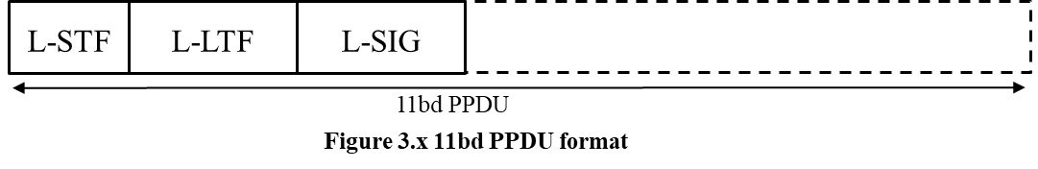
Background (1/2)
11bd PPDU format is under discussion.
  FRD&SFD Motion #2 and Motion #9 passed [1] as below
    “11bd PPDU format includes L-STF, L-LTF, and L-SIG fields as shown in Figure 3.x
    “11bd PPDU includes a NGV-Signal field to indicate the transmission information”
      The location of NGV-SIG field is TBD”
  For packet classification, some options are suggested [2]
    Opt. 1: Checking constellation mapping (e.g. QBPSK like 11n, 11ac and 11ax)
    Opt. 2 : Using RL-SIG repetition of L-SIG and its validity check [3] in 11ax
L-STF
L-LTF
L-SIG
RL-SIG
NGV-SIG

Slide 3
Background (2/2)
As for SP3 in [2],
  Which option do you support for packet classification ?
    Option 1 : using NGV-SIG field / 0
    Option 2 : using repeated L-SIG / 10
    Need for more information / 18
  Many agreed more information needed.
In this contribution, with 11bd PPDU format given so far, take a look at potential auto-detection approaches and corresponding L-SIG content modification to provide more information.

Slide 4
Auto-Detection
Receiving either 11p PPDU or 11bd PPDU, 11bd PPDU devices need to guarantee immediate and reliable detection to make it clear which type of packet transmitted.
Design goals to be considered
  Backward compatibility
    Robust 11p deferral
  Minimize false detection
    Low probability of 11p PPDU detected as 11bd
  Detection timing

Slide 5
Option 1. RL-SIG
It has been adopted in 11ax [3]
  Auto-detection with two L-SIGs using RL-SIG followed by L-SIG
    1st step: Repetition detection
      Multiple ways of frequency domain repetition detection
        Implementation issues
    2nd step: L-SIG validity check
      Parity = OK
      L-Rate = 6Mbps
      L-Length (mod 3) != 0
  Enable range extension by L-SIG and RL-SIG MRC
Detection Algorithm by
Repeated L-SIG
L-STF
L-LTF
L-SIG
RL-SIG
…
L-STF
Timing/CFO compensation
L-LTF
Equalization
L-SIG
Repetition Detection
N
RL-SIG
Y
MRC &
L-SIG Validity Check
N
Legacy
Detection
Y
t
11ax detect
11n
11ac
11a

Slide 6
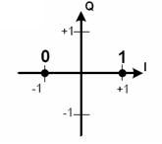
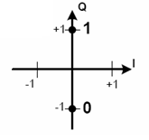
Option 2. QBPSK (1/2)
It has been adopted in 11n, 11ac and 11ax
  For example, two options for 11bd
  Repeated L-SIG is not excluded yet
    Requirement of at least 3 dB lower sensitivity in preamble portion
BPSK
QBPSK
11a
LSTF
LLTF
LSIG
Data
11n-MM
LSTF
LLTF
LSIG
HT-SIG1
HT-SIG2
…
11n-GF
HT-STF
HT-LTF1
HT-SIG1
HT-SIG2
…
11ac
LSTF
LLTF
LSIG
VHT-SIGA1
VHT-SIGA2
…
11ax ER SU (Extended Range)
LSTF
LLTF
LSIG
LSIG
HE-SIGA1
HE-SIGA2
HE-SIGA3
HE-SIGA4
…
Opt. 2-1
L-STF
L-LTF
L-SIG
RL-SIG
NGV-SIG
…
Opt. 2-2
L-STF
L-LTF
L-SIG
RL-SIG
NGV-SIG
…

Slide 7
Option 2. QBPSK (2/2)
Guaranteeing the most reliable auto-detection with largest Euclidean Distance (BPSK and QBPSK) qualified through a long history
As for QBPSK auto-detection
  Measure values from frequency domain equalizer
    E.g.) compare I vs Q energy levels and 11bd format detection with stronger Q energy
  Simple and practical auto-detection approach

Slide 8
Consideration on L-SIG
L-SIG content modification
  L-SIG Spoofing
    Receiving 11bd PPDU, 11p devices can recognize up to L-SIG but not the following NGV portion.
    The values in L-SIG field allow 11p devices to properly defer for the duration indicated by Length and Rate fields.
      Setting to the lowest OFDM PHY data rate, it can support flexibility to the duration of 11bd PPDU as long as possible.
  L-SIG validity check for RL-SIG auto-detection
    Parity = OK
    L-Rate = 3 Mbps
      In 11ax, the RATE field shall be set to the value (e.g. 1104) representing 6 Mb/s with the lowest data rate in the 20 MHz channel spacing
    L-Length (mod 3) != 0
      11a PPDU can be sent with modulo-3 payload length of 1 or 2 as well.
        For example, RTS, CTS, and ACK has 20, 14, and 14 bytes which are modulo-3 of 2
      Might lose one of critical criteria for L-SIG validity check to use RL-SIG.
        The modulo length changes to L-SIG Length is NOT a fool-spoof solution

Slide 9
Consideration on NGV-SIG
NGV-SIG field may include
  BW(1), Coding(1), LDPC extra symbol(1), Midamble(1), Compressed MA(1), Midamble Periodicity (1), MCS(3 or 4), DCM (1), reserved(TBD), CRC(4 or 8) and Tail(6)
    Some field could be jointly encoded.
  Assuming one spatial stream accepted in OCB as Motion #15 passed[1], with one NGV-LTF, the indication for multiple streams not required.
NGV-SIG field of two OFDM symbols (48 bits) seem unreasonable
  In case more space (e.g. only one or two) required, adding extra tones on the both sides of L-SIG like 11ax to have 26 bits of NGV-SIG field might be available. [4]
One NGV-SIG with QBPSK may be enough in terms of efficient 11bd PPDU format and reliable auto-detection.

Slide 10
Timing For Detection
Time
L-STF
L-LTF
L-SIG
RL-SIG
NGV-SIG
…
Option 1
11ax LSIG repetition Det
Y
11ax Combined L-SIG:
Parity, Lrate, LLENGTH checks
Y
11bd detected
L-STF
L-LTF
L-SIG
RL-SIG
NGV-SIG
…
Option 2
11bd detected
…
L-STF
L-LTF
L-SIG
RL-SIG
NGV-SIG
QBPSK
11bd detected
All options show reasonable timing to be ready for 11bd portion after NGV-SIG.

Slide 11
Simulation Configuration 1/2
General configuration:
  1 TX, 1 RX, 1 SS, 300 bytes
# of channel realizations: 10,000
C2C Channel Model (including Enhanced C2C channel Model)
  12.5ns sampling rate, tapped delay line with Doppler shift
  channel power distribution with the total power normalized to 1.
Impairments
  PA Non-linearity : RAPP PA model with p = 3.
  Carrier Frequency Offset : fixed 20 ppm
  Phase noise with a pole-zero model
    PSD(0) = -100 dBc/Hz
    Pole frequency fp = 250 kHz
    Zero frequency fz = 7905.7 kHz
Rx processing:
  Ideal timing and Real PPDU detection
  CFO estimation and compensation in preamble portion

Slide 12
Simulation Configuration 2/2
False Detection with QBPSK for auto-detection
  11p PPDU detected as 11bd PPDU in 11bd receiver
Mis Detection with QBPSK for auto-detection
  11bd PPDU detected as 11p PPDU in 11bd receiver
L-SIG PER
  Simulation for RL-SIG PER using MRC not conducted
11ac 20MHz DC2 with LDPC
  VHT-LTF as Midamble inserted on every 4 data symbols
  MCS0 DCM enabled
  LDPC tone mapper (i.e., D_{TM,DCM}) for DCM not optimized

Slide 13
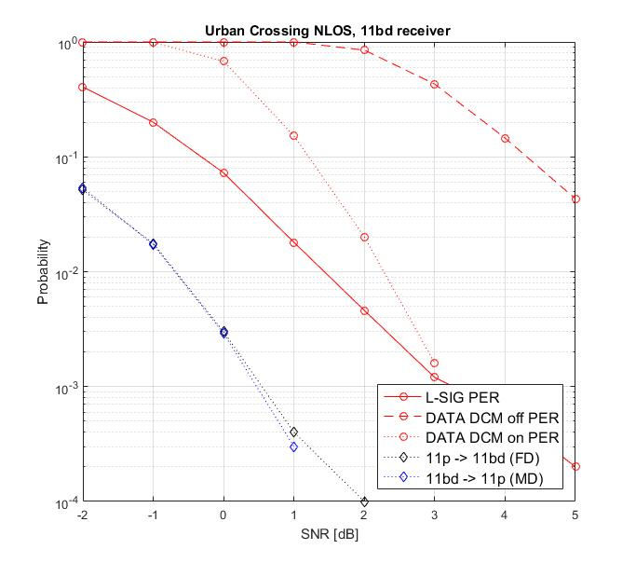
Urban-Crossing NLOS
Given misdetection and false detection probabilities, QBPSK constellation mapping seems reasonable and reliable approach for auto detection in NGV
  Mis detection probability is lower than the error rate of L-SIG
  Low false detection probability.
Improving sensitivity level of both data portion (e.g. DCM under discussion) and preamble portion need to come together
  Shows potential 3 dB enhancement in data portion

Slide 14
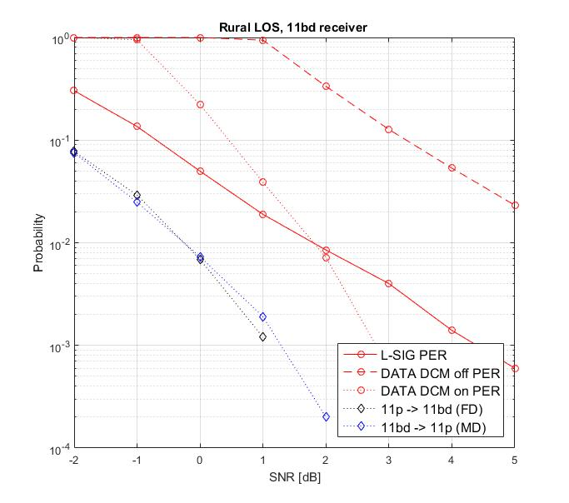
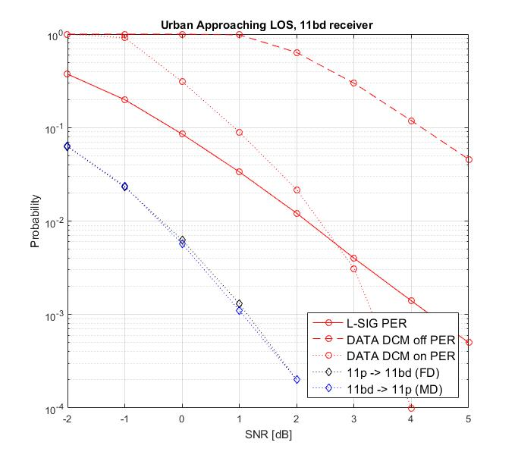
Rural LOS and Urban Approaching LOS
Similar simulation results are observed

Slide 15
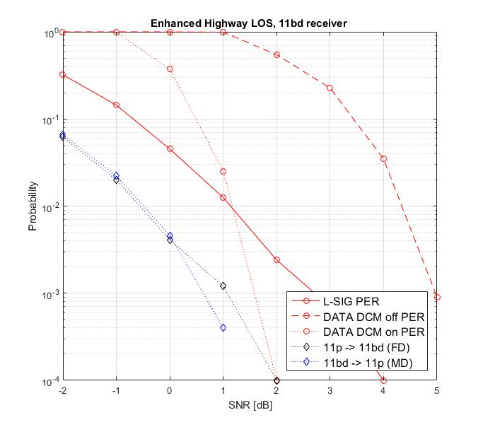
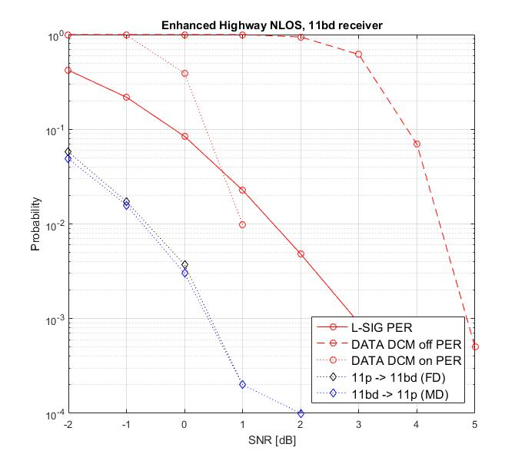
Enhanced Highway LOS and
Enhanced Highway NLOS
Similar simulation results are observed

Slide 16
Comparisons
 | Backward Compatibility | Timing | Minimize False Detection | Range Extension
Option 1. RL-SIG Repetition | L-SIG Spoofing | Reasonable timing to be ready for 11bd portion after NGV-SIG | Need to study the impact from L-SIG validity check in 11bd PPDU | Possible range extension
Option 2. QBPSK constellation mapping |  |  | Reliable with largest Euclidean Distance | Need to study the sensitivity levels of both L-SIG and NGV-SIG

Slide 17
Summary
Auto-detection based on QBPSK constellation mapping for 11bd is preferred.
  Simple, intuitive and robust ever known
  The mis-detection and false detection probabilities have been fully verified through 11n, 11ac and so on comparing to any other new scheme.
Repeated L-SIG for better coverage
  MRC gain
  Auto-detection using repeated L-SIG still not prohibited
    Implementation dependent if needed.

Slide 18
SP1
Do you agree to add the following to section 3 in 11bd SFD?
  “RATE field in L-SIG shall be set to the value representing 3 Mb/s with the lowest data rate in the 10 MHz channel spacing
  Y
  N
  A

Slide 19
SP2
Do you agree to add the following to section 3 in 11bd SFD?
  “At least one OFDM symbol in preamble portion of NGV PPDU shall be 90-degree rotated BPSK (QBPSK) modulated on its data tones.”
  Y
  N
  A

Slide 20
SP3
Do you agree to add the following to section 3 in 11bd SFD?
  “11bd preamble shall have a 4us symbol repeating the L-SIG content, right after the legacy section.
  This symbol shall be modulated by BPSK and rate ½ BCC.”
  Y
  N
  A
L-STF
L-LTF
L-SIG
RL-SIG
11bd PPDU

Slide 21
Reference
[1] 11-19/0514r4 Motion Booklet for IEEE 802.11 TGbd
[2] 11-19/0739r3 PPDU Format for 11bd
[3] 11-15/0579r4 802.11ax Preamble Design and Auto-detection
[4] 11-15/1357r1 Extra tones in the preamble

