Slide 1
Midamble in NGV
Date: 2019-09-15
Authors:
Name | Affiliation | Address | Phone | Email
Yujin Noh | Newracom |  |  | yujin.noh at newracom.com
Sichan Noh | Newratek |  |  | sc.noh at newratek.com

Slide 2
Background (1/2)
11bd PPDU format is under discussion.
FRD&SFD Motion #10 as below [1]
“11bd PPDU design shall support Midamble(s) in Data field. Midamble is composed by long training field, with design TBD. Midamble periodicity is TBD.”
Different aspects upon Midamble structure suggested
Compressed Midamble [2]
Midamble periodicity [3], [4]
FRD&SFD Motion #11 passed with “11bd devices shall support 256 QAM. The 256 QAM constellation mapping is the same as that defined in 21.3.10.9 (Constellation mapping)” [1]
Considering OCB mode, it becomes mandatory
Already accepted, it is important to make sure how to use it well for different circumstances as much as possible to achieve high throughput

Slide 3
Background (2/2)
In this contribution, with additional simulation results on two topics below, Midamble is intensely taken into account to help the group make a progress this meeting.
Midamble structure
The number of Midamble periodicity and its values

Slide 4
Midamble Structure 1/2
Given Midamble is a valuable candidate to mitigate Doppler effect, it needs to get Midamble structure clarified.
In 11ax, when there is only one residue data symbol over the last midamble period, it does not insert the last midamble.
Assuming the number of information bits in the last symbol is small (e.g. data rate is low), inserting the midamble may reduce the efficiency while not improving the PER much.
The number of Midamble periods,
$$N_{MA}=\max\left(0,\left\lceil \frac{N_{SYM}−1}{M}\right\rceil −1\right)$$
N_{SYM} : the number of data symbols
(End of NGV PPDU with M=4)
last midamble period
…
MA
DATA1
DATA2
DATA3
DATA4
DATA5

Slide 5
Midamble Structure 2/2
However, different from 11ax channel circumstance, since NGV considers high Doppler effect more seriously, the impact of this final touch needs to be verified based on simulation results.
Propose the way not to ignore Doppler impact onto the very last one data symbol
The number of Midamble period,
$$N_{MA}=\left\lfloor \left(N_{SYM}−1\right)/M\right\rfloor$$
last midamble period
(End of NGV PPDU with M=4)
…
MA
DATA1
DATA2
DATA3
DATA4
MA
DATA5

Slide 6
Simulation Configuration 1/2
General configuration:
1 TX, 1 RX, 1 SS
# of channel realizations: 5,000
C2C Channel Model (including Enhanced C2C channel Model)
12.5ns sampling rate, tapped delay line with Doppler shift
channel power distribution with the total power normalized to 1.
Impairments
PA Non-linearity : RAPP PA model with p = 3.
Carrier Frequency Offset : fixed 20 ppm
Phase noise with a pole-zero model
PSD(0) = -100 dBc/Hz
Pole frequency fp = 250 kHz
Zero frequency fz = 7905.7 kHz
Rx processing:
Ideal timing and ideal PPDU detection
CFO estimation and compensation in preamble portion

Slide 7
Simulation Configuration 2/2
11ac 20MHz DC2 with LDPC
VHT-LTF as Midamble with M4
Option 1) Midamble adopted in 11ax
Option 2) Midamble suggested for 11bd
Goodput = Rate_{MCS}*(1-per_{SNR,MCS})*(M/(M+1))
Payload carefully selected to see the performance gap between two options
Payload to have only one residue data symbol over the last midamble period.
M = 4 (M4) | Payload (bytes)
MCS0 | 310 | 780 | 1300
MCS2 | 310 | 780 | 1300
MCS4 | 310 | 780 | 1300
MCS6 | 390 | 740 | 1360
MCS8 | 310 | 770 | 1410

Slide 8
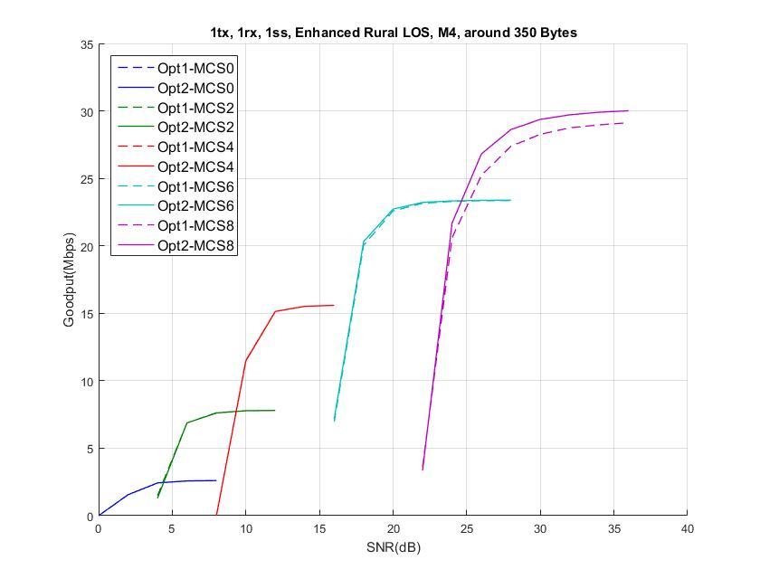
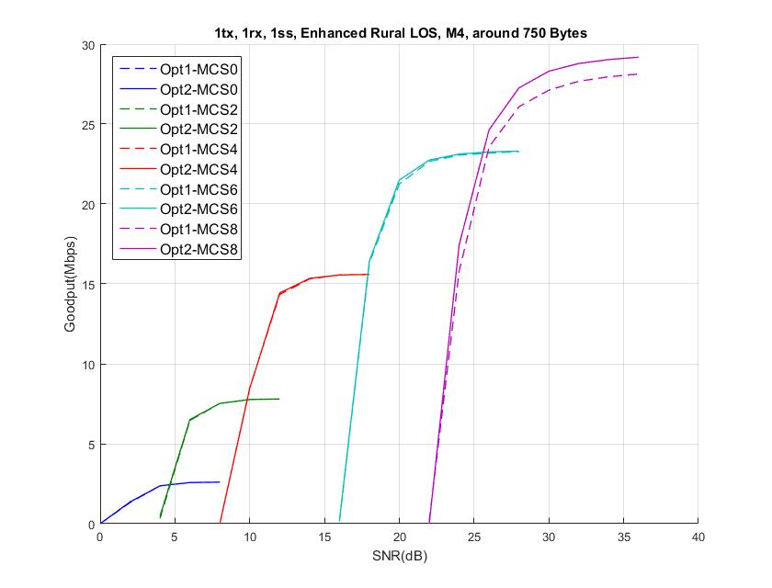
Enhanced Rural LOS
PER curve in Appendix 1
For MCS 8 (256 QAM), Opt.2 shows better throughput for around 350 bytes and around 750 bytes of PPDUs.

Slide 9
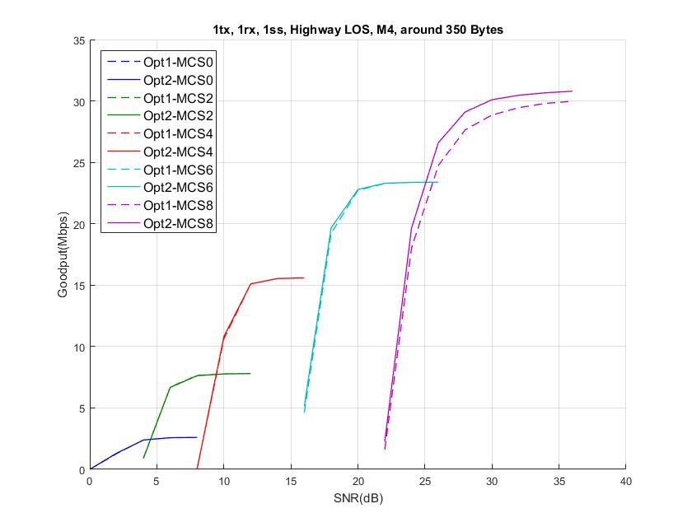
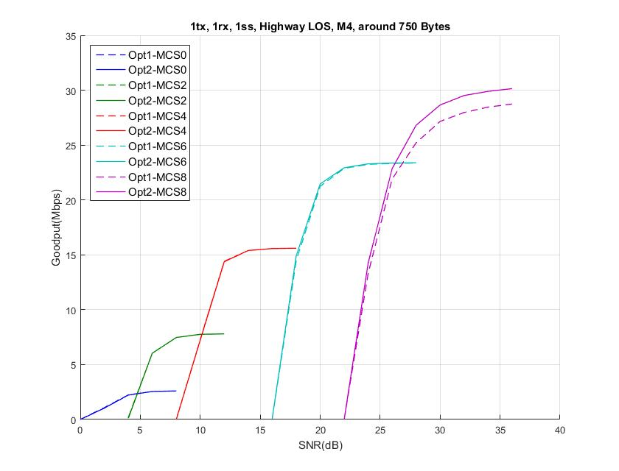
Highway LOS
PER curve in Appendix 1
For MCS 8 (256 QAM), Opt.2 shows better throughput for around 350 bytes and around 750 bytes of PPDUs

Slide 10
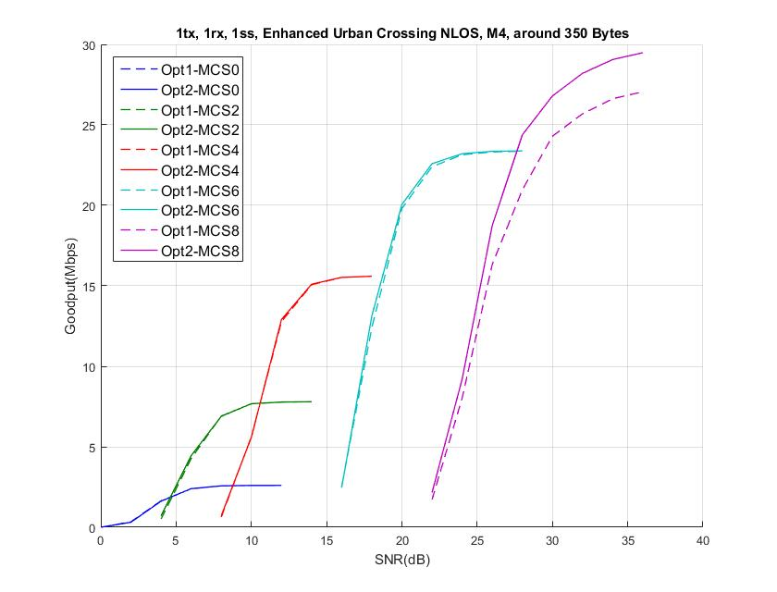
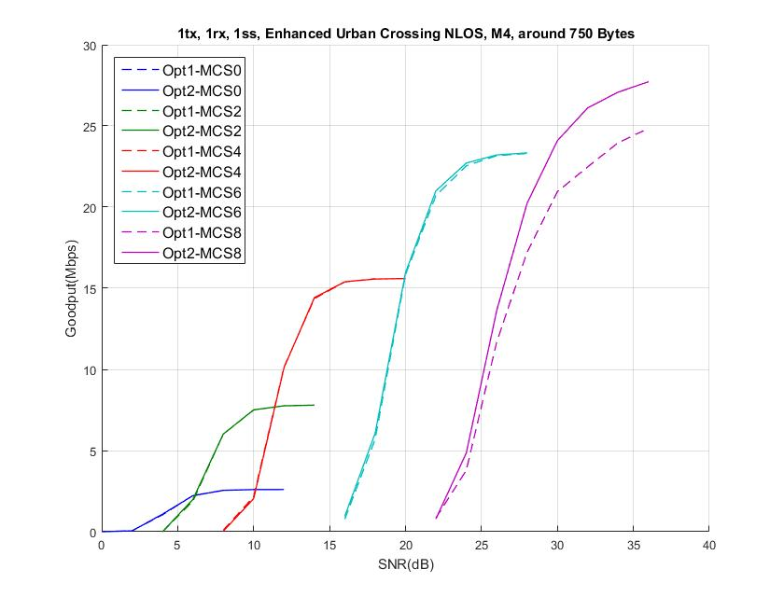
Enhanced Urban Crossing NLOS
PER curve in Appendix 1
For MCS 8, Opt.2 provides opportunity to use 256 QAM with high throughput even for around 750 bytes of PPDUs at wide SNR range

Slide 11
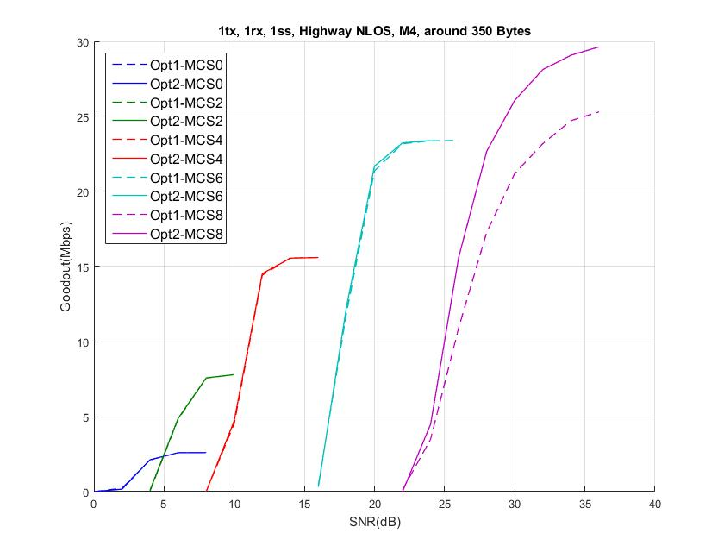
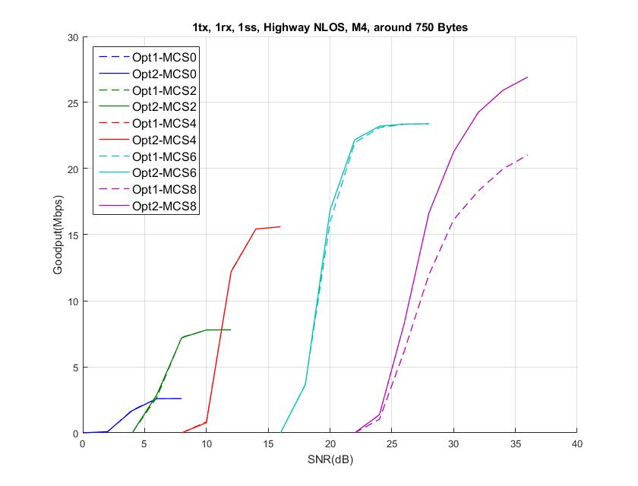
Highway NLOS
PER curve in Appendix 1
For MCS 8, Opt.2 provides opportunity to use 256 QAM with high throughput for around 350 bytes and around 750 bytes of PPDUs even in high Doppler channel

Slide 12
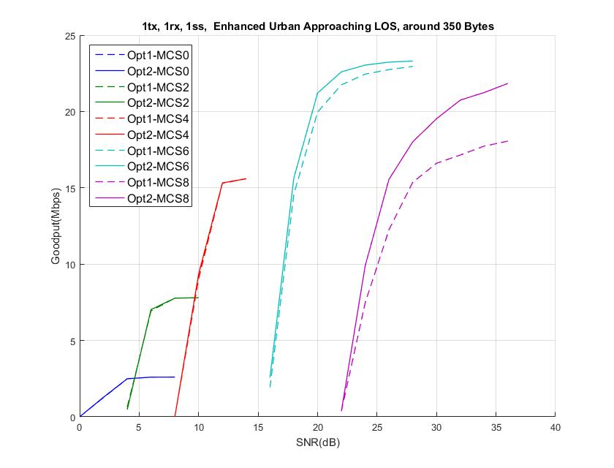
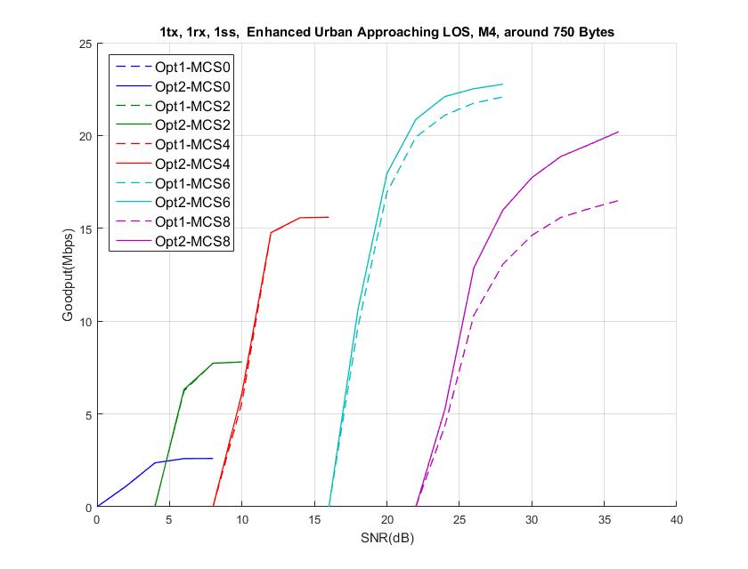
Enhanced Urban Approaching LOS
PER curve in Appendix 1
Getting Doppler impact severe, for MCS 6 (64 QAM), Opt.2 starts showing better throughput for around 350 bytes and around 750 bytes of PPDUs.
For MCS 8 with performance degradation, MCS 6 provides better throughput for around 350 bytes and around 750 bytes of PPDUs.

Slide 13
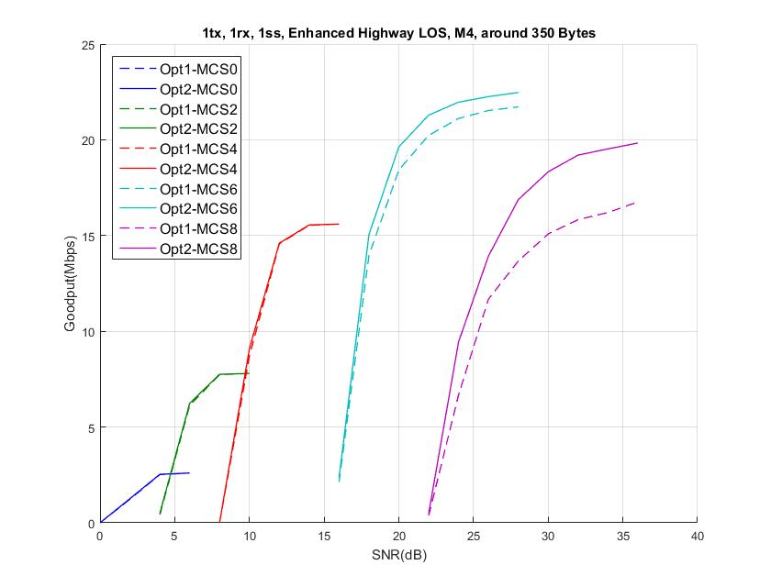
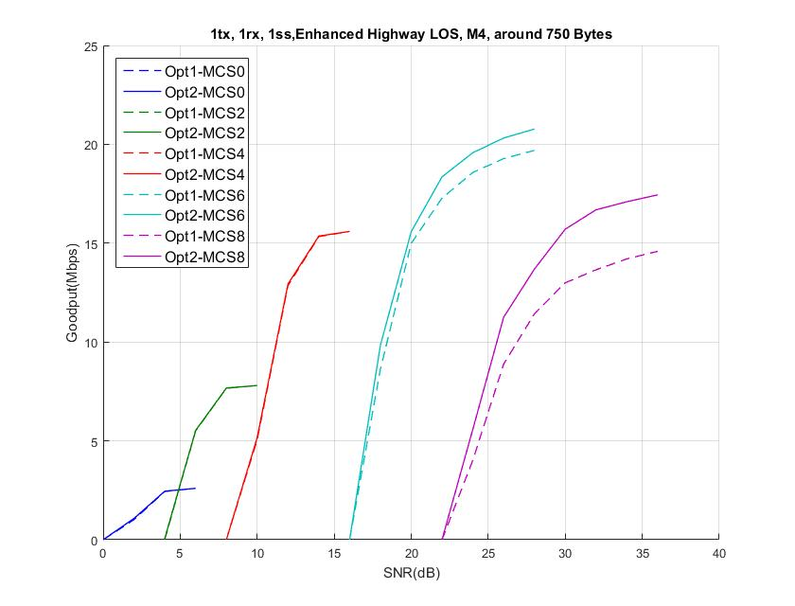
Enhanced Highway LOS
PER curve in Appendix 1
For MCS 6 (64 QAM), Opt.2 shows better throughput for around 350 bytes and around 750 bytes of PPDUs.
For MCS 8 with performance degradation, MCS 6 provides better throughput for around 350 bytes and around 750 bytes of PPDUs.

Slide 14
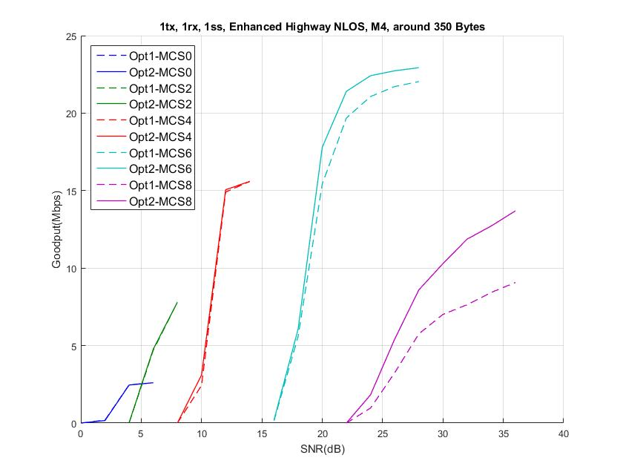
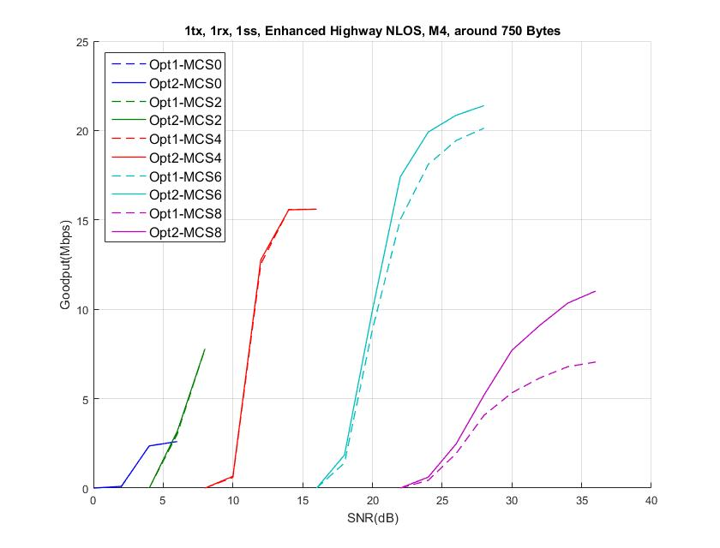
Enhanced Highway NLOS
PER curve in Appendix 1
For MCS 6 (64 QAM), Opt.2 shows better throughput for around 350 bytes and around 750 bytes of PPDUs.
For MCS 8 with performance degradation, MCS 6 provides better throughput for around 350 bytes and around 750 bytes of PPDUs.

Slide 15
Midamble Periodicity
Option 1) fixed Midamble periodicity [3]
Insist that it can simplify Midamble design and limit PHY signal overhead.
Option 2) Midamle periodicity to be chosen depending on MCS and channel circumstance
NGV-SIG seems to have enough room to add one bit of control information to improve performance for either mid-to-high MCS or mid-to high Doppler circumstances.
Those are focused circumstances for gain of Midamble to be prominent comparing to DACE in terms of PER performance at the price of overhead. [4]

Slide 16
Simulation Configuration
11ac 20MHz DC2 with LDPC
VHT-LTF as Midamble
Option 1) one Midamble Periodicity with M6
Option 2) two Midamble Periodicity with M4 and M8
Payload below
 | Payload (bytes)
MCS0 | 310 | 780
MCS2 | 310 | 780
MCS4 | 310 | 780
MCS6 | 390 | 810
MCS8 | 310 | 900

Slide 17
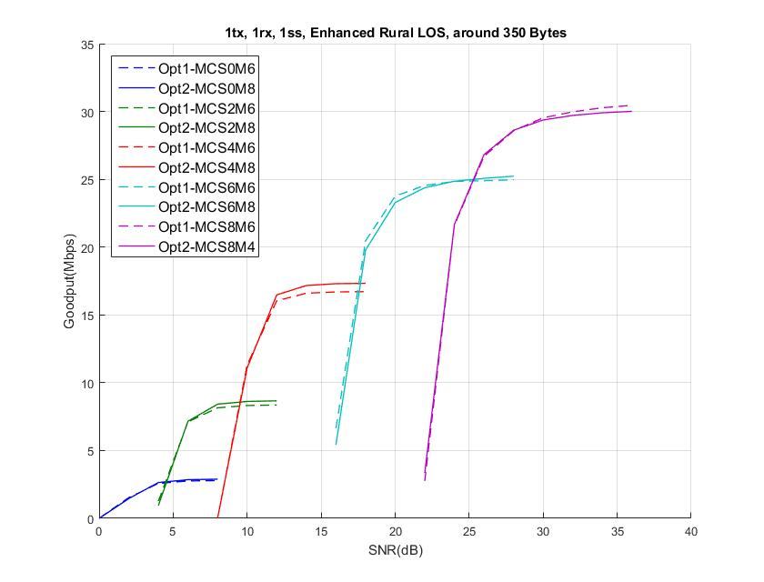
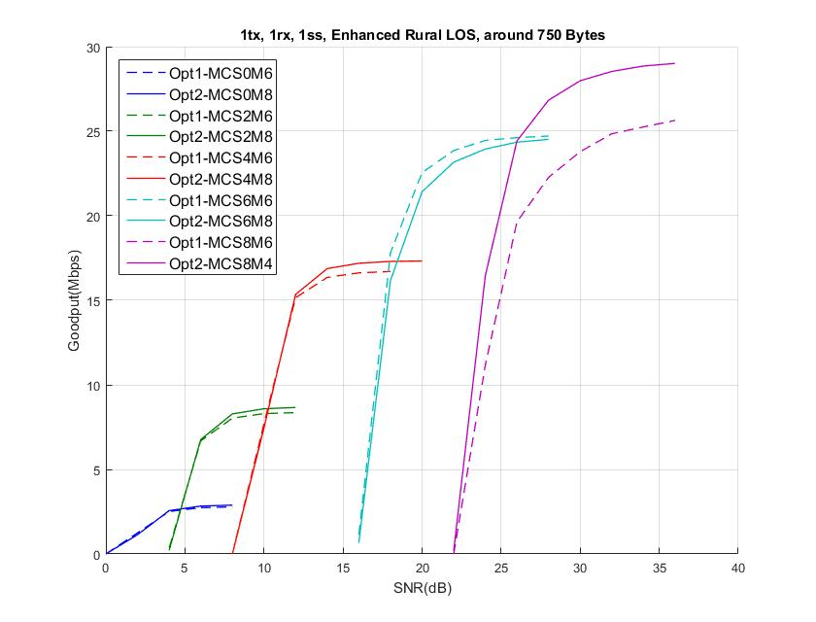
Enhanced Rural LOS
PER curve in Appendix 2
Opt. 2: M8 with MCS0/2/4/6 and M4 with MCS8
Opt. 2: M8 with MCS0/2/4/6 and M4 with MCS8
For most SNR range with different packet length, Opt.2 shows competitive throughput
Especially for MCS 8, Opt.2 provides opportunity to use up to 256 QAM with high throughput for around 750 bytes of PPDU.

Slide 18
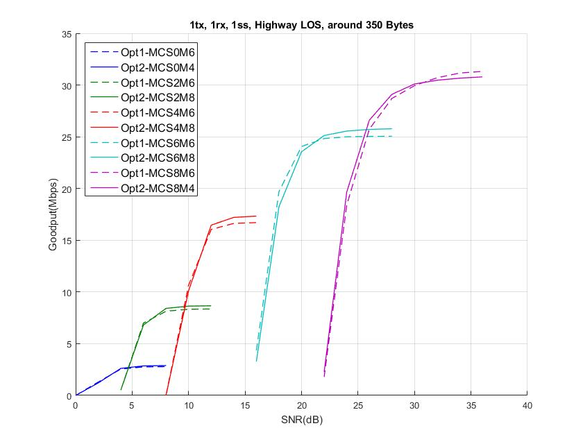
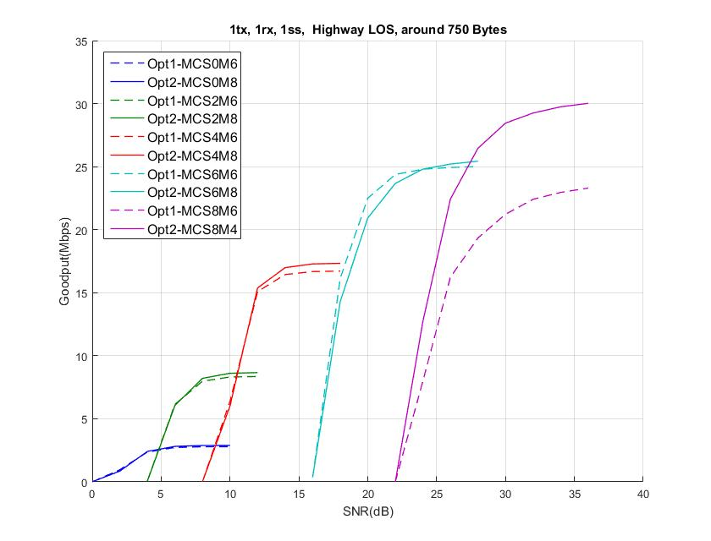
Highway LOS
PER curve in Appendix 2
Opt. 2: M8 with MCS0/2/4/6 and M4 with MCS8
Opt. 2: M8 with MCS0/2/4/6 and M4 with MCS8
For most SNR range with different packet length, Opt.2 shows competitive throughput
Especially for MCS 8, Opt.2 provides opportunity to use up to 256 QAM with high throughput for around 750 bytes of PPDUs even in high Doppler channel

Slide 19
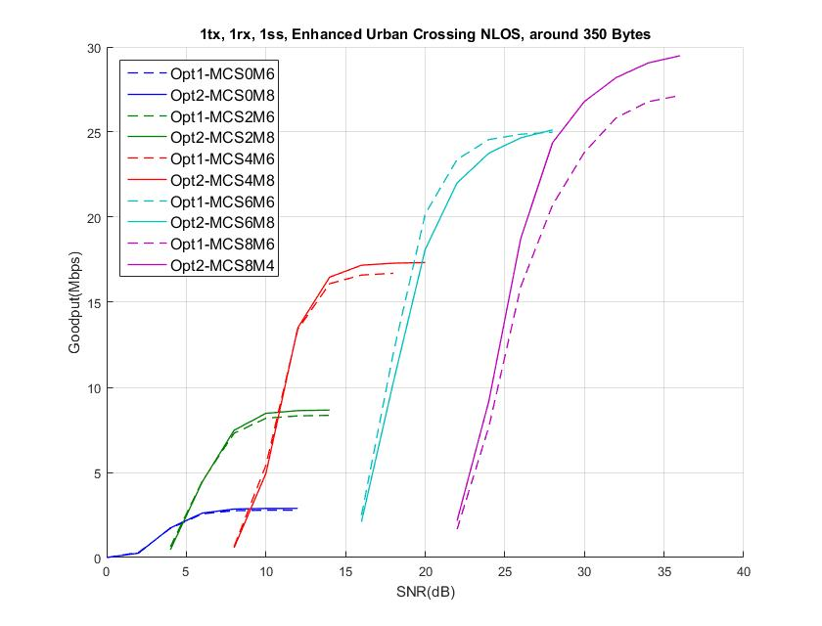
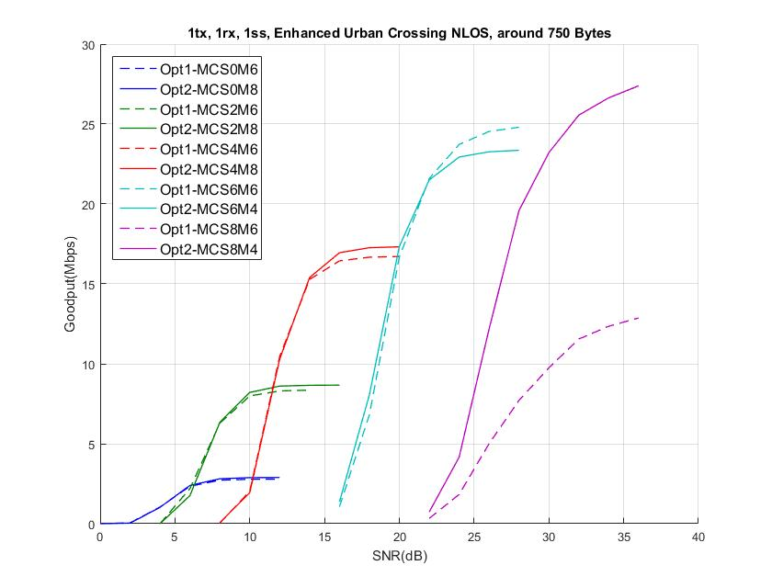
Enhanced Urban Crossing NLOS
PER curve in Appendix 2
Opt. 2: M8 with MCS0/2/4/6 and M4 with MCS8
Opt. 2: M8 with MCS0/2/4 and M4 with MCS6/8
For most SNR range with different packet length, Opt.2 shows competitive throughput
Especially for MCS 8, Opt.2 provides opportunity to use up to 256 QAM with high throughput for around 350 bytes and around 750 bytes of PPDU.

Slide 20
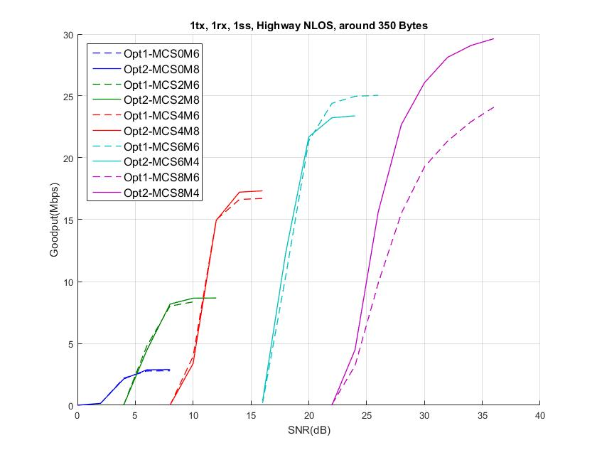
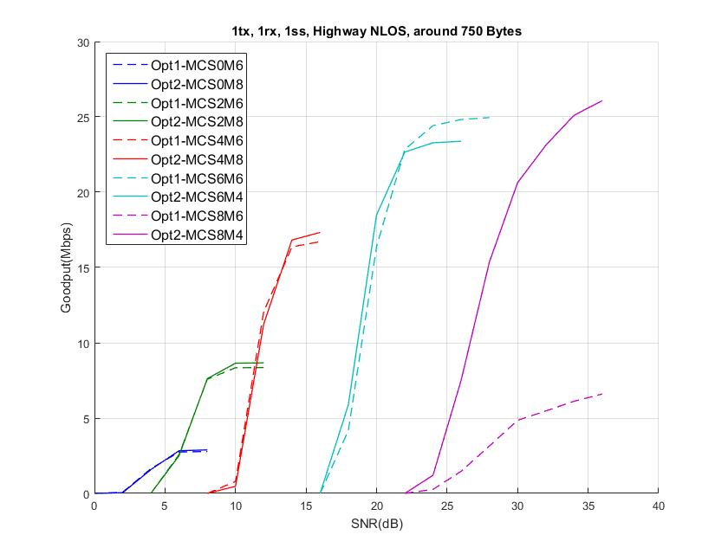
Highway NLOS
PER curve in Appendix 2
Opt. 2: M8 with MCS0/2/4 and M4 with MCS6/8
Opt. 2: M8 with MCS0/2/4 and M4 with MCS6/8
For most SNR range with different packet length, Opt.2 shows competitive throughput
Especially for MCS 8, Opt.2 provides opportunity to use up to 256 QAM with high throughput for around 350 bytes and around 750 bytes of PPDUs even in high Doppler channel

Slide 21
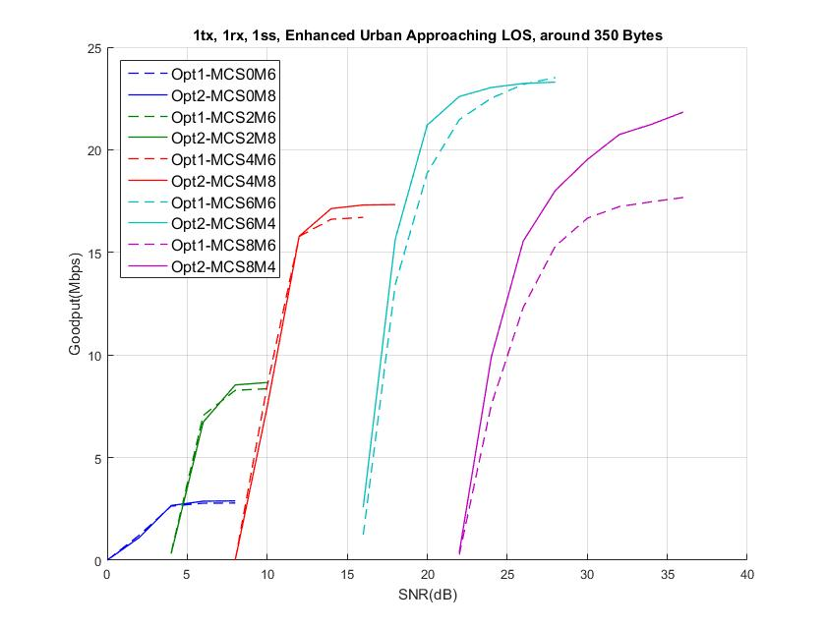
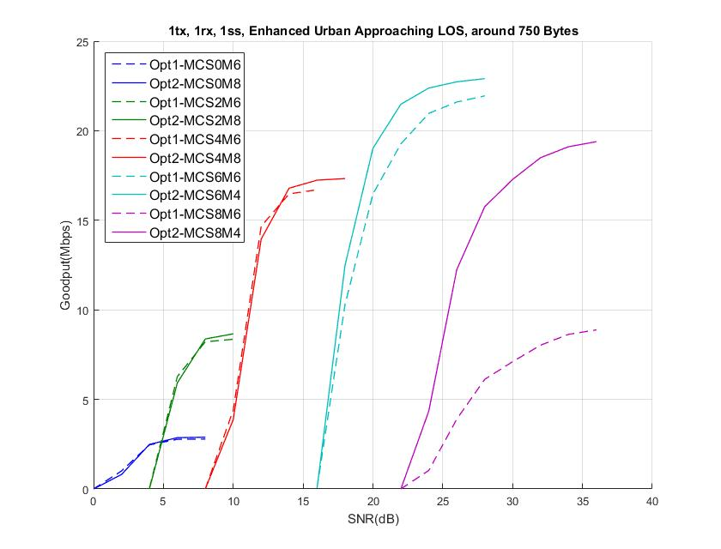
Enhanced Urban Approaching LOS
PER curve in Appendix 2
Opt. 2: M8 with MCS0/2/4 and M4 with MCS6/8
Opt. 2: M8 with MCS0/2/4 and M4 with MCS6/8
For most SNR range with different packet length, Opt.2 shows better throughput
For MCS 8 with performance degradation, MCS 6 provides better throughput for around 350 bytes and around 750 bytes of PPDUs

Slide 22
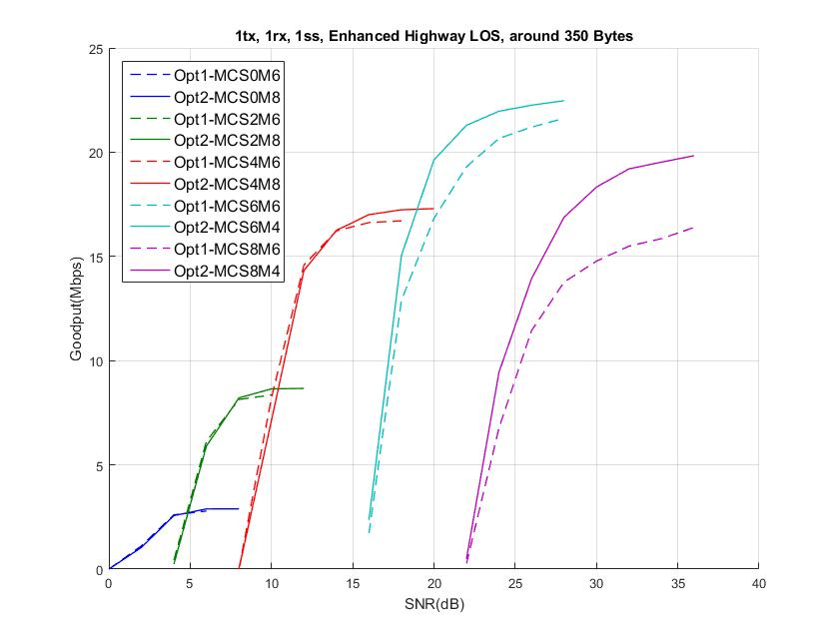
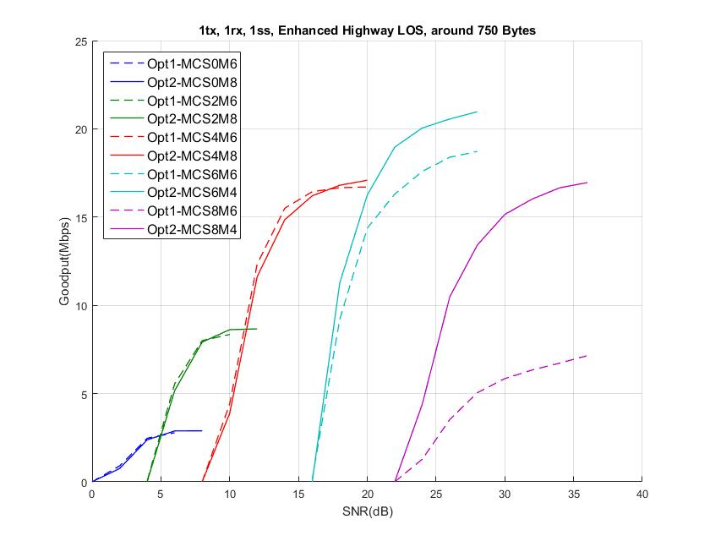
Enhanced Highway LOS
PER curve in Appendix 2
Opt. 2: M8 with MCS0/2/4 and M4 with MCS6/8
Opt. 2: M8 with MCS0/2/4 and M4 with MCS6/8
For most SNR range with different packet length, Opt.2 shows better throughput
Especially for MCS 6, Opt.2 provide prominent throughput gain.
For MCS 8 with performance degradation, MCS 6 provides better throughput for around 350 bytes and around 750 bytes of PPDUs

Slide 23
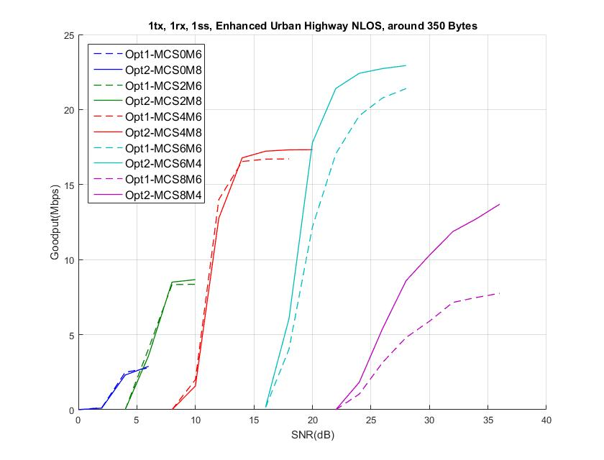
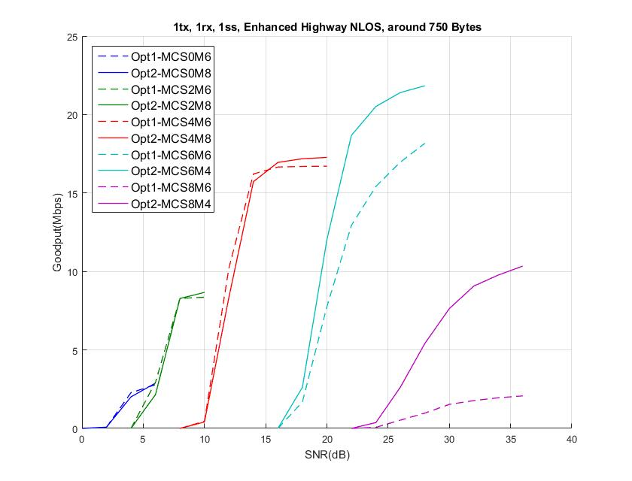
Enhanced Highway NLOS
PER curve in Appendix 2
Opt. 2: M8 with MCS0/2/4 and M4 with MCS6/8
Opt. 2: M8 with MCS0/2/4 and M4 with MCS6/8
For most SNR range with different packet length, Opt.2 shows better throughput
Especially for MCS 6, Opt.2 provide prominent throughput gain.
For MCS 8 with performance degradation, MCS 6 provides better throughput for around 350 bytes and around 750 bytes of PPDUs

Slide 24
Summary
Midamble structure protecting the very last data symbol from Doppler effect is preferred
Meaningful throughput gap observed especially for 64 QAM and 256 QAM in different C2C channel models (e.g. mid-high Doppler environments).
Barely no impact in terms of overhead
Midamble periodicity with at least two values (Opt.2) provide prominent gain with 1 bit of control information overhead
Opt. 2 shows better throughput for most SNR range with different packet length,
For low-to-medium MCSs, M8 provides overhead advantages while M6 does not improve PER much.
For medium-to-high MCSs, M4 results in noticeable performance gain (both throughput and PER) by compensating high Doppler effect as much as possible.

Slide 25
SP1
Do you agree to add the following to section 3 in 11bd SFD?
The number of midamble periods,
$$N_{MA}=\left\lfloor \left(N_{SYM}−1\right)/M\right\rfloor$$
N_{SYM} : the number of data symbols

Slide 26
SP2
Do you agree to add the following to section 3 in 11bd SFD?
“11bd PPDU shall support at least two values of midamble periodicity. Midamble periodicity is TBD.”
Y
N
A

Slide 27
SP3
Do you agree to add the following to section 3 in 11bd SFD?
“11bd PPDU shall support Midamble periodicity indication that
indicates the Midamble periodicity in number of OFDM symbols
in the Data field.
Y
N
A

Slide 28
Reference
[1] 11-19/0514r4 Motion Booklet for IEEE 802.11 TGbd
[2] 11-19/0685r2 Midamble Compression
[3] 11-19/0684r0 Midamble Periodicity
[4] 11-19/0740r4 Performance evaluation of Mid-amble

Slide 29
APPENDIX 1 - Midamble structure

Slide 30
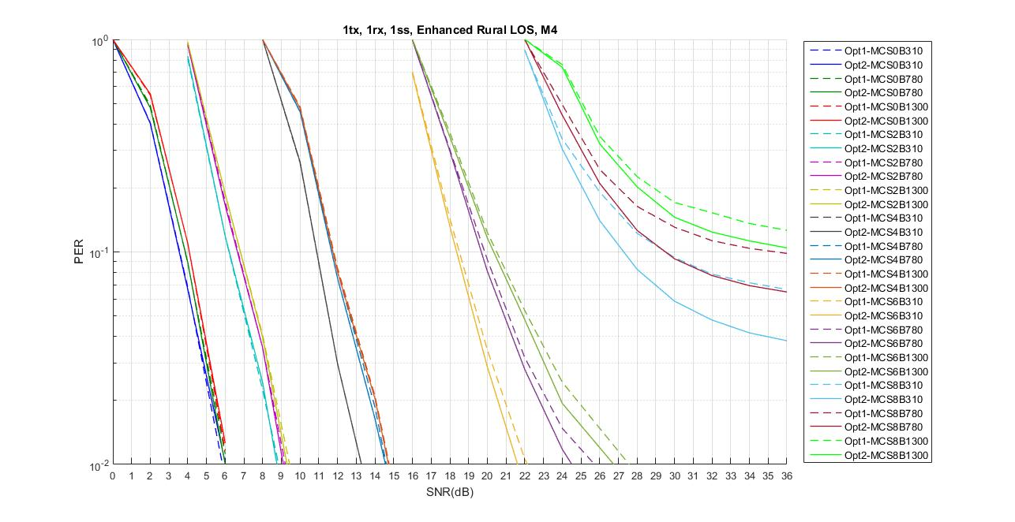
Enhanced Rural LOS

Slide 31
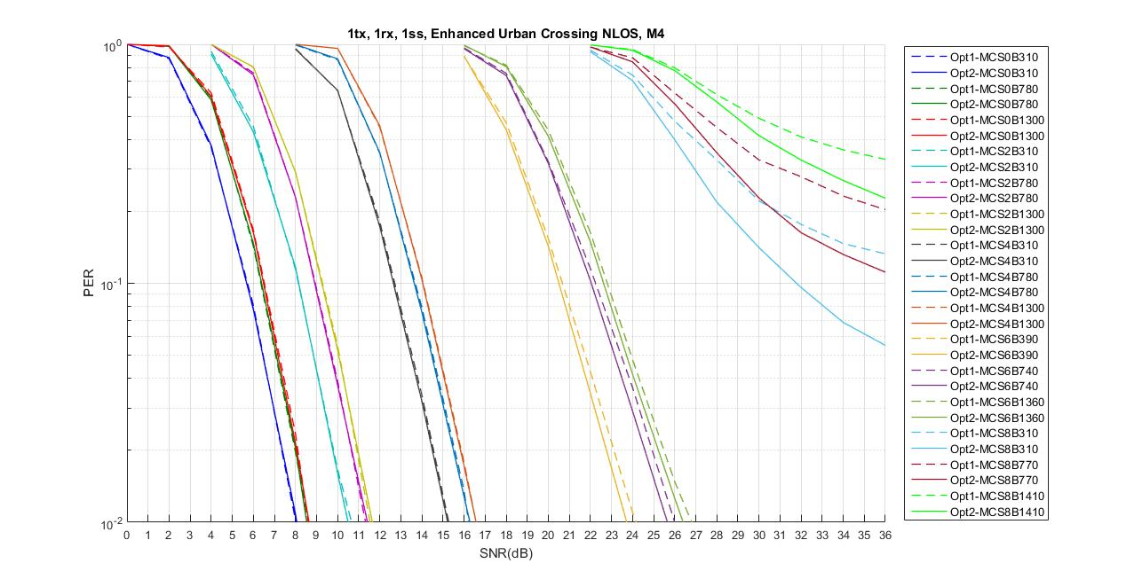
Enhanced Urban Crossing NLOS

Slide 32
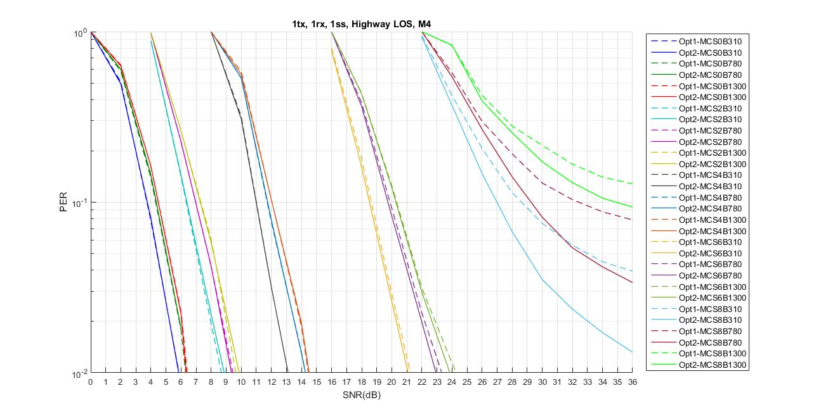
Highway LOS with M4

Slide 33
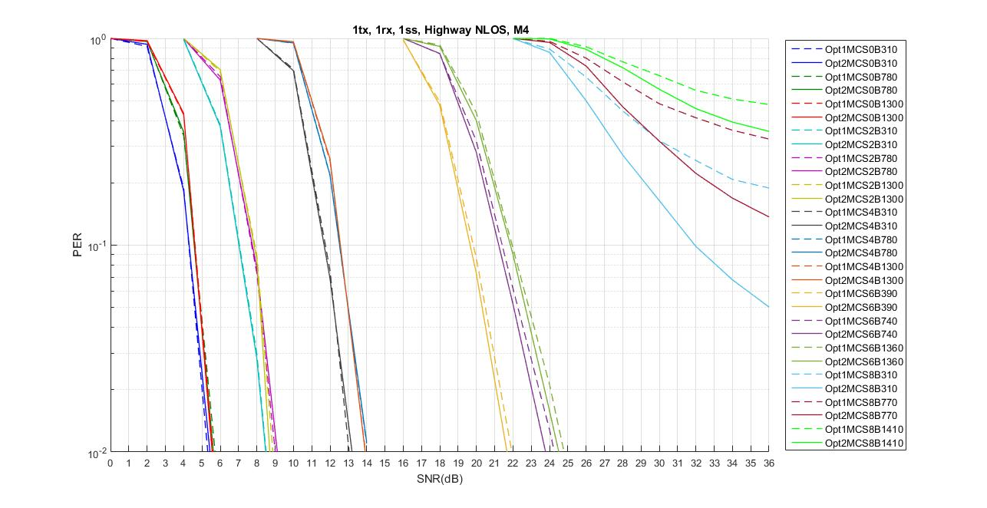
Highway NLOS

Slide 34
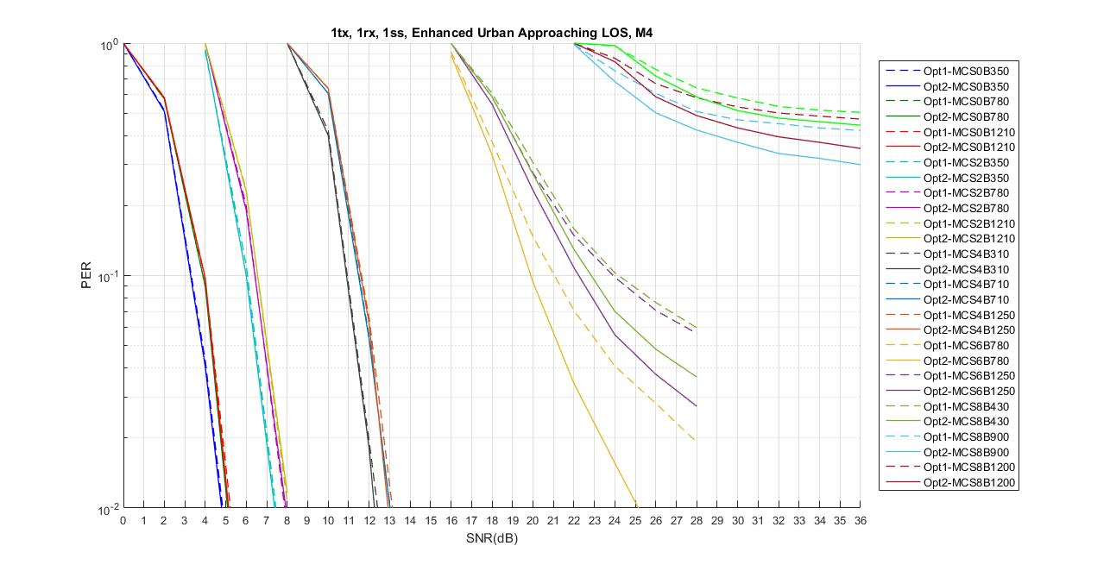
Enhanced Urban Approaching LOS

Slide 35
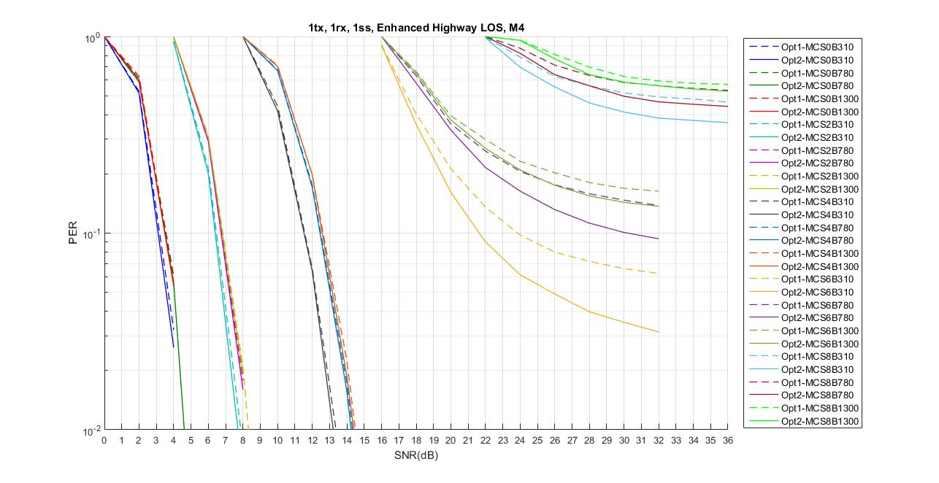
Enhanced Highway LOS

Slide 36
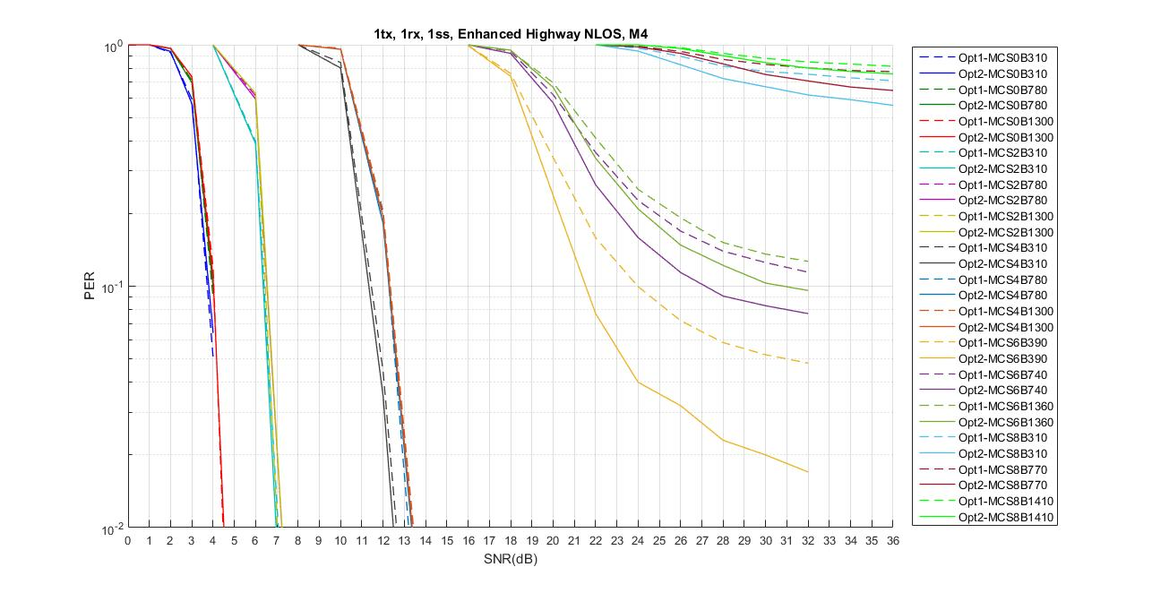
Enhanced Highway NLOS

Slide 37
APPENDIX 2 – The number of Midamble periodicity and its values

Slide 38
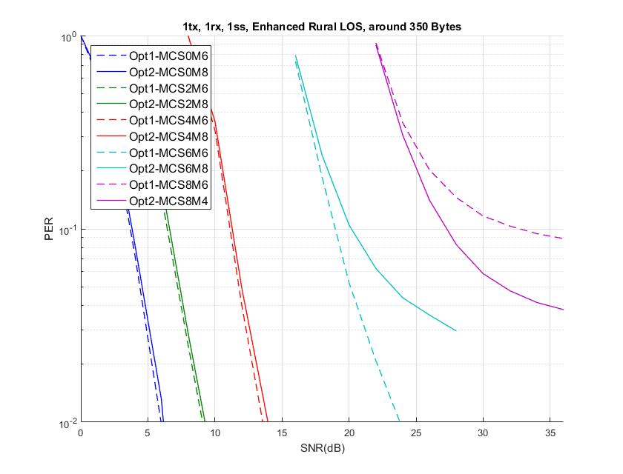
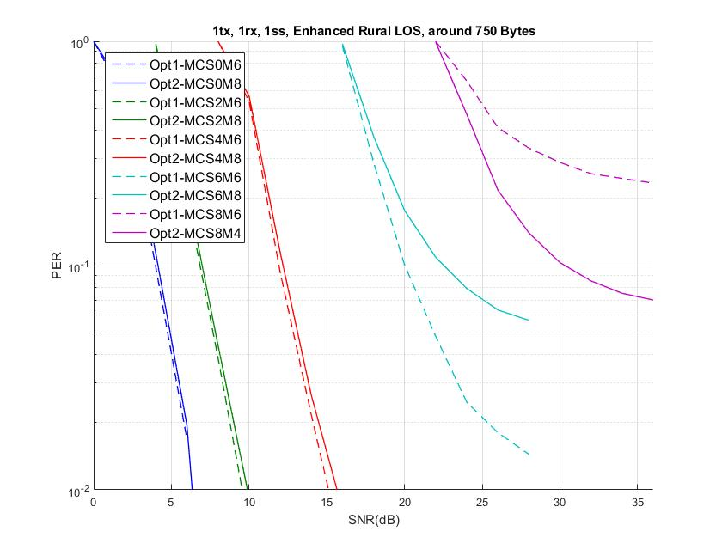
Enhanced Rural LOS

Slide 39
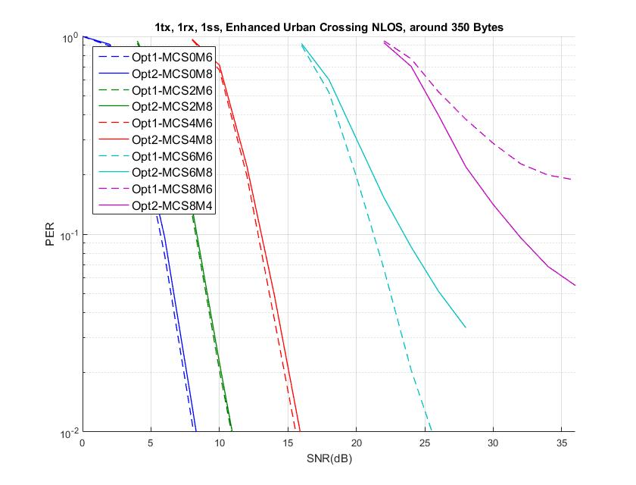
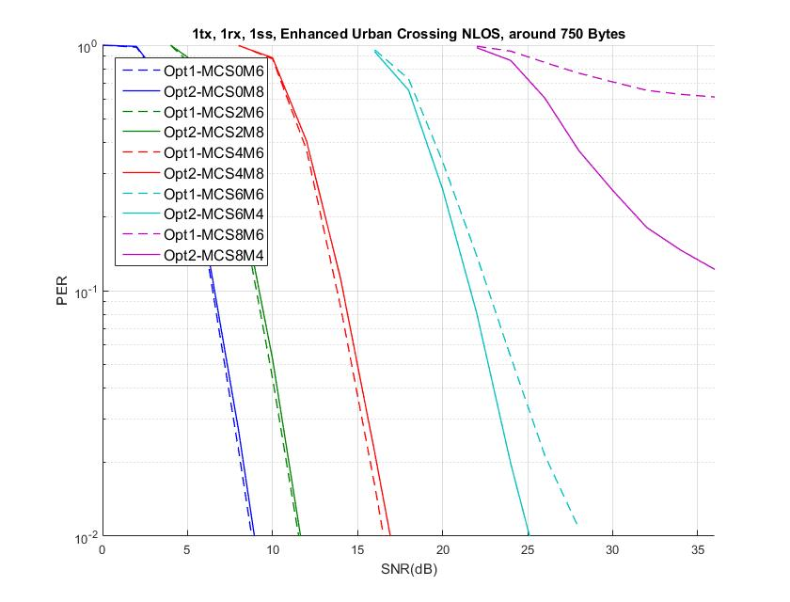
Enhanced Urban Crossing NLOS

Slide 40
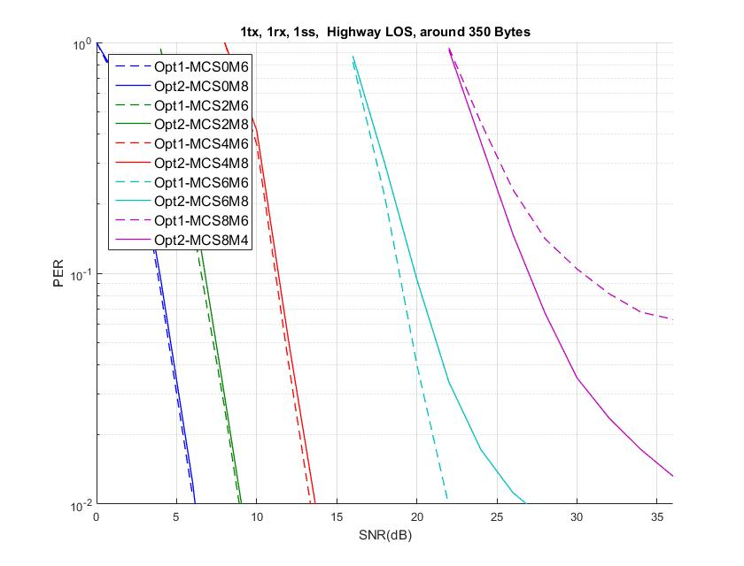
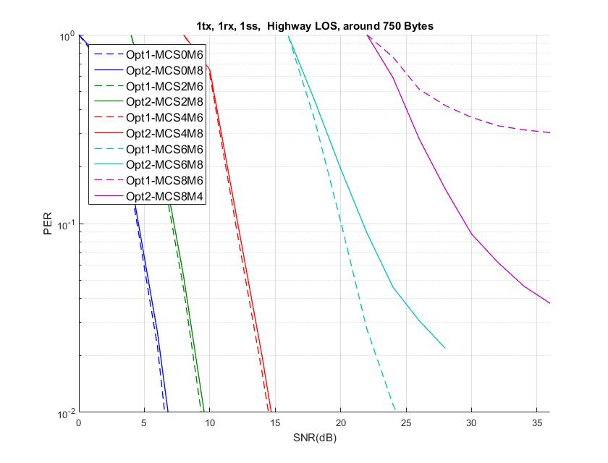
Highway LOS

Slide 41
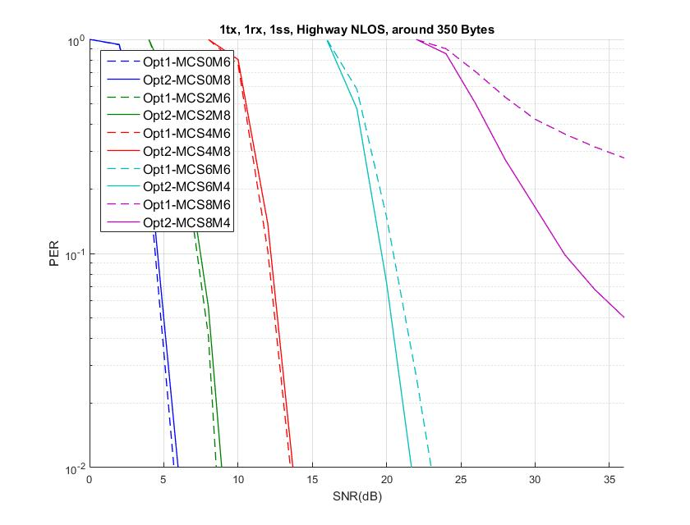
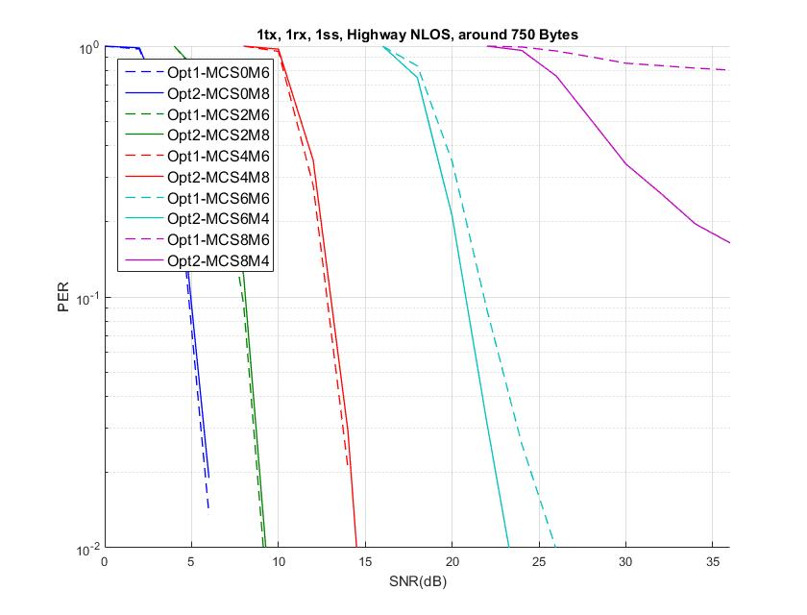
Highway NLOS

Slide 42
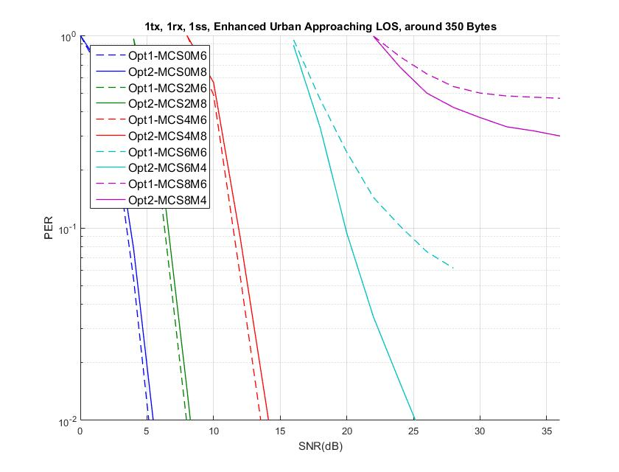
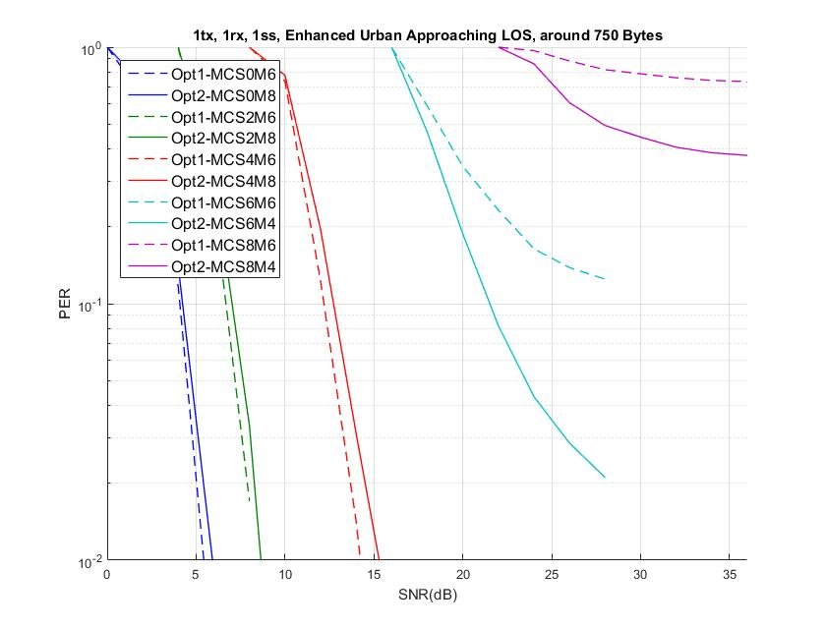
Enhanced Urban Approaching LOS

Slide 43
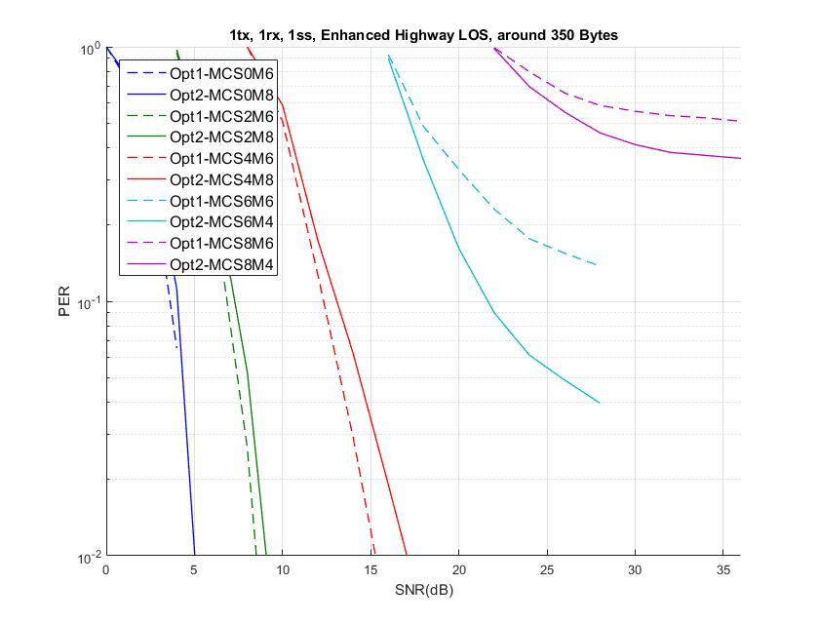
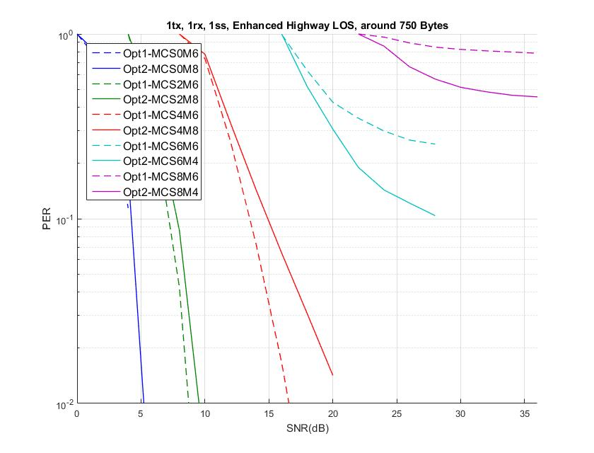
Enhanced Highway LOS

Slide 44
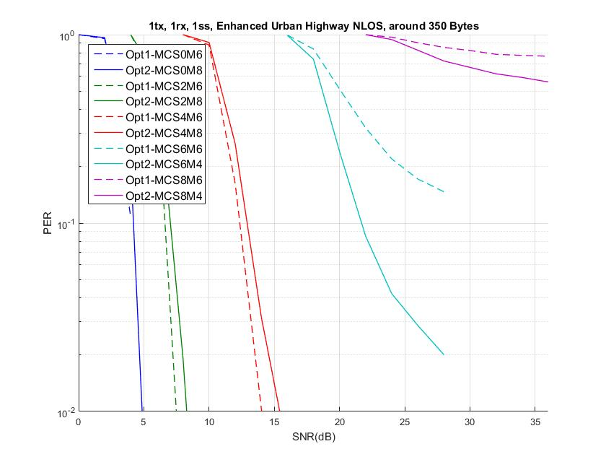
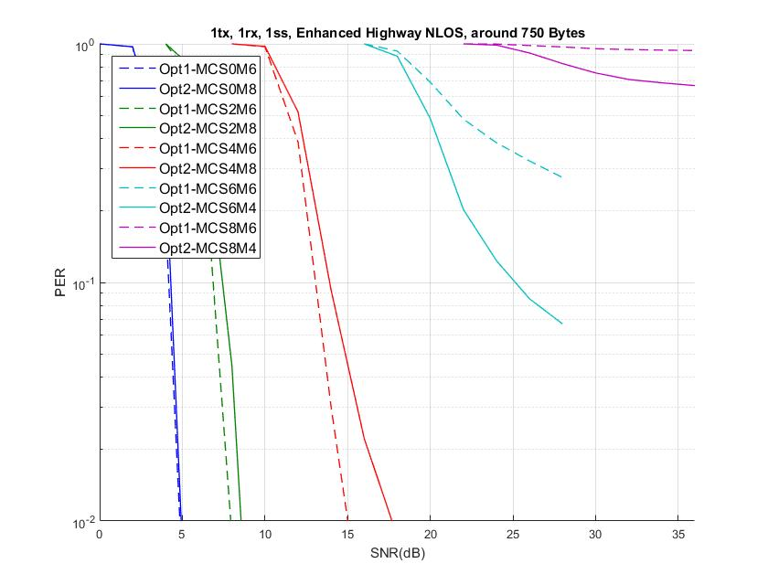
Enhanced Highway NLOS

