Slide 1
HARQ Punctured CC Performance Evaluation
Date: 2019-09-12
Authors:
Name | Affiliation | Address | Phone | Email
Yanyi Ding | Panasonic Corporation |  |  | yanyi.ding@sg.panasonic.com
Lei Huang
Rojan Chitrakar
Yoshio Urabe

Slide 2
HARQ CC
Two types of HARQ CC
  HARQ Regular CC
  HARQ Punctured CC [1]
For initial transmission, all encoded bits are transmitted.
For retransmission, retransmitted bits are extracted from the encoded bits according to a retransmission percentage.
  The retransmission percentage is the ratio of the number of retransmitted bits to the total number of coded bits.
  HARQ Regular CC can be treated as a special case of HARQ Punctured CC (i.e. puncturing pattern for HARQ Regular CC indicates no puncturing)

Slide 3
Aspects to be Investigated
In this contribution, we investigate the following aspects that may affect HARQ CC performance
  Method of MCS selection [2]
    Optimal MCS selection: select MCS for maximizing goodput, or
    Sub-optimal MCS selection: select MCS with PER less than 10% and highest goodput based on long-term SNR measurement
  Retransmission percentage:
    3/4, 1/2, 1/3 or 1/4
  Number of retransmissions
    Up to 2 retransmissions or up to 4 retransmissions

Slide 4
Simulation Settings
20 MHz, regular GI, 4x HE-LTF, TGnD channel
SISO, LDPC, MCS 0~11
Packet length = 4096 bytes, single MPDU per PPDU
Same channel realization is applied to all (re)transmissions
Real channel estimation
Ideal ACK/NACK feedback
Preamble detection error is considered
For HARQ Regular CC, frequency diversity is applied
For HARQ Punctured CC, retransmitted bits are uniformly extracted from encoded bits according to retransmission percentage
Goodput = total number of correctly decoded bits / total air time
  For total air time, HARQ feedback overhead is not considered

Slide 5
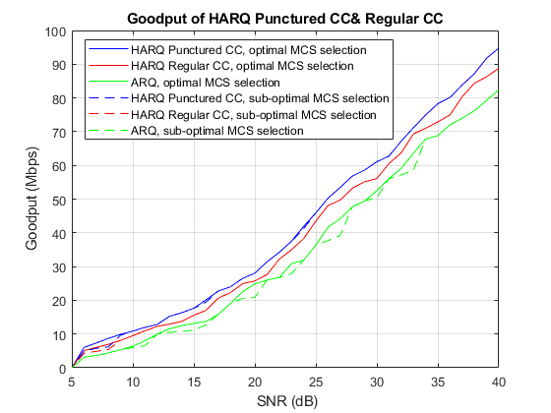
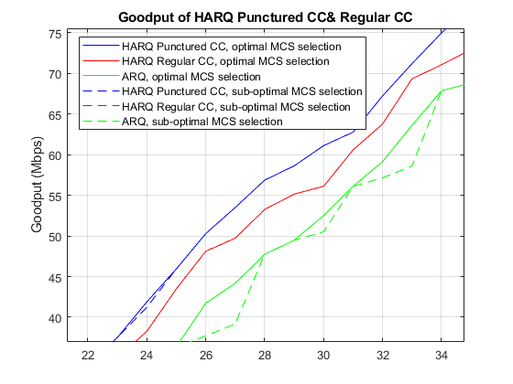
Method of MCS Selection
1dB SNR gain
2dB SNR gain
Note:
  Up to 4 retransmissions
  Same retransmission percentage for every retransmission
  Best results among four different retransmission percentages are shown above
Observation:
  HARQ CC shows smoother curve with sub-optimal MCS selection.
  HARQ Punctured CC performs better than HARQ regular CC.

Slide 6
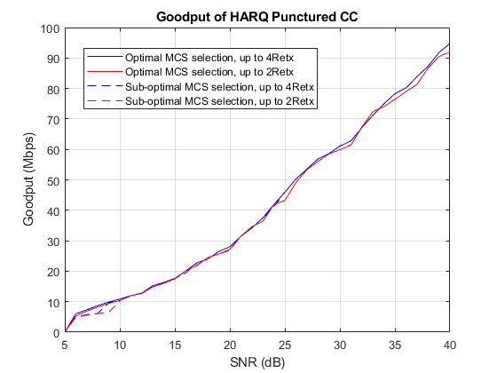
Number of Retransmissions
Note:
  Same retransmission percentage for every retransmission
  Best results among four different retransmission percentages are shown above
Observation:
  HARQ punctured CC with up to 2 or 4 retransmissions has similar performance.

Slide 7
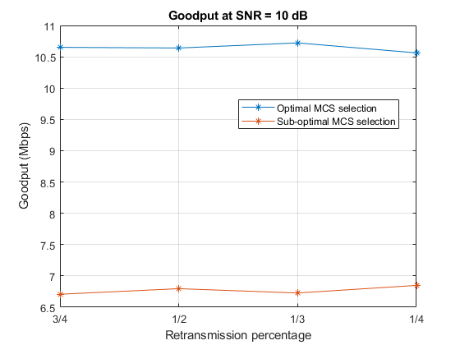
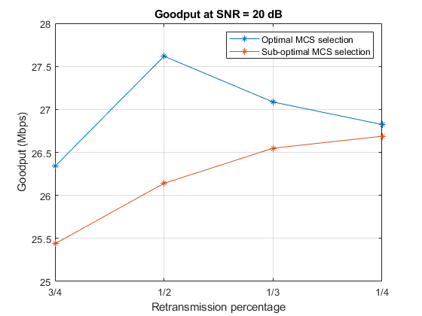
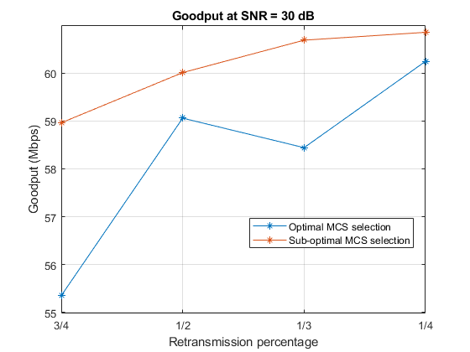
Retransmission Percentage
Note
  Up to 2 retransmissions
  Same retransmission percentage for every retransmission
Observation
  In different SNR regions, the retransmission percentage which can achieve the best performance are different. For example,
    In low SNR region (e.g. 10dB), different retransmission percentages have similar performance.
    In high SNR region (e.g. 30dB), the smallest retransmission percentage achieves the best performance.

Slide 8
Summary
HARQ Punctured CC seems to have a better performance than HARQ Regular CC.
Up to 2 retransmissions seems enough for HARQ Punctured CC.
It is important to appropriately select the retransmission percentage for securing HARQ Punctured CC performance.

Slide 9
Reference
[1] 11-19-0792-02-00be-comparisons-of-harq-transmission-schemes-for-11be
[2] 11-19-0780-00-00be-consideration-on-harq

