Slide 1
Channel Access for Multi-link Operation
Date: 2019-07-15
Authors:
Name | Affiliation | Address | Phone | Email
Insun Jang | LG Electronics | 19, Yangjae-daero 11gil, Seocho-gu, Seoul 137-130, Korea |  | insun.jang@lge.com
Jinsoo Choi |  |  |  | js.choi@lge.com
Jeongki Kim |  |  |  | jeongki.kim@lge.com
Suhwook Kim |  |  |  | suhwook.kim@lge.com
Sungjin Park |  |  |  | allean.park@lge.com
Taewon Song |  |  |  | taewon.song@lge.com

Slide 2
Introduction
In the last meeting, Asynchronous (or independent) operation and Synchronous (or simultaneous) operation are addressed as modes of multi-link aggregation/operation [1]-[6]
In this contribution, we discuss the operation and channel access for those modes

Slide 3
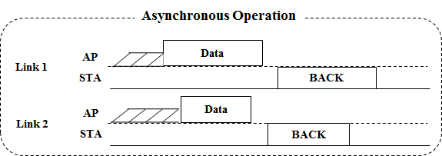
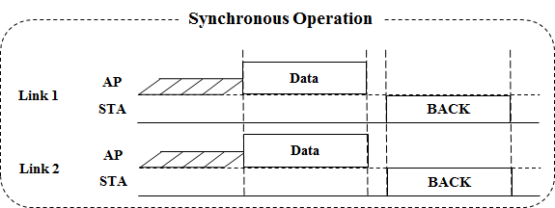
Modes of Multi-link Operation
Both of Asynchronous (Async.) mode and Synchronous (Sync.) mode are proper multi-link operations to increase the peak throughput by aggregating multi-links
Basically, we need to consider channel access for (re)transmission using multi-link operation

Slide 4
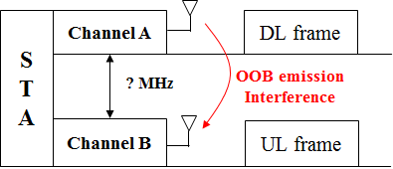
Enabling Asynchronous Mode
In Async. mode, an 11be STA (re)transmits and receives frames on each link independently
  It means that simultaneous (independent) DL/UL over multi-link can happen
However, Async. mode can cause the interference by out-of-band (OOB) emission unless their channels are sufficiently away [6]
  It mainly would occur between channels in a band (e.g., 2 channels in 5GHz)
Therefore, the Async. mode will require a method for reducing the interference such as large distance between channels

Slide 5
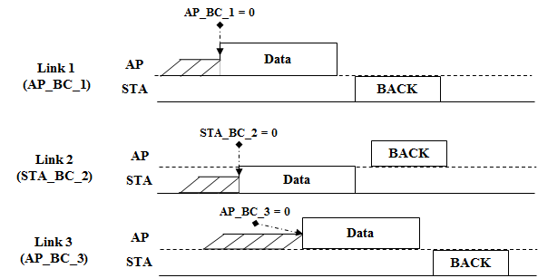
Channel Access in Asynchronous Mode
For the Async. Mode (satisfying the requirements), each EDCA parameters set (e.g., contention window (CW), AIFSN, etc.) should be used on a primary channel of each link, independently

Slide 6
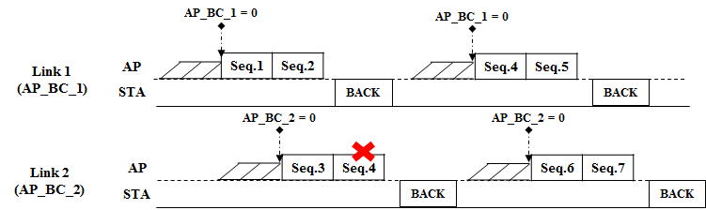
Channel Access in Asynchronous Mode with Common TID
In Async. mode, a common TID over multi-link may be supported
  It means traffic flows for a common TID can be transmitted on multi-link
  Especially, support of a common TID over multi-link enables a retransmission on some other links on behalf of the link that an initial transmission is performed for the quick re-ordering
Independent EDCA on each link can support the transmission on multi-link with a common TID without any problems

Slide 7
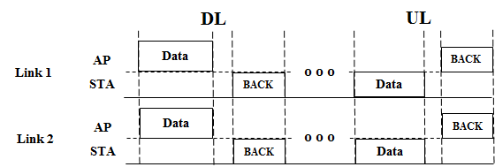
Enabling Synchronous Mode
Sync. mode is a proper alternative not to generate the interference between links
  It means that simultaneous (independent) DL/UL Tx over multi-link is not supported, i.e., DL only Tx or UL only Tx over multi-link is supported
Therefore, Sync. mode requires the synchronization of the timing of transmission
  It can have a single primary channel or multiple primary channels over multi-link

Slide 8
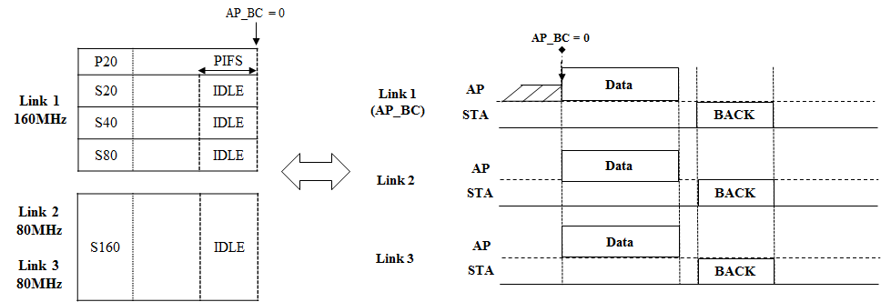
Channel Access in Synchronous Mode with Single Primary
Sync. mode with a single primary channel would use the original EDCA channel access over all of links to aggregate links as in the single-link
For more than 160MHz, an additional rule might be needed (e.g., Secondary160)

Slide 9
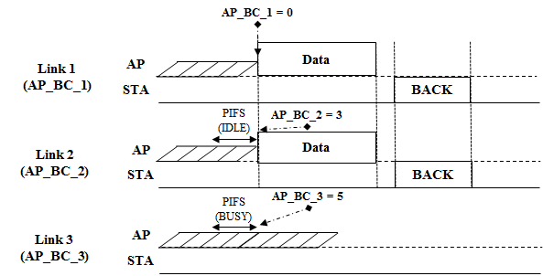
Channel Access in Synchronous Mode with Multiple Primary
Sync. mode with multiple primary channels would use the original EDCA channel access in each link
To facilitate aligning the timing of transmission over multi-link, it needs to design a proper channel access over multi-link
  For example, if BC of a link becomes zero and the channel states of other links during a certain period are idle, frames can be transmitted by using the links
    A certain period can be PIFS for the priority or AIFS for the fairness

Slide 10
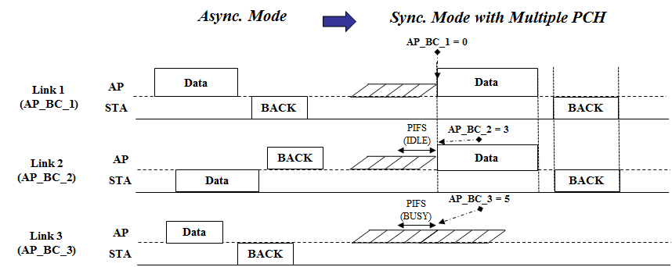
Discussion on Mode Operation
Operation mode (Async. or Sync.) can be maintained without change, e.g.,
  Sync. Mode only operate on several links due to interference
  Async. Mode only operate on several links without interference
Operation mode may be changed, e.g., Async. -> Sync. -> Async.
    For some use cases such as applications requiring considerable amount of traffic in a short time

Slide 11
Summary
We have discussed the operation and channel access in both of Asynchronous mode and Synchronous mode
Asynchronous mode can perform the independent EDCA channel access on each link even in case of a common TID
Synchronous mode with multiple primary needs to perform a proper channel access to facilitate multi-link aggregation while Synchronous mode with a single primary would perform the original channel access used in a single link

Slide 12
Straw Poll 1
Do you agree that the 802.11be amendment shall support two modes, i.e., Asynchronous mode and Synchronous mode for multi-link operation?
  Asynchronous mode means frames are transmitted non-concurrently over multiple links regardless of downlink or uplink
  Synchronous mode means frames are transmitted concurrently over multiple links only for either downlink or uplink

Slide 13
Straw Poll 2
Do you agree that in Asynchronous mode, each link follows the EDCA channel access protocol used in a single link?

Slide 14
Straw Poll 3
Do you support multiple primary channels for Synchronous mode in TGbe?

Slide 15
References
[1] 802.11-19/0731r0 EHT Multi-link Operation
[2] 802.11-19/0766r1 Enhanced Multi-band/Multi-channel Operation
[3] 802.11-19/0764r0 Multi-Link Aggregation: Gain Analysis
[4] 802.11-19/0823r0 Multi-Link Aggregation
[5] 802.11-19/0821r0 Multiple Band Operation Discussion
[6] 802.11-18/1908r0 Overview of Full Duplex over Multi- Band (FD-MB) for EHT

